Slide 1
SWAG Network Head and Neck Cancer
Clinical Advisory Group
Research Update - Claire Matthews
17/01/2023

Slide 2
National Recruitment to Head and Neck Cancer Studies
Apr 2022 - Jan 2023
Apr 2021 - Mar 2022
Data cut 10/01/2023
Source: ODP All Portfolio

Slide 3
National vs Regional Recruitment to Head and Neck Cancer Studies Apr 2019 - Jan 23
National Recruitment
West of England Recruitment
Data cut 10/01/2023
Source: ODP All Portfolio

Slide 4
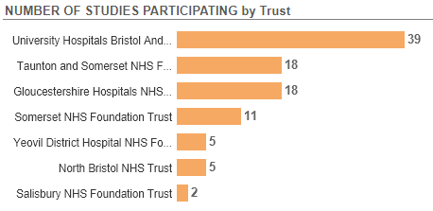
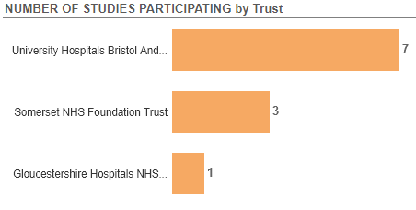
Trust Participation in Studies
All Years
2022/223 (site has recruited)
Data cut 10/01/2023
Source: ODP All Portfolio

Slide 5
West of England (+ Taunt/Yeov/Sal) Open Head and Neck Cancer Studies 21-23
CPMS ID | Short Name | Sites | Opening | Closure | Sample Size Eng | Eng Recruits
50360 | PETNECK 2 | UHBW 0 | 14/02/22 | 30/07/25 | 653 | 29
48988 | HoT (Hemithyroidectomy or Total-Thyroidectomy) | UHBW 1/30 | 13/12/21 | 31/07/25 | 344 | 27
47863 | PD-1/TIM-3 & PD-1/LAG-3 vs. NIVOLUMAB IN PATIENTS WITH ADVANCED AND/OR METASTATIC ESOPHAGEAL CANCER | UHBW | 06/12/21 | 26/05/23 | 5 | 1
44709 | MK7902-009 (Lenvatinib with pembrolizumab R/M HNSCC) | Mus 3/4 | 18/12/20 | 21/11/23 | 14 | 13
44418 | INSPIRE | UHBW 0 | 13/05/20 | 31/12/22 | 50 | 34
43839 | TORPEdO | RUH 1/5, UHBW 6/4 | 24/02/20 | 20/07/23 | 160 | 134
42228 | PEARL: PET-BASED ADAPTIVE RADIOTHERAPY CLINICAL TRIAL | UHBW 1/2 | 16/01/20 | 01/01/24 | 25 | 2
40113 | POPPY | UHBW 1/2, Mus 7/3 | 05/07/19 | 31/07/23 | 53 | 30
37192 | SAVER | UHBW 0/8 | 24/09/19 | 31/05/25 | 110 | 39
18645 | PATHOS | RUH 27, UHBW 17 | 02/10/15 | 31/10/23 | 740 | 666
18621 | CompARE Trial | Chelt 7/3, RUH 6/3, UHBW 27/35, Mus 16/6 | 06/07/15 | 30/09/23 | 670 | 492
15941 | NIHR BioResource - Rare Diseases | NBT 5/17, RUH 31/20, UHBW 310 | 13/09/12 | 30/11/24 | 22000 | 16146
Data cut 10/01/2023
Source: ODP All Portfolio

Slide 6
West of England In Setup Head and Neck Cancer Studies
CPMS No. | Short Name | Sites | Planned Opening | Planned Closure | Sample Size England | Sample Size UK
54004 | XRAY VISION:A randomized, double-blind, placebo-controlled, 2-arm Phase III study to assess efficacy and safety of xevinapant and radiotherapy compared to placebo and radiotherapy for demonstrating improvement of disease-free survival in participants with resected squamous cell carcinoma of the head and neck, who are at high risk for relapse and are ineligible for high-dose cisplatin | Somerset NHS FT | 20/03/2023 | 23/12/2025 | 8 | 9
49832 | NANORAY-312: Ph III Study of NBTXR3 Activated by Investigator's Choice of RT Alone or RT in Combination with Cetuximab for Platinum-Based Chemo-Ineligible Elderly Patients with LA-HNSCC | UHBW, Chelt | 14/01/2023 | 31/12/2024 | 12 | 16
National In Setup Head and Neck Cancer Studies (open to new sites)
CPMS No. | Short Name | Title | Phase | Planned Opening | Planned Closure | Sample Size England
53806 | RAPTOR | Randomised Controlled Trial of PENTOCLO in Mandibular Osteoradionecrosis | II | 09/01/2023 | 08/01/2025 | 90
54359 | Saliva proteomic biomarkers for head & neck cancer: case-control study | Salivary proteomic biomarkers for head & neck cancer: a case-control study | NA | 01/03/2023 | 31/12/2023 | 100
Data cut 10/01/2023
Source: ODP All Portfolio

Slide 7
Associate PI Scheme
https://www.nihr.ac.uk/health-and-care-professionals/career-development/associate-principal-investigator-scheme.htm
A six month in-work training opportunity, providing practical experience for healthcare professionals starting their research career. People who would not normally have the opportunity to take part in clinical research in their day to day role have the chance to experience what it means to work on and deliver a NIHR portfolio trial under the mentorship of an enthusiastic Local PI.
CIs working with a CTU can register their study on the scheme https://www.nihr.ac.uk/health-and-care-professionals/career-development/register-your-study-for-the-associate-principal-investigator-scheme.htm
HoT: Hemithyroidectomy or total thyroidectomy in “low risk” thyroid cancers. 1 API in region (UHBW)
TORPEdO: Ph III trial of intensity modulated proton beam therapy vs intensity modulated radiotherapy for multi-toxicity reduction in oropharyngeal cancer. No APIs in region
POPPY: Ph II trial to assess the efficacy and safety profile of pembrolizumab in patients with performance status 2 with recurrent or metastatic squamous cell carcinoma of the head and neck No APIs in region
PATHOS: Ph II/III trial of risk stratified reduced intensity adjuvant treatment in patients undergoing transoral surgery for HPV pos oropharyngeal cancer No APIs in region

Slide 8
Research Delivery Manager
claire.matthews@nihr.ac.uk
Research Portfolio Facilitator
Rebecca.pienaar@nihr.ac.uk
Sub-specialty Lead
steve.thomas@bristol.ac.uk

