Slide 1
South West Genomic Medicine Service update
Tracie Miles, Associate Director of Nursing & Midwifery

Slide 2
Transformation Projects : delivering change to improve services
Transformation Projects funded nationally …
…..delivered locally

Slide 3
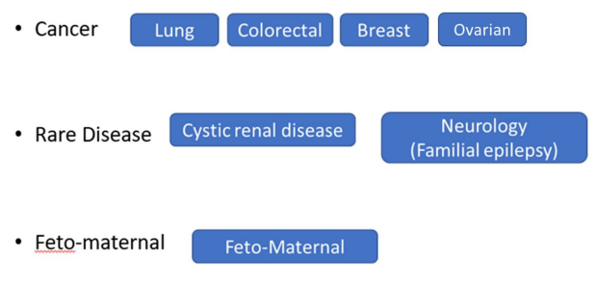
Nursing and Midwifery Leads
Enabling nurse and midwife leaders to drive strategic and systematic integration of genomics across nursing and midwifery practice in the NHS in England
SW Lead: Tracie Miles
SW GMSA Nursing and Midwifery Lead
tracie.miles@nhs.net
Nursing and Midwifery

Slide 4
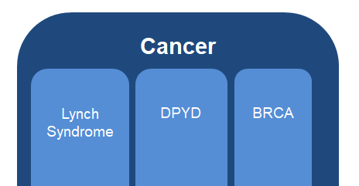
BRCA variant PLUS
Patients diagnosed with breast or gynaecological cancer who have a germline BRCA variant that is a risk of cancer will receive consistent management and support
Relatives of those with a germline BRCA variant that is a risk for cancer offered cascade testing to be diagnosed and supported
Type of Project | Local
Lead GMSA | SW GMS Alliance
SW Lead: Tracie Miles
SW GMSA Nursing and Midwifery Lead
tracie.miles@nhs.net

Slide 5
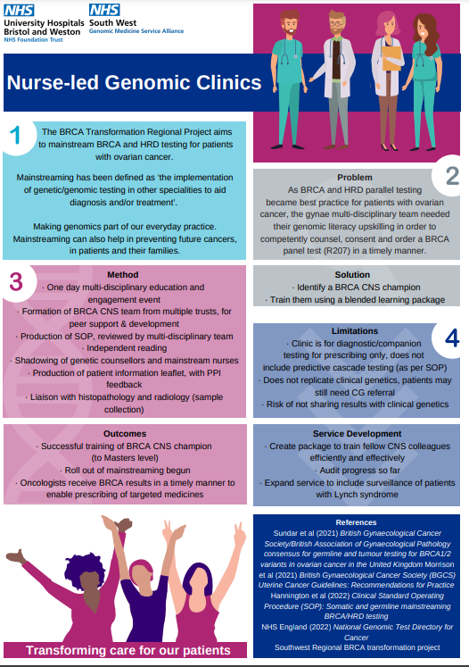
Nurse-led
Genomic clinics

Slide 6
R207 / R208 changes
Reporting for new tests requests for panels R208 (inherited breast cancer) and R207 (inherited ovarian cancer) will now include the genes detailed below:
Test | Current genes reported | Genes to be reported on samples received from 3rd October 2022
R207 | BRCA1, BRCA2 | BRCA1, BRCA2, BRIP1, MLH1, MSH2, MSH6, RAD51C, RAD51D, PALB2
R208 | BRCA1, BRCA2, PALB2 | BRCA1, BRCA2, PALB2, ATM, CHEK2
To review the eligibility criteria for testing and the specialities able to request these tests, please visit:
The test will be being delivered within the genomic laboratory hub (GLH) network and samples should be sent to the local South West GLH laboratory (Bristol or Exeter)
https://www.england.nhs.uk/publication/national-genomic-test-directories/
If you need advice on which genetic test to request please contact the GLH via : nbn-tr.SWGLHcancer@nhs.net
For information about ordering a genetic test for your patients through the GLH please visit our website
If you require support setting up your pathway please contact the Genomic Healthcare Practitioners via rde-tr.swgenomicpractitioner@nhs.net
https://www.nbt.nhs.uk/south-west-genomic-laboratory-hub

Slide 7
Whole Genome Sequencing

Slide 8
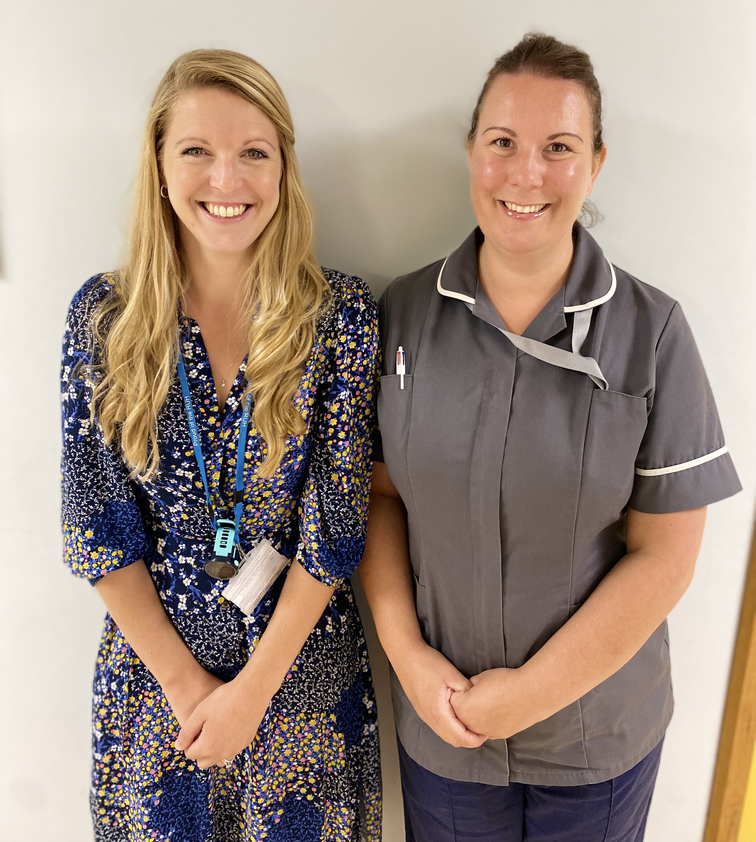
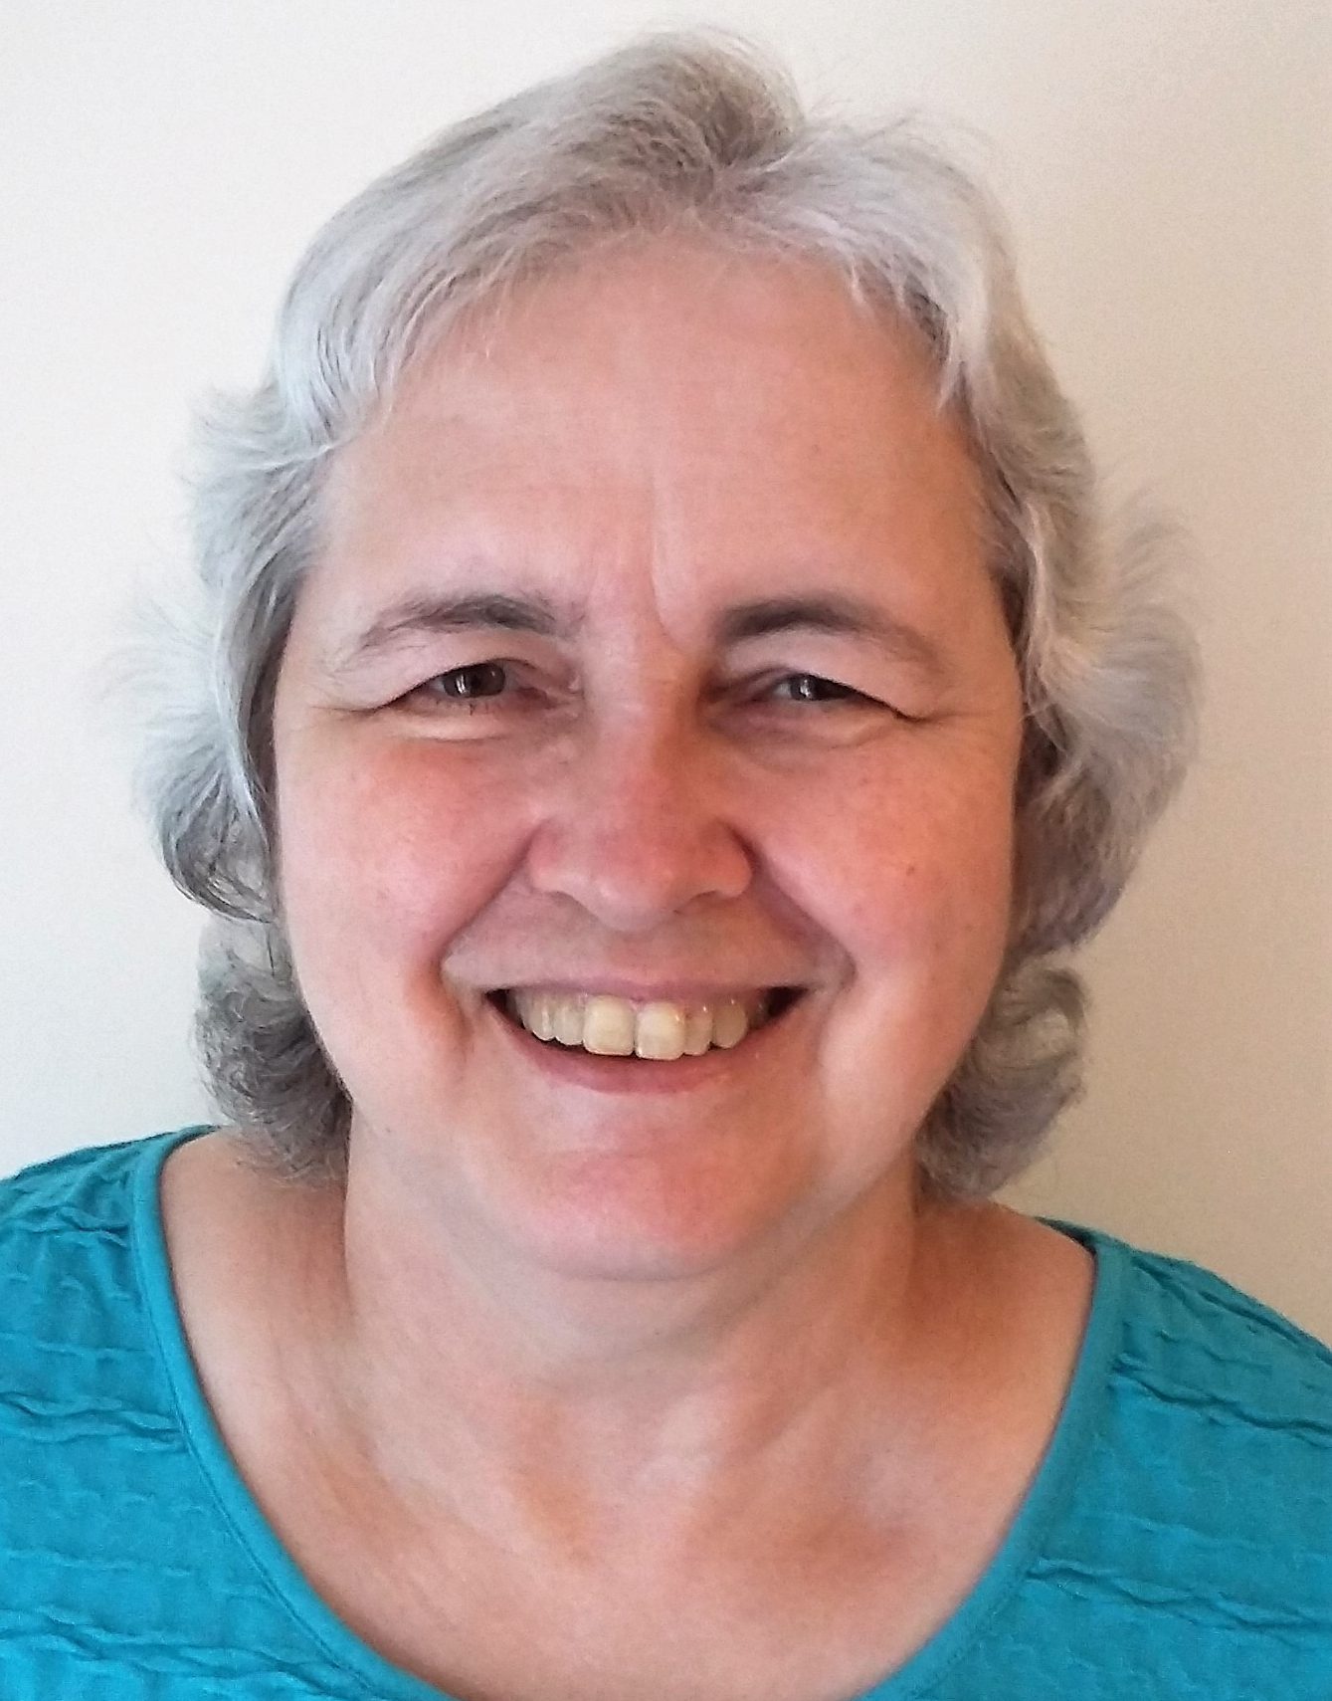
Macmillan Cancer Support and RUH Bath Gynae team working in partnership to offer digitally inclusive video appointments to cancer patients
Piloting a digitally inclusive approach:-
Macmillan Engagement
Leads: Di Charlton and
Kath Gillett
Patient representative:
Mary Pearce
RUH Bath Gynae Oncology clinical team: Laura Atherton, Clinical Fellow & Emily Davies, CNS

