Slide 1
Genomic Medicine Update
Jonathan Miller, Programme Director
South West Genomic Medicine Service

Slide 2
New National Genomic Strategy
Accelerating Genomic Medicine in the NHS
A strategy for embedding genomics in the NHS over the next 5 years (Oct 22)
https://www.england.nhs.uk/publication/accelerating-genomic-medicine-in-the-nhs/
Delivering equitable genomic testing for improved prediction, prevention, diagnosis and precision medicine.
Genomics will be at the heart of this future and the next generation of healthcare in the NHS.
The NHS will explore the utility of genomic testing to support population screening for cancer [GALLERI Trial]
Notes:
Value proposition
Digital pathology and radiology
MAINSTREAMING

Slide 4
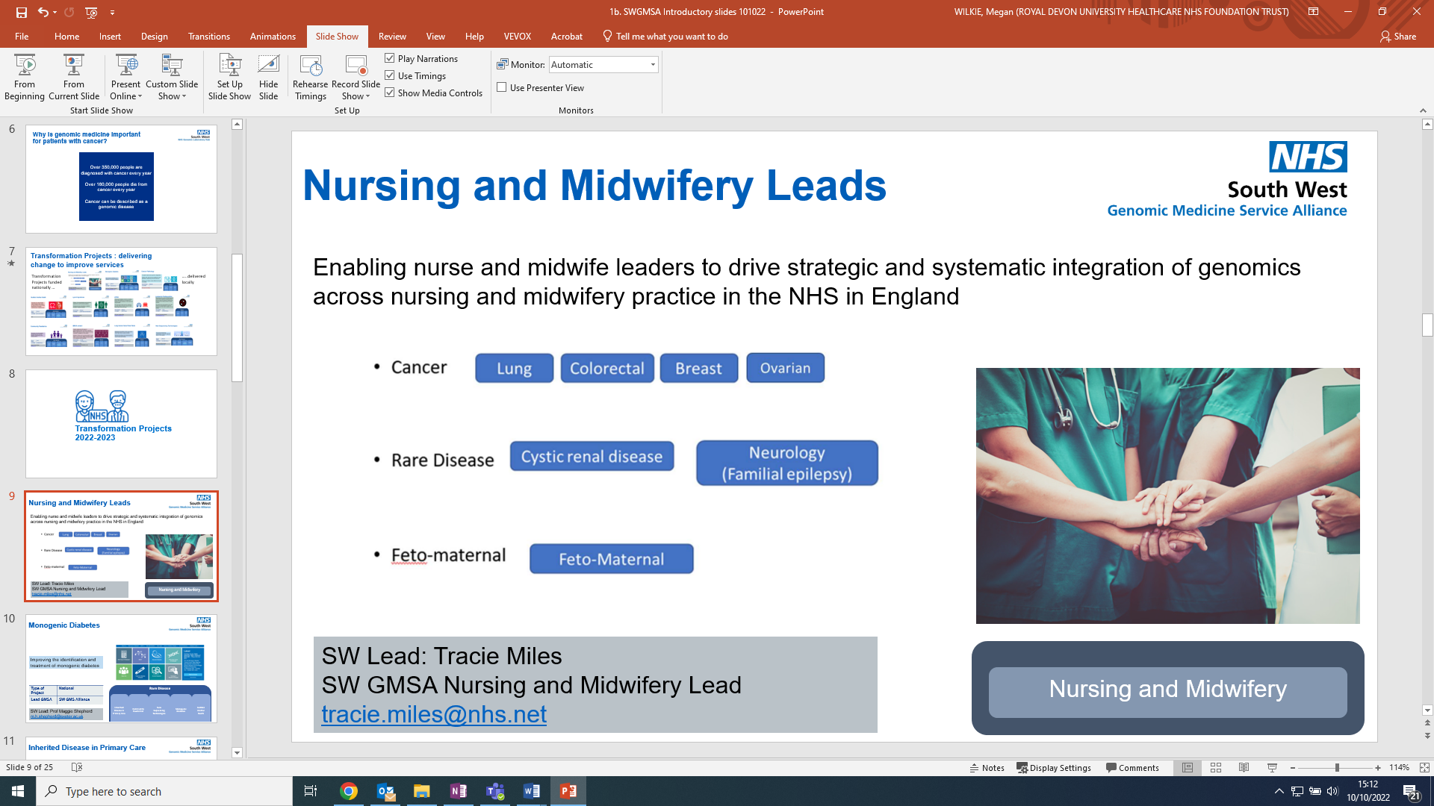
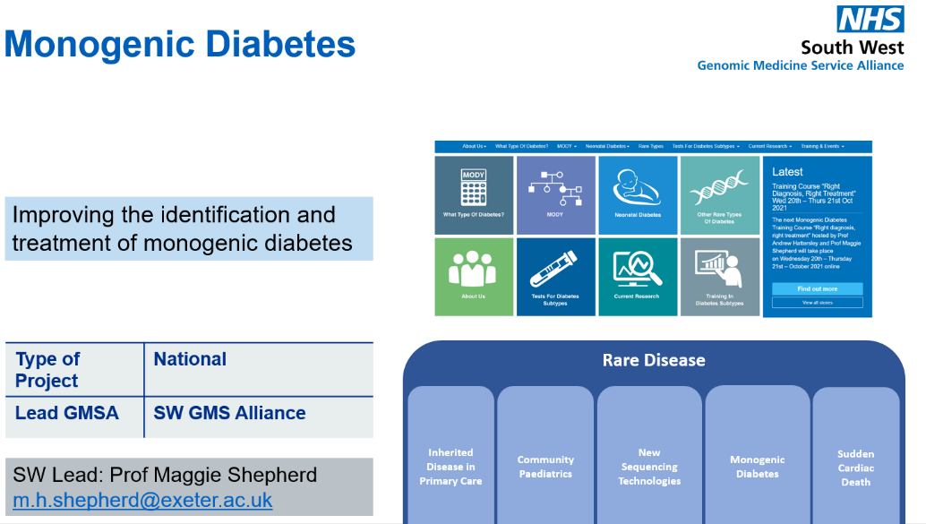
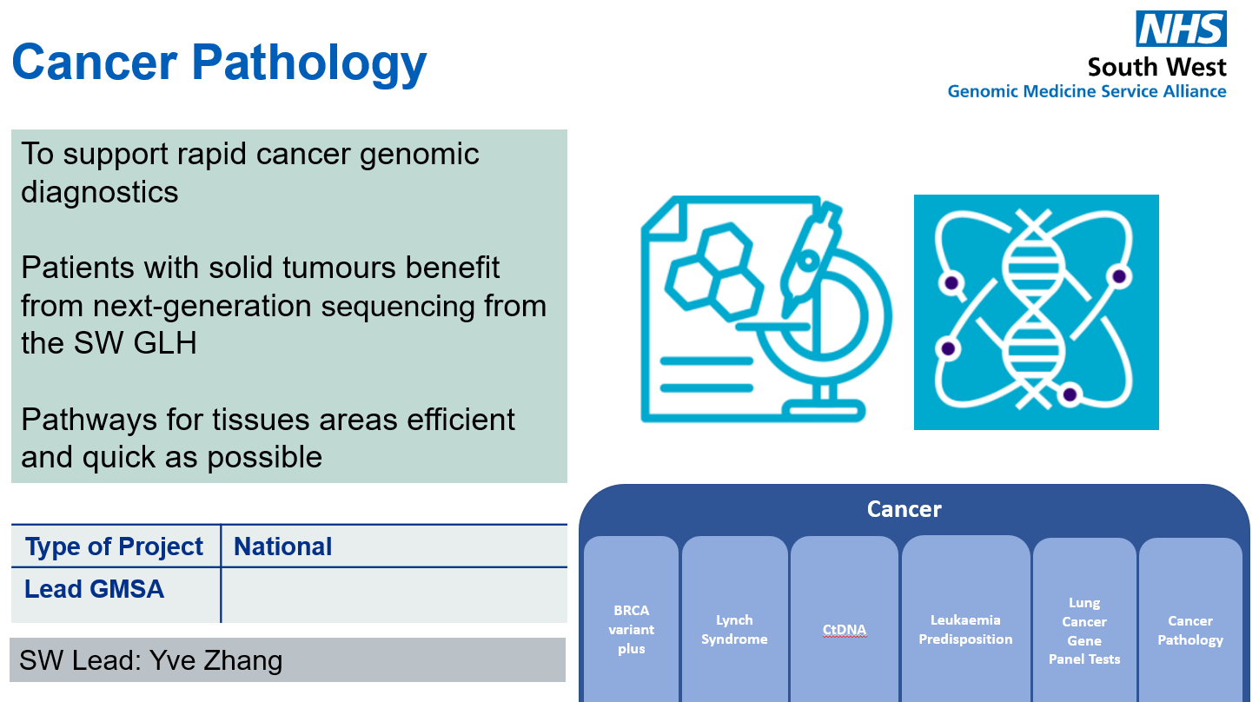
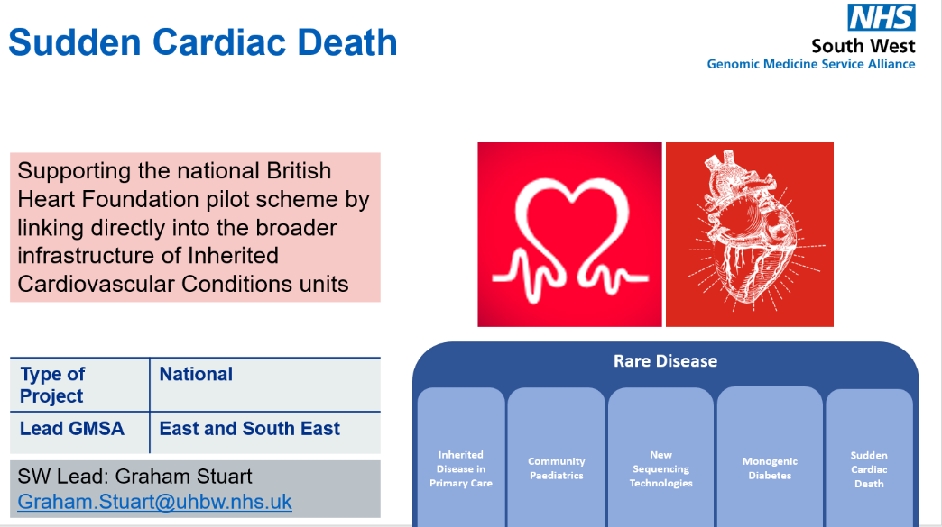
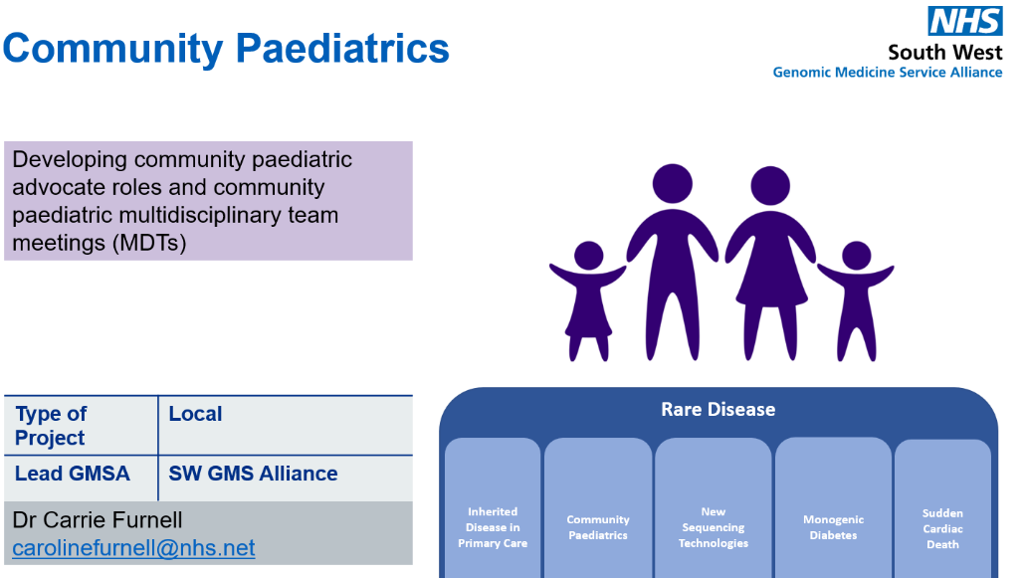
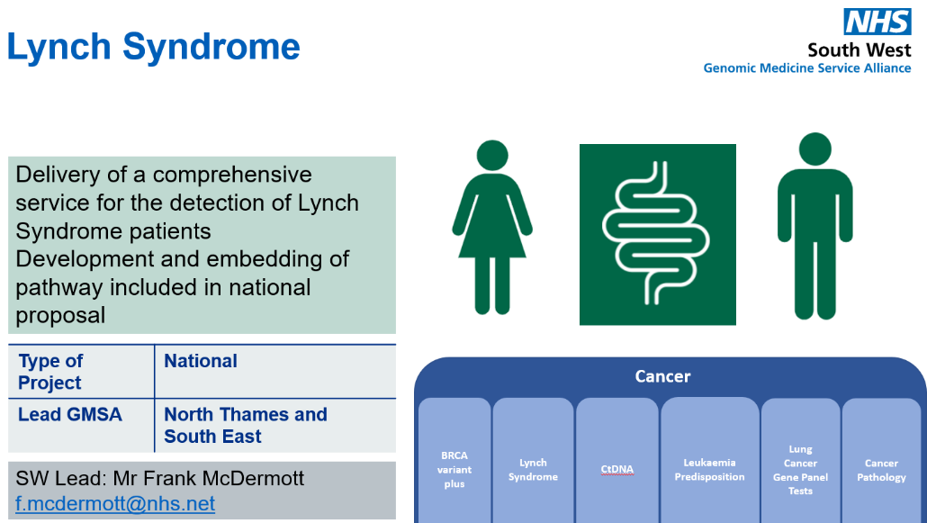
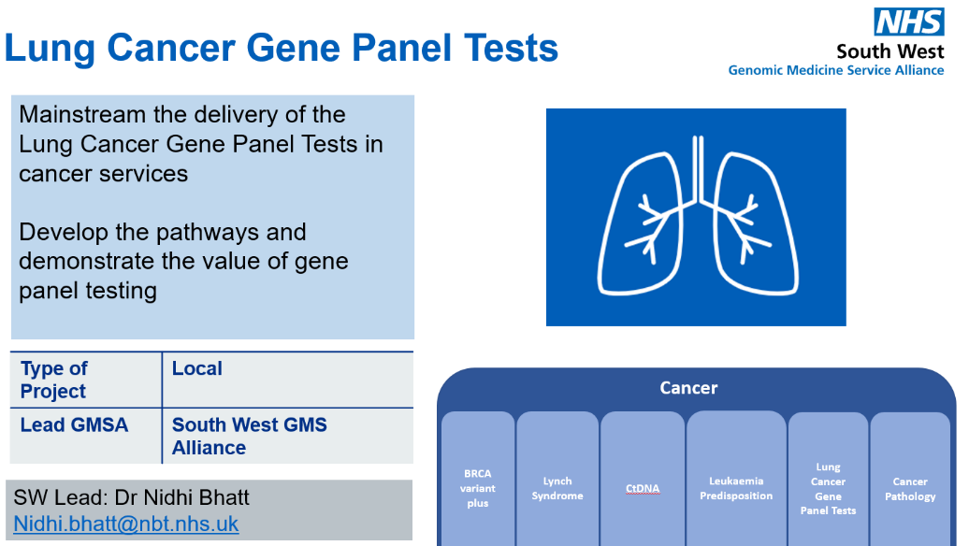
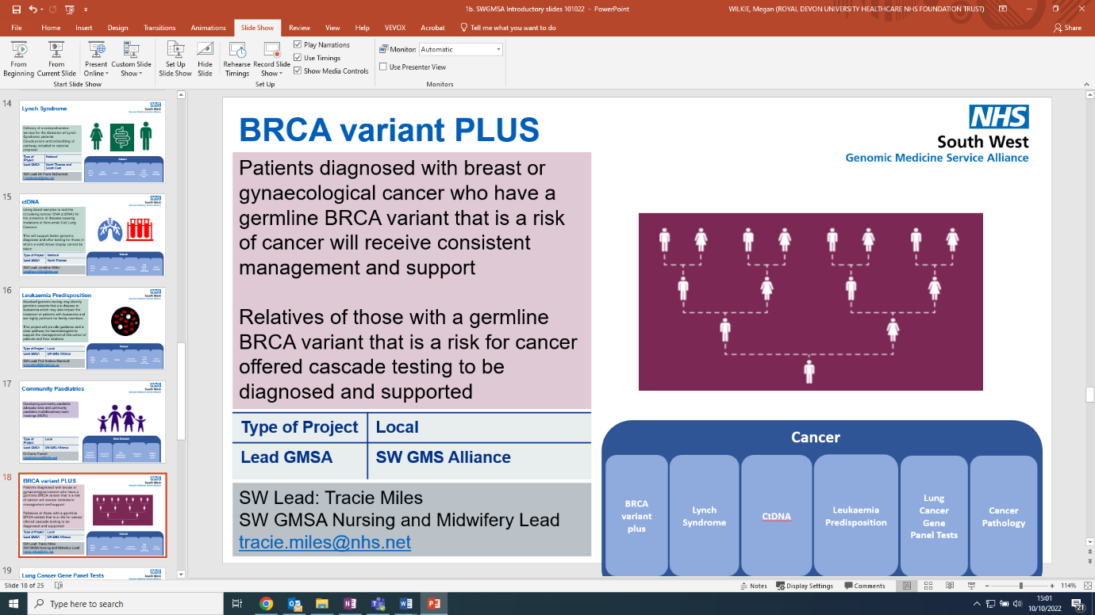
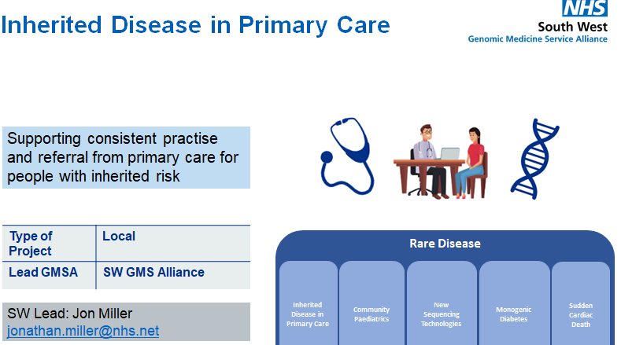
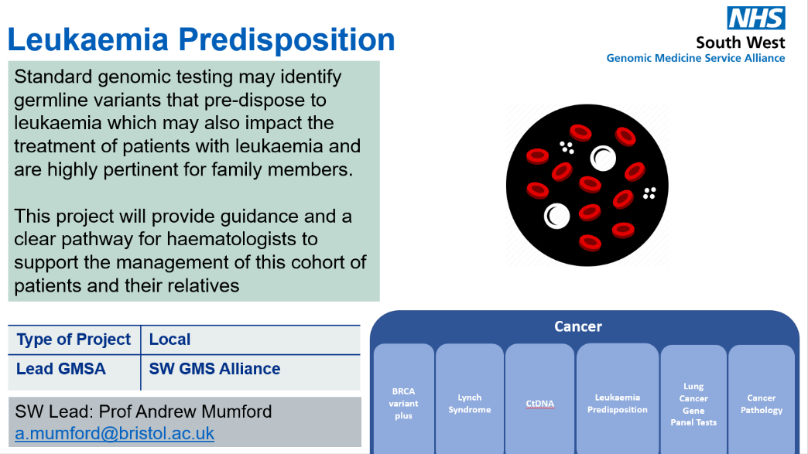
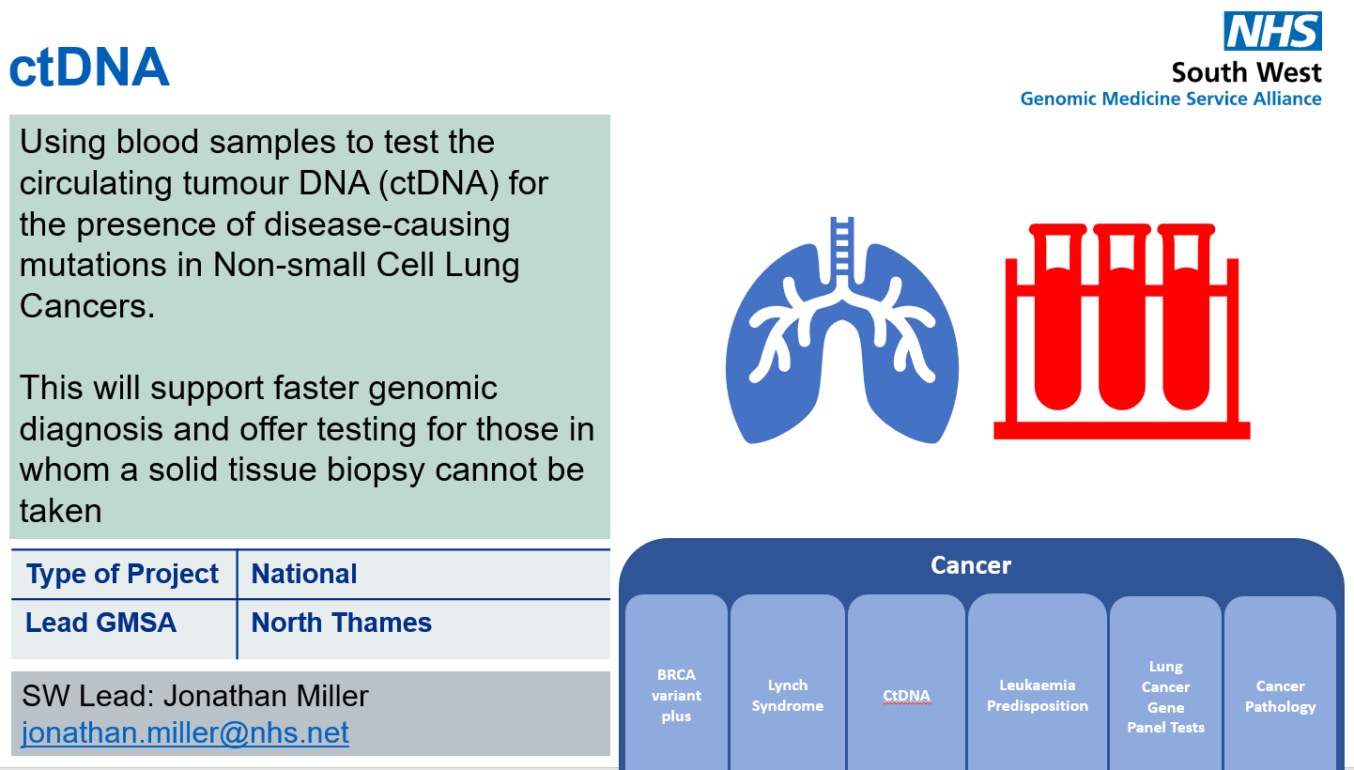
Transformation Projects : delivering change to improve services
Transformation Projects funded nationally …
…..delivered locally

Slide 5

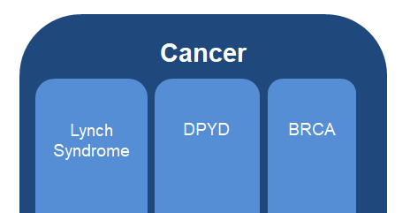
Lung Cancer Gene Panel Tests
Mainstream the delivery of the Lung Cancer Gene Panel Tests in cancer services
Develop the pathways and demonstrate the value of gene panel testing
Type of Project | Local
Lead GMSA | South West GMS Alliance
SW Lead: Dr Nidhi Bhatt
Nidhi.bhatt@nbt.nhs.uk

Slide 6
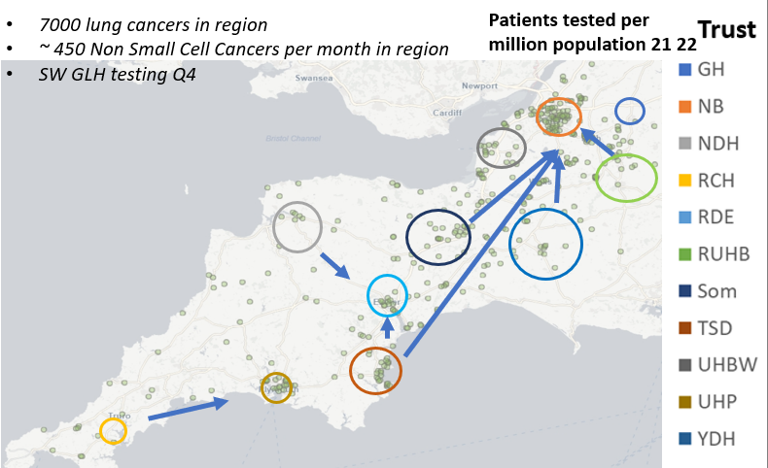
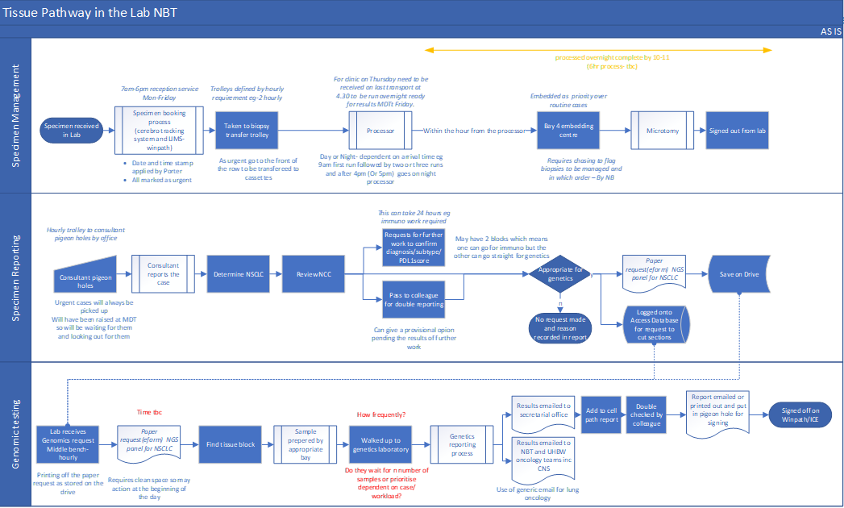
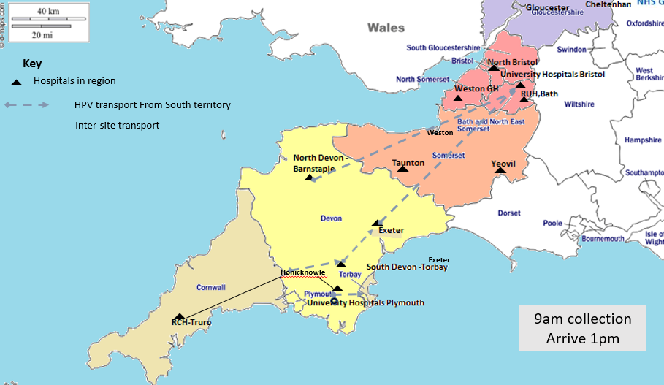
Lung Cancer Pathology Pathways: Referral to treatment
Day 0?
Day 6?
Day 21?
Day 49?
How do patients enter the service?
Where do patients enter the service?
Where is the appointment ?
Is testing same day?
Is testing same site
Who is the appointment with?
What tests are requested?
Who does the testing?
What is the failure rate?
How long does each part take?
What is the capacity?
How does this link to research
Do we know we are optimising testing to support clinical trials
Are genomic reports discussed?
How are outcomes recorded
Integrated into diagnostic testing?
Is this used to impact on treatment decisions
Are you using molecular reports to drive personalised treatment?
Is there anything missing?
Straight to test?
Waiting times
Where does it take place?
What range of tests are available locally
Virtual or in person?
Integrated into diagnostic testing?
When does the clock start?
Reflex testing?
OR who requests molecular testing and when?
What testing is in house?
What testing is send away?
Where are samples stored?
Where is the report sent?
Who is responsible for the report?
Where is the report kept and who has access?
What is the impact on reporting times for individual and integrated reporting/Diagnostic v treatment reporting?
Does everyone know what to do with the report and its findings?

Slide 7
Gloucestershire Hospitals Genomic Pathology Project
Torbay and South Devon Hospital
Pilot of MDT Coordinator time for Genomics, including
Audit of Lung Panel
Gloucestershire Hospitals Genomic Pathology Project
Lynch Syndrome Pathways
Gynaecological Cancer Pathway – HRD/BRCA
NTRK – tumour agnostic
General impact on cellular pathology
General impact on wider workforce, patient and Trust

Slide 8
National Genomic Pathology Accelerator Programme
Audit of pathology processes for genomic testing in 10 NSCLC cases
Series of workshops
Walking the Path
14th Sept 2022
Make it flow
17th Oct 2022
Tissue Pathways:
        Introduction to phase 2
        Setting the baseline
        Genomic friendly pathways
        Tissue handling; establishing best practice
        Pathway choices
Test requests and sample logistics:
Request mechanism electronic V paper
Metadata and minimum datasets
Routing
Roles and responsibilities
Joining the dots
24th Nov 2022
The missing links
14th Dec 2022
Interpretation and integrated reporting:
Overviews
PreTABs
GTABs
Integrated reporting
Access to clinical trials
IT, reporting and interoperability:
Back to school
Jan 2023
Thinking outside the box
Feb 2023
Training and education:
Overview of training and education
Workforce planning and strategy/ Recruitment and retention
Update from National Programmes
Discussion and next steps
Research and Development:
Overview of current R&D within the GMSAs
Novel fixatives
Alternative approaches to sample acquisition
Tumour cellularity assessment AI/IA
Collaborative R&D between Cellular Pathology and Genomics
Pulling it all together
March 2023
What have we achieved?:
Summary and reflection form each GMSA on the workshop they hosted.
Summary from each GMSA on progress made during the project.
Next steps

Slide 9
Cancer Pathology & Genomics
Clinical Case For Change
Policy
What is Expected
What is Required
Workforce
Informatics
Pathways
GLH Component
Commissioning
Pathology Policy
Cancer Policy

Slide 10


DPYD Gene
Optimising and improving clinical effectiveness of DPYD Gene Testing for patients with Cancer
DPYD testing before receiving fluoropyrimidine chemotherapy
DPYD testing embedded in local standard operating procedures and patient pathways
Type of Project | National
Lead GMSA | North West GMS Alliance
SW Lead: Rachel Palmer SW GMSA Pharmacy Lead
rachel.palmer6@nhs.net

Slide 11



ctDNA
Using blood samples to test the circulating tumour DNA (ctDNA) for the presence of disease-causing mutations in Non-small Cell Lung Cancers.
This will support faster genomic diagnosis and offer testing for those in whom a solid tissue biopsy cannot be taken
Type of Project | National
Lead GMSA | North Thames
SW Lead: Jonathan Miller
jonathan.miller@nhs.net

Slide 12
National ctDNA Project
NHS England has funded an evaluation of the use of blood samples to test the circulating free DNA (cfDNA) for the presence of disease-causing variants
so that it can make the case for making ctDNA routinely available for NSCLC
This is being offered to patients with radiological evidence of suspected stage 3 or 4 thoracic malignancy (assuming performance status 0 to 2 and suitable for SACT)
Liquid Biopsy (ctDNA blood test) is to be taken as early as possible after the initial CT scan (prior to biopsy)
SW GMSA
GMSA has procured 100 ctDNA tests from Roche
Signed up:
NBT, UHBW, RUHB, Somerset (MPH)
Gloucestershire already using ctDNA with SWAG funding

Slide 13



Lynch Syndrome
Delivery of a comprehensive service for the detection of Lynch Syndrome patients
Development and embedding of pathway included in national proposal
Type of Project | National
Lead GMSA | North Thames and South East
SW Lead: Mr Frank McDermott
f.mcdermott@nhs.net

Slide 14

Leukaemia Predisposition
Standard genomic testing may identify germline variants that pre-dispose to leukaemia which may also impact the treatment of patients with leukaemia and are highly pertinent for family members.
This project will provide guidance and a clear pathway for haematologists to support the management of this cohort of patients and their relatives
Type of Project | Local
Lead GMSA | SW GMS Alliance
SW Lead: Prof Andrew Mumford
a.mumford@bristol.ac.uk

Slide 15

Inherited Breast & Ovarian Cancer
Patients diagnosed with breast or gynaecological cancer who have a germline BRCA variant that is a risk of cancer will receive consistent management and support
Relatives of those with a germline BRCA variant that is a risk for cancer offered cascade testing to be diagnosed and supported
Type of Project | Local
Lead GMSA | SW GMS Alliance
SW Lead: Tracie Miles
SW GMSA Nursing and Midwifery Lead
tracie.miles@nhs.net

Slide 16
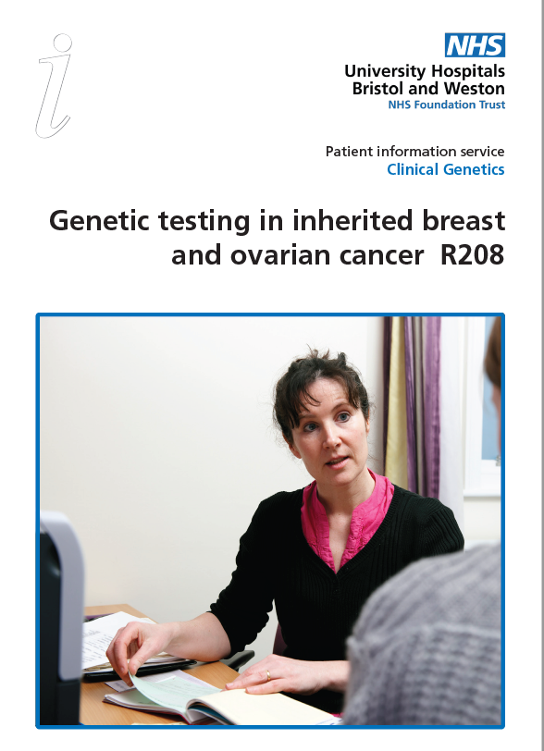
Inherited Breast and Ovarian Cancer
Key Achievements
Five BRCA nurses trained to educate and cascade mainstreaming in breast and ovarian pathway.
Two genetic counsellors supporting the project working closely with the 5 BRCA nurses.
Supporting mainstreaming requesting of R208 (BRCA+ PALB2, ATM, CHEK2 )
Breast Cancer Genes and Me
Grant to include a breast cancer information animation and online counselling and consenting package
Patient Info
CONTENTS

