Slide 1
GAPS: Gloucestershire Allied Health Professional (AHP) Prehabilitation Service GAPS
May - October 2022

Slide 2
The service The Team
Physiotherapy
Occupational therapy
Psychology
Dietitian
Prescription of exercise, nutrition and psychological interventions.
Proactive activities of daily life(ADL) management based on frailty status.

Slide 3
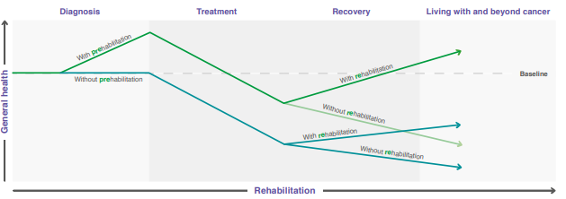
The Project Aims to increase resilience and ability to manage treatments with reduced effects.

Slide 4
Our Pathway

Slide 5
The service
SCREENING
Dietetic – Scored Patient generated subjective global assessment (PG-SGA)
Psychology – PHQ-4
OT – Rockwood clinical frailty Score
Physio – International Physical Activity Questionnaire (IPAQ)
INTERVENTIONS
Universal Talk (one off)
Why participate in prehab
Myth busting
Universal Weekly Group exercise classes
Targeted First Line advice
Nutrition, physical or psychological
Specialist 1:1 interventions
As screening identifies

Slide 6
Staffing Resource Outline

Slide 7
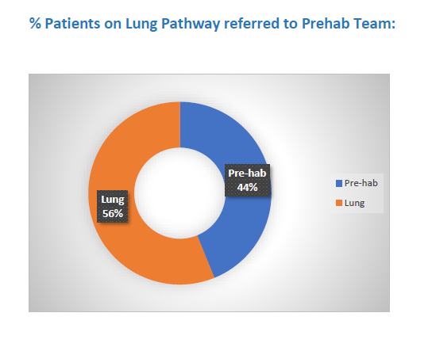
Referral Rates into Prehab

Slide 8
% of Lung patients referred and seen, referrals by staging

Slide 9
Outcomes of Lung patients referred to Prehab Service

Slide 10
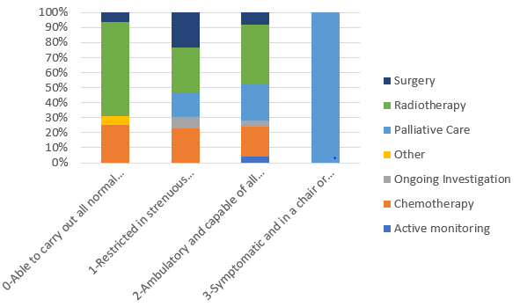
Performance Status: Treatment Collated at the request of Lung Clinical Team to help guide future management of patients with a performance status of 2
Notes:
Add notes/breakdown of WHO Performance Status

Slide 11
Treatment by Age Group of patients seen by Prehab Team

Slide 12
Impact of Prehab in maintaining and reducing Performance Status: All Lung Patients with input from Prehab Team

Slide 13
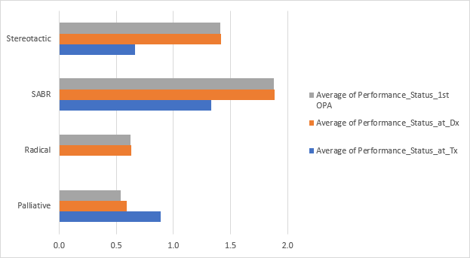
Impact of Prehab in maintaining and reducing Performance Status: Radiotherapy Breakdown

Slide 14
Impact of Prehab in maintaining and reducing Performance Status: Lung Patients seen in face-to-face Prehab Team sessions

Slide 15
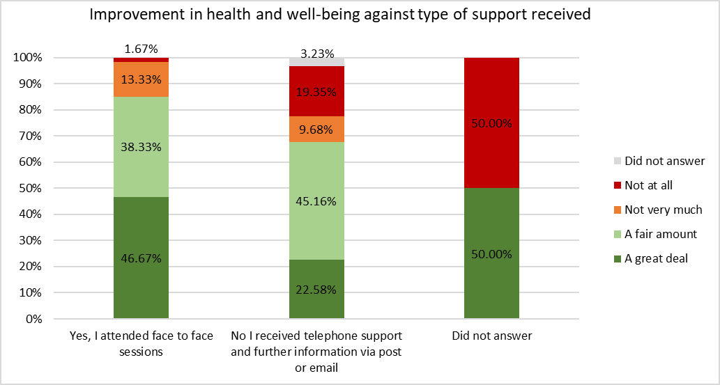
Patient satisfaction is higher in face to face sessions

Slide 16
Impact of Prehab in maintaining and reducing Performance Status: Lung Patients with input from Prehab Team: face-to-face/virtual/advice

Slide 17
Qualitative Survey Results Service satisfaction Maintained behaviour change post intervention

Slide 18
Patient Engagement
Out of 190 referrals:
158 participated
32 declined/ incomplete
= 83% participation rate
Reasons for non-engagement
Felt ‘fit enough’
Felt ‘too much going on’
Wanted to wait for results and then treatment started
Reasons for incomplete
Rapid deterioration
Surveillance and not for treatment
Non-cancerous
Alternate primary
OOA

Slide 19
Strategies to improve
Prehabilitation Team
Reviewing pathway to offer more targeted and specialist support to non-engagers
Improving links in community to refer to other services (ie Sue Ryder, Maggie’s, Glos Can Exs) etc
New psychology post
Lung Team
Referral at point of first contact to optimise Prehab time
Referral criteria- all patients
Cc’ing onto clinic letters working well
Highlight importance of Prehab at consult
‘Referral to Prehab Leaflet’ available to distribute to patients on intranet + internet

Slide 20
What we have learnt
Patients are most likely to engage when advised to do so by the clinical team (Medics & nurses).
Interventions are most effective and more likely to affect change in treatment with patients with a performance status of 2, but all PS patients benefit from general messaging, increasing physical activity and proactive management.
Need Physio rather than a personal trainer to deliver exercise to this complex clinical group to prevent delays.

Slide 21
What we have learnt, continued
Completing outcomes measures at the end of treatment is difficult and does not necessarily indicate positive change.
All patients regardless of PS benefit from general messaging, increasing physical activity and proactive management.
Need more emphasis on long term smoking cessation and continuing exercise.
Need smooth transition to rehab services.

Slide 22
Prehab AHP’s
Dietitian
Role Challenges
(patient’s already been provided with nutrition advice prior to dietetic consult)
OT
Role Challenges
Proactive frailty identification and palliation
Physiotherapist
Role Challenges
Need for more targeted interventions
(managing breathlessness, DBE’s)
Offer more than weekly exercise
Psychologist
Role Challenges
AP role difficult in a new evolving service
New post to be advertised for Psychologist

Slide 23
Case Study
Overview
79yr old female
T3 M2 N0
PS =1
PG-SGA =8
IPAQ- no activity
PHQ4= 0
Treatment Plan- Palliative chemotherapy

Slide 24
Prehab Intervention
Universal Session
covering topics such as: Optimising nutrition prior to treatment, optimising physical activity, promoting oral hygiene, fatigue management strategies, and improving emotional resilience.
Specialist Dietitian
Tailored 1:1 Dietetics providing individualised support in order to optimise nutritional status and minimise further weight loss prior to treatment beginning
High Percentage weight loss, at high risk of cachexia, poor appetite
Specialist Physiotherapy
Group exercise classes weekly
Personalised home exercise programme
Tailored goal setting support

Slide 25
Prehabilitation Outcomes
 | Initial | Discharge
Pre test RPE (Borg Scale) | 1 | 1
Number of Repetitions | 7 | 8
Post test RPE (Borg Scale) | 7 | 2
Initial Weight | Discharge Weight
72kg | 72kg
Conclusion:
Utilising a person-centred approach, the Prehabilitation intervention supported Mrs P to optimise her pre-treatment baseline to reduce the severity and onset of treatment related side effects. Mrs P was able to tolerate all of her scheduled cycles of chemotherapy.

