Slide 1
SWAG Network Colorectal Cancer
Clinical Advisory Group
Research Update - Claire Matthews
06/10/2022

Slide 2
National Colorectal Cancer Research Recruitment
Apr 21 - Mar 22
Apr 22 - Sep 22
Source: ODP All Portfolio
Data cut: 28/09/2022

Slide 3
National vs Regional Recruitment
National
Regional (WE)
Source: ODP All Portfolio
Data cut: 28/09/2022

Slide 4
Colorectal Cancer Studies - opened in SWAG region 21/22
CPMS | Short Name | Opening | Closure | Sample Size Eng | England Recruits
52250 | NERO | 11/07/2022 | 11/07/2023 | 68 | 4
52006 | Reconstruction in Extended MArgin Cancer Surgery (REMACS) | 17/05/2022 | 01/03/2025 | 100 | 8
51104 | CITRuS Stage 1; Feasibility | 22/03/2022 | 23/03/2024 | 571 | 28
50780 | COLO-SPIRIT | 25/11/2021 | 30/12/2022 | 60 | 18
50663 | ARIEL | 25/04/2022 | 30/09/2024 | 319 | 2
49772 | FOxTROT Platform | 07/02/2022 | 20/09/2026 | 848 | 13
48768 | MK-4280A Versus Standard of Care in Previously Treated Metastatic PD-L1 positive CRC | 01/11/2021 | 01/10/2022 | 20 | 40
48716 | FIT for Lynch Syndrome V. 1.0 | 16/09/2021 | 01/06/2025 | 400 | 124
47716 | MK1308A-008 | 24/11/2021 | 01/09/2023 | 6 | 0
46173 | Improving patient experience and outcomes in bowel cancer screening | 01/06/2021 | 31/07/2023 | 2000 | 391
45744 | Seal-G / Seal-G MIST Study (DLG-072-06 Rev5.0 18Apr2021) | 19/01/2022 | 30/04/2023 | 50 | 7
44909 | The BREAKWATER Study | 17/06/2021 | 20/11/2024 | 10 | 0
44738 | CONSCOP 2 | 28/07/2021 | 31/01/2023 | 884 | 336
44421 | Sarcopenia, frailty and nutritional status in colorectal cancer | 01/04/2021 | 31/03/2023 | 25 | 0
Notes:
In March, on behalf of the Department of Health and Social Care, the NIHR set up a mechanism (UK-wide portal) for applying for funding and/or prioritised support for urgent public health research into COVID-19.
The goal was to gather the necessary clinical and epidemiological evidence to inform national policy and enable new diagnostics, treatments and vaccines to be developed and tested.
The set-up and delivery of UPH studies is expedited by all necessary organisations across the research, health and social care systems including the HRA.
There is a commitment to ensure that research findings and data relevant to COVID-19 from UPH research are shared rapidly and openly.
Currently there are 67 UPH studies, 47 of which are running in CRN WE.
Restart framework was introduced in May with the aim of
Restoring a fully active portfolio of NIHR research
Continuing to support COVID-19 NIHR research
Providing a structure to guide the restarting of a full range of NIHR research
Work in close collaboration with key stakeholders, regulators, HRA, MHRA, patients and the public, and health and care research organisations to support the pace and coordination of this Restart and to ensure coordinated UK-wide working
2nd wave guidance:
The NIHR issued guidance to protect both COVID-19 and non-COVID-19 research during a ‘second wave’ of high COVID-19 activity.
The guidance makes very clear that research staff funded by NIHR should not be deployed to front line duties except in exceptional circumstances. This is in contrast to the ‘first wave’ when numerous staff were deployed to the clinical front line.
Dr William van't Hoff, CEO of the NIHR Clinical Research Network (CRN) and Senior Responsible Officer for the Restart Programme, said: “As the number of people with COVID-19 starts to rise again, it is imperative that our research staff focus on priority COVID-19 studies including vaccine studies. But we also need our teams to continue to support the restart of non-COVID-19 research, both commercial and non-commercial, in tandem with the restoration of NHS routine clinical services. The impact of research being paused in the Spring has been severe and we will make every effort to maintain recruitment rates across the portfolio.”

Slide 5
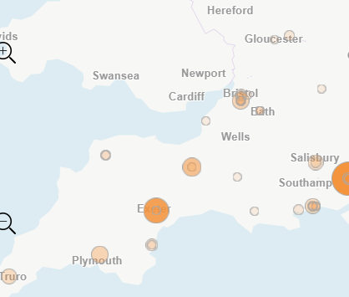
Colorectal Cancer Studies - open in SWAG region
A total of 34 studies are open in the SWAG region
Full list of studies available on request
How can we best share this data?
Studies that have recruited
Source: ODP All Portfolio
Data cut: 28/09/2022

Slide 6
Colorectal Cancer Studies - in set up in SWAG region
CPMS Study ID | Short Name | Trust
53642 | COLO-PREVENT: A platform for developing COLOrectal cancer PREVENTion therapies | Yeovil, UHBW
52581 | STELLAR-303 | UHBW
52280 | BNT122-01 BioNTech SE Colorectal Cancer 4781/0016 | Somerset, UHBW, Yeovil
52011 | MOUNTAINEER-03 | UHBW
51892 | Correct – MRD I | Salisbury, UHBW
51497 | 61186372CRC2001 | UHBW
48817 | Metastatic Colorectal Cancer | Yeovil
41403 | PRESERVE | North Bristol, Salisbury
Source: ODP All Portfolio
Data cut: 28/09/2022
Notes:
In March, on behalf of the Department of Health and Social Care, the NIHR set up a mechanism (UK-wide portal) for applying for funding and/or prioritised support for urgent public health research into COVID-19.
The goal was to gather the necessary clinical and epidemiological evidence to inform national policy and enable new diagnostics, treatments and vaccines to be developed and tested.
The set-up and delivery of UPH studies is expedited by all necessary organisations across the research, health and social care systems including the HRA.
There is a commitment to ensure that research findings and data relevant to COVID-19 from UPH research are shared rapidly and openly.
Currently there are 67 UPH studies, 47 of which are running in CRN WE.
Restart framework was introduced in May with the aim of
Restoring a fully active portfolio of NIHR research
Continuing to support COVID-19 NIHR research
Providing a structure to guide the restarting of a full range of NIHR research
Work in close collaboration with key stakeholders, regulators, HRA, MHRA, patients and the public, and health and care research organisations to support the pace and coordination of this Restart and to ensure coordinated UK-wide working
2nd wave guidance:
The NIHR issued guidance to protect both COVID-19 and non-COVID-19 research during a ‘second wave’ of high COVID-19 activity.
The guidance makes very clear that research staff funded by NIHR should not be deployed to front line duties except in exceptional circumstances. This is in contrast to the ‘first wave’ when numerous staff were deployed to the clinical front line.
Dr William van't Hoff, CEO of the NIHR Clinical Research Network (CRN) and Senior Responsible Officer for the Restart Programme, said: “As the number of people with COVID-19 starts to rise again, it is imperative that our research staff focus on priority COVID-19 studies including vaccine studies. But we also need our teams to continue to support the restart of non-COVID-19 research, both commercial and non-commercial, in tandem with the restoration of NHS routine clinical services. The impact of research being paused in the Spring has been severe and we will make every effort to maintain recruitment rates across the portfolio.”

Slide 7
Associate PI Scheme
https://www.nihr.ac.uk/health-and-care-professionals/career-development/associate-principal-investigator-scheme.htm
ARIEL: A biomarker enrichment trial of anti-EGFR agents in patients with advanced colorectal cancer (aCRC) with wild-type RAS and right primary tumour location (right-PTL)
REFINE: A multi-arm phase II basket protocol testing reduced intensity immunotherapy across different cancers
FOxTROT Platform: FOxTROT: Personalising neo-adjuvant Chemotherapy in Locally advanced but operable colon cancer. A randomised trial programme.
PLATO - PersonaLising Anal cancer radioTherapy dOse: PLATO - PersonaLising Anal cancer radioTherapy dOse - Incorporating Anal Cancer Trials (ACT) ACT3, ACT4 and ACT5
Prepare-ABC: Supportive Exercise Programmes for Accelerating Recovery after major Abdominal Cancer surgery (PREPARE-ABC)
TRACC - Predicting Relapse in eArly Colorectal Cancer: Tracking mutations in cell free tumour DNA to predict Relapse in eArly Colorectal Cancer
Add-Aspirin: A phase III double-blind placebo-controlled randomised trial assessing the effects of aspirin on disease recurrence and survival after primary therapy in common non-metastatic solid tumours.

Slide 8
PRES 2021/22
Report Summary

Slide 9
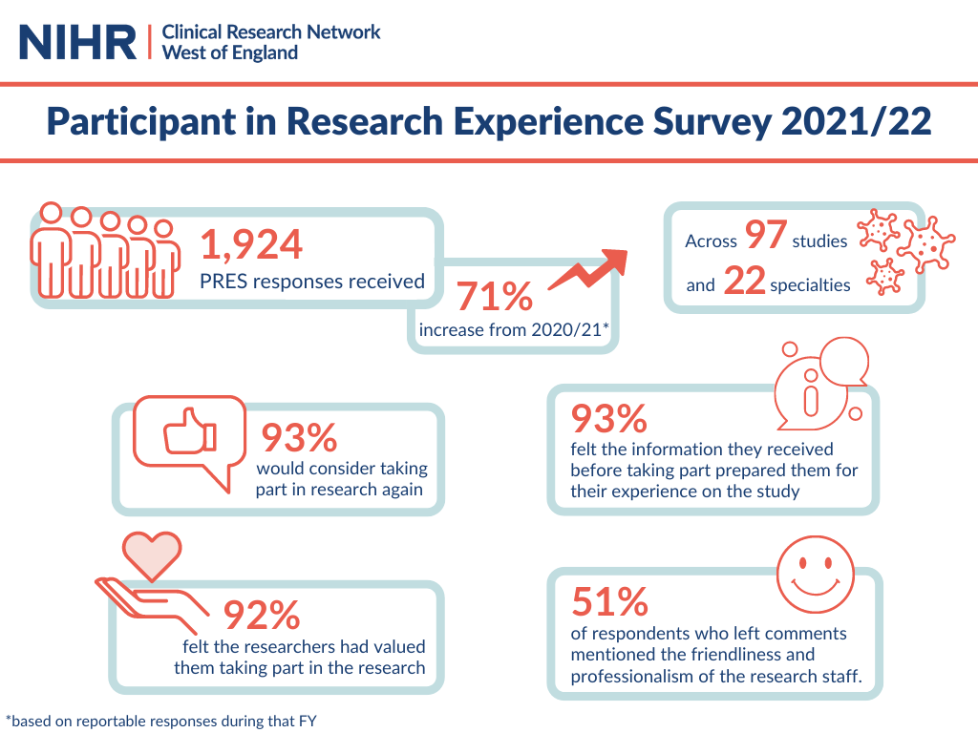
Notes:
We saw responses from across all seven Trusts in the region and four Primary Care sites.

Slide 10
What was positive about your research experience?

Slide 11
Recommendations and next steps
Key themes from this year's feedback include:
Communication with participants
Results to individual tests.
Clear information about how to get in contact with the study team.
Explore how participants can be offered more diverse clinic times, including out-of-hours and weekends.
Discussions with participants and research staff about the areas that are most important.
Projects which aim to improve the participant experience.

Slide 12
NIHR ODP
Open data platform. Data on performance and restart across whole CRN, including all specialty areas
NIHR Be Part of Research
See which studies are open across the country
National Cancer Research Institute Portfolio Maps
View current national portfolio of open, closed and ‘in set up’ cancer studies
Find a Clinical Research Study (ODP)
Search for a study to fit criteria. Good for horizon scanning, eligibility criteria

Slide 13
Research Delivery Manager
claire.matthews@nihr.ac.uk
Research Portfolio Facilitator
rebecca.pienaar@nihr.ac.uk
Sub-specialty Lead
Colorectal: Stephen.falk@uhbw.nos.uk
Upper GI/ Colorectal: sharath.gangadhara@nhs.net

