Slide 1
Breast Pain Specialist Clinics Caroline Osborne Consultant Breast Surgeon Yeovil District Hospital

Slide 2
Background
In last 10 years OSC have grown by nearly 100% nationally
Breast cancer diagnoses risen by 14%
51% breast units – (at the end of the pandemic) were failing to see patients within the 2 week target standard
Women with breast pain constitute 20 - 40% of attendees (est 20% at YDH)
The incidence of breast cancer in women with breast pain only is 0.4%, = background prevalence (0.8% in screening population)

Slide 3
National guidance
NHS England has stated that
“Based on NG12, in the absence of associated red flag symptoms, i.e. lump or skin changes, breast pain alone is not a symptom of cancer and should not be automatically referred on an urgent cancer pathway”

Slide 4
Why do we need breast pain clinics?
Women with breast pain should be assessed and managed by skilled clinicians who can:
address and understand the presenting complaint of breast pain
manage it appropriately
allow time to give advice and address patient concerns
OSC format has been designed to diagnose cancer not to manage breast pain
Referral to a cancer diagnostic clinic
increases anxiety,
can lead to inappropriate imaging in contravention of NICE and Royal College of Radiology guidance
influences patient expectations

Slide 5
Family history and other risk factors
Up to 30% of women with breast pain only have a family history of breast cancer
A background family history heightens anxiety about the symptom
Opportunities to address the family history risk and other breast cancer risk factors are missed in OSC
Breast cancer awareness and prevention advice takes time

Slide 6
Setting up the clinic
As a quality improvement project
Engagement with primary care – in particular the wording in referral “breast pain only” and to set patient expectation (not within 2 weeks, cancer not suspected)
No additional funding was needed (due to expansion of the whole breast service)
Initially consultant led with a view to training specialty doctor/ACP
Clinic paperwork design and reviewed by MDT

Slide 7
How the clinics run
Patients referred with breast pain only are vetted into specific breast pain clinics
Primary care engagement
Appointments are 30 minutes long
The appointment includes:
Detailed history of the pain
Medical history
Menstrual history
Family history risk assessment (Qgenome app)
Review of other breast cancer risk factors
An examination
Advice on managing symptoms.

Slide 8
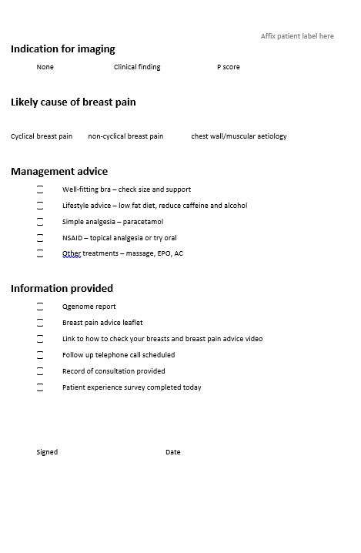
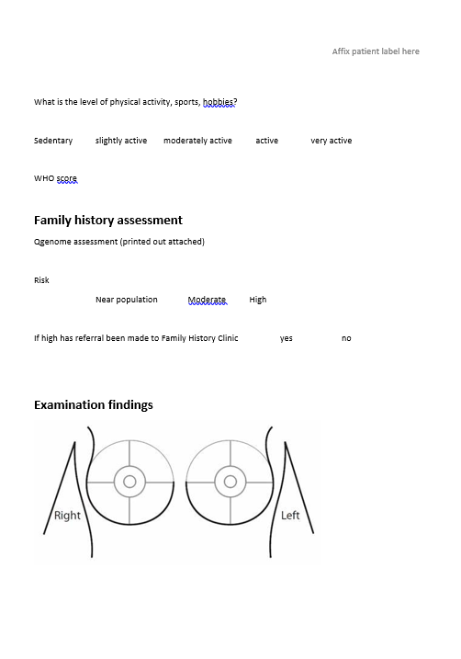

Slide 9
Outcomes from the clinic
Onward referral to family history clinic if identified by risk assessment.
Women only referred for breast imaging if any red flag signs identified.
Women receive written information about managing breast pain along with a personalized summary of the consultation.
Telephone follow up in 4 weeks to assess outcomes of interventions
Capacity for up to 200 patients annually, and this is covered with a weekly clinic with 5 slots. (currently 100 patients pa)
Frees up capacity within the one stop system.

Slide 11
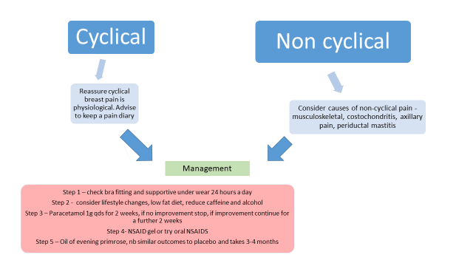

Slide 12
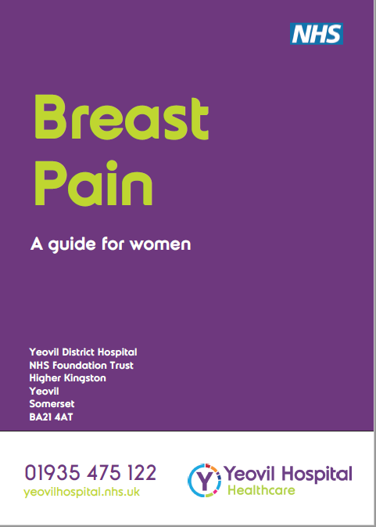

Slide 13
Evaluation
Outcome questionnaire about the breast pain clinic experience
Follow up in 4 weeks with a telephone consultation reassessing symptoms
Data collected electronically
Important to identify subsequent cancer diagnoses – all patient records will be reviewed 1 year following breast pain appointment
Collect data about re-referrals for the same symptom within 1 year
Support with this as a registered QI project
Support from ABS – ASPIRE - multicentre platform study to evaluate the breast pain pathways, which units have developed for the management of patients with isolated breast pain or mastalgia.

Slide 14
Review of consultations
39 consultations so far
Mean average age = 56y (range 26 – 84y)
Duration of symptoms ranged from 2 weeks to 5 years
Laterality of symptom
Bilateral – 5,
Left 19
Right 15
2 had previous breast cancer diagnosis
1 had trauma to the breast
51% (20/39) had family history of breast cancer
12.9% (5/39) moderate/high risk of breast cancer as per Qgenome – onward referral to family history clinic
1 patient referred for mammogram (P1 very anxious and no recent mammo, M1),
1 patient referred for mammo and USS (P2 asymmetrical fullness in UOQ – M2 (asymmetry)/U1

Slide 15
Age range of patients

Slide 16
Review of consultations
Type of breast pain recorded
Non-cyclical – 31%
Chest wall pain - 61%
Cyclical – 8%
Outcomes recorded after 4 weeks telephone consultation
Pain reported as
Same – 3%
Improved – 74% Bra fitting the reason for improvement – 45%
Gone – 23%
Represented – 0 so far

Slide 17
Distribution of type of breast pain by age

Slide 18
Pateint Experience Questionnaire – electronic (PALS)
You have just had a consultation about breast pain. Please could you answer a few simple questions regarding your experience?
Do you feel reassured about the cause of your breast pain?
Do you feel you have learned strategies to manage your breast pain?
Did you find the family history risk assessment helpful?
Did you have the opportunity to talk about your personal risk of breast cancer?
Did you find it helpful to talk about your risk of breast cancer?
Would you recommend this clinic to other women with breast pain?

Slide 19
Patient reported outcomes
Do you feel reassured about the cause of your breast pain?
100% felt reassured or very reassured
Do you feel you have learned strategies to manage your breast pain?
97% satisfied or very satisfied
Did you find the family history risk assessment helpful?
93% found it helpful or very helpful

Slide 20
Patient reported outcomes (cont)
Did you find it helpful to talk about your risk of breast cancer?
96% found it helpful or very helpful to talk about their personal risk of breast cancer
Would you recommend this clinic to other women with breast pain?
100% would recommend the clinic

Slide 21
The future of the breast pain clinic
The initial review of the clinic is being presented to primary care teams
The clinic will continue and adjusted to meet demand
Currently demand is sustainable but as awareness of the clinic grows the demand may increase
Annual review of all patient records to assess re-presentation with breast pain and incidence of breast cancer

