Slide 1
SWAG Network Breast cancer
Clinical Advisory Group
Research Update - Claire Matthews
07/03/2023

Slide 2
National Recruitment to Breast Cancer Studies
Apr 2021 - Mar 2022
Apr 2022 - Mar 2023
Data cut 06/03/2023
Source: ODP All Portfolio

Slide 3
National vs Regional Recruitment to Breast Cancer Studies Apr 2019 - Mar 23
National Recruitment
SWAG Region Recruitment
Data cut 06/03/2023
Source: ODP All Portfolio

Slide 4
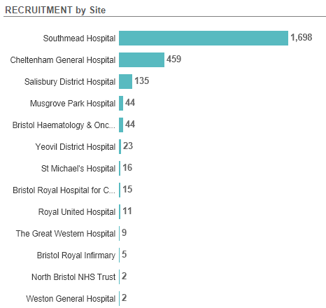
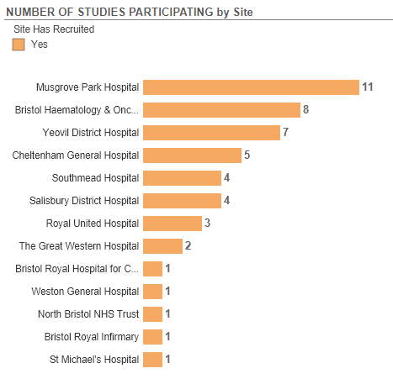
Recruitment by Site to Breast Cancer Studies 2022/2023
Data cut 03/03/2023
Source: ODP All Portfolio

Slide 5
SWAG region Lead Network Studies
Short Name | CI | Title | Opening | Closure | Sample Size Eng | Eng Recruits
E-bikes and breast cancer: CRANK-B | Miranda Armstrong | Increasing physical activity levels using e-bikes to enhance breast cancer survival: A randomised pilot study | 03/08/2022 | 31/03/2023 | 40 | 0
EUCHARIS | Mark Beresford (Lead Eng Site) | European treatment patterns and outcomes associated with first line CDK and Hormonal therapies Assessed in a Real-world non-Interventional Study | 08/06/2022 | 31/12/2022 | 0 | Study not required to provide recruitment data to CPMS.
Breast Cancer: Early diagnosis using materials immortalisation | Prof Keith Rogers | Analysis of breast calcifications in benign and malignant biopsy samples using elemental analysis, X-ray diffraction, and vibrational spectroscopy - for diagnosis of malignancy and prediction of progression. | 01/09/2020 | 01/09/2023 | 320 | NA
COMPULSE | Sarah Vinnicombe | Comparison trial of open-tip pulsed needle biopsy and conventional core biopsy in axillary lymph nodes (COMPULSE) | 15/07/2020 | 31/12/2024 | 320 | 29
ASTEFANIA | ? | T-DM1 + Atezolizumab in high-risk HER2+ patients with residual disease after neoadjuvant taxane-based and HER2-targeted therapy | 07/05/2021 | 01/11/2024 | 120 | 0
Data cut 03/03/2023
Source: ODP All Portfolio

Slide 6
SWAG region Breast Cancer Studies Opened 2022/23 (full list to be circulated)
CPMS ID | Short Name | Site & recruitment | Opening | Closure | Sample Size Eng | Eng Recruits
52781 | TROPION Breast 03 | Somerset (0) | 19/01/2023 | 28/02/2025 | - | 0
52477 | Ascent-03 | Glos (0) | 16/01/2023 | 31/03/2023 | 11 | 0
52782 | SWEET | GWH (0) | 12/01/2023 | 30/04/2023 | 90 | 3
53324 | Entia Liberty: Home Study | Salis (0) | 06/01/2023 | 06/06/2023 | 33 | 4
53118 | PRE-DX Study | Yeovil (0), Salis (0) | 10/10/2022 | 01/09/2023 | 245 | 55
50765 | SGNTUC-028 | RUH (0) | 28/09/2022 | 30/11/2023 | 14 | 3
50331 | heredERA | RUH (0), Salis (0) | 16/09/2022 | 15/07/2025 | 40 | 0
52372 | EndoNET | Yeovil (0), Salis (0), NBT (0) | 23/08/2022 | 31/05/2025 | 1200 | 10
51692 | E-bikes and breast cancer: CRANK-B | NBT (0) | 03/08/2022 | 31/03/2023 | 40 | 0
51326 | ANG-010 (INFORM Study) | NBT (3), Salis (0) | 30/06/2022 | 31/01/2024 | 155 | 127
50904 | The NERLYFE study | Yeovil (0), Salis (0) | 15/06/2022 | 12/04/2024 | 207 | 5
49188 | EUCHARIS | Yeovil (0), RUH (0), Somerset (0), Salis (0) | 08/06/2022 | 31/12/2022 | 0 | 0
48418 | PEAR-TNBC | Glos (0) | 24/05/2022 | 01/09/2023 | 4 | 10
50679 | Tropion-02 Breast | UHBW (0), Salis (0) | 29/04/2022 | 18/09/2023 | 30 | 10
50218 | TRAK-ER | UHBW (0) | 18/03/2022 | 31/10/2023 | 553 | 18
51297 | IMPARTER:4 | Yeovil (4) | 28/02/2022 | 31/01/2024 | 250 | 127
Full list of open studies to be circulated

Slide 7
West of England In Setup Breast Cancer Studies 2023
CPMS ID | Short Name | Sites | Planned Opening | Planned Closure | Sample Size England | Sample Size UK
54260 | LION | Yeovil | 24/04/2023 | 01/04/2025 | 89 | 89
54131 | CELC-G-301 | UHBW, RUH, Somerset | 24/04/2023 | 18/12/2024 | 18 | 18
53902 | INAVO121 | Salisbury | 15/04/2023 | 22/03/2027 | - | 20
53671 | INAVO122 | Salisbury, Somerset | 01/07/2023 | 30/09/2026 | 5 | 6
53569 | Phase 3 Study of Giredestrant in Patients with Locally Advanced or Metastatic Breast Cancer | Salisbury | 30/04/2023 | 30/01/2024 | - | 12
53010 | PEAR-MET | Salisbury | 01/05/2023 | 31/12/2023 | - | 30
52963 | J2J-MC-JZLH / EMBER-4 / Imlunestrant for ER+, HER2- Early Breast Cancer | Salisbury | 15/02/2023 | 03/11/2024 | - | 110
51185 | ARV471 MetBC w 1prior line | RUH, Salisbury | 30/06/2023 | 16/07/2024 | - | -
40689 | IMpALA | Yeovil | 01/03/2023 | 31/10/2024 | 42 | 42
37535 | BR-003 Confirmatory Study Novilase Ablation Malignant Breast Tumours | NBT | 28/02/2023 | 31/12/2023 | - | 20
Data cut 06/03/2023
Source: ODP All Portfolio

Slide 8
Cancer Patient Experience Survey 2021 Results - Research Question
Somerset, Wiltshire, Avon and Gloucestershire: Published July 2022.
The score shows the percentage of respondents who gave the most favourable response to a question
The expected range charts in this report show a bar with the lowest and highest score received for each question nationally. Within this bar, an expected range is given (in grey) and a black diamond represents the actual score for this Alliance.

Slide 9
Cancer Patient Experience Survey 2021 Results - Research Question
How do we increase conversations about research in your tumour site?

Slide 10
Associate PI Scheme
https://www.nihr.ac.uk/health-and-care-professionals/career-development/associate-principal-investigator-scheme.htm
A six month in-work training opportunity, providing practical experience for healthcare professionals starting their research career. People who would not normally have the opportunity to take part in clinical research in their day to day role have the chance to experience what it means to work on and deliver a NIHR portfolio trial under the mentorship of an enthusiastic Local PI.
CIs working with a CTU can register their study on the scheme
https://www.nihr.ac.uk/health-and-care-professionals/career-development/register-your-study-for-the-associate-principal-investigator-scheme.htm

Slide 11
API Scheme Breast Cancer Studies open in SWAG Region
CPMS ID | Study Short Name | Sites
53118 | PRE-DX Study | Yeovil, Salisbury
52372 | EndoNET | Yeovil, Salisbury, NBT
50425 | HER2-RADiCAL | Yeovil, UHBW, Salisbury
50218 | TRAK-ER | UHBW
50013 | The MARECA study | NBT, Somerset, Yeovil
46520 | ATNEC | GHFT, UHBW, NBT, Somerset, Yeov, Salis
44805 | POETIC-A | RUH, GWH, NBT, Yeov, Salis
44010 | Body composition and chemotherapy toxicity in breast cancer (CANDO-3) | Salisbury
30876 | FORECEE: Case control study of inherited women's cancer | UHBW
18067 | Add-Aspirin | Weston, UHBW, GHFT, GWH, NBT, Salis, Taunt, Yeovil
12255 | OPTIMA | RUH, UHBW, Weston, GWH

Slide 12
NIHR ODP https://odp.nihr.ac.uk/
Open data platform. Data on performance and restart across whole CRN, including all specialty areas
NIHR Be Part of Research https://www.ukctg.nihr.ac.uk/
See which studies are open across the country
National Cancer Research Institute Portfolio Maps http://csg.ncri.org.uk/portfolio/portfolio-maps/
View current national portfolio of open, closed and ‘in set up’ cancer studies
Find a Clinical Research Study (ODP) http://csg.ncri.org.uk/portfolio/portfolio-maps/
Search for a study to fit criteria. Good for horizon scanning, eligibility criteria

Slide 13
Research Delivery Manager
claire.matthews@nihr.ac.uk
Research Portfolio Facilitator
rebecca.pienaar@nihr.ac.uk
Sub-specialty Lead
Mark Beresford

