Slide 1
SWAG Network Haematological Cancer
Clinical Advisory Group
Research Update - Claire Matthews
23/02/2023

Slide 2
National Recruitment to Haematological Cancer Studies
Apr 2022 - Feb 2023
Apr 2021 - Mar 2022
Data cut 20/02/2023
Source: ODP All Portfolio

Slide 3
National vs Regional Recruitment to Haematological Oncology Studies
National Recruitment
SWAG region Recruitment
Data cut 20/02/2023
Source: ODP All Portfolio

Slide 4
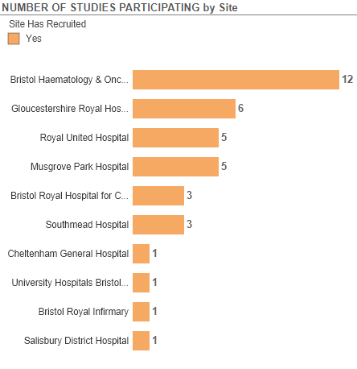
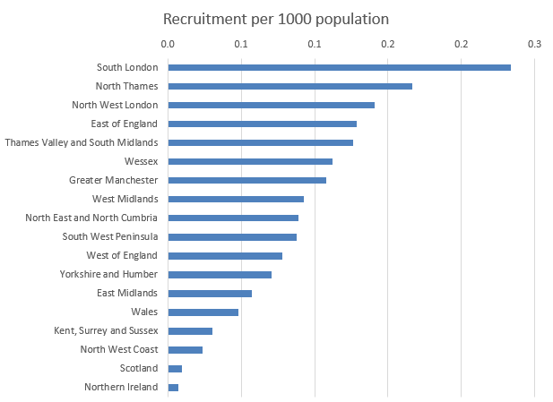
National Recruitment to Haematological Cancer Studies 22/23
SWAG region recruiting studies 22/23

Slide 5
Studies Open to recruitment in SWAG region
Total number of studies currently open: 69
Full list of studies available from Helen Dunderdale or here:
Haem Onc Open studies SWAG region Feb23
Table on next slide lists studies opened from 2021

Slide 6
CPMS ID | Short Name | Sites | Open | Closure | Sample Size Eng | Eng Recruits
49183 | CA057-001 | Salis, Glos | 13/01/23 | 15/02/25 | 35 | 0
52538 | DETERMINE | BHOC, BRHC | 16/11/22 | 18/09/27 | 685 | 0
51232 | A Phase 2/3 Study to Assess the Safety and Efficacy of ALVR105 | BHOC, BRHC | 22/09/22 | 01/03/24 | 25 | 0
51332 | RATinG: Risk Adapted Therapy in Acute GvHD | BHOC | 14/09/22 | 01/01/25 | 526 | 0
50512 | GS-US-590-6154 | BHOC | 06/09/22 | 31/12/23 | 29 | 0
50000 | EPIC - NIS in CLL patients treated with acalabrutinib through the EAP | RUH | 26/08/22 | 01/03/26 | 140 | 81
51460 | ELECTRIC: qualitative observational study in UK patients with CLL | Musgrove, BHOC | 08/07/22 | 31/08/23 | 114 | 22
51194 | CELESTIMO | Glos, Chelt | 27/05/22 | 31/07/23 | 12 | 7
49320 | CARTITUDE-5 | BHOC, Southmead | 15/02/22 | 20/09/23 | 26 | 11
50721 | Standard of Care for Relapsed Refractory Multiple Myeloma | Southmead, Salisbury | 18/11/21 | 15/02/23 | 9 | 12
47308 | INCB 50465-313 | Glos | 27/09/21 | 30/04/24 | 13 | 5
47088 | Phase 3 double-blind trial of tafasitamab plus lenalidomide in DLBCL | BHOC, RUH | 28/07/21 | 09/05/23 | 25 | 16
43937 | DOLPHIN-VIVO (ex vivo study) | Glos | 04/06/21 | 28/02/23 | 250 | 30
46867 | VICTOR | BHOC, Salisbury | 01/06/21 | 01/06/24 | 109 | 20
43741 | ALLTogether1 | BHOC, BRHC, RUH, Musgrove, Salisbury, Glos | 18/05/21 | 31/05/27 | 1745 | 180
45687 | CAR-T Long Term Follow-Up Study | BHOC | 18/05/21 | 24/07/26 | 14 | 0
45865 | ALXN-1210-TMA-314 | BRHC | 14/05/21 | 29/07/23 | 2 | 0
44923 | RADAR (UK-MRA Myeloma XV) | Glos, BHOC, Musgrove, RUH, Salisbury | 11/05/21 | 30/05/24 | 1040 | 256

Slide 7
SWAG In Setup Haematological Cancer Studies
CPMS ID | Sites | Short Name | Planned Opening | Planned Closure | Sample Size UK
54560 | BHOC, Salis | IM048-022 | 02/09/2023 | 09/08/2025 | 38
54152 | Yeovil | SECURE | 01/03/2023 | 15/12/2025 | 2000
53924 | BRHC | BrigaPED | 27/03/2023 | 27/03/2032 | 6
53633 | BHOC | EPCORE™ DLBCL-3 | 22/03/2023 | 01/01/2025 | 16
52548 | Musgrove, Salis | CA057-008 - 480Kd vs Kd | 31/01/2023 | 30/09/2023 | 19
52411 | RUH, Glos, Chelt, Salis | asciminib versus nilotinib in patients with Philadelphia Chromosome +ve Chronic Myelogenous Leukemia | 09/04/2023 | 29/08/2025 | 20
51771 | RUH | NS-018 versus Best Available Therapy in Subjects with Primary Myelofibrosis | 31/01/2023 | 01/08/2023 | 6
51751 | Salis | EFC15951 | 16/12/2022 | 17/12/2023 | 15
50867 | Chelt, Glos | MK-2140 | 28/02/2023 | 13/02/2025 | 9
50718 | BHOC, BRHC | Relatlimab + Nivolumab in Pediatric and Young Adult Lymphomas (RELATIVITY-069) | 30/09/2022 | 31/05/2023 | 30
50622 | Salis | ZUMA-22 | 01/03/2023 | 15/05/2024 | 27
49295 | BHOC | A FIH study of KO-539 in patients with relapsed or refractory AML | 01/12/2022 | 07/04/2023 | 6
48681 | BHOC | ALXN1210-TMA-313 | 30/09/2022 | 29/05/2023 | 10
48215 | BHOC, Musgrove, Glos | Epcoritamab in first line diffuse large B-cell lymphoma | 03/06/2023 | 18/11/2025 | 60
Data cut 21/02/2023
Source: ODP All Portfolio

Slide 8
National In Setup Haematological Cancer Studies open to new sites
CPMS ID | Commercial Study | Short Name | Phase | Planned Opening | Planned Closure | Sample Size Eng | Sample Size UK | Chief Investigator Email
54152 | Non-Commercial | SECURE | N/A | 01/03/2023 | 15/12/2025 | 2000 | 2000 | karthik.ramasamy@ouh.nhs.uk
51359 | Non-Commercial | CARAMEL | II | 01/01/2023 | 01/07/2024 | 19 | 26 | toby.eyre@ouh.nhs.uk
48347 | Non-Commercial | Update of the EORTC QLQ-MY20 QOLQ for MM | N/A | 09/05/2022 | 30/06/2023 | 20 | 20 | charalampia.kyriakou1@nhs.net
47305 | Non-Commercial | E-MPN | N/A | 15/02/2021 | 01/04/2024 | 150 | 150 | claire.harrison@gstt.nhs.uk
43724 | Non-Commercial | The UK-MPN-MF Registry | N/A | 31/07/2021 | 31/01/2022 | 150 | 200 | Chief Investigator Email
Data cut 21/02/2023
Source: ODP All Portfolio

Slide 9
Cancer Patient Experience Survey 2021 Results - Research Question
Somerset, Wiltshire, Avon and Gloucestershire Published July 2022.
The score shows the percentage of respondents who gave the most favourable response to a question
The expected range charts in this report show a bar with the lowest and highest score received for each question nationally. Within this bar, an expected range is given (in grey) and a black diamond represents the actual score for this Alliance.

Slide 10
Cancer Patient Experience Survey 2021 Results - Research Question
How do we increase conversations about research in your tumour site?

Slide 11
Associate PI Scheme
https://www.nihr.ac.uk/health-and-care-professionals/career-development/associate-principal-investigator-scheme.htm
A six month in-work training opportunity, providing practical experience for healthcare professionals starting their research career. People who would not normally have the opportunity to take part in clinical research in their day to day role have the chance to experience what it means to work on and deliver a NIHR portfolio trial under the mentorship of an enthusiastic Local PI.
CIs working with a CTU can register their study on the scheme
https://www.nihr.ac.uk/health-and-care-professionals/career-development/register-your-study-for-the-associate-principal-investigator-scheme.htm
There are currently no APIs in the region for Haematology studies

Slide 12
CPMS ID | Short Name | Sites in region
15938 | AML18: A Trial for Older Patients with Acute Myeloid Leukaemia and High Risk Myelodysplastic Syndrome | BHOC, Chelt, Musgrove,Salis, RUH, Glos
41275 | AMADEUS: A Double-Blind, Phase III, Randomised Study to Compare the Efficacy and Safety of Oral Azacitidine (CC-486) Versus Placebo in Subjects with Acute Myeloid Leukaemia or Myelodysplastic Syndromes as Maintenance after Allogeneic Haematopoietic Stem Cell Transplantation | BHOC, Southmead
41409 | COSI: An International Randomised Clinical Trial of Therapeutic Interventions with the Potential to Improve Outcome in Adults with Acute Myeloid Leukaemia and High Risk Myelodysplasia Undergoing Allogeneic Stem Cell Transplantation | BHOC
43741 | ALLTogether1: ALLTogether1– A Treatment study protocol of the ALLTogether Consortium for children and young adults (0-45 years of age) with newly diagnosed acute lymphoblastic leukaemia (ALL) | BRHC, BHOC, RUH, Musgrove, Salisbury, Glos
44923 | RADAR (UK-MRA Myeloma XV): Risk-Adapted therapy Directed According to Response comparing treatment escalation and de-escalation strategies in newly diagnosed patients with multiple myeloma (NDMM) suitable for stem cell transplant (TE). | Glos, BHOC, Musgrove, Yeovil, Salisbury
46867 | VICTOR: Venetoclax or Intensive Chemotherapy for Treatment Of Favourable Risk Acute Myeloid Leukaemia: A Molecularly Guided Phase 2 Study | BHOC, Salisbury
49183 | CA057-001: A Phase 3, Randomized, Multicenter, Open-Label Study, Comparing CC-92480, Bortezomib and Dexamethasone (480Vd), with Pomalidomide, Bortezomib and Dexamethasone (PVd) in Subjects with Relapsed or Refractory Multiple Myeloma (RRMM) | Salisbury, Glos
50140 | RADAR: A randomised phase III trial with a PET response adapted design comparing ABVD +/- ISRT with A2VD +/- ISRT in patients with previously untreated stage IA/IIA Hodgkin lymphoma | BHOC
52538 | DETERMINE: Determining Extended Therapeutic indications for Existing drugs in Rare Molecularly defined Indications using a National Evaluation platform trial | BHOC, BRHC

Slide 13
NIHR ODP https://odp.nihr.ac.uk/
Open data platform. Data on performance and restart across whole CRN, including all specialty areas
NIHR Be Part of Research https://www.ukctg.nihr.ac.uk/
See which studies are open across the country
National Cancer Research Institute Portfolio Maps http://csg.ncri.org.uk/portfolio/portfolio-maps/
View current national portfolio of open, closed and ‘in set up’ cancer studies
Find a Clinical Research Study (ODP) http://csg.ncri.org.uk/portfolio/portfolio-maps/
Search for a study to fit criteria. Good for horizon scanning, eligibility criteria

Slide 14
Research Delivery Manager
claire.matthews@nihr.ac.uk
Research Portfolio Facilitator
rebecca.pienaar@nihr.ac.uk
Sub-specialty Lead
sallymoore5@nhs.net

