Slide 1
Haem Genomics update
Chris Wragg, Haematological Cancer Lead Scientist,
South West Genomic Laboratory Hub
23rd February 2023

Slide 2
Haem Genomics update
Haem germline findings
NGS testing for MPN
TATs
SNP arrays
WGS

Slide 3
Haem Germline Findings
A number of the genes included in haem NGS panels for their somatic actionability are also cancer susceptibility genes (CSGs) in the germline setting e.g. CEBPA, RUNX1, DDX41
It is not possible to determine whether variants identified by NGS of a somatic sample (e.g. bone marrow) are of tumour or germline origin, although type and abundance of variant can be informative
In lieu of national guidance, we have written a guidance document to support laboratory staff and clinicians
Possible inherited variant cases can be discussed at the Regional Acute Leukaemia Advisory Panel (RALAP) which has multidisciplinary input including Clinical Geneticists.
Please email rduh.regionalacuteleukaemia@nhs.net or thomas.coats@nhs.net for more details

Slide 4
MPN Panel testing
We will be changing the way that we perform testing for MPN
All samples that require sequential MPN testing (CALR/JAK2 Exon 12/MPL) will be tested on a ‘mini NGS panel’:
Mini-MPN panel is a virtual panel restricted to CALR/JAK2 exon 12/exon 14 and MPL genes.
ddPCR for JAK2 V617F will continue to be the first line analysis, the panel will only be applied if sequential testing is indicated
If an extended MPN panel is required please indicate on the referral form
Benefits to the change include:
Streamlining of services - one assay rather than multiple assays for sequential testing
Reduced turn around times
Clarification of CALR variant type [type 1/2]
Option to request re-analysis of data for extended analysis
Discussed at the supra-regional MPN MDT on 31st Jan 2023
Implemented from 6th February 2023

Slide 5
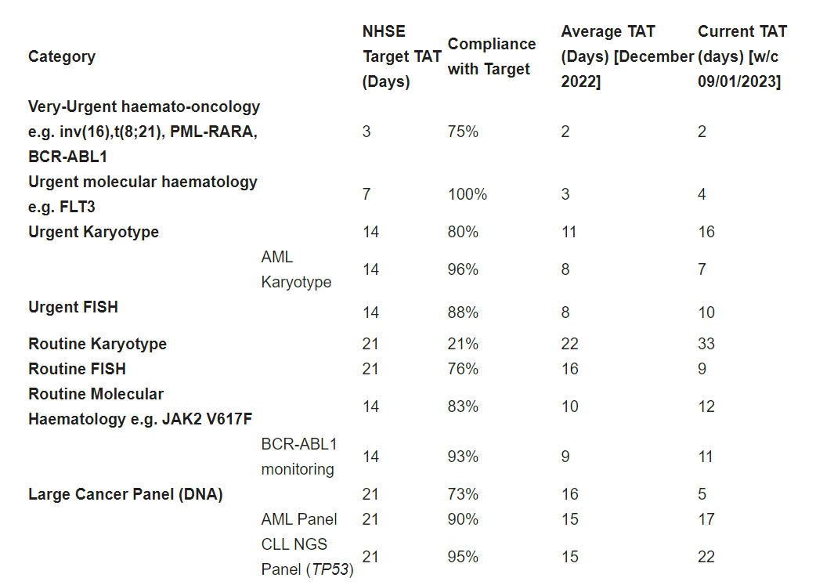
Genomics TATs
In order to improve visibility of our cancer turnaround times (TATs) we are improving information available on the SW GLH website SWGLH Quality | North Bristol NHS Trust (nbt.nhs.uk).

Slide 6
SNP Array: SW GLH Overview
Launched for A2G trial January 2021 (inc. T-ALL for MRD target ID)
Expanded to include:
Adult ALL
Cases where conventional cytogenetic analysis has failed
Characterisation of results from other tests
Fresh frozen pathways for brain tumour referrals
Reviewing testing strategy in MDS and MPN:
Increase in demand for cytogenetic analysis in MDS
Highly skilled and manual process, significant training requirements
Current mandated scientist training program has limited cytogenetic component
Shortage skill set with ageing workforce and high turnover in junior grades
2/7 GLHs have moved from cytogenetic analysis to SNP-A testing in low risk MDS
BSH MPN guidance also supports use of SNP-A in ET/PMF instead of karyotype

Slide 7
SNP microarray
Implemented January 2021
Genome wide, high resolution copy number:
Genome wide high resolution genotyping:
Gain
Loss
BB
AB
AA

Slide 8
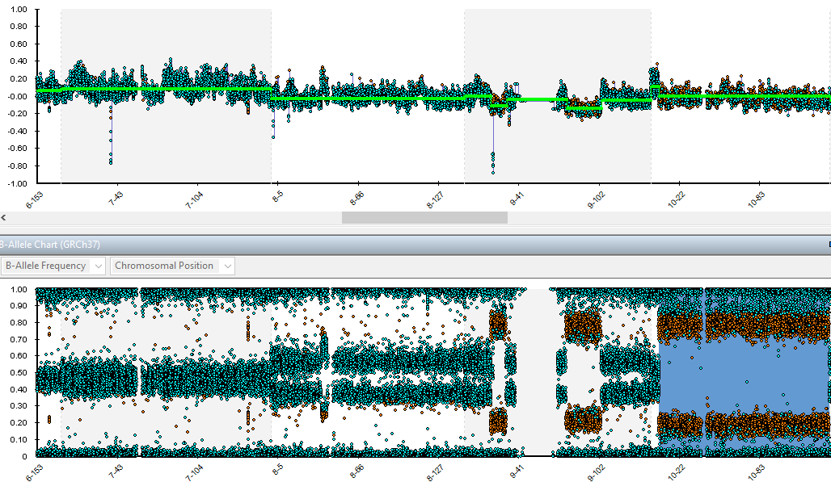
SNP microarray

Slide 9
SNP-A in MDS
SNP array and karyotype will both detect unbalanced abnormalities i.e. deletions and gains
SNP array will detect sub-microscopic changes and cytogenetically cryptic changes e.g. deletion/LOH for TP53
SNP array will not detect balanced abnormalities
IPSS based upon conventional karyotype
Where sufficient sample is available for DNA extraction SNP-A success rate is 100%
Audit from 20 paired analyses (Karyotype and SNP array):
15/20 concordant (although SNP provides more granular detail was not prognostic)
2/5 discordant cases SNP showed additional prognostic abnormalities
3/5 discordant cases karyotype showed additional prognostic abnormalities
These were high risk MDS cases and would have received karyotype
Cell culture seems to enrich for the abnormal clone, notably for trisomy 8
SNP-A a suitable replacement for conventional cytogenetic analysis in low risk MDS

Slide 10
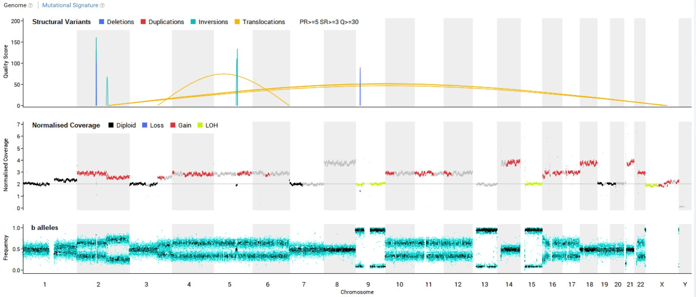
Cancer Whole Genome Sequencing (WGS)
Exhausted SoC testing or treatments
Aligned to Clinical Trials
Somatic (fresh) sample; [>30% tumour, <20% necrosis]
Germline sample [cultured skin]
WGS Test Order Form (TOF)
Record of Discussion (RoD)
Phase 1
Childhood Cancer (≤19 years of age)
Acute leukaemia (AML, ALL, ALAL, BPDCN)
Sarcoma
Phase 2/3
‘Paediatric cancer’ (≤25 years of age)
Proven or suspected malignancy exhausted all standard of care (SoC) testing and treatment
Malignant CNS tumours
Breast and ovarian cancer pilots

Slide 11
Any questions?
Chris Wragg
Christopher.wragg@nbt.nhs.uk
0117 414 6141

