Slide 1
The Big Impact of Brief Encounters
Jo Chambers
Patient Rep

Slide 2
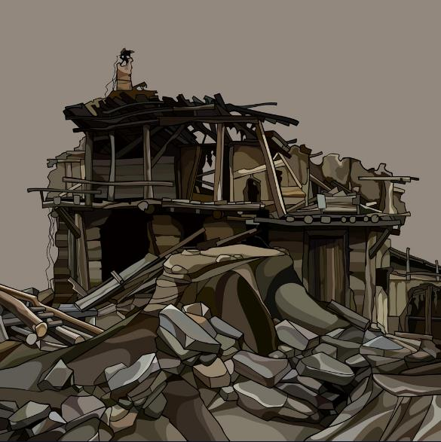
Success!!!

Slide 4
CNS Teams
Invaluable gift of time
No judgement
Not phased by anything
Pull everything together across the multidisciplinary team

Slide 5
Continuity of care
Helps all of the previous points happen more easily
Build a relationship and build trust
Continuation of conversations and monitoring
Build a better understanding of the patient as a person
Leads to significantly better experience of care

Slide 6
Get my name right
Ask “how are you really feeling”
Explain what is going to happen
Give back as much control as possible
See me as a real person with a life outside of cancer
Build a relationship and build trust
It’s not just about getting chemo into people or operating on people.
The small things matter – they take very little time but they have a big impact.

