Slide 1
The SWAG Cancer Alliance approach to reducing Health Inequalities
September 2022

Slide 2
Context
Key issues
1 in 2 people in the UK will be diagnosed with some form of cancer during their lifetime
40% of cancer are preventable as they are related lifestyle risk factors
Poorer outcomes for population groups in the more deprived quintiles due to late diagnoses
Pandemic and cost of living crisis has exacerbated the above issues
A new report from the Institute of Health Equity makes the case for prioritising reducing fuel poverty to address health inequalities and provides a useful framework for healthcare institutes to address health inequalities.
Notes:
Cancer is the second biggest burden of disease after CVD, and close to half of all cancers are preventable.
(Microsoft Power BI) Lung , bowel, melanoma and breast cancers are projected to be the most significant burden of preventable cancers over the next decade.
The burden of disease falls disproportionately on those least well of in society, and the pandemic has worsened cancer outcomes for patients, especially for those with poor access to health and care services.
1. UK has a high death rate overall and survival rates are poor when compared to countries of similar GDP (EuroStat). The premature mortality rate from cancer is variable across the SWAG area with 38/100 000 in BaNES (lowest) and 66/100 000 in Bristol (highest) (2017 – 2019 data).
2. Lifestyle risk factors are closely related to deprivation and this is reflected in the poorer outcomes for cancer in more deprived population groups. Cancer incidence rates are 16.5% (for men) and 19.5% (for women) higher in the most deprived 20% of areas in England, compared to the 20% least deprived areas.
3. People in the most socio-economically deprived areas in England are 20% more likely to have their cancer diagnosed at a late stage than people in the least deprived areas. (Macmillan Cancer Support 2019 – Health Inequalities – Time to talk) and therefore have poorer outcomes.
4. Prevention has the largest potential for reducing cancer inequalities in all settings (WHO 2019)
GP consultations account for 90% of the public’s contact with healthcare professionals in the UK.
Therefore primary care is a key lever through which health inequalities can either be exacerbated or mitigated. NB effect of pandemic on this.
5. 63% of cancers detected through screening are at the earliest stage (but only 6% of pts diagnosed), followed by urgent GP referral at 31% (but 37% of pts diagnosed) CRUK 2015/16

Slide 3
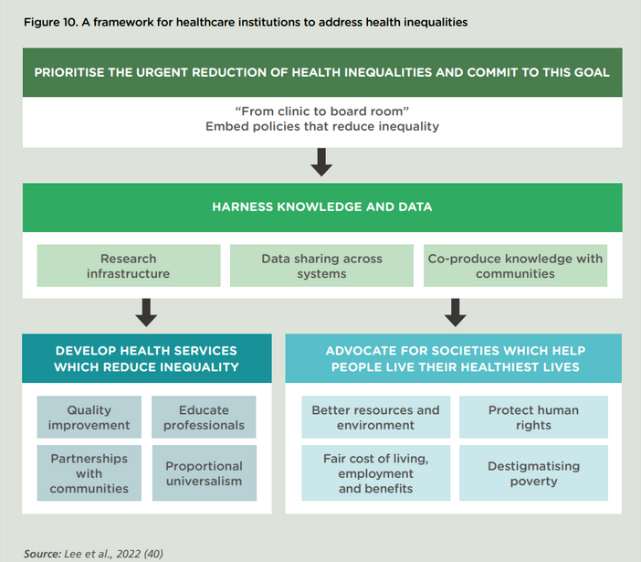
Context

Slide 4
Policy drivers
NHS Long Term Plan: National Ambitions for Cancer - A commitment to reduce health inequalities and increase ‘healthy life expectancy by 2035’
Operational planning guidance: continued focus on reducing health inequalities
ICS: one of the 4 core purposes of ICSs is to reduce health inequalities in outcomes, experience and access
Core20Plus5: ‘Exceptional quality healthcare for all through equitable access, excellent experience and optimal outcomes’ using a CQI approach
Notes:
LTP - Stronger NHS action on health inequalities
The social and economic environment in which we are born, grow up, live, work and age, as well as the decisions we make for ourselves and our families collectively have a bigger impact on our health than health care alone.
For reasons both of fairness and of overall outcomes improvement, the NHS Long Term Plan therefore takes a more concerted and systematic approach to reducing health inequalities and addressing unwarranted variation in care.
Tackling Inequalities through operational planning - Five priority areas for systems to progress during 2021/22
Priority 1: Restore NHS services inclusively
Priority 2: Mitigate against digital exclusion
Priority 3: Ensure datasets are complete and timely
Priority 4: Accelerate preventative programmes that proactively engage those at greatest risk of poor health outcomes
Priority 5: Strengthen leadership and accountability
Four Core Purposes of ICS’s
Improving outcomes in population and healthcare
Tackling inequalities in outcomes, experiences, and access
Enhancing productivity and value for money
Helping the NHS to support broader social and economic development
‘Core20PLUS5’ initiative to drive targeted health inequalities improvements in the following areas:
Core 20 – Most deprived 20% of our population
PLUS – Other population groups as identified by local population health data e.g. ethnic minority communities
5 – Targeting five key clinical areas of health inequalities:
1) Early Cancer diagnosis (screening & early referral),
2) Hypertension case finding,
3) Chronic Respiratory disease (driving Covid & Flu vaccination uptake),
4) Annual health checks for people with Serious Mental Illness,
5) Continuity of maternity carer plans
COVID-19: The disproportionate impact of the pandemic people from the most deprived areas, ethnic minority communities, and other vulnerable groups, has highlighted now more than ever the urgent need to tackle health inequalities.

Slide 5
National Cancer Alliance Planning 2022/23
Through delivery of the NHS Long Term Plan, we will transform cancer care and outcomes so that from 2028:
We will get there by:
Diagnosing cancers earlier and faster.
Ensuring every patient has access to optimal, personalised treatment and care and effective follow-up.
Enabling research and innovation so that new, smarter and kinder diagnosis and treatment methods are developed and quickly adopted.
The ambitions will be delivered in a way which:
Improves quality of life outcomes;
Improves patient experience outcomes;
Reduces variation; and
Reduces inequalities.
Achieving the early diagnosis ambition requires the successful delivery of a number of different interventions. The ‘waterfall’ chart on the next slide sets out our central estimates for the percentage point improvement these different interventions have the potential to deliver.
3 in 4 (75%) of cancers will be diagnosed at stages 1 and 2
55,000 more people per year will survive their cancer for five or more years
Notes:
To achieve our ambition, we need to develop new programmes of work, as well as accelerate progress in existing programmes.

Slide 6
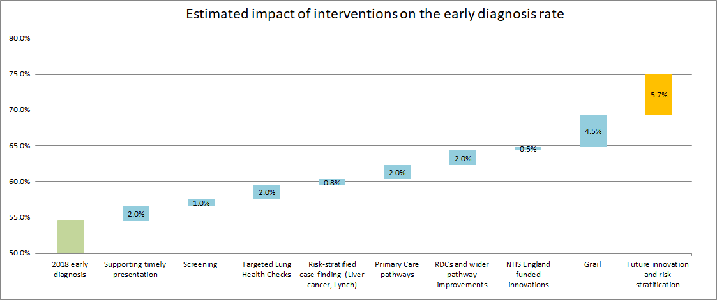
National Cancer Alliance Planning 2022/23
The 2022/23 operational planning guidance, published on 24 December 2021, firmly steers the focus back to the cancer Long Term Plan ambitions, in particular, ambition on early diagnosis.
There are three key delivery areas for cancer outlined in the Planning Guidance. Complete work on post-pandemic cancer recovery objectives:
to return the number of people waiting for longer than 62 days to the level in February 2020
to meet the increased level of referrals and treatment required to reduce the shortfall in number of first treatments
With a particular focus on the three cancers making up two thirds of the national backlog (lower GI, prostate and skin)

Slide 7
Cancer Alliance roles on behalf of ICBs
Planning – Alliances will contribute to ICB plans by leading the development and delivery of their cancer element – strategic plans for cancer covering both the delivery of the LTP ambitions for cancer and activities to support the delivery of cancer services in line with waiting times standards and national standards for specialised cancer services.
Whole-system and whole-pathway delivery – Alliances will work with provider collaboratives and other system partners to support the effective delivery of cancer pathways, including the operational standards for cancer, and embed best practice for cancer care. They will also work across the whole pathway, providing the link to partners including: prevention, screening and public health services; primary care; diagnostic networks; Operational Delivery Networks (eg. for radiotherapy); Community Diagnostic Centres; and, end of life care providers. Alliances will also ensure alignment with wider system plans, for example on workforce, health inequalities, digital and research and innovation.
Clinical leadership – Cancer Alliances will facilitate clinical expert groups for cancer to provide clinical leadership for the local system and to inform strategic and operational decisions related to transformation and improvement projects across the ICB(s).
Strategic commissioning – as part of their planning role, Cancer Alliances will advise their ICB(s) on the commissioning of routine and specialised cancer services, including associated diagnostic services, to ensure that there is sufficient capacity to meet the needs of people with cancer or suspected cancer.
Notes:
Four Core Purposes of ICS’s
Improving outcomes in population and healthcare
Tackling inequalities in outcomes, experiences, and access
Enhancing productivity and value for money
Helping the NHS to support broader social and economic development

Slide 8
NHS Cancer Programme Delivery Principles
There are four key principles we expect to be embedded and reflected in delivery plans.
1
Identifying, monitoring and reducing health inequalities
2
Understanding and improving experience of care by embedding patient, carer and public voices in policy and service development and delivery
Background Tackling inequalities in outcomes, experience and access is a key focus of the Long Term Plan and 22/23 Planning Guidance.
Priorities As well as continuing to use and respond to local data in delivering programmes of work, Cancer Alliances should take specific action on health inequalities in line with three priorities: 1. Increase early stage diagnosis in areas of high deprivation, in particular through the delivery of existing projects and programmes of work (e.g. Targeted Lung Health Checks, FIT roll out, primary care, etc). 2. Improve access to treatment for older people 3. Improve patient experience and personalised care for all sections of the community, including: using CPES and other relevant data to reduce variation in experience of care, ensuring implementation of PSFU benefits all patient groups, and improving uptake of the Quality of Life Survey in populations with lower response rates. In addition, Cancer Alliances should continue to take action to ensure that recovery from the pandemic is delivered in an equitable way.
Supporting Information Covid-19 Cancer Equity Data for FDS referrals and first treatment activity: available on the dedicated health inequalities page on the Workspace, and published with greater granularity in Foundry Summary grid of key cancer inequality indicators
Background NHSE/I has a legal duty to involve patients and the public in work to improve services. Co-production is recognised as a critical change ingredient for COVID recovery by NHSE/I Beneficial Changes Network.
Priorities Cancer Alliances should take specific action to work with people with lived experience by: 1. Ensuring there is a nominated Cancer Alliance Patient Experience Lead and involvement strategy 2. Promoting the uptake of Cancer Patient Experience Survey (CPES)/Under 16 CPES 3. Using patient insights to reduce variation in experience of care. 4. Embedding relevant Cancer Experience of Care Improvement Collaborative projects across the Cancer Alliance
Supporting Information NHS England and NHS Improvement Resource Hub: NHS England Involvement Hub Statutory guidance for CCGs and NHS England: guidance NIHR: UK Standards for Public Involvement
It’s not currently possible to isolate the impact of our activity, however:
  Overall cancer referrals continue to rise when campaign activity went live correlating with our campaign activity (when we may have expected a drop due to rising Covid-19 cases & restrictions)
  Increases can be seen in the key cancers that the campaign symptoms indicate (breast, gynaecological, lower GI and lung)
3
Working in partnership to maintain the cancer workforce
4
Taking a data-driven approach to transforming cancer outcomes
Background Achieving the Long Term Plan objectives requires enough people with the right skills and experience. Leadership at a local and national level is needed to deliver this.
Priorities As a minimum, Cancer Alliances should take a leading role in working with partners to deliver the following actions: 1. Promote and enable take up of available training opportunities for the cancer workforce. 2. Implement innovative approaches to enable skill mix and maximise the productivity of the current workforce. 3. Ensure that an appropriate workforce is in place to deliver the Long Term Plan programmes. This includes using relevant funding to ensure the allocation of pathway navigators to Rapid Diagnostic Centre pathways.
Supporting Information Workforce section of Cancer Alliance Workspace
Background Data is fundamental to providing system-wide oversight and transforming cancer services and outcomes. During the pandemic and subsequent recovery period, high quailty data has been instrumental in enabling the system to manage and monitor recovery.
Priorities Cancer Alliances should: Use a wide range of data and analysis to inform plans to improve performance, with a focus on pathways which will have the greatest impact on performance and outcomes. Use data to track delivery and pinpoint areas of emerging concern. Undertake local evaluations to develop evidence and best practice that can be shared across all Cancer Alliances and the National Cancer Programme. Monitor and support improvements in the completeness of staging data.
Supporting Information CADEAS Products and Publications : CADEAS area on Cancer Alliance Workspace
Notes:
The SWAG Cancer Alliance will work with all systems to:
Address health and care inequalities in cancer.
Address unwarranted variation in cancer access, experience of services and outcomes.
Reducing HI is a golden thread throughout all the programmes in the SWAG delivery plan.

Slide 9
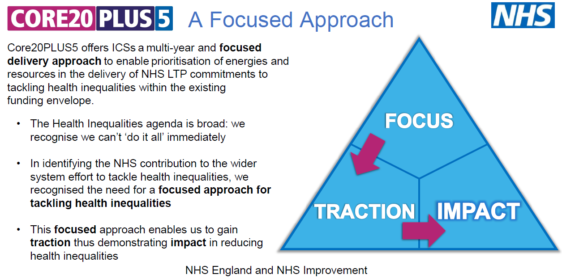

Slide 10
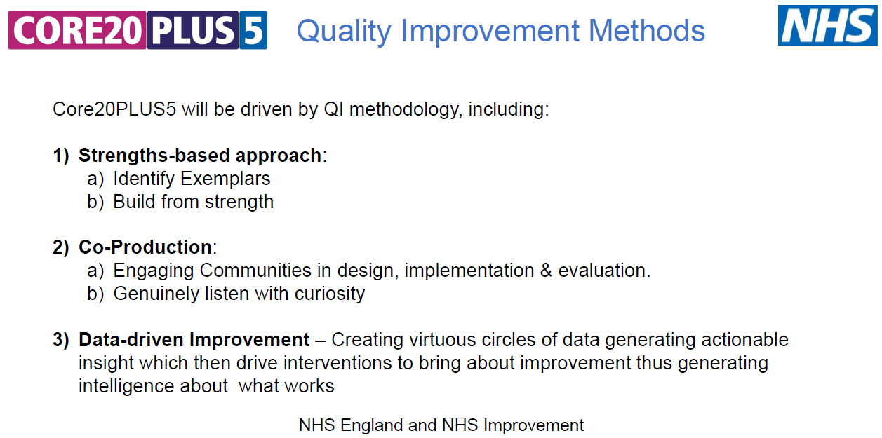

Slide 11
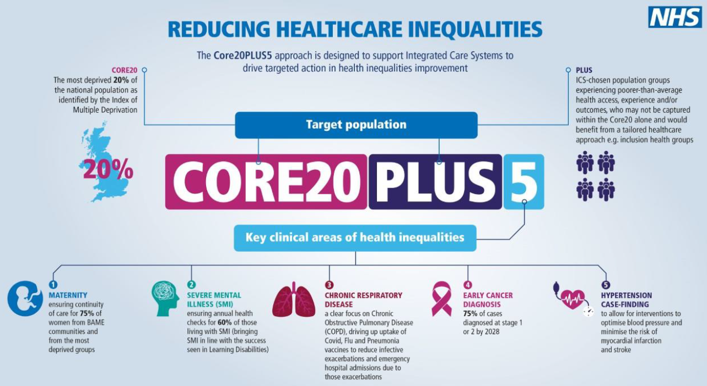
Notes:
Core20PLUS5 is a national NHS England and NHS Improvement approach to support the reduction of health inequalities at both national and system level. The approach defines a target population cohort – the ‘Core20PLUS’ – and identifies ‘5’ focus clinical areas requiring accelerated improvement.
Core20
The most deprived 20% of the national population as identified by the national Index of Multiple Deprivation (IMD). The IMD has seven domains with indicators accounting for a wide range of social determinants of health.
PLUS
PLUS population groups we would expect to see identified are ethnic minority communities; inclusion health groups; people with a learning disability and autistic people; coastal communities with pockets of deprivation hidden amongst relative affluence; people with multi-morbidities; and protected characteristic groups; amongst others.
Inclusion health groups include: people experiencing homelessness, drug and alcohol dependence, vulnerable migrants, Gypsy, Roma and Traveller communities, sex workers, people in contact with the justice system, victims of modern slavery and other socially excluded groups.
5
The final part sets out five clinical areas of focus. Governance for these five focus areas sits with national programmes; national and regional teams coordinate local systems to achieve national aims.
Maternity: ensuring continuity of care for 75% of women from Black, Asian and minority ethnic communities and from the most deprived groups.
Severe mental illness (SMI): ensuring annual health checks for 60% of those living with SMI (bringing SMI in line with the success seen in learning disabilities).
Chronic respiratory disease: a clear focus on Chronic Obstructive Pulmonary Disease (COPD) driving up uptake of COVID, flu and pneumonia vaccines to reduce infective exacerbations and emergency hospital admissions due to those exacerbations.
Early cancer diagnosis: 75% of cases diagnosed at stage 1 or 2 by 2028.
Hypertension case-finding and optimal management and lipid optimal management: to allow for interventions to optimise blood pressure and minimise the risk of myocardial infarction and stroke.

Slide 12
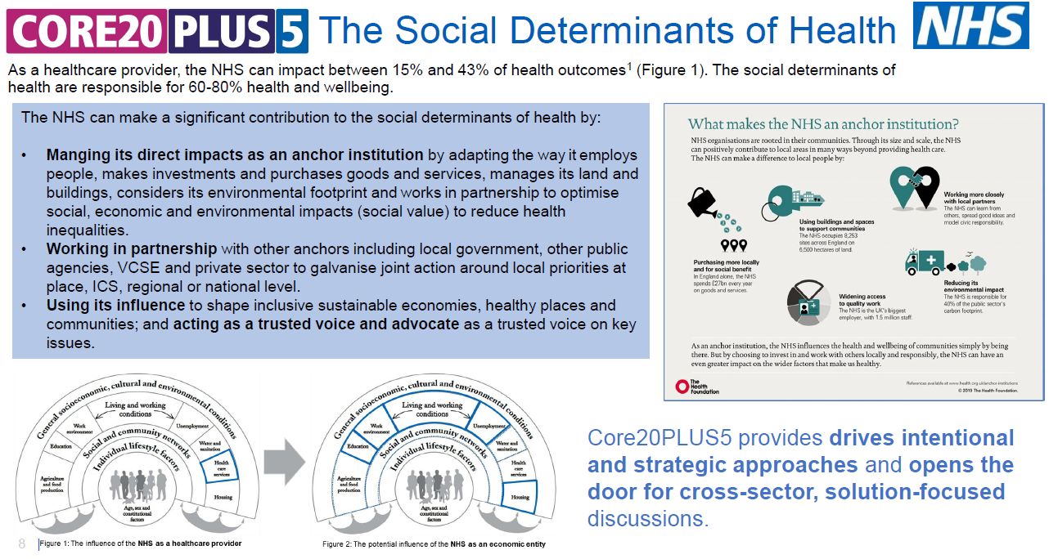

Slide 13
South West region priorities for health inequalities, 2022-24
Our overarching priority will be to increase healthy life expectancy and reduce the gap in life expectancy at birth for the South West population.
To achieve this, detailed below are the areas of focus referred to as Health Outcome Categories:
Oral health (children)
Children and Young people, including child obesity
Smoking
Public Mental health (suicide and self harm)
Cancer (early cancer diagnosis, cervical)
CVD (Hypertension case finding)
Coastal inequalities
Addiction
Social care
Employment
Obesity
Golden Threads
***
Core20PLUS5 embedded throughout
***
Inclusion Health Groups embedded throughout
***
Learning Disabilities, Autism and Neurodiversity embedded throughout
***
C&YP embedded throughout
Agreed March 2022

Slide 14
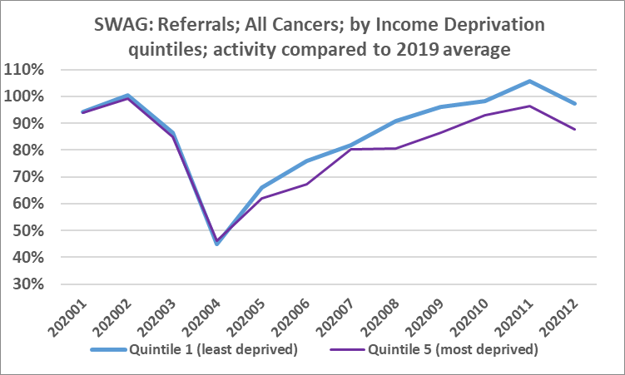
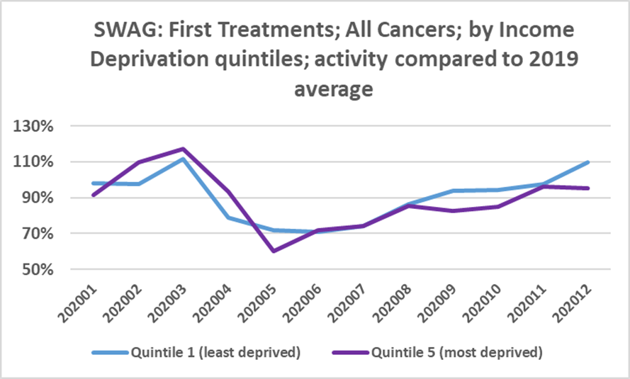
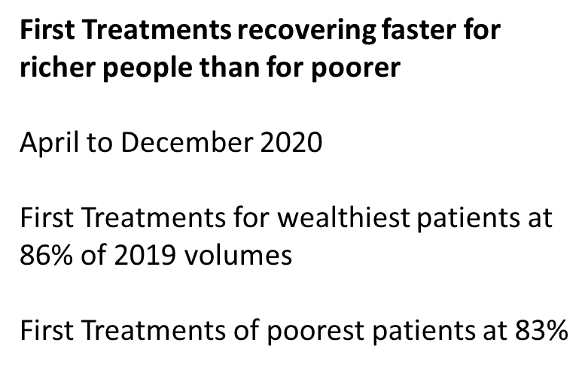

Referral rates recovering more quickly for wealthy people than for poorer people
April to December 2020
Referrals of wealthiest patients at 84% of 2019 volumes
Referrals of poorest patients at 77%
Notes:
ACCESS
Do we have this data by age and sex breakdown?
Are referral rates for older people recovering to the same extent as younger people?
Are referrals rates for men recovering more slowly than females?
What are the recovery referral rates between different ethnic groups?
Do we have cancer champions in seldom heard communities?

Slide 15
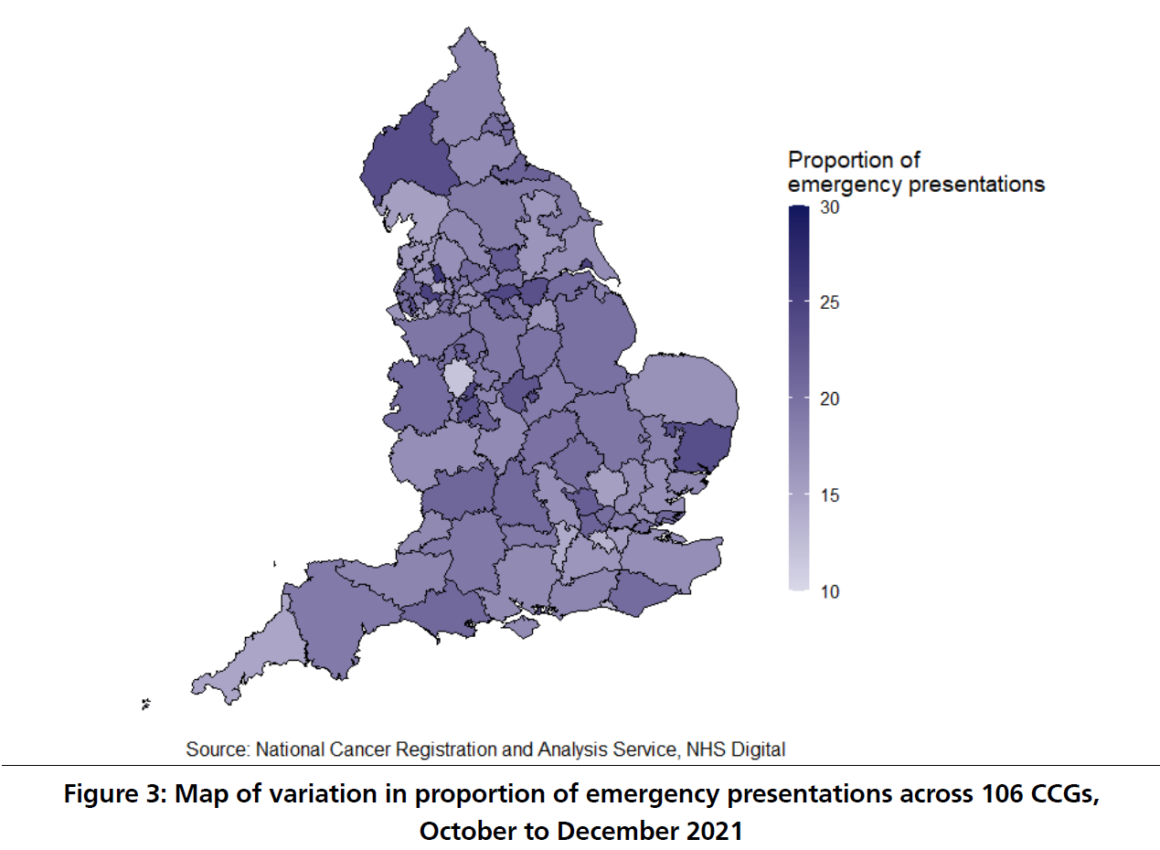
Notes:
ACCESS
Across the 106 Clinical Commissioning Groups (CCGs), the proportion of cancer patients
presenting as an emergency varied for the three most recent quarters (April to June 2021,
July to September 2021 and October to December 2021) (Table 1). There are no obvious
Geographical patterns to the CCG variation (Figure 3).
April –June 2021 14.2 – 29.7%
July –Sep 2021 11.5-27%
Oct-Dec 2021 11.9-26.2%
There is a 8.4% gap in early stage diagnosis between those living in the most deprived quintile vs those
living in the least deprived quintile.

Slide 16
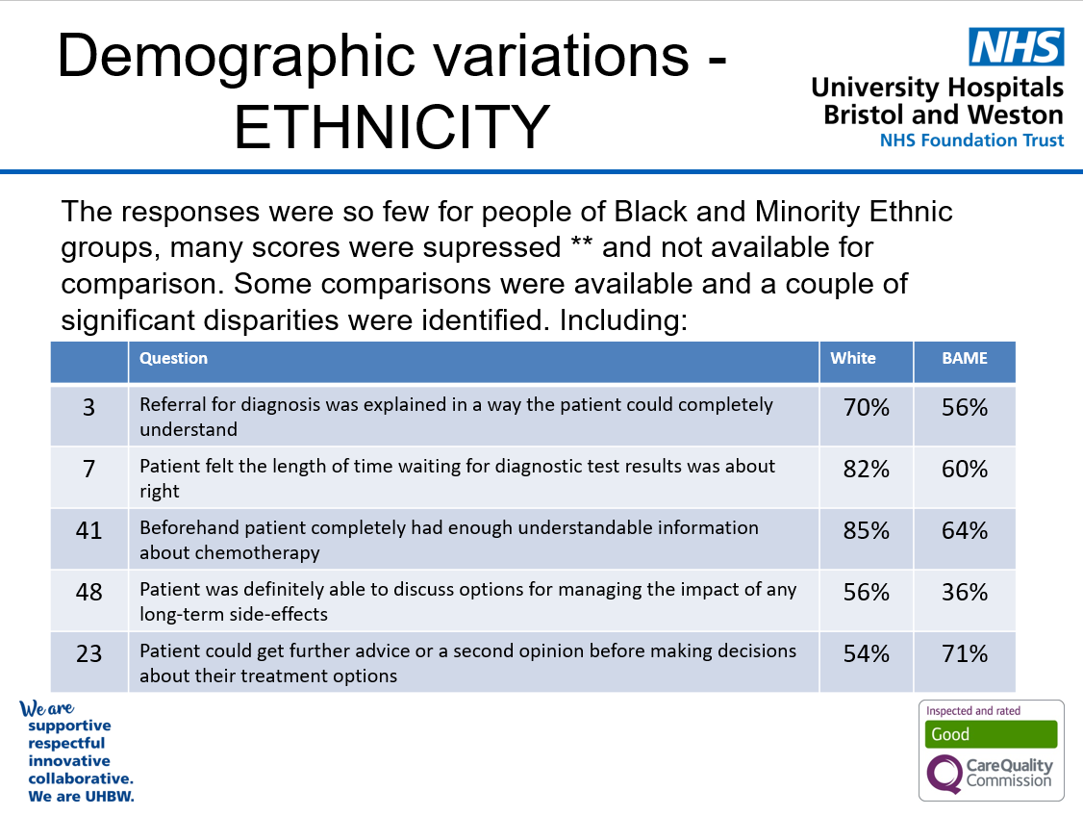
Notes:
EXPERIENCE
NCPES (nat cancer pt exp survey)
Deprivation: Overall, there was a moderate variation in levels of experience, mainly within 0-10% between all five quintiles. The majority of answers, were s
cored more highly (indicating a higher level of patient experience) by those in IMD quintiles 1&2 (more deprived).
Theme of low scores relating to
- communication and shared care, between care providers, Trusts, departments
- Information giving (including side effects, immunotherapy)
- access to support from community & primary care services
Access to personalised care and support not always taken up by certain groups.
CSW in secondary care and care co-ordinators in PCNs in Somerset
Pt reps – take a steer for actions on this.
How do we co-produce information to support understanding and manage expectations across pop groups?
Is there a role for SWAG CA in this? Agree action by 24 Nov Delivery Grp mtg

Slide 17
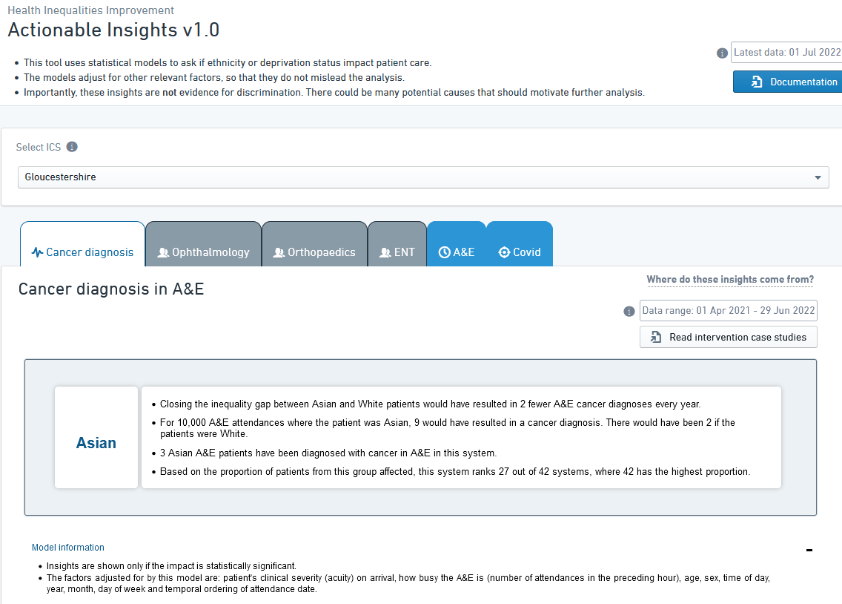
Notes:
OUTCOMES

Slide 18
Co-Production with PPV
Co-production is a collaborative model of research that includes stakeholders such as patients, the public, donors, clinicians, service providers, and policy makers.
It is a sharing of power, with stakeholders working together to develop the agenda, design and implement services, research, and interpret, disseminate, and implement the findings.
Co-production requires trust, genuine power sharing, and respect for the different expertise brought by stakeholders. Trust also relies on effective communication and honest discussions about what can and cannot be done.
(BMJ, 2021)
Notes:
GIT and hepatobiliary incidence in cancer incidence in the UK between ethnic groups:
2 times higher incidence of oesophageal cancer in Bangladeshi women compared with white women
Black Caribbean men and women had higher incidences of gastric cancer compared with white counterparts
6 times increased risk of oesophageal cancer in Bangladeshi women compared with Pakistani women
4 times higher incidence rate of liver cancer in Chinese compared with whites
2 times higher incidence rate of liver cancer in Bangladeshis compared with Indians
3 times higher incidence rate of liver cancer in black Africans compared with black Caribbeans
Genitourinary
Prostate cancer incidence significantly increased in black Caribbean and black Africans compared with whites
Prostate cancer incidence increased in Indian, Pakistani and mixed white and black Caribbean/African groups

Slide 19
Co-Production with Lived Experience
We are passionate about including patient voices at the heart of all our research, projects and findings and we understand it’s importance hence we endeavour to implement the “What Matters To You” approach in all SWAG HI Work.
Examples of current SWAG co-production work:
PPV Community Group:
SWAG HI Priorities Working Group
PPV Induction Pack
SWAG Website including Jo’s repository
SWAG Quality Improvement Working Group
Digital Story
Notes:
GIT and hepatobiliary incidence in cancer incidence in the UK between ethnic groups:
2 times higher incidence of oesophageal cancer in Bangladeshi women compared with white women
Black Caribbean men and women had higher incidences of gastric cancer compared with white counterparts
6 times increased risk of oesophageal cancer in Bangladeshi women compared with Pakistani women
4 times higher incidence rate of liver cancer in Chinese compared with whites
2 times higher incidence rate of liver cancer in Bangladeshis compared with Indians
3 times higher incidence rate of liver cancer in black Africans compared with black Caribbeans
Genitourinary
Prostate cancer incidence significantly increased in black Caribbean and black Africans compared with whites
Prostate cancer incidence increased in Indian, Pakistani and mixed white and black Caribbean/African groups

Slide 20
SWAG CA strategic ambitions for reducing health inequalities is to demonstrate that it has made a difference to improving access, experience and outcomes for those population groups most in need

Slide 21
SWAG CA strategic objectives to reduce health inequalities:
Work with systems to fulfil the LTP ambitions for cancer to reduce health inequalities and increase healthy life expectancy by 2035
Drive the NHS Core20Plus5 approach by working with systems, their communities and patients to improve access, experience and outcomes for cancer
Strengthen provider and community engagement to understand barriers to accessing healthcare and co-producing solutions. Supporting this through VCSE, academic involvement and clinical health inequalities champions
Provide intelligence which informs insights to drive action across the SWAG CA.
Communicate with all stakeholders through regular information sharing e.g. website, newsletters, network meetings
Ensure SWAG CA, together with systems, makes progress on addressing the health inequalities commitments in the SWAG CA cancer delivery plan
Notes:
Core20 = 20% most deprived population groups nationally
PLUS = pop groups with poor access, experience and outcomes
5 = focus on 5 disease areas which includes cancer early diagnosis
VCSE = voluntary, community and social enterprise

Slide 22
Strategic priorities for SWAG CA to reduce health inequalities:
Continue to host SWAG CA health inequalities forums for systems to share their progress, learning, good practice and innovation
Continually review progress against the health inequality objectives in the SWAG cancer delivery plan and the NHS Core20 Plus5 approach
Strengthen links with a wide range of stakeholders and partners, including e.g. the VCSE and academic sectors and system HI leads, to address health inequalities through initiatives, transformation and regular communication
Identify clinical cancer HI champions to work with the SWAG CA
Work with all stakeholders and communities on engagement and to improve the recording of race and ethnicity to influence research, design and planning of services
Develop a SWAG HI intelligence dashboard to inform insights and action to reduce variation in patient access, experience and outcomes
Notes:
e.g. PCN clinical leads meetings, Pop health and HI group
Monitor delivery plan
Building SWAG CA HI website; build connections with the ICS HI leads, acute trust HI leads, PCN HI leads etc. Using a test and learn approach
Links with digital and national HI team
Developing HI dashboard
?investigate disproportionate experience of harm in core20plus groups in SWAG services

Slide 23
Reducing health inequalities in the SWAG CA strategic programmes of work:
Examples with a particular focus on reducing health inequalities include:
Targeted Lung Health Checks
Bristol and Severn ODN Liver Health Checks
Prostate Cancer in black men
EOI pilot for community pharmacy
Work with C’aafi Health on community engagement in Bristol
Collaboration with CRN on a 6 month community engagement project

Slide 24
HI: Rebuilding Trust
Another area of focus is rebuilding the trust between SWAG and our hardly reached communities, we are improving our relationship with stakeholders who have little to no trust in the NHS services or in healthcare professional so our ongoing projects can be co-produced with them, reducing inequalities and ensuring equal representation for each communities.
We are currently working and engaging with third sector groups such as: C’aafi Health, Friends of Caswell Thompson (FOCT), Health Links, Voluntary Action Network, Living Through This and many more.
In doing this, we hope to have a community of engaged stakeholders and possibly a diverse representation of Patient and Public Voice (PPV) representatives.

Slide 25
Key questions for consideration
1. How can SWAG CA add value to the work of the ICS’s?
2. How can the Alliance advocate for progressive disease prevention?
3. How do we address equity of access, experience and outcomes?
4. What do we focus on in the short, medium and longer term?
5. Can we strengthen continuous quality improvement and reduce variation?
6. How can we use a PHM approach to reduce health inequalities?
7. Do we need to do something different in the spirit of test and learn?
8. Do we have the intelligence to develop these insights and formulate meaningful actions to address the issues?
Notes:
Questions posed previously to the SWAG CA Board in September 2021 for deliberation and still relevant:
1. Health inequalities is everyone’s business and there are ICS, place-based and PCN health inequalities leads to drive this agenda. Driving delivery and improving outcomes will be all our responsibility. How can we add value and not duplicate the work of the ICS’s across the SWAG area?
2. Trends in population health show that increasingly we are living longer but in poor health. Multimorbidity is increasing. Both of these are worse in poorer and under-served population groups. How can we use the alliance’s voice to advocate and drive disease prevention and access to services?
3.
4. Need to bear in mind that the UK is expected to diagnose 500,000 new cases per year by 2030 (approx. 40% increase since 2014) compounded by effect of pandemic. How are we going to keep up with demand e.g. in diagnostics and workforce?
5. Where should we focus to reduce variation in practice across SWAG e.g. access to psychological therapies or late effects treatment?
6. Already use PHM to identify cohorts in a primary care setting that are most at risk – deprivation, multimorbidity, lifestyle risk factors. Can we use PHM to greater effect across whole patient pathways?
7. There is already good practice in systems and the cancer HI grp is a forum in which the spread of innovation and learning could be facilitated. e.g. reverse care pathways.
8. Current data, focussing on screening and early diagnosis, will to help inform and prioritise actions.

