Slide 1
Melanoma NICE Update 2022
Dr Amrit Darvay
NBT
Melanoma: assessment and management. July 2015 updated July 2022.
www.nice.org.uk/guidance/ng14
SWAG Meeting Bristol November 2022
Notes:
highlight some of recommendations that are new/nuance of 2015
Starts with a section on communication and support which is crucial but no major differences that I can see

Slide 2
1.2.3 P9
2015 (p 243) consider minimizing or avoiding immunosuppressants for people with melanoma
For people on immunosuppressants and immunomodulators seek advice from the patient’s specialist team (Page 9)
Notes:
Inform/ copy in transplant physician ask how they are inform the transplant physician or general phyisican
Enquire on aza/mycophen neuro/gastro etc
Page 9 of 44

Slide 3
1.3.9 P10
Consider BRAF analysis Stage IIA and IIB
Carry out BRAF analysis IIC-IV
LSMDT arrange BRAF tests
First test Immunohistochemistry (BRAF V600E)
If IHC negative use a molecular test
Notes:
Why
speed up decision making for replapsed disease noted that significant number reaplwe

Slide 4
1.4 Staging and SLNB P11
1.4.2
Do not offer imaging before SLNB unless nodes or distant mets suspected
1.4.3
Consider SLNB for Breslow 0.8mm to 1.0mm with at least one
  Ulceration
  LVI
  Mitotic Index >2

Slide 5
1.4
1.4.5 Discuss the option of delaying SLNB until after pregnancy
Consider CT Staging for IIB (2015 Page 25 IIC)
Offer CT staging IIC to IV
1.4.8 Consider staging with brain MRI if locally available and after discussion and agreement with the SSMDT
Notes:
Increased sensivity for detecting brain mets for MRI compared to CT
Committee agreed that mri has utility in staging

Slide 6
1.4.9-10 P12
Whole body and brain MRI
  Age <24
  Pregnant women IIB to IV
Brain MRI instead of brain CT IIIC to IV and one of
  mitotic index of >5
  Primary scalp melanoma

Slide 7
1.4.11
Consider a repeat staging scan before starting adjuvant treatment, unless imaging done within the last 8 weeks is available
Notes:
Noted a high rate of recurrence in the interim period between syugery and starting adjuvant therapy

Slide 8
1.5 Management Stages 0 to II P12
1.5.1 consider a clinical margin of at least 0.5 mm (2022)
Page 26 2015 Guidance the same
If excision doesn’t achieve adequate histological margins discuss at SSMDT (2015 discuss at MDT)
Notes:
What is adequate margins ?

Slide 9
1.5.3 P13
WLE 1cm for Stage 1 or 2cm for Stage 2
The clinical margin should be around the histological biopsy scar and take into account the primary melanoma margin
2015 at least 1cm or at least 2cm (page 124)
Notes:
Smaller margins due to cosmetic or surgical issues to be discussed face head digits etc

Slide 10
Stage III P13
1.6.1 Do not routinely offer completion lymph node dissection with stage III disease and micrometastatic nodal disease detected by SLNB unless there are factors that might make recurrent nodal disease difficult to manage e.g.
  Melanoma of the head and neck
  Adjuvant contraindicated
  Regular FU not possible
  Adjuvant tx for stage III not specifically discussed in the 2022 guidance
Notes:
What are they ? In transit A type of metastasis in which skin cancer spreads through a lymph vessel and begins to grow more than 2 centimeters away from the primary tumor but before it reaches the nearest lymph node.
Microscopic satellites (microsatellites) in primary melanoma are defined as one or more discontinuous nests of neoplastic melanocytes measuring more than 0.05 mm in diameter that are clearly separated by normal dermis (i.e., no fibrosis or inflammation) from the main invasive component of the melanoma by a distance of at least 0.3 mm.
Completion does not improve survival compared to surveillance and increases risk of lymphoedema

Slide 11
1.7 In Transit Mets Stage III and IV P15
SSMDT discussion and offer surgery unless
Not feasible
Recurrent
Then consider
  Systemic tx
  ECP
  T-VEC ( talimogene laherparepvec)
  ISI/P
  Radiotherapy
  Imiquimod
Notes:
begins to grow more than 2 centimeters away from the primary tumor but before it reaches the nearest lymph node.
T-VEC is an oncolytic virus therapy, a treatment that uses a virus to infect and kill cancer cells while avoiding normal, healthy cells. T-VEC is made from a genetically modified herpes virus, commonly known as the cold sore virus. The therapy is designed to replicate inside melanoma cells to kill those cells. It may also enhance the immune system's ability to fight cancer.

Slide 12
No evidence for SLNB benefit in Stage III and microsatellite disease
‘the presence of microsatellite lesions indicates that the melanoma has progressed beyond the lymph nodes and so would automatically become stage IIIB or IIIC disease’.
most centres do not offer SLNB in stage III disease
(Page 34)

Slide 13
1.8 Stage IV and Unresectable Stage III P16
SSMDT consider surgery or other ablative treatments in consultation with other site-specific MDTs
C02 laser ablation dropped in 2022 guidance

Slide 14
Systemics Stage IV and Unresectable Stage III P17
Immunotherapy and targeted treatments, ‘the committee noted the complexities and nuances in the treatment pathway’
Immuno more effective than targeted (though higher toxicity)
nivolumab & ipilimumab most clinically and cost effective
Immuno monotherapy to decrease toxicity e.g. those with poor performance status, nivolumab or pembrolizumab similar clinical effectiveness so either should be offered.

Slide 15
P36
If Immuno is unsuitable then targeted therapies based on BRAF status are an option
targeted therapy is a possibility in e.g.
  High disease burden
  Rapidly progressive disease
Notes:
May not have enough time to generate the necessary immune response associated with immunotherapy

Slide 16
Targeted P18
Encorafenib plus binimetinib or
Trametinib plus dabrafenib
  Both have similar clinical and cost effectiveness. Either option.
If both these options unsuitable then monotherapy with dabrafenib or vemurafenib should be offered
If not suitable then dacarbzine and/or best supportative care

Slide 17
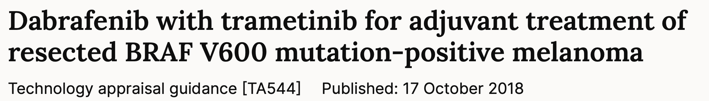
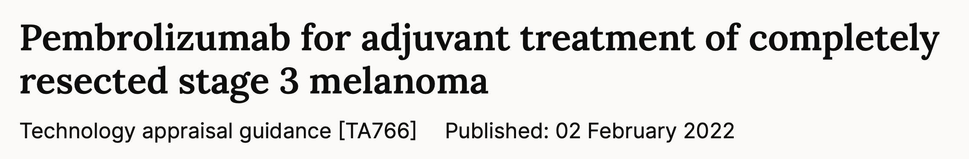
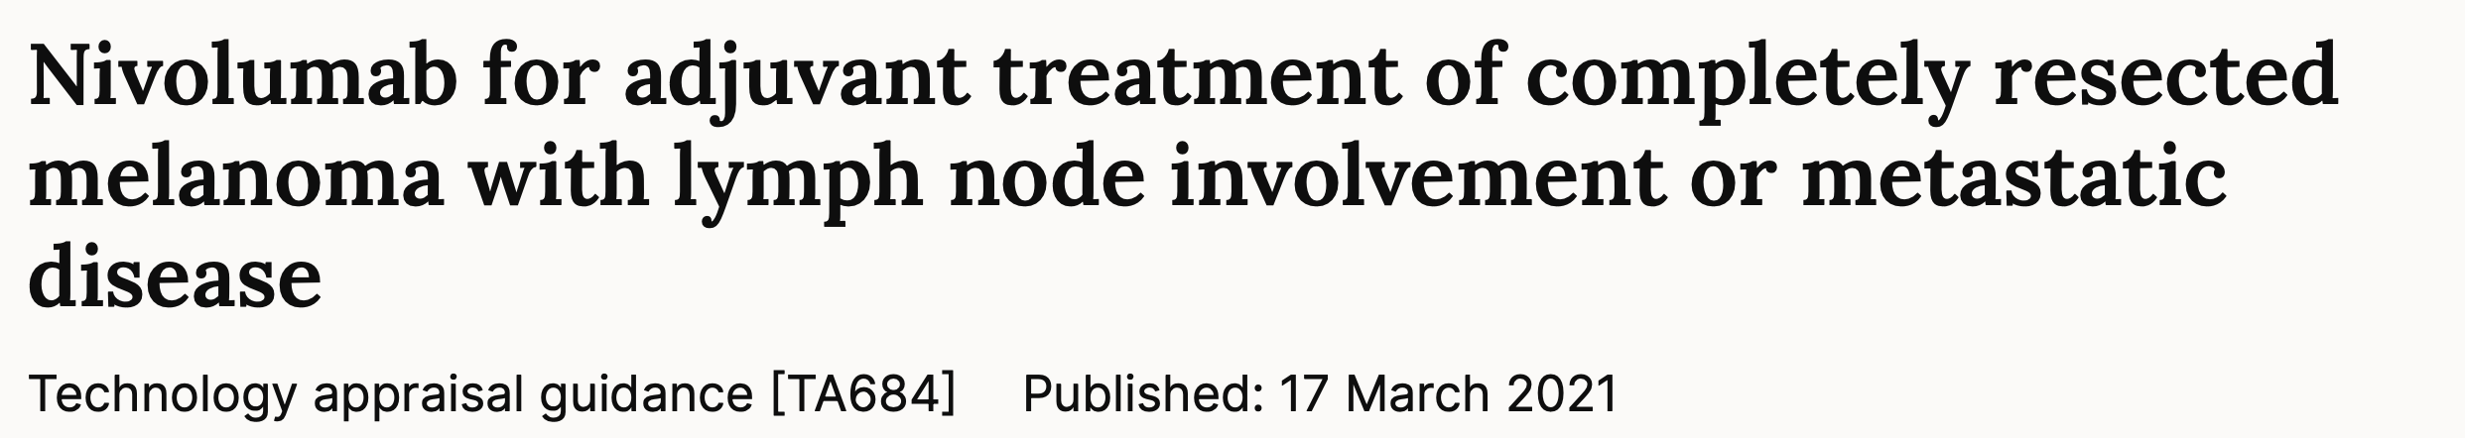
Adjuvant
See NICE technology appraisals

Slide 18
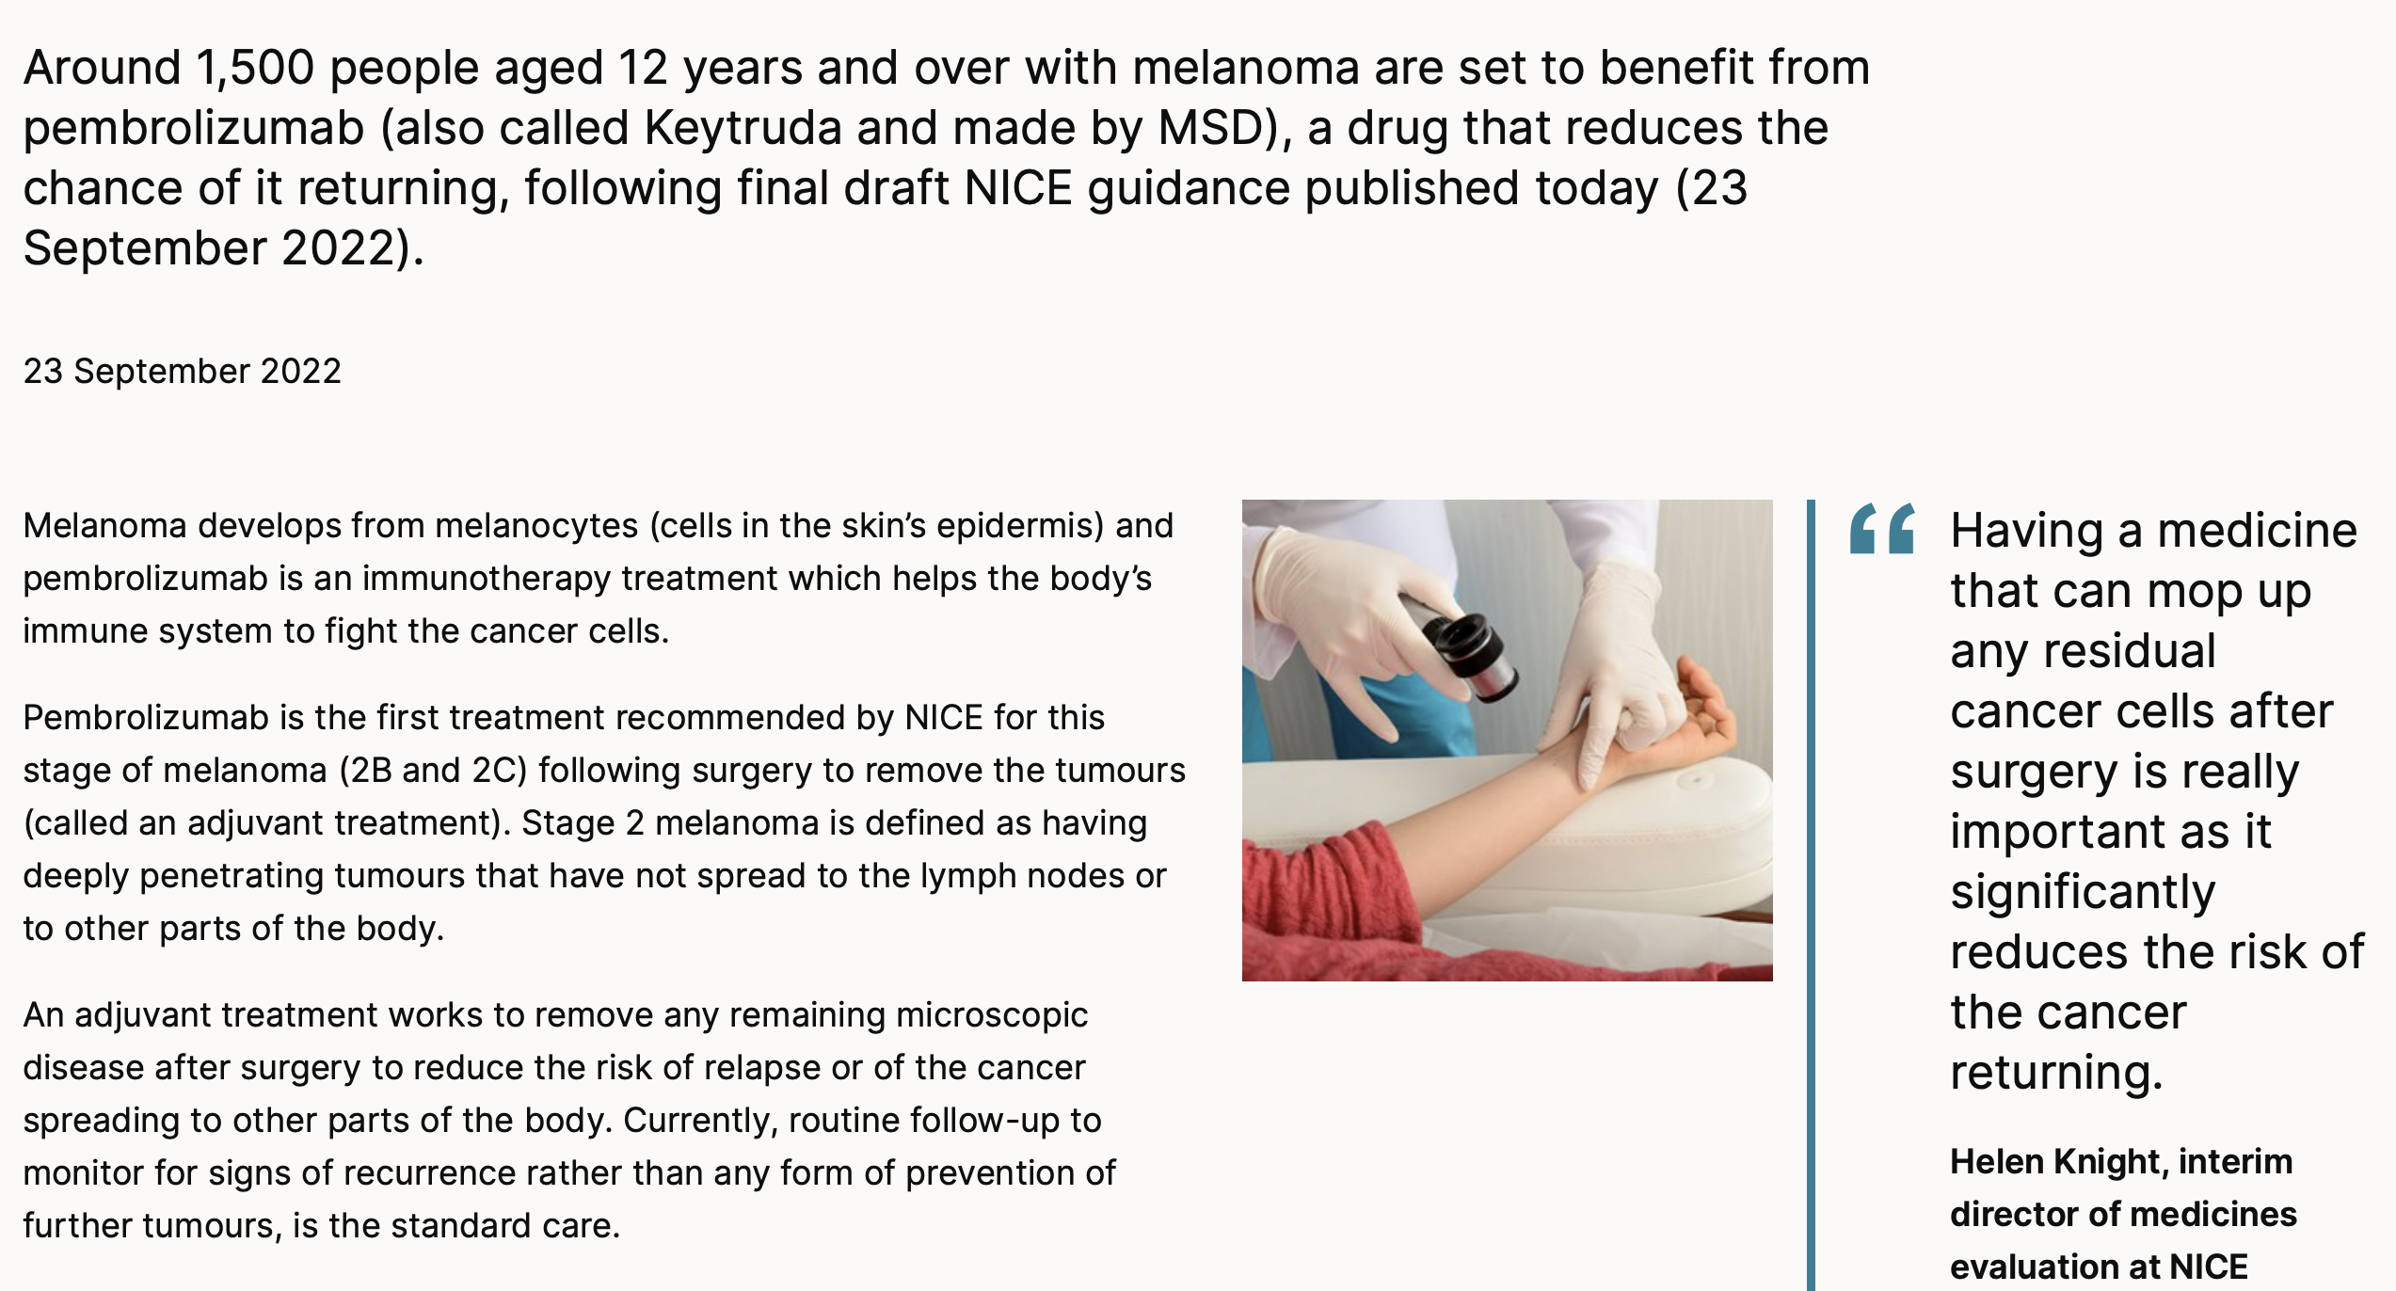
NICE Sept 22. Stage IIB and IIC Adjuvant
Notes:
Adjuvant keynote 054 pembro and the checkmate 238 niv over ipi

Slide 19
1.9 Follow Up P20
Stage 0 Melanoma in situ. One FU OPA
Unresectable Stage III and IV. Personalised FU
Personalised FU for patients with multiple MMs including in situ, first degree family MM, atypical mole syndrome
Notes:
PIFU

Slide 20
Routine FU (with access to dermoscopy and photography) (2015 IB plus Total 16 FU OPAs)
1A Year 1 2 FU appointments (previously 2 to 4 visits)
IB Year 1 2 FUs plus consider 2 u/s of draining nodal basin(s) if SLNB not done
Years 2&3 1 FU/year plus consider 1 u/s per year as above
Years 4 & 5 1 FU/year (6)
IIA Years 1&2 2 FUs/year consider 6/12thly u/s if SLNB not done
Year 3 1 FU plus 1 u/s
Years 4&5 1FU/year (7)
IIB Years 1&2 4 FUs/year consider 6/12thly CT. Consider additional 6/12thly u/s as above
Year 3 2 FUs and consider 6/12thly CT. Additional 6/12thly u/s as above (12)
Years 4 &5. 1 FU/year and consider 1 CT each year
Notes:
16 over 5 years

Slide 21
IIC Years 1&2 4 FUs/year with 6/12thly CT. Consider additional 6/12thly u/s as above
Year 3 2 FUs/year with 6/12thly CT. Additional 6/12thly u/s as above (12)
Years 4 & 5 1 FU/year and 1 CT per year
Non-Adjuvant
IIIA-C Years 1 to 3 4 FUs/year with 6/12thly CT. Consider additional 6/12thly u/s if +SLNB
Years 4 & 5 2 FU/year with yearly CT (16)
IIID-IV Years 1 to 3 4 FUs/year with 3/12thly CT. (16)
Years 4 & 5 2 FU/year with 6/12thly CT
On Adjuvant: base follow protocols up on therapeutic requirements.

Slide 22
1.9.12 For those having CT and u/s alternate between the types of scan
FU protocols aimed to balance the prompt identification of recurrence with the need to reduce numbers of FUs.
Lower frequency of FU for IB to IIC
PET not to be routinely used as not cost-effective despite being more sensitive than CT for detecting mets.
u/s more sensitive than clinical examination and CT for detection of nodal mets
Committee recommends u/s surveillance for 3 years for positive SLNB and for those patients considered for but did not have a SLNB. (Page 39)
Use of CT, MRI and u/s will increase and CT-PET will decrease.

Slide 23
More BRAF analysis
SLNB and dissections
Less FU
Imaging changes. A lot more u/s

