Slide 1
SWAG Network Oesophago-gastric (OG) Cancer
Clinical Advisory Group
Research Update
Claire Matthews & Sharath Gangadhara
30/09/2022

Slide 2
National Recruitment to Upper GI Cancer Studies
Apr 21 - Mar 22
Apr 22 - Sep 22
Data cut 22/09/2022
Source: ODP All Portfolio

Slide 3
National vs Regional Recruitment to Upper GI Cancer Studies Apr 2019 - Sep 22
National Recruitment
West of England Recruitment
(no activity in south Somerset)
Data cut 22/09/2022
Source: ODP All Portfolio

Slide 4
SWAG region Open OG Cancer Studies
CPMS ID | Comm Study | Short Name | Phase | Opening | Closure | Sample Size Eng | England Recruits
50090 | Commercial | Ph1b/3 Bemarituzumab in Advanced Gastric Gastroesophageal Cancer | I/III | 30/06/22 | 14/12/24 | 26 | 0
49425 | Commercial | HERIZON-GEA-01 | III | 11/04/22 | 31/01/25 | 33 | 0
42715 | Non-Comm | WAKING: Wnt and checKpoint INhibition in Gastric cancer | II | 11/02/20 | 31/12/24 | 52 | 14
8880 | Non-Comm | OCCAMS: Multicentre Study Determining Predictive Biomarkers & Targets for Oesophageal Adenocarcinoma | N/A | 19/07/10 | 31/03/26 | 5000 | 3,900
1203 | Non-Comm | RECaD | I/II | 01/01/01 | 31/12/22 | 500 | 463
20358 | Non-Comm | SCOPE 2 | II/III | 15/12/15 | 01/12/22 | 146 | 201
18432 | Non-Comm | PLATFORM | II | 23/02/15 | 31/03/23 | 694 | 1,017
50774 | Non-Comm | Augmented biomarker response in oesophagogastric cancer | N/A | 28/02/22 | 01/07/23 | 558 | 70
45150 | Commercial | YO42137 ATEZOLIZUMAB WITH OR WITHOUT TIRAGOLUMAB (ANTI-TIGIT ANTIBODY) | III | 18/12/20 | 01/12/22 | 20 | 6
42573 | Commercial | Pembrolizumab & Chemoradiation in Oesophageal Carcinoma Participants | III | 06/08/20 | 24/01/23 | 32 | 13
42082 | Non-Comm | Non-Invasive Testing for Early Oesophageal Cancer and Dysplasia | N/A | 19/08/19 | 01/10/24 | 900 | 518
Data cut 22/09/2022
Source: ODP All Portfolio

Slide 5
Early stage
Short Name | Sites | Opening date | Closure date | Sample Size England | England Recruits
SCOPE 2-A Randomised Phase II/III Trial to Study Radiotherapy Dose Escalation in Patients With Oesophageal Cancer Treated With Definitive Chemo-radiation With an Embedded Phase II Trial for Patients With a Poor Early Response Using Positron Emission Tomography (PET) | BHOC, Chelt, MUS | 15/12/2015 | 01/12/2022 | 146 | 165
Augmented biomarker response in oesophagogastric cancer | N/A | 28/02/22 | 01/07/23 | 558 | 70
Non-Invasive Testing for Early Oesophageal Cancer and Dysplasia | N/A | 19/08/19 | 01/10/24 | 900 | 518

Slide 6
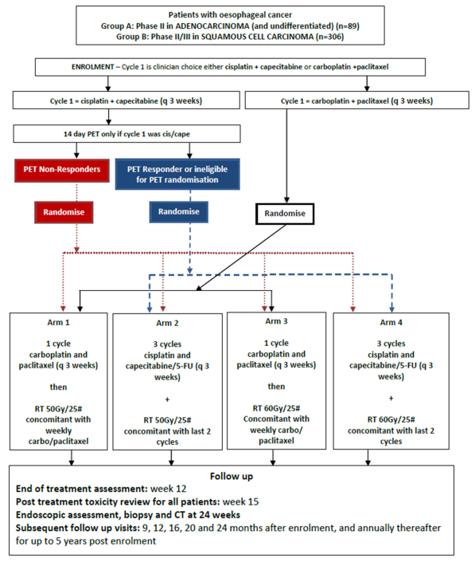
SCOPE-2 Trial Schema

Slide 7
Advanced/Metastatic
Short Name | Sites | Opening date | Closure date | Sample Size England | England Recruits
Ph1b/3 Bemarituzumab in Advanced Gastric Gastroesophageal Cancer | I/III | 30/06/22 | 14/12/24 | 26 | 0
HERIZON-GEA-01 | III | 11/04/22 | 31/01/25 | 33 | 0
WAKING: Wnt and checKpoint INhibition in Gastric cancer | BHOC | 06/07/2020 | 11/02/2022 | 52 | 7
PLATFORM-Planning Treatment for Oesophago-gastric Cancer: a Maintenance Therapy Trial | MUS, GWH, WES, YEO, RUH, UHBW | 23/02/2015 | 16/02/2020 | 694 | 939
YO42137 ATEZOLIZUMAB WITH OR WITHOUT TIRAGOLUMAB (ANTI-TIGIT ANTIBODY) SKYSCRAPER-07 | III | 18/12/20 | 01/12/22 | 20 | 6
Pembrolizumab & Chemoradiation in Oesophageal Carcinoma Participants | III | 06/08/20 | 24/01/23 | 32 | 13

Slide 8
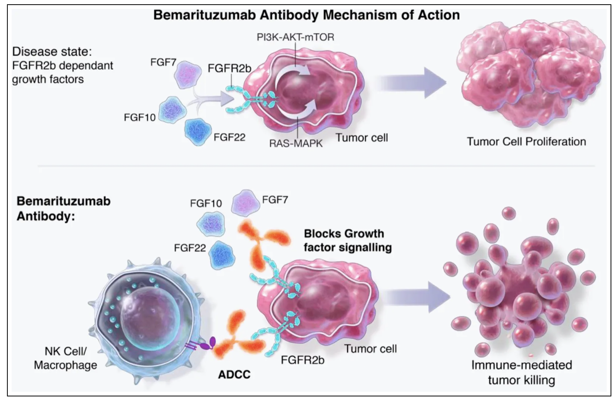
Ph1b/3 Bemarituzumab in Advanced Gastric/Gastroesophageal Cancer-inoperable FGFR2b-positive HER2-negative

Slide 9
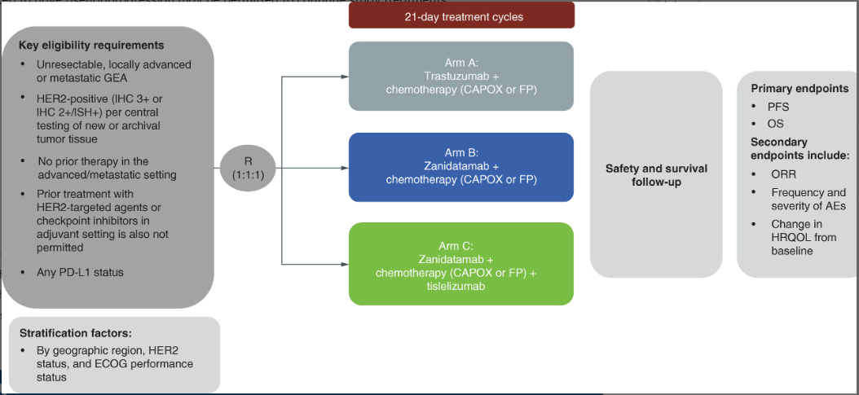
HERIZON-GEA-01: Zanidatamab + chemo ± tislelizumab for 1L treatment of HER2-positive gastroesophageal adenocarcinoma

Slide 10
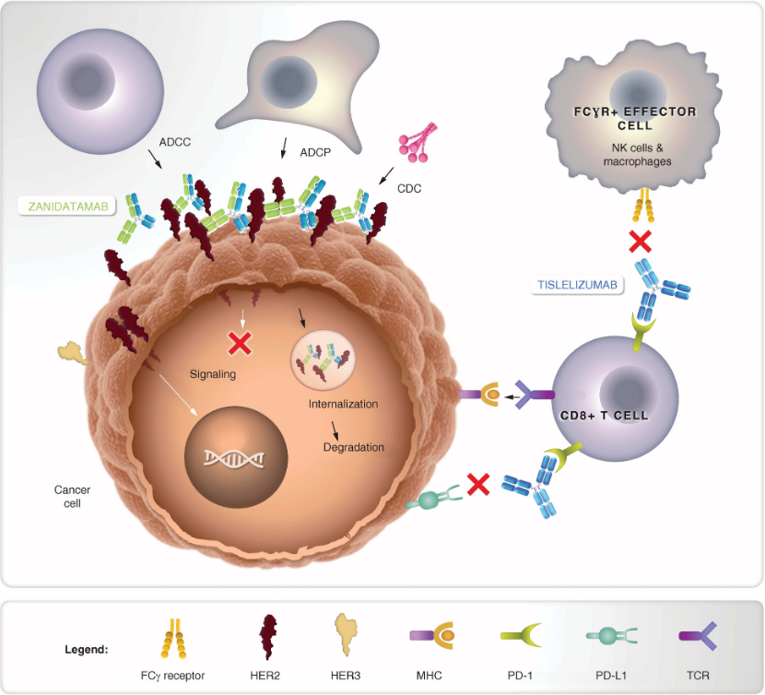
Zanidatamab – a novel, bispecific HER2-targeting monoclonal antibody

Slide 11
SKYSCRAPER-07: Atezolizumab ± Tiragolumab in Unresectable Esophageal SCC Without Progression After Definitive Chemoradiation
Phase III randomized, double-blinded, placebo-controlled study
Primary endpoint: PFS (arm A vs C), OS (arm A vs C and arm B vs C)
Secondary endpoints: PFS (arm B vs C and arm A vs B), OS (arm A vs B), ORR, DoR, safety, PK/PD
Patients with unresectable squamous cell carcinoma of the esophagus who received definitive chemoradiation,
ECOG PS 0/1,
(N = 750)
Arm A:
Atezolizumab 1200 mg + Tiragolumab 600 mg Q3W
Randomized 1:1:1
Arm B:
Atezolizumab 1200 mg + Placebo Q3W
Arm C:
Placebo + Placebo Q3W
NCT04543617.
Slide credit: clinicaloptions.com
Notes:
DoR, duration of response; ECOG, Eastern Cooperative Oncology Group; ORR, overall response rate; OS, overall survival; PD, pharmacodynamics; PFS, progression-free survival; PK, pharmacokinetics; PS, performance status; SCC, squamous cell carcinoma.

Slide 12
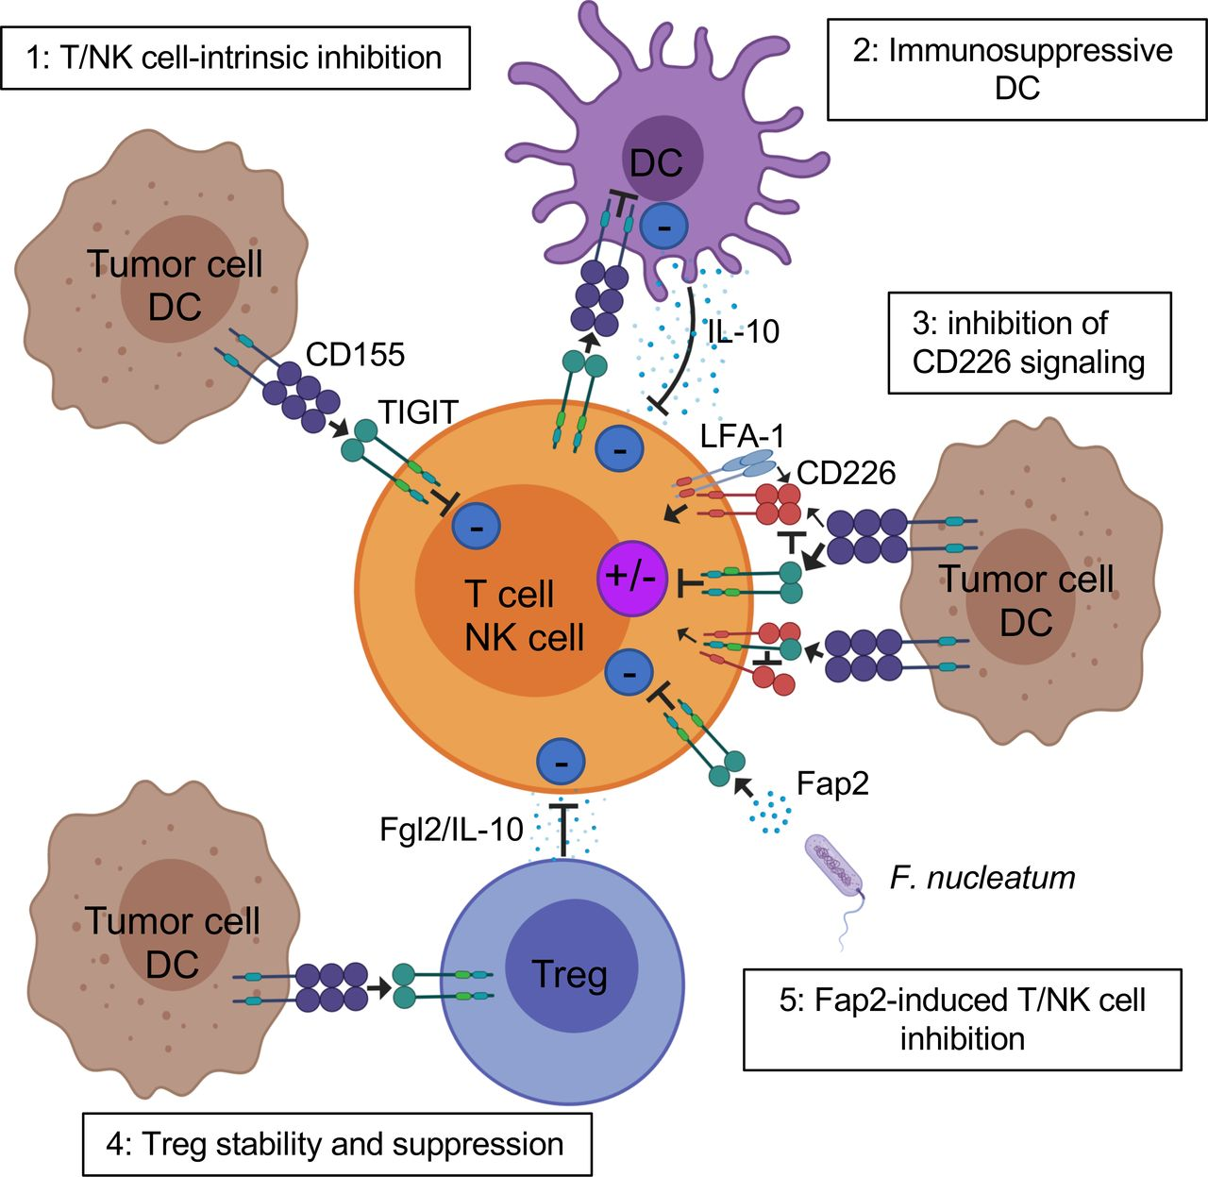
Mechanisms of TIGIT inhibition of T cells in the TME. TIGIT displays multiple inhibitory mechanisms in T cells. 1: TIGIT binds CD155 and triggers direct inhibitory signals in T cells. 2: TIGIT binds CD155 on APCs to trigger IL-10 production and decrease IL-12 production, which indirectly inhibits T cells. 3: TIGIT binds CD155 with higher affinity than CD226 or disrupts CD226 homodimerization to impede CD226-mediated T cell activation. 4: TIGIT signaling in Tregs enhances their immunosuppressive functions. 5: Fap2 protein from the gut bacteria Fusobacterium nucleatum binds TIGIT to trigger inhibitory signals.
Joe-Marc Chauvin, and Hassane M Zarour J Immunother Cancer 2020;8:e000957
© Author(s) (or their employer(s)) 2020. Re-use permitted under CC BY-NC. No commercial re-use. See rights and permissions. Published by BMJ.
Notes:
Mechanisms of TIGIT inhibition of T cells in the TME. TIGIT displays multiple inhibitory mechanisms in T cells. 1: TIGIT binds CD155 and triggers direct inhibitory signals in T cells. 2: TIGIT binds CD155 on APCs to trigger IL-10 production and decrease IL-12 production, which indirectly inhibits T cells. 3: TIGIT binds CD155 with higher affinity than CD226 or disrupts CD226 homodimerization to impede CD226-mediated T cell activation. 4: TIGIT signaling in Tregs enhances their immunosuppressive functions. 5: Fap2 protein from the gut bacteria Fusobacterium nucleatum binds TIGIT to trigger inhibitory signals. APCs, antigen-presenting cells; IL, interleukin; ITIM, immunoreceptor tyrosine-based inhibitory motif; TIGIT, T cell immunoreceptor with immunoglobulin and ITIM domain; Tregs, regulatory T cells.

Slide 13
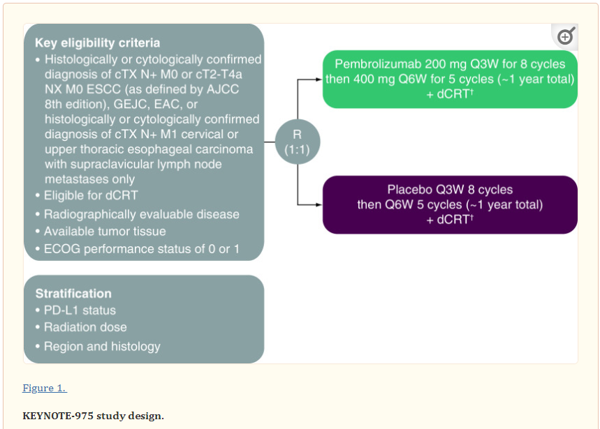
KEYNOTE-975 study design: a Phase III study of definitive chemoradiotherapy plus pembrolizumab in patients with esophageal carcinoma

Slide 14
Other-Epidemiologic/Diagnostic/Genetic
Short Name | Sites | Opening date | Closure date | Sample Size England | England Recruits
OCCAMS: Multicentre Study Determining Predictive Biomarkers & Targets for Oesophageal Adenocarcinoma | GRH | 19/07/2010 | 31/03/2026 | 2000 | 3,814

Slide 15
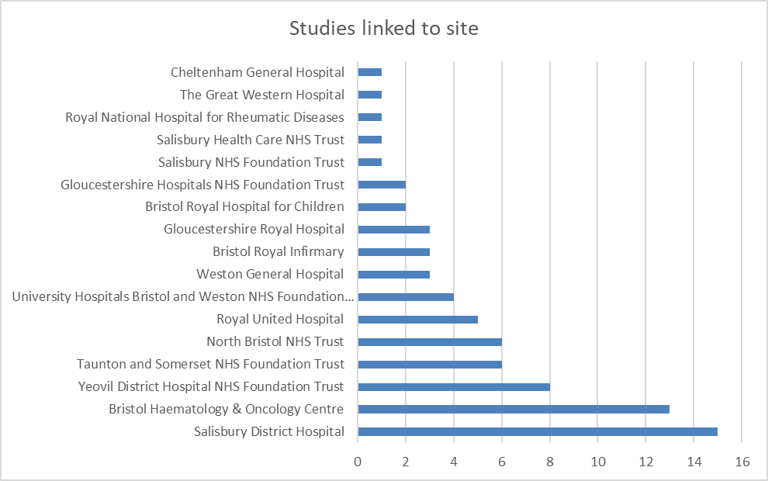
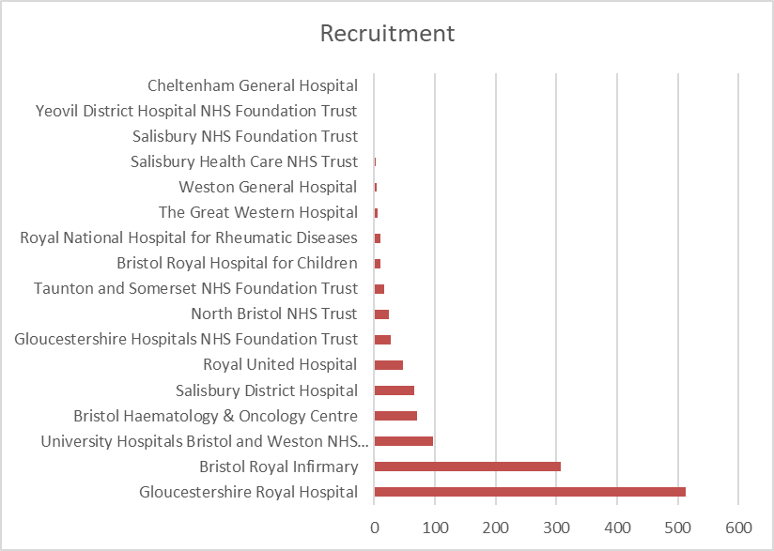
Data cut 22/09/2022
Source: ODP All Portfolio

Slide 16
SWAG region In Setup OG Cancer Studies 21/22
CPMS ID | Short Name |  | Site Name | Opening | Closure | Sample Size Eng
53394 | EvIDHence - Longitudinal retrospective CCA chart review study | Longitudinal retrospective CCA chart review study | Salisbury DH, BHOC | 30/09/2022 | 15/02/2023 | 32
52911 | NAV-1003 | A Phase 1 Study of the SHP2 Inhibitor BBP-398 (formerly known as IACS-15509) in combination with the KRAS-G12C Inhibitor Sotorasib in Patients with Advanced Solid Tumors and a KRAS-G12C Mutation | Yeovil DH | 01/03/2023 | 13/06/2025 | 9
50599 | Echo-CAT Study | Echocardiographic assessment of cardiotoxicity in adult cancer patients receiving trastuzumab and other HER2-targeted cancer therapies: comparison of manual and with automated analyses | Royal United Hospital | 03/10/2022 | 31/03/2023 | 300
Data cut 26/09/2022
Source: ODP All Portfolio

Slide 17
Notes:
We saw responses from across all seven Trusts in the region and four Primary Care sites.

Slide 18
What was positive about your research experience?

Slide 19
Recommendations and next steps
Key themes from this year's feedback include:
Communication with participants
Results to individual tests.
Clear information about how to get in contact with the study team.
Explore how participants can be offered more diverse clinic times, including out-of-hours and weekends.
Discussions with participants and research staff about the areas that are most important.
Projects which aim to improve the participant experience.

Slide 20
NIHR ODP https://odp.nihr.ac.uk/
Open data platform. Data on performance and restart across whole CRN, including all specialty areas
NIHR Be Part of Research https://www.ukctg.nihr.ac.uk/
See which studies are open across the country
National Cancer Research Institute Portfolio Maps http://csg.ncri.org.uk/portfolio/portfolio-maps/
View current national portfolio of open, closed and ‘in set up’ cancer studies
Find a Clinical Research Study (ODP) http://csg.ncri.org.uk/portfolio/portfolio-maps/
Search for a study to fit criteria. Good for horizon scanning, eligibility criteria

Slide 21
LCRN Contacts
Research Delivery Manager
claire.matthews@nihr.ac.uk
Research Portfolio Facilitator
rebecca.pienaar@nihr.ac.uk
Sub-specialty Lead
sharath.gangadhara@nhs.net

