Slide 1
Dietetic Assessments for New OG patients
Sarah Perkins

Slide 2
Background
High percentage of malnourished patients at presentation of OG cancer
Evidence that nutritional screening risk can predict likelihood of surgical complications
Role of prehab clinics gaining momentum in UK, with Macmillan developing resources for prehab services
Would early formalised nutritional screening and Dietetic intervention help implement nutritional support sooner and improve outcomes?

Slide 3
Previous experience: Nutritional screening in Head and Neck MDT clinic
Advantages | Challenges
Establish early relationship with patients | Patients awaiting diagnosis – couldn’t take in information
Identify malnutrition risk early on | Resourcing for time and data entry
Possible role for healthy weight loss in obese cohort | Unable to see everyone
Allowed tracking of weight history and monitoring | Patient privacy and space for conversations

Slide 4
Discussion
How do we see early nutritional assessment fitting into pathways at UHBW?
How does it work in other centres?
Is there any disparity within SWAG?

Slide 5
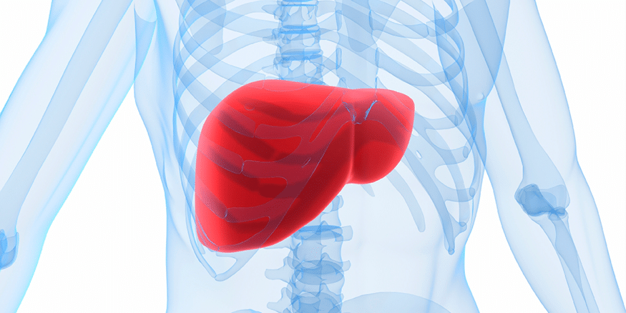
The Liver Reducing Diet in Upper GI Surgery
Sarah Perkins

Slide 6
Background
The liver reducing diet is a restrictive very low calorie diet (~1000kcal/day) designed to deplete liver glycogen stores and fatty infiltration pre- surgery
1000kcal/day likely represents 25-50% nutritional requirements in obese patient group
Usually 1-3 weeks in duration
Aim is to shrink the liver to reduce the risk of bleeding/ operative complications, but weight loss is usually a side effect, although not the primary aim of the diet
Evidence base is in bariatric surgery and obese cholecystectomy patients

Slide 7
Evidence
Library literature search
Majority of papers bariatric surgery and cholecystectomy
Some papers on liver cirrhosis/ ALD/ NAFLD
1 paper on OG surgery in general
An investigation into the current nutritional management of patients undergoing upper gastrointestinal surgery (Molloy et al. 2020)
Questionnaire from UK OG Dietitians showed majority of approach around high energy and protein nutritional support but 86% also using liver shrinkage diets when requested – likely for cholecystectomy

Slide 8
UHBW practice
Original remit was the liver reducing diet sheet provided in pre-op assessment for patients with BMI >40kg/m2 undergoing cholecystectomy
Diet to be followed for two weeks prior to surgery
UHBW and NBT Dietetic teams have noticed the diet being more widely applied in OG surgery e.g. oesophagectomy patients
Is there a place for this?

Slide 9
Possible benefits
Obesity is a widespread problem and a risk factor for oesophageal adenocarcinoma
Obesity increases risk of surgical complications
Ideally want patients to be as fit as possible for surgery, and be a healthy weight
The liver reducing diet is likely to cause rapid weight loss

Slide 10
Possible risks
No evidence
Mixed messages for patients
Time duration likely too short to achieve meaningful weight loss in obese cohort
Likely insufficient protein intake
Likely nutritional deficit post op
May be already nutritionally compromised by diagnosis/ neoadjuvant chemo
May be going into further oncological treatment
Strong evidence that malnutrition worsens outcomes in oesophageal cancer
Contradicts messages from ESPEN and ERAS about early nutritional support and avoiding pre-operative fasting

Slide 11
Limitations
Difficult to define outcome measures in this group
Level of complications?
% of nutritional requirements met?
% weight loss? – but will lose weight anyway
Selection/ inclusion criteria for this diet?
BMI threshold – but could still be depleted?
Liver size?
How would this be communicated?

Slide 12
Proposed solution
Short term
Update current diet sheet to specifically state cholecystectomy
Utilise healthy eating in cancer diet sheets for obese patients who are not malnourished pre-op
Still promotes balanced diet and weight loss but less restrictive than liver reducing diet
Long term
Dietetic prehab
Nutritional screening in clinics and referral pathways to relevant nutritional support

Slide 13
Discussion
How does liver reducing diet fit within OG pathways?
If this is something we want to take forward – how do we do this robustly and safely, and how do we evaluate it?

Slide 14
References
Long E, Beales IL. The role of obesity in oesophageal cancer development. Therap Adv Gastroenterol. 2014 Nov;7(6):247-68. doi: 10.1177/1756283X14538689. PMID: 25364384; PMCID: PMC4212467.
Cho, J.H., Shin, C.M., Han, KD. et al. Abdominal obesity increases risk for esophageal cancer: a nationwide population-based cohort study of South Korea. J Gastroenterol 55, 307–316 (2020). https://doi.org/10.1007/s00535-019-01648-9
C. Molloy, An investigation into the current nutritional management of patients undergoing upper gastrointestinal surgery, Clinical Nutrition ESPEN, Volume 35, 2020, Pages 249-250, ISSN 2405-4577, https://doi.org/10.1016/j.clnesp.2019.12.093. (https://www.sciencedirect.com/science/article/pii/S2405457719305935)
Steenhagen E. Preoperative nutritional optimization of esophageal cancer patients. J Thorac Dis. 2019 Apr;11(Suppl 5):S645-S653. doi: 10.21037/jtd.2018.11.33. PMID: 31080641; PMCID: PMC6503268.
Yin Liangyu, Cheng Nian, Chen Ping, Zhang Mengyuan, Li Na, Lin Xin, He Xiumei, Wang Yingjian, Xu Hongxia, Guo Wei, Liu Jie, (2021) Association of Malnutrition, as Defined by the PG-SGA, ESPEN 2015, and GLIM Criteria, With Complications in Esophageal Cancer Patients After Esophagectomy , rontiers in Nutrition volume 8, URL=https://www.frontiersin.org/articles/10.3389/fnut.2021.632546 DOI=10.3389/fnut.2021.632546 ISSN=2

Slide 15
References
Jingjing Cao, Hongxia Xu, Wei Li, Zengqing Guo, Yuan Lin, Yingying Shi, Wen Hu, Yi Ba, Suyi Li, Zengning Li, Kunhua Wang, Jing Wu, Ying He, Jiajun Yang, Conghua Xie, Fuxiang Zhou, Xinxia Song, Gongyan Chen, Wenjun Ma, Suxia Luo, Zihua Chen, Minghua Cong, Hu Ma, Chunling Zhou, Wei Wang, Qi Luo, Yongmei Shi, Yumei Qi, Haiping Jiang, Wenxian Guan, Junqiang Chen, Jiaxin Chen, Yu Fang, Lan Zhou, Yongdong Feng, Rongshao Tan, Junwen Ou, Qingchuan Zhao, Jianxiong Wu, Xin Lin, Liuqing Yang, Zhenming Fu, Chang Wang, Li Deng, Tao Li, Chunhua Song, Hanping Shi, (2021) Nutritional assessment and risk factors associated to malnutrition in patients with esophageal cancer, Current Problems in Cancer, Volume 45, Issue 1, 100638, ISSN 0147-0272, https://doi.org/10.1016/j.currproblcancer.2020.100638. (https://www.sciencedirect.com/science/article/pii/S0147027220301331)296-861X
R Alfieri, M Nardi, V Moretto, E Pinto, M Briarava, L Pomba, M Scarpa, P L Pilati, C Castoro, O193 ROLE OF MALNUTRITION IN 0ESOPHAGEAL SURGERY FOR CANCER, Diseases of the Esophagus, Volume 32, Issue Supplement_2, November 2019, doz092.193, https://doi.org/10.1093/dote/doz092.193
Prognostic significance of malnutrition in metastatic esophageal squamous cell carcinoma. Kirsty Taylor, Osvaldo Espin-Garcia, Di Maria Jiang, Daniel Yokom, Lucy Xiaolu Ma, Charles Henry Lim, Bryan Anthony Chan, Peiran Sun, Hao-Wen Sim, Akina Natori, Geoffrey Liu, Gail Elizabeth Darling, Rebecca Wong, Eric Xueyu Chen, Raymond Woo-Jun Jang, Patrick Veit-Haibach, Dmitry Rozenberg, and Elena Elimova, Journal of Clinical Oncology 2019 37:4_suppl, 171-171

