Slide 1
SWAG Network Brain & CNS Cancer
Clinical Advisory Group
Research Update - Claire Matthews
12/10/2022

Slide 2
National Colorectal Cancer Research Recruitment
Apr 21 - Mar 22
Apr 22 - Sep 22
Source: ODP All Portfolio
Data cut: 04/10/2022

Slide 3
National vs Regional Recruitment
National
Regional (WE)
Source: ODP All Portfolio
Data cut: 04/10/2022

Slide 4
Brain Cancer Studies - open in SWAG region
CPMS ID | Short Name | Opening | Closure | Sample Size Eng | England Recruits
45956 | FUTURE GB | 18/12/2020 | 31/10/2023 | 332 | 109
45917 | Identifying and validating molecular targets in nervous system tissue | 20/07/2020 | 20/07/2024 | 938 | 8
45650 | Long-term implications of rare brain tumours | 29/07/2020 | 01/03/2023 | 54 | 35
44006 | Tessa Jowell BRAIN MATRIX - Platform Study | 24/11/2020 | 01/01/2025 | 800 | 139
42202 | SIOP-HRMB | 19/01/2021 | 15/10/2027 | 202 | 6
41890 | BTB | 31/01/2020 | 31/01/2025 | 500 | 218
40175 | Improving treatment of glioblastoma, 1.0 | 04/10/2019 | 26/05/2024 | 500 | 334
33914 | SPECTA (EORTC 1553) | 07/06/2018 | 30/09/2027 | 288 | 122
33552 | PARADIGM 2 | 08/11/2016 | 30/09/2023 | 52 | 39
18503 | SIOP Ependymoma II | 12/02/2016 | 12/02/2026 | 230 | 176
18137 | PARADIGM (Cancer) | 03/03/2015 | 30/04/2023 | 143 | 106
15941 | NIHR BioResource - Rare Diseases | 13/09/2012 | 30/11/2022 | 22000 | 15,386
8630 | Molecular Genetics of Adverse Drug Reactions (MOLGEN) | 01/06/2009 | 30/04/2023 | 3000 | 2,916
4663 | AIP | 01/03/2007 | 31/12/2037 | 8500 | 4,476
Notes:
In March, on behalf of the Department of Health and Social Care, the NIHR set up a mechanism (UK-wide portal) for applying for funding and/or prioritised support for urgent public health research into COVID-19.
The goal was to gather the necessary clinical and epidemiological evidence to inform national policy and enable new diagnostics, treatments and vaccines to be developed and tested.
The set-up and delivery of UPH studies is expedited by all necessary organisations across the research, health and social care systems including the HRA.
There is a commitment to ensure that research findings and data relevant to COVID-19 from UPH research are shared rapidly and openly.
Currently there are 67 UPH studies, 47 of which are running in CRN WE.
Restart framework was introduced in May with the aim of
Restoring a fully active portfolio of NIHR research
Continuing to support COVID-19 NIHR research
Providing a structure to guide the restarting of a full range of NIHR research
Work in close collaboration with key stakeholders, regulators, HRA, MHRA, patients and the public, and health and care research organisations to support the pace and coordination of this Restart and to ensure coordinated UK-wide working
2nd wave guidance:
The NIHR issued guidance to protect both COVID-19 and non-COVID-19 research during a ‘second wave’ of high COVID-19 activity.
The guidance makes very clear that research staff funded by NIHR should not be deployed to front line duties except in exceptional circumstances. This is in contrast to the ‘first wave’ when numerous staff were deployed to the clinical front line.
Dr William van't Hoff, CEO of the NIHR Clinical Research Network (CRN) and Senior Responsible Officer for the Restart Programme, said: “As the number of people with COVID-19 starts to rise again, it is imperative that our research staff focus on priority COVID-19 studies including vaccine studies. But we also need our teams to continue to support the restart of non-COVID-19 research, both commercial and non-commercial, in tandem with the restoration of NHS routine clinical services. The impact of research being paused in the Spring has been severe and we will make every effort to maintain recruitment rates across the portfolio.”

Slide 5
Associate PI Scheme
https://www.nihr.ac.uk/health-and-care-professionals/career-development/associate-principal-investigator-scheme.htm
A six month in-work training opportunity, providing practical experience for healthcare professionals starting their research career.
People who would not normally have the opportunity to take part in clinical research in their day to day role have the chance to experience what it means to work on and deliver a NIHR portfolio trial under the mentorship of an enthusiastic Local PI.
Tessa Jowell BRAIN MATRIX - Platform Study
A British feasibility study of molecular stratification and targeted therapy to optimize the clinical management of patients with glioma by enhancing clinical outcomes, Reducing avoidable toxicity, improving management of post-operative residual & recurrent disease and improving survivorship - Platform Study
Open 24/11/2020-01/01/2025 BHOC, Chris Herbert

Slide 6
Identifying and validating molecular targets in nervous system tissue
CI: Prof Kathreena Kurian, Consultant Neuropathologist. kathreena.kurian@bristol.ac.uk
Single site study running at Southmead Hospital.
Current recruitment 8/938. Closing date 20/07/2024
Currently low-grade (benign) and high-grade (malignant) brain tumours are treated by surgery or radiation therapy plus or minus chemotherapy. The aim of the study is to discover and validate new molecular biomarkers and drug targets for brain tumours (low- and high- grade) using laboratory research and comparing the findings with control tissue. We hope that in vitro research will reveal biomarkers for these tumours which, in the future, could indicate successful drug action or are specific for a genetic subtype of tumour. In addition we hope that these biomarkers could aid early diagnosis of CNS tumours.
https://local.nihr.ac.uk/news/study-open-in-bristol-aims-to-address-the-urgent-need-to-identify-brain-tumours-earlier/30059

Slide 7
PRES 2021/22
Report Summary

Slide 8
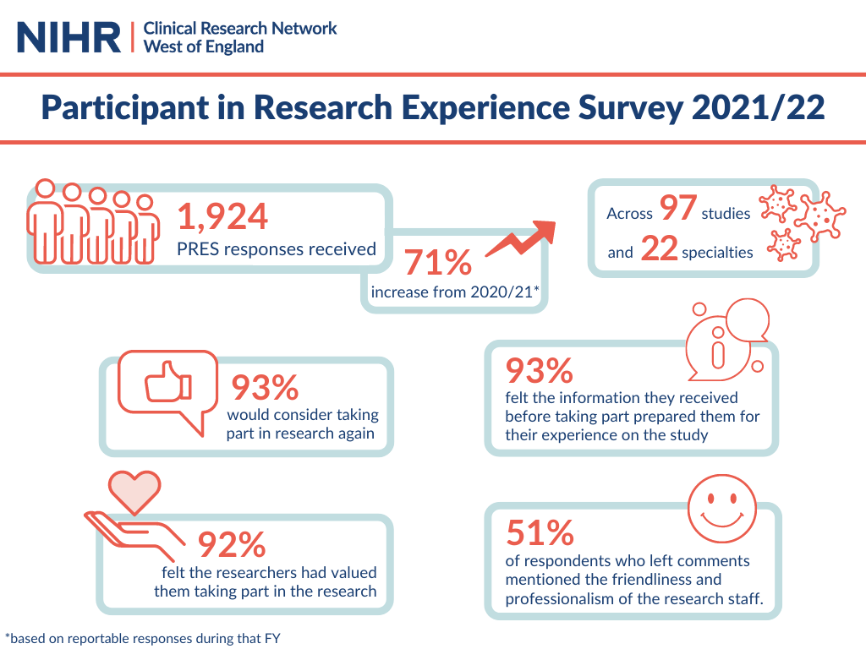
Notes:
We saw responses from across all seven Trusts in the region and four Primary Care sites.

Slide 9
What was positive about your research experience?

Slide 10
Recommendations and next steps
Key themes from this year's feedback include:
Communication with participants
Results to individual tests.
Clear information about how to get in contact with the study team.
Explore how participants can be offered more diverse clinic times, including out-of-hours and weekends.
Discussions with participants and research staff about the areas that are most important.
Projects which aim to improve the participant experience.

Slide 11
NIHR ODP
Open data platform. Data on performance across whole CRN,
including all specialty areas
NIHR Be Part of Research
See which studies are open across the country
National Cancer Research Institute Portfolio Maps
View current national portfolio of open, closed and ‘in set up’ cancer studies
Find a Clinical Research Study (ODP)
Search for a study to fit criteria. Good for horizon scanning, eligibility criteria

Slide 12
Research Delivery Manager
claire.matthews@nihr.ac.uk
Research Portfolio Facilitator
rebecca.gleeson@nihr.ac.uk
Brain Cancer Sub-specialty Lead
christopher.herbert@uhbw.nhs.uk
Notes:
Section separator template using the motifs.

