Slide 1
Breast Cancer Pressures
20/09/2022

Slide 2
Metastatic Breast Cancer Pressures – National Group
In early summer the East of England Clinical Networks reached out to site specific clinical cancer meetings with clinical leads from other Alliances – keen to share commonalities with leading their network groups, work programmes, ideas & challenges.
This morning the breast cancer group met for the second time and the focus was very definitely a significant shared concern for the changing landscape in metastatic breast disease. The number and complexity of these patients was rising prior to COVID but the pandemic has certainly increased the number of patients presenting with metastatic disease (MBC). The increasing pace and number of new treatments on offer now, whilst good news for the patients, has an increasing number of episodes / oncology contacts to manage these patients through new lines of treatment and more complex toxicities that these new generation of treatment agents generate.
Dr Carlo Palmieri has been working on pulling together local evidence that he will share but that clearly demonstrates that in 12 -18 months they will be unable to see and prescribe treatment for new patients. Other clinicians on the call voiced the same concern facing struggles already, Emma McInnes reported a 60% increase in number of patients with MBC
Nationally it has been reported that within England there are currently 25 -35,000 patients living with metastatic breast cancer, this number however has been found to be 55,000 made up of approximately 970,000 oncology contact episodes and rising.
It was felt that this issue was not in the public’s consciousness in the same way that ambulance waits or primary care accessibility is highlighted and that nationally it did not seem to be a focus either with sights set only on recovering at the ‘front end’.

Slide 3
How can we help?
There is a list of Cancer Alliance breast cancer clinical leads that currently are part of this meeting group and are supportive of raising the profile of this issue. Can you encourage your breast leads to join please. If you share their details with me I will include them in the working group.
I will shortly be sharing some data item requests that will evidence an unsustainable increase in number of MBC patients, impact on workload and unmet patient need - It would be ever so powerful if we could present nationally a united front with evidence from every alliance.
Carlo will contact the Director of Breast Cancer Now whom have been beating this drum for some years
We will also work on addressing new ways of working. Sharing ideas on workforce changes such as using Consultant Pharmacists & Radiologists (understanding they too are under significant pressures). Home delivery, self- administration and out reach clinics all have value but again cognisant that they rely heavily on aseptic units that are equally under resourced and struggling to recruit.

Slide 4
MBC Data Points
Day case chemotherapy visits per month numbers: overall; breast; breast metastatic
Oncology OPA: total numbers seen in breast; proportion of breast oncology OPAs that have a metastatic diagnosis; number of appts per patient (overall); number of appts per patient per year (breast metastatic)
Some of this may be available through HES?
Impact on MDT - number of discussions in MDTM per patient?
Impact on pathology - additional biopsies, additional tests, WGS / PDL-1 etc. - Total number of pathology episodes per metastatic patient per year?
Breast care nursing caseload: overall and metastatic
Impact on BCN practice - number of calls / interactions per patient, mechanisms of reviewing patients during chemo.
Palliative care referrals with breast diagnosis / year
In patient episodes with complications of chemotherapy for all breast; metastatic breast
Other health care professionals that are involved to consider also reviewing changing referrals / episodes: lymphoedema team, physiotherapy, radiology - surveillance CTs, percut biopsies etc

Slide 5
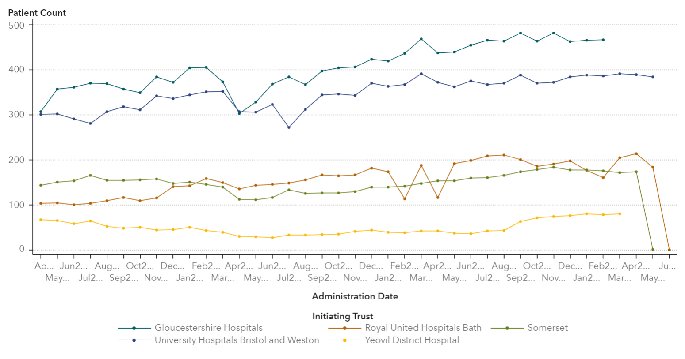
Number of patients receiving SACT treatments each month

