Slide 1
SWAG Network Breast cancer
Clinical Advisory Group
Research Update - Claire Matthews
18/03/2022

Slide 2
National Recruitment to Breast Cancer Studies
Apr 2021 - Mar 2022
Apr 2022 - Sep 2022
Data cut 15/09/2022
Source: ODP All Portfolio

Slide 3
National vs Regional Recruitment to Breast Cancer Studies Apr 2019 - Sep 22
National Recruitment
West of England Recruitment (exc T, Y, S)
Data cut 15/09/2022
Source: ODP All Portfolio

Slide 4
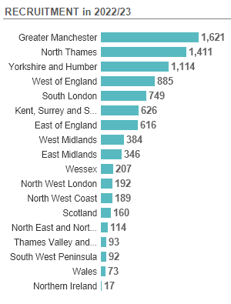
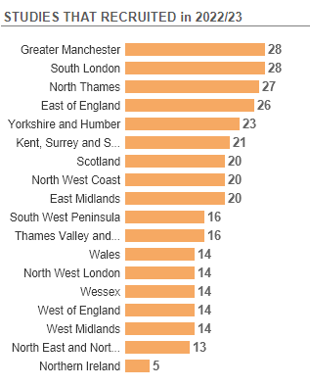
Recruitment by CRN region to Breast Cancer Studies 2022/2023
Data cut 15/09/2022
Source: ODP All Portfolio

Slide 5
SWAG region Lead Network Studies
Short Name | CI | Title | Opening | Closure | Sample Size Eng | Eng Recruits
E-bikes and breast cancer: CRANK-B | Miranda Armstrong | Increasing physical activity levels using e-bikes to enhance breast cancer survival: A randomised pilot study | 03/08/2022 | 31/08/2022 | 40 | 0
EUCHARIS | Mark Beresford (Lead Eng Site) | European treatment patterns and outcomes associated with first line CDK and Hormonal therapies Assessed in a Real-world non-Interventional Study | 08/06/2022 | 31/10/2022 | 0 | 0
Best-BRA | Shelley Potter | Is subpectoral or pre-pectoral implant placement Best in immediate BReAst reconstruction? | 26/07/2021 | 31/01/2023 | 15 | 7
Breast Cancer: Early diagnosis using materials immortalisation | Prof Keith Rogers | Analysis of breast calcifications in benign and malignant biopsy samples using elemental analysis, X-ray diffraction, and vibrational spectroscopy - for diagnosis of malignancy and prediction of progression. | 01/09/2020 | 01/09/2023 | 320 | NA
COMPULSE | Sarah Vinnicombe | Comparison trial of open-tip pulsed needle biopsy and conventional core biopsy in axillary lymph nodes (COMPULSE) | 15/07/2020 | 31/12/2024 | 320 | 29
The ANTHEM Feasibility Study | Shelley Potter | The ANTHEM Feasibility Study : Is A Novel THErapeutic mammaplasty procedure a safe and effective surgical alternative to Mastectomy for treatment of breast cancer? | 04/12/2020 | 31/12/2022 | 340 | 240

Slide 6
SWAG region Breast Cancer Studies Opened 2022
Full list of open studies to be circulated
CPMS No. | Short Name | Open | Closure | Sample Size England | England Recruits
52372 | EndoNET | 23/08/2022 | 31/05/2025 | 1200 | 0
51326 | ANG-010 (INFORM Study) | 30/06/2022 | 31/01/2024 | 500 | 4
48418 | PEAR-TNBC | 24/05/2022 | 30/06/2023 | 4 | 1
50679 | Tropion-02 Breast | 29/04/2022 | 18/09/2023 | 30 | 2
50904 | The NERLYFE study | 15/06/2022 | 15/03/2023 | 207 | 0
51297 | IMPARTER:4 | 28/02/2022 | 31/01/2023 | 250 | 49

Slide 7
West of England In Setup Breast Cancer Studies 21/22
CPMS No. | Short Name | Sites | Planned Opening | Planned Closure | Sample Size England | Sample Size UK
51327 | EFC16133 (Comm) | BHOC, YEO | 29/07/2022 | 28/02/2024 | 120 | 120
52477 | Ascent-03 (Comm) | Chelt | 31/08/2022 | 31/10/2022 | 11 | 11
50765 | SGNTUC-028 (Comm) | RUH | 01/07/2022 | 30/11/2023 | 14 | 14
50331 | heredERA (Comm) | RUH | 31/08/2022 | 23/03/2025 | - | 60
50218 | TRAK-ER (Non-Comm) | BHOC | 01/11/2021 | 31/10/2023 | 553 | 650
37535 | BR-003 Confirmatory Study Novilase Ablation Malignant Breast Tumours (Comm) | NBT | 10/11/2022 | 31/12/2023 | - | 20
53118 | PRE-DX Study (Non-Comm) | YEO | 03/10/2022 | 02/06/2023 | 245 | 330
40689 | IMpALA (Non-Comm) | YEO | 01/05/2019 | 31/01/2021 | 42 | 42
Data cut 15/09/2022
Source: ODP All Portfolio

Slide 8
Plans to share information across region
Asking for buy-in from research leads at each site in the region
Aim to produce a list of all open studies with contact details for PI and inclusion/exclusion criteria if possible
Frequency may be determined by workload
How else could we share information?

Slide 9
Ongoing Activities
Research Reset - DHSC initiative to revitalise the research portfolio by amending or closing studies that are no longer viable. Aim is to free up capacity for other research
https://sites.google.com/nihr.ac.uk/thefutureofukclinicalresearch/home/research-reset
CRN 2024 restructure and new name - NIHR Research Delivery Network
West of England will expand to include Dorset and Salisbury
Currently open to EoIs for host organisations
https://www.nihr.ac.uk/explore-nihr/support/clinical-research-network.htm

Slide 10
NIHR ODP https://odp.nihr.ac.uk/
Open data platform. Data on performance and restart across whole CRN, including all specialty areas
NIHR Be Part of Research https://www.ukctg.nihr.ac.uk/
See which studies are open across the country
National Cancer Research Institute Portfolio Maps http://csg.ncri.org.uk/portfolio/portfolio-maps/
View current national portfolio of open, closed and ‘in set up’ cancer studies
Find a Clinical Research Study (ODP) http://csg.ncri.org.uk/portfolio/portfolio-maps/
Search for a study to fit criteria. Good for horizon scanning, eligibility criteria

Slide 11
Research Delivery Manager
claire.matthews@nihr.ac.uk
Research Portfolio Facilitator
rebecca.pienaar@nihr.ac.uk
Sub-specialty Lead
Mark Beresford

