Slide 1
SWAG Network Head and Neck Cancer
Clinical Advisory Group
Research Update - Claire Matthews
17/05/2022

Slide 2
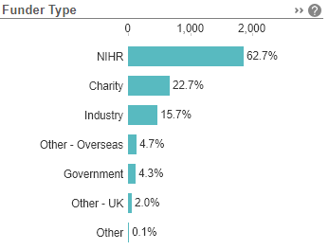
National Recruitment to Head and Neck Cancer Studies Apr 2021 - Mar 2022
Data cut 12/105/2022
Source: ODP All Portfolio

Slide 3
National vs Regional Recruitment to Head and Neck Cancer Studies Apr 2020 - Mar 22
National Recruitment
Apr 20 - Mar 21 recruitment during the pandemic
Apr 21 - Mar 22
significant recovery of recruitment to research
Apr 2020 - Mar 2021
Apr 2021 - Mar 2022
Apr 2022 - May 2022
West of England Recruitment
Apr 20 - Mar 21 recruitment during the pandemic
Apr 21 - Nov 22
Recovery of recruitment to research now being seen
Apr 2020 - Mar 2021
Apr 2021 - Mar 2022
Data cut 12/05/2022
Source: ODP All Portfolio

Slide 4
West of England (+ Taunt/Yeov) Open Head and Neck Cancer Studies 21/22
CPMS No. | Short Name | Sites | Open | Closure | Sample Size Eng | England Recruits
18621 | CompARE Trial | UHBW (25/35), Chelt (4/3), RUH (3), Musgrove (16/6) | 06/07/15 | 31/01/22 | 670 | 447 (Extension request to September 2023 has been submitted to the funder)
18645 | PATHOS | RUH (19/6), UHBW (16/18) | 02/10/15 | 31/10/23 | 740 | 575
37192 | SAVER | UHBW (Dental) (0) | 24/09/19 | 01/07/22 | 100 | 21
37926 | Best-Of | UHBW (1/6) | 01/01/18 | 31/12/22 | 12 | 3
39082 | Cemiplimab with/without ISA101b in HPV16 Positive Platin-Resistant OPC | Musgrove (1/4) | 16/05/19 | 30/06/22 | 8 | 4
40113 | POPPY | Musgrove (5/3), UHBW (0/2) | 05/07/19 | 31/07/22 | 53 | 22
42228 | PEARL: PET-based adaptive radiotherapy clinical trial | UHBW (in set up) | 16/01/20 | 01/01/23 | 25 | 0
42229 | INOVATE | RUH (19/10), UHBW 1/4) | 01/01/20 | 24/05/22 | 166 | 151
43839 | TORPEdO | RUH (1/5), UHBW (6/4) | 24/02/20 | 20/07/23 | 160 | 67
44418 | INSPIRE | UHBW (0) | 13/05/20 | 31/12/22 | 50 | 32
44709 | MK7902-009 Ph II, lenvatinib comb pembrolizumab vs soc chemo and lenvatinib monotherapy R/M HNSCC progressed after PD-1/PD-L1 inhibitors | Musgrove (5/4) | 18/12/20 | 21/11/23 | 14 | 13
48988 | HoT: Hemithyroidectomy or Total-Thyroidectomy in 'low-risk' thyroid cancers | Somerset Partnership NHS & Social Care Trust (0/16) | 13/12/21 | 31/07/25 | 456 | 6
50360 | PETNECK 2 | Yeovil (0) | 14/02/22 | 30/07/25 | 653 | 0

Slide 5
West of England In Setup Head and Neck Cancer Studies
CPMS No. | Short Name | Sites | Planned Opening | Planned Closure | Sample Size England | Sample Size UK
51169 | NIFTy- NIRF Imaging to prevent PoSH after thyroid surgery | Yeovil District Hospital NHS Foundation Trust | 31/05/2022 | 31/05/2023 | 454 | 454
49832 | NANORAY-312: Ph III Study of NBTXR3 Activated by Investigator's Choice of RT Alone or RT in Combination with Cetuximab for Platinum-Based Chemo-Ineligible Elderly Patients with LA-HNSCC | UHBW, Chelt | 12/08/2022 | 05/12/2022 | 13
National In Setup Head and Neck Cancer Studies
CPMS No. | Short Name | Title | Phase | Planned Opening | Planned Closure | Sample Size England
49918 | SafeRDC | What can we learn about diagnostic safety culture in cancer referral pathways, which will inform future improvement and service design of diagnostic pathways across the NHS? | N/A | 01/09/21 | 30/09/23 | 110

Slide 6
Local updates
UHBW: (Steve Thomas, Barry Main)
Main issue is the capacity within the surgical research team at the Trust.
Exploring options with the oncology team
Aim to open three studies
PETNECK II feasibility
SAVER
RAPTOR
The ideal would be a H&N dedicated research nurse if we are to build our portfolio of national trials going forward.

Slide 7
CRN WE Cancer Research
As part of the NIHR, the CRN WE works to the NIHR Strategic Framework set out in Best Research for Best Health: The Next Chapter.
Aims for CRN in 22/23 include:
Increasing research opportunities for underserved communities and those with major health needs by supporting equitable access to research
Improve the lives of people with Multiple Long Term Conditions (MLTC) by improving access to research and by cross-specialty working
Embedding EDI across the NIHR CRN

Slide 8
Our local aims
Local Specialty Objectives:
Engagement with TYA team at BHOC to plan a youth-led event. CRN TYA Research nurse taking a lead on this.
Collate data on Cancer Surgical trials and compare regional participation against national
Develop a network in radiotherapy research linking in with CRN Research Scholar, SWAG and ODN.
We have equity of access to trials as an overarching aim and have been awarded an NIHR CRN Development Bid (£20K) to employ an outreach worker (via SWAG) to work with underserved communities.
This will provide funding for a band 6, 0.5 WTE until April 2023 to work with community groups and other colleagues already working in this field to improve the understanding and uptake of research participation.

Slide 9
Inequity of Access - building a network
Kathryn Hamilton - equity audit of cancer research participation in BNSSG.
Older adults and people from the most deprived backgrounds are currently under-represented in cancer research.
People from ethnic minorities may be under-represented, but our data for ethnicity is poor and needs improving.
“A call to action on health inequalities”
Shoba Dawson - work at UoB where under-representation of ethnic minority groups is found across different research work streams.

Slide 10
What the CRN offers
Research Scholars: an initiative to develop early career researchers. The programme includes two core components:
A development pathway towards becoming a Principal and Chief investigator, including: a personalised learning plan, quarterly learning days; mentoring; peer learning; and support with self-directed learning.
Protected and funded time to engage in learning, and to support and deliver NIHR-funded research. The scheme provides funding for one day per week, or equivalent, for a two year period, subject to an annual review.
Inaugural Cohort of four, including Sarah Hargreaves, Consultant Clinical Oncologist, UHBW.
https://local.nihr.ac.uk/documents/crn-we-research-scholars-programme-2022-2024/29586

Slide 11
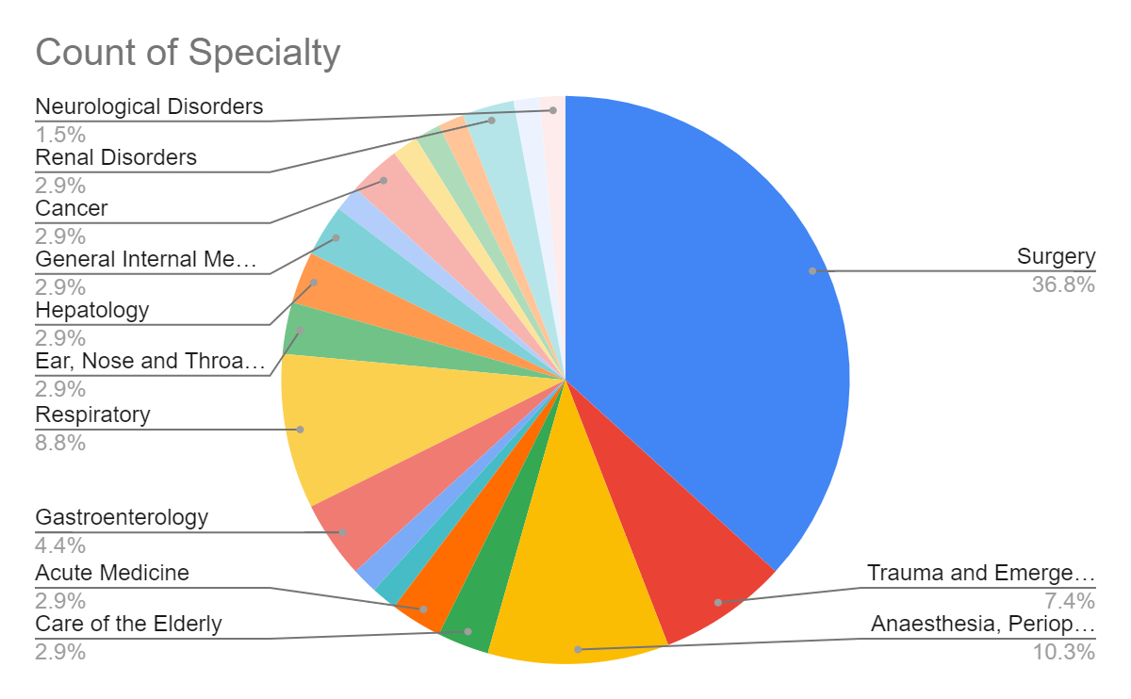
What the CRN offers
Associate PI Scheme: aims to develop doctors, nurses and other health professionals to become the Principal Investigators (PIs) of the future. It is a six month in-work training opportunity, providing practical experience for healthcare professionals starting their research career.
Participants receive formal recognition of engagement in NIHR Portfolio research studies through the certification of Associate PI status, endorsed by the NIHR and Royal Colleges.
https://www.nihr.ac.uk/health-and-care-professionals/career-development/associate-principal-investigator-scheme.htm
Jan 2022

Slide 12
NIHR ODP
Open data platform. Data on performance and restart across whole CRN, including all specialty areas
NIHR Be Part of Research
See which studies are open across the country
National Cancer Research Institute Portfolio Maps
View current national portfolio of open, closed and ‘in set up’ cancer studies
Find a Clinical Research Study (ODP)
Search for a study to fit criteria. Good for horizon scanning, eligibility criteria

Slide 13
Research Delivery Manager
claire.matthews@nihr.ac.uk
Research Portfolio Facilitator
vacant
Sub-specialty Lead
steve.thomas@bristol.ac.uk, barry.main@uhbw.nhs.uk

