Slide 1
Head and Neck CAG
Frank McDermott
Cancer lead SW GMSA

Slide 2
Patients at the heart of change
Patients expect clinical teams to know the best treatment for them in order to get the best outcomes
Clinicians need all the clinical information together in order to make the best treatment decisions for individual patients
Research requires the right patients to enter trials to move best treatments forward for patients
Research
Clinician
Patient
Research
Clinician
Patient
Slide by Louise Medley

Slide 3
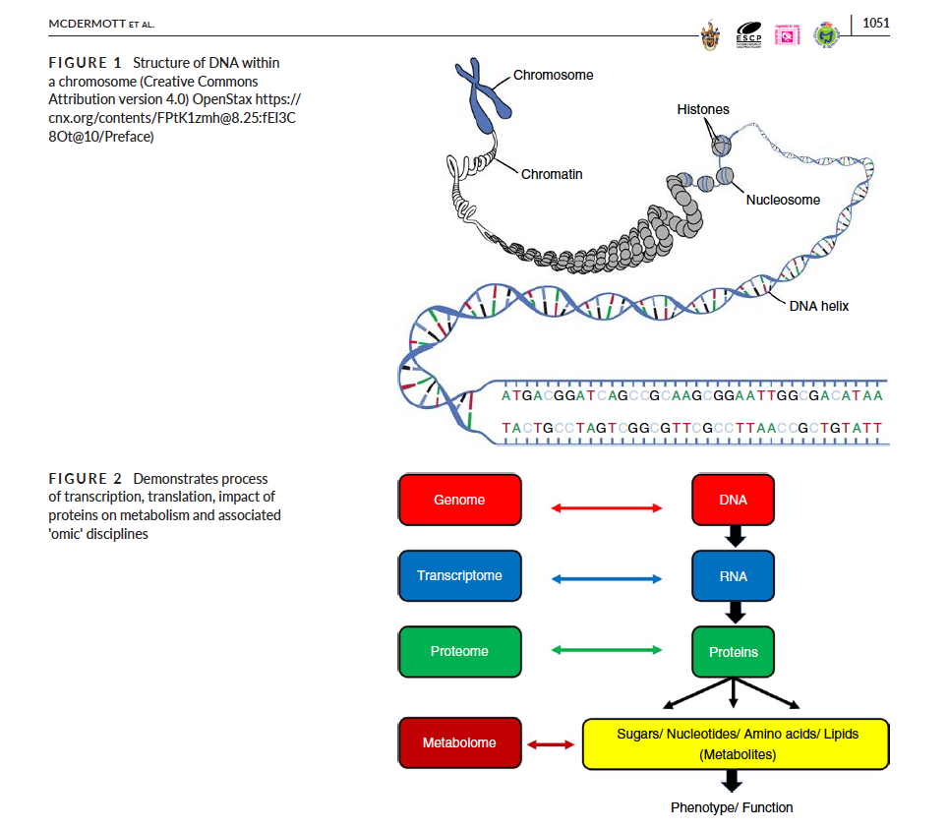

Slide 4
Notes:
Discuss germline versus somatic

Slide 5
Hallmarks of Cancer: The Next Generation
Hanahan et al CellVolume 144, Issue 5, p646–674, 4 March 2011

Slide 6
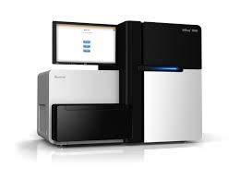

Slide 7
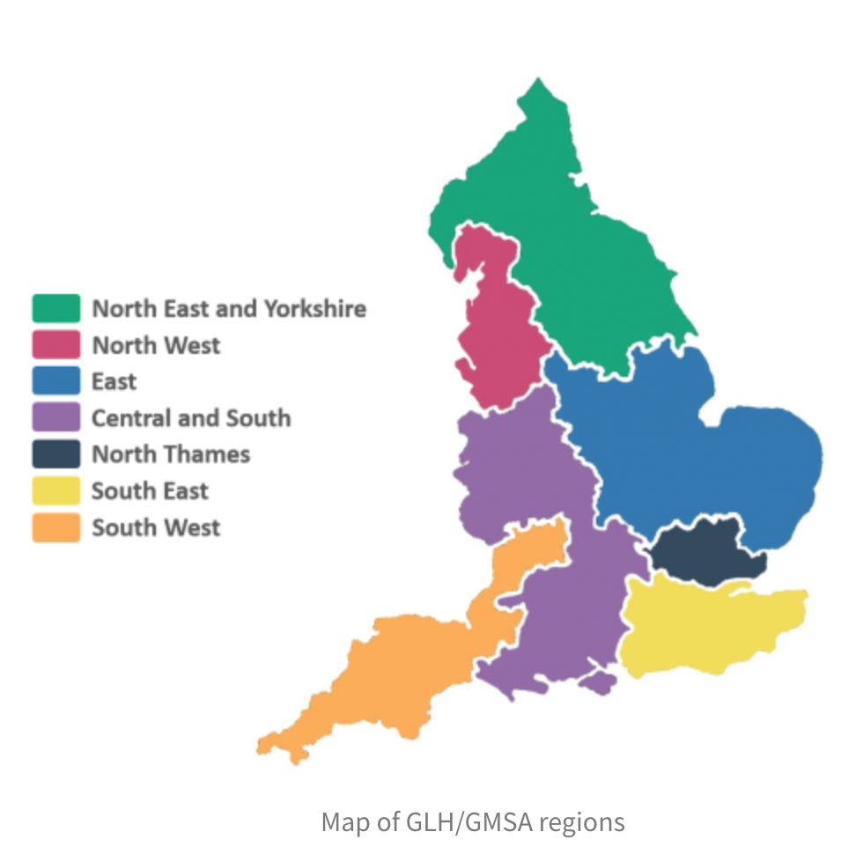
GLH/ GMSA

Slide 8
Current Testing
WGS – Sarcoma, haemonc, paediatric cancers
Solid tumours – TSO 500 gene panel
Other tests e.g. DPYD

Slide 9
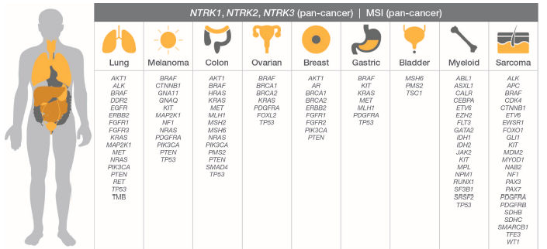
Mainstreaming genomic medicine
TruSight Oncology 500 (TSO500)
Pan-cancer NGS assay using DNA and RNA simultaneously
Targets 523 genes for SNV’s, indels & CNVs and 55 genes for fusions
Captures known and novel fusions
Includes key and emerging biomarkers
Anatomical sites include (but not limited to):
Notes:
Polygenic risks scores, oncotype Dx, endometrial cancer and lymphadenectomy

Slide 10
National Genomic Test Directory
https://www.england.nhs.uk/publication/national-genomic-test-directories/

Slide 11
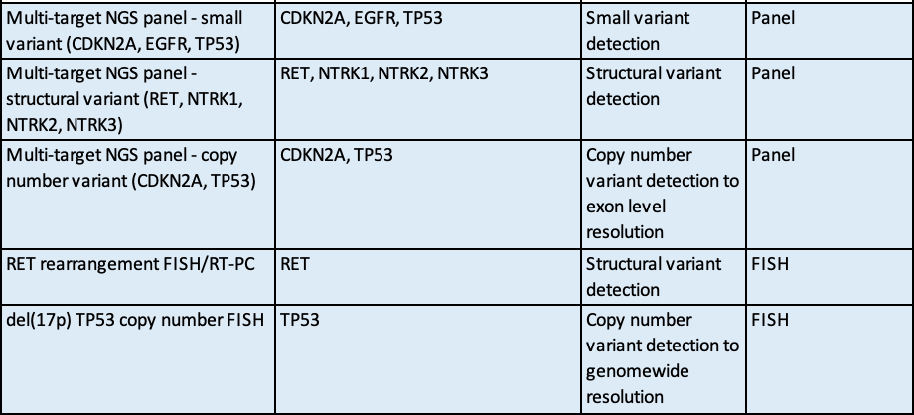
Head and Neck SCC

Slide 13
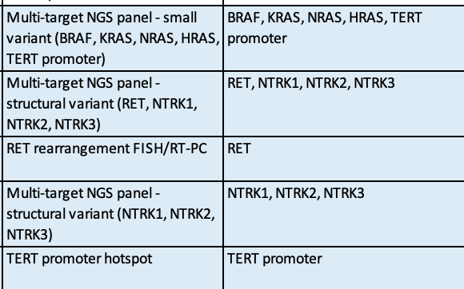
Thyroid Papillary

Slide 14
DPYD
Dihydropyrimidine dehydrogenase (DPD), an enzyme encoded by the DPYD gene, is the rate limiting step
Deactivates more than 80% of standard doses of 5FU and the oral 5FU prodrug capecitabine
Notes:
Dihydropyrimidine dehydrogenase

Slide 16
Neurotrophic Receptor Tyrosine Kinase 1,2,3 (NTRK)
Chromosomal translocation – oncogenic properties.
All cancer 0.3%
Salivary gland 2.6%
Thyroid 1.6%
Potential target for TRK inhibition
TRK inhibition e.g. Larotrectinib / entrectinib

Slide 17
GLH: https://www.nbt.nhs.uk/south-west-genomic-laboratory-hub

Slide 18
Future & Challenges
Expansion of testing
Carcinoma unknown primary
ctDNA/ MRD
GTABs
Cancer event
My email: f.mcdermott@nhs.net

Slide 19
Resources
https://www.genomicseducation.hee.nhs.uk/

