Slide 1
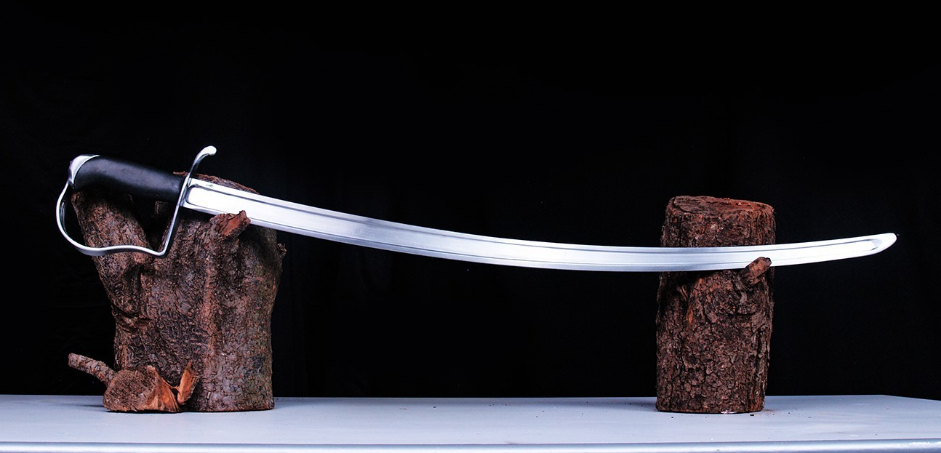
SABR

Slide 2
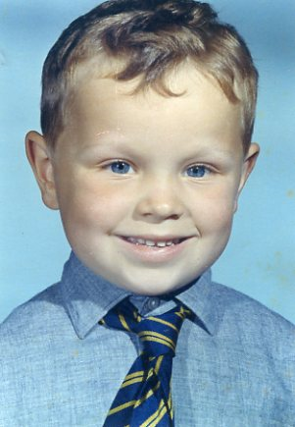
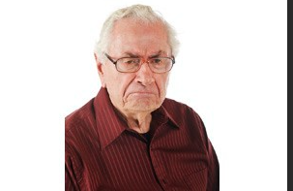
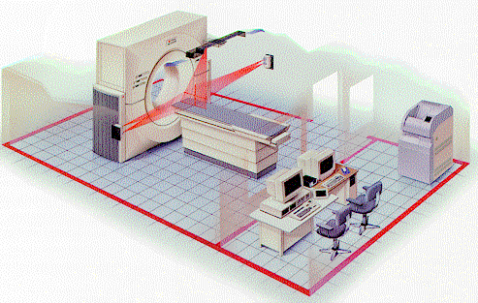
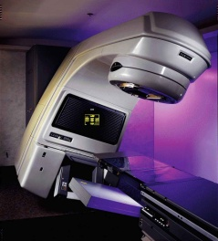
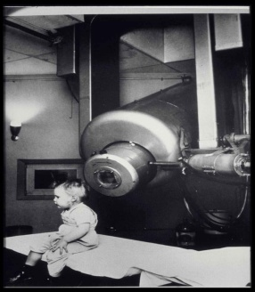
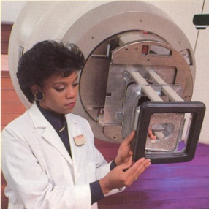
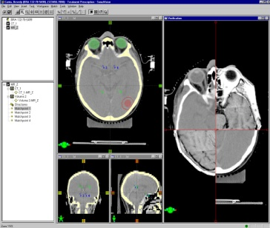
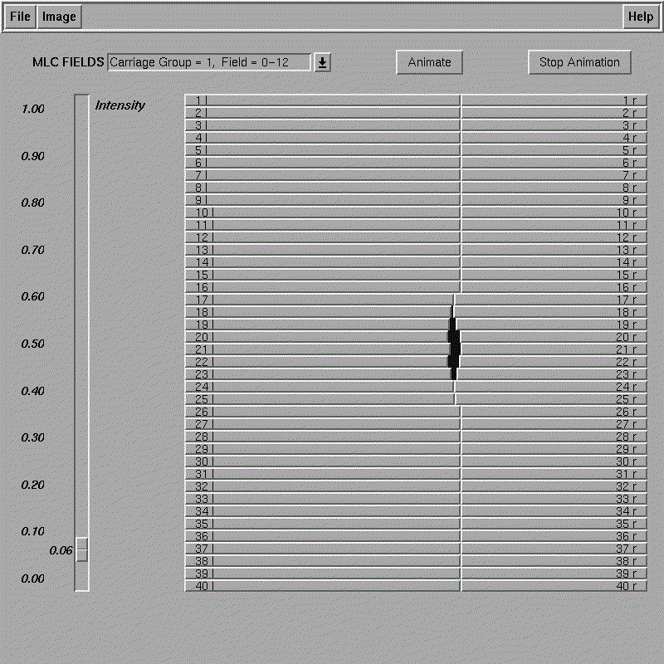
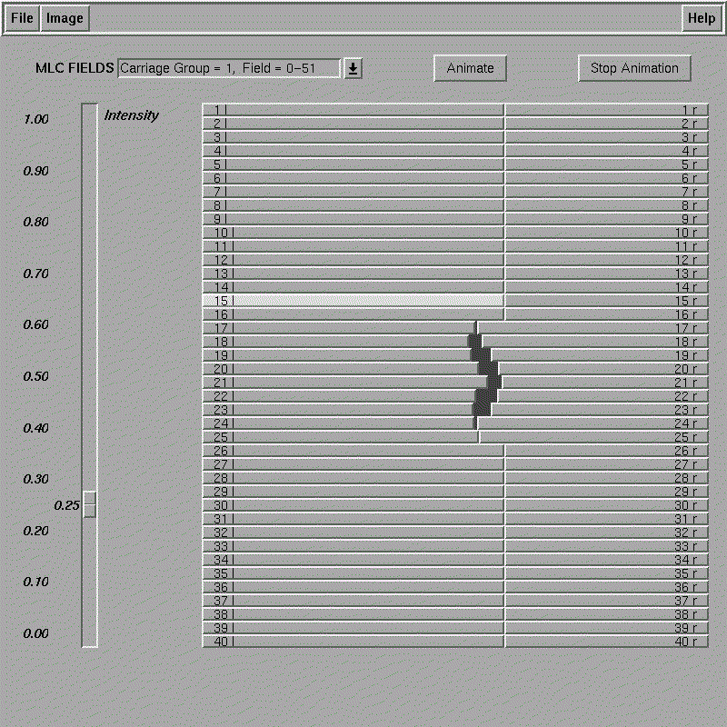
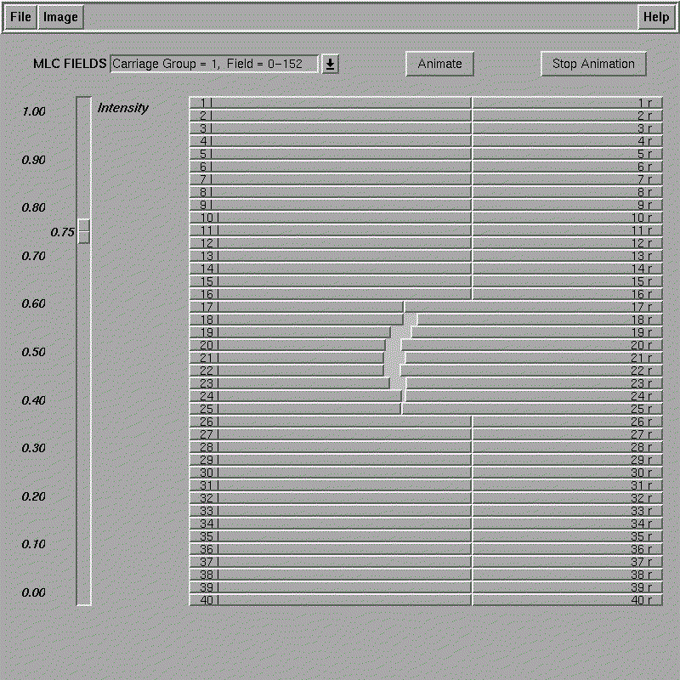
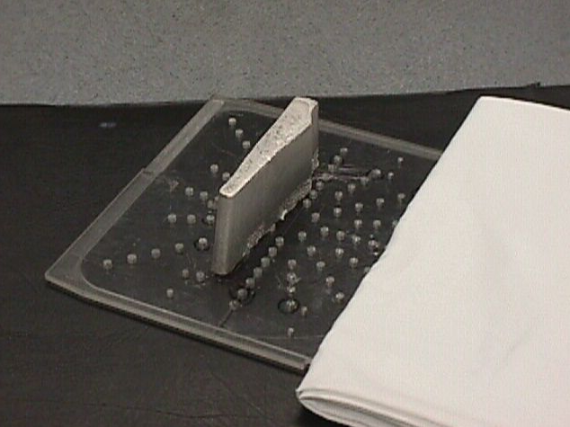
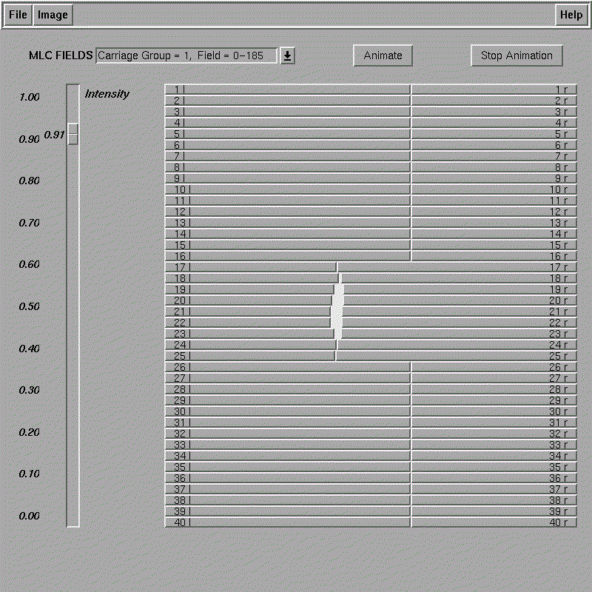
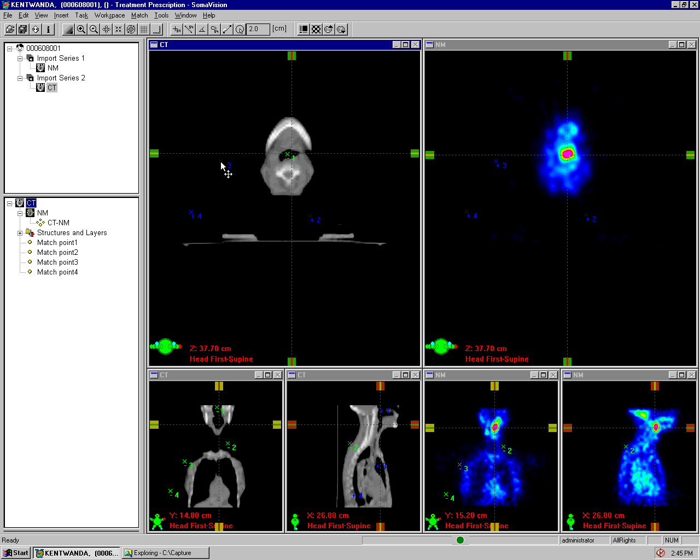
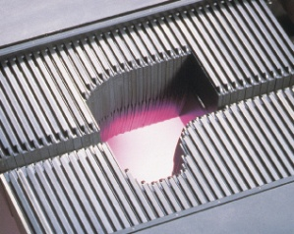

The Evolution of
Radiation Therapy
1960’s
1980’s
1990’s
1970’s
Computerized 3D CT Treatment Planning
2000’s
The First Clinac
Functional Imaging
Cerrobend Blocking
Electron Blocking
Multileaf Collimator
Dynamic MLC
and IMRT
High resolution IMRT
Standard Collimator
Blocks were used to reduce the dose to normal tissues
IMRT Evolution evolves to smaller and smaller subfields and high resolution IMRT along with the introduction of new imaging technologies
The linac reduced complications compared to Co60
MLC leads to 3D conformal therapy which allows the first dose escalation trials.
Computerized IMRT introduced which allowed escalation of dose and reduced compilations
Notes:
Key points to make:
Completely new carriage and leaf design to
Other improvements made:
Reduced Head Diameter by 10 cm from previous “Standard” MLC

Slide 3
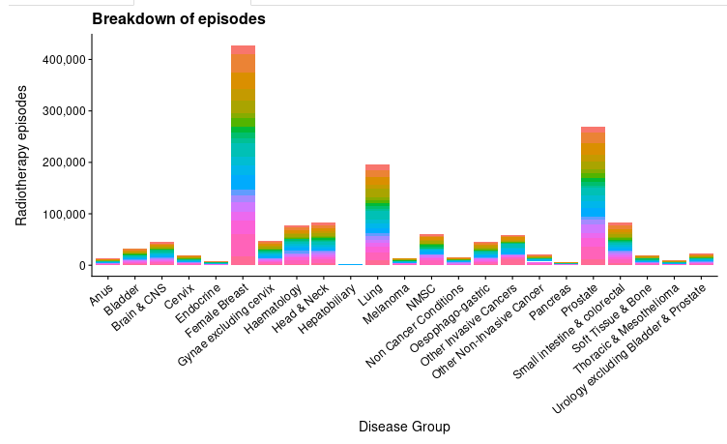
Who gets Radiotherapy in the UK

Slide 4
SABR – what is it?
Stereotactic
Ablative
  Extremely high dose
Body
  As opposed to intracranial
Radiotherapy

Slide 5
SABR - History
Stereotactic radiotherapy is an old technique
Developed at Karolinska Institute in 1960s for treatment of intracranial lesions
Use of multiple radiotherapy fields (7 or more) delivering a high dose to the target but low dose to surrounding structures
Taken up by Japanese to treat peripheral lung tumours

Slide 6
Why now?
3 main technical advances
  Continuous movable multileaf collimators and Arc therapy
  Compensation for tumour motion
    4DCT
    ABC
    Respiratory gating
  Image guided radiotherapy
    Daily CT imaging of target to ensure accuracy

Slide 7
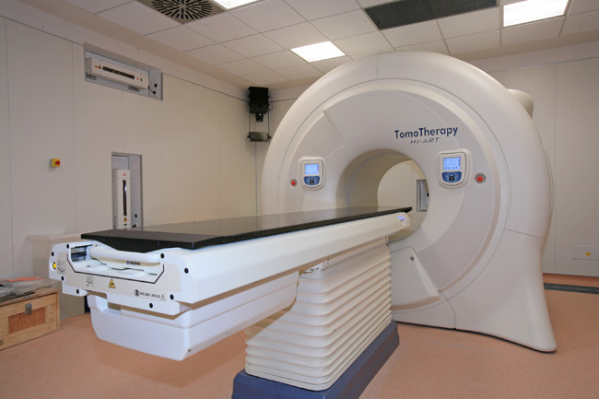
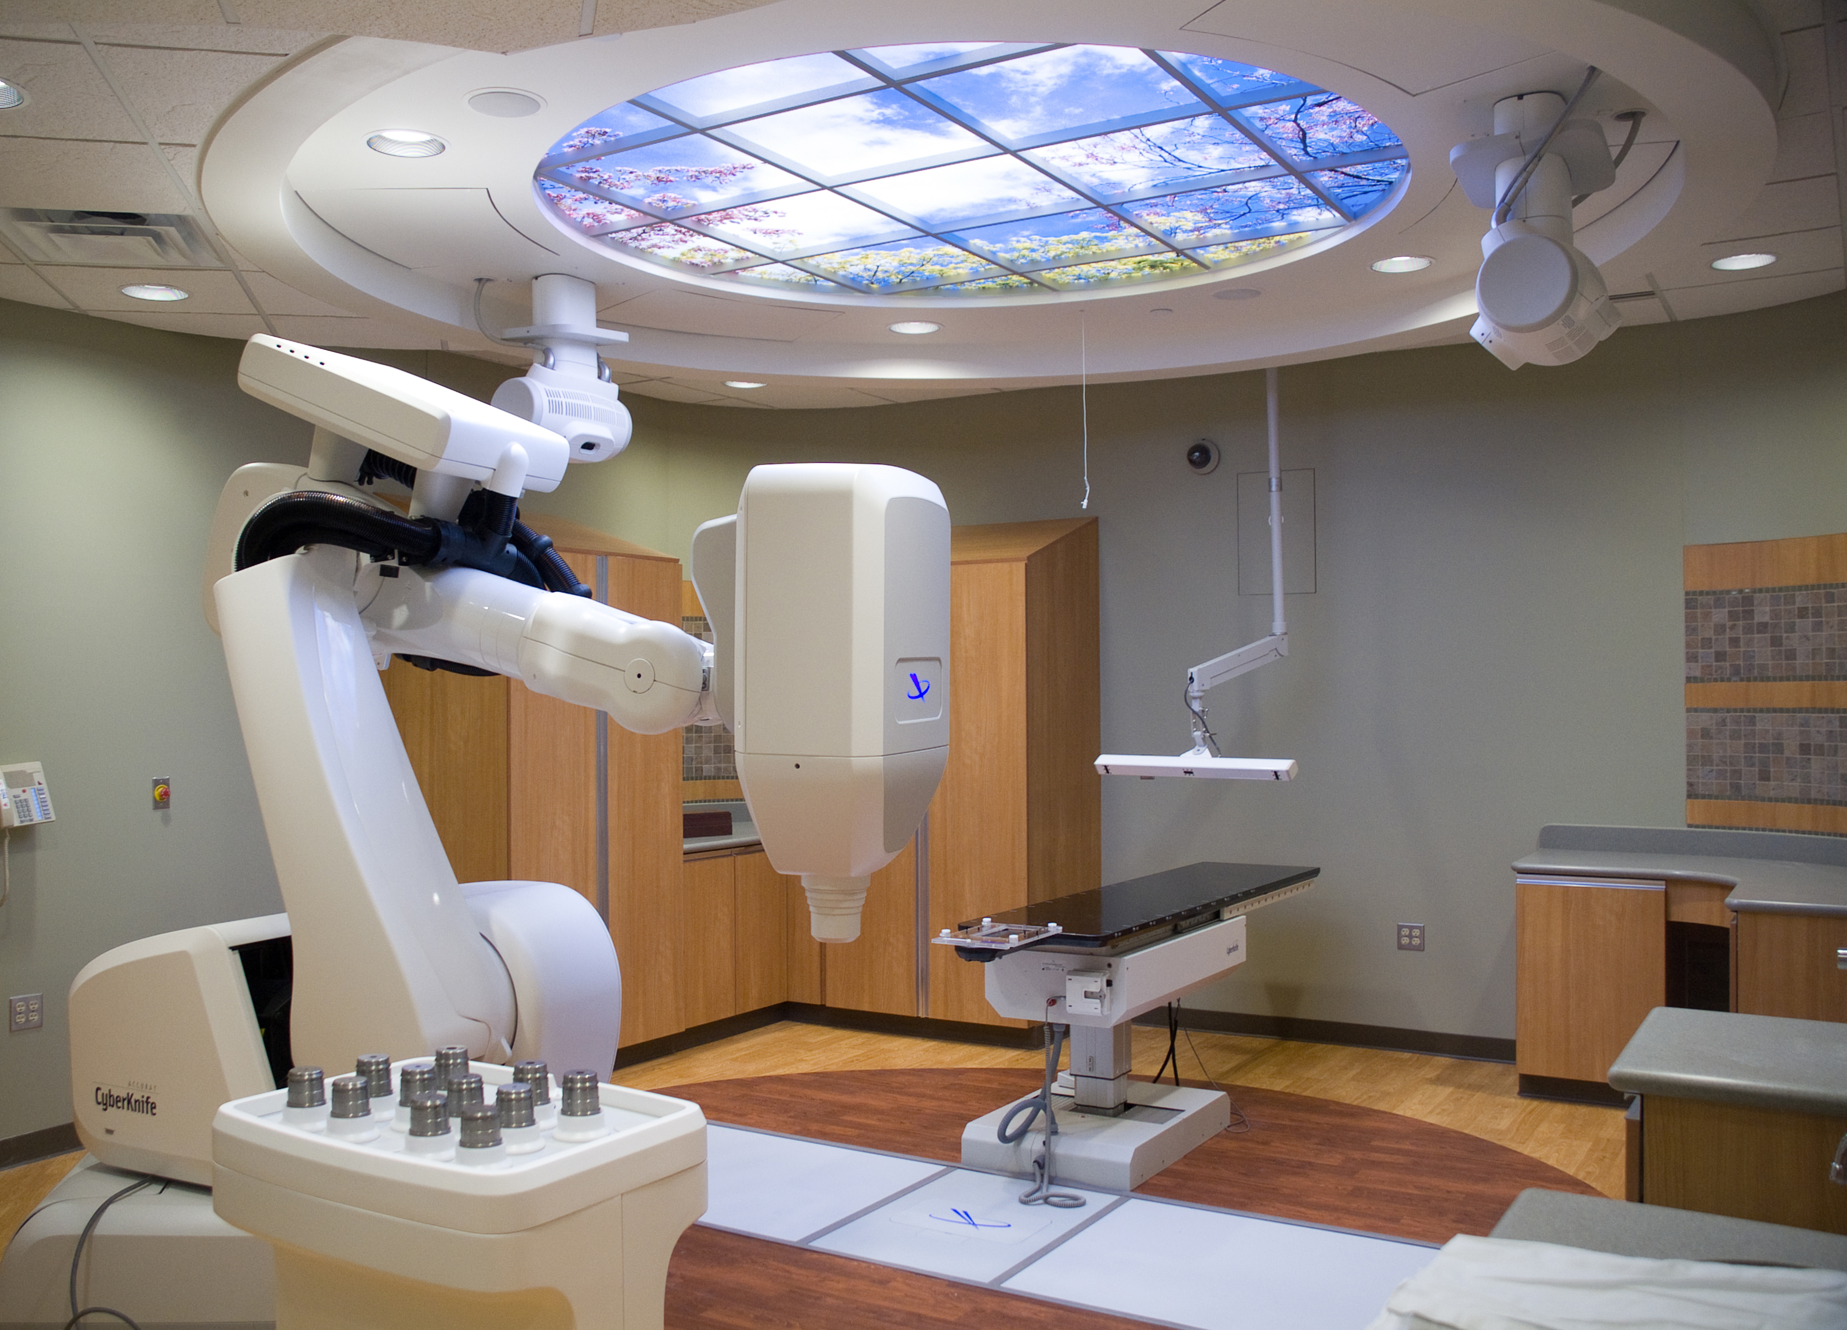
SABR platforms
Tomotherapy
Cyberknife

Slide 8
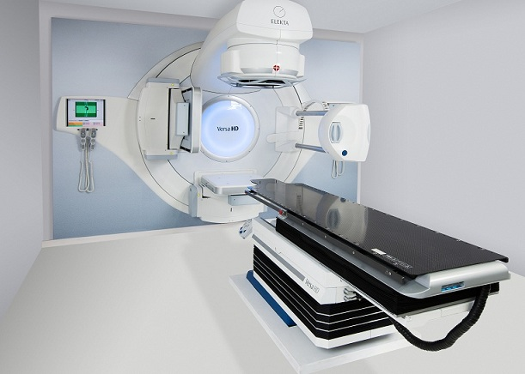
Linear Accelerator

Slide 9
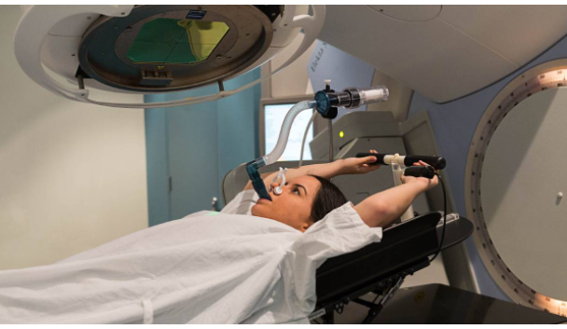

Slide 10
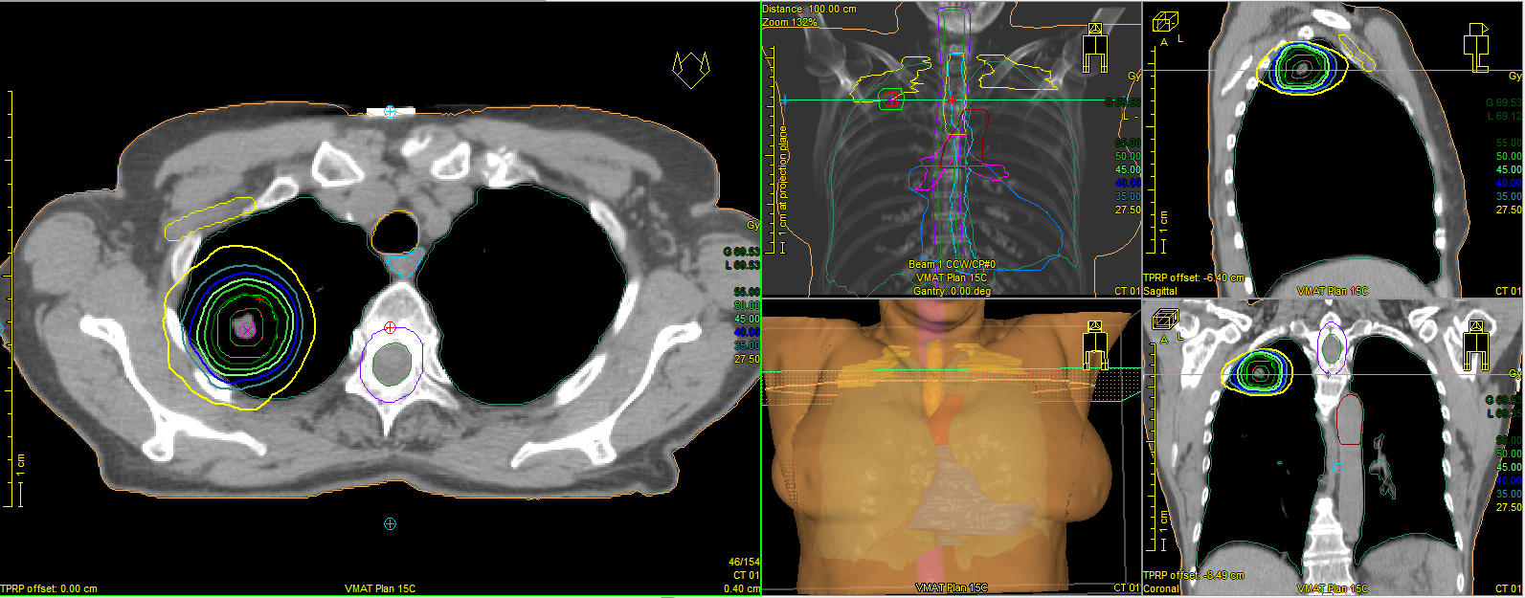
SABR plan

Slide 11
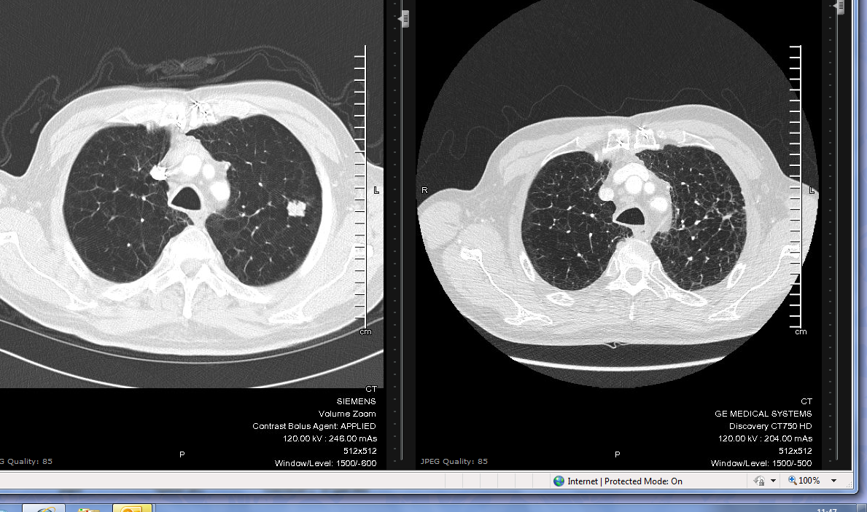

Slide 12
Oligometastatic disease
What is this?
  The clinical state of oligometastatic disease was proposed in 1995 by Hellman and Weichselbaum.
  They hypothesized that, in some patients with a limited number of clinically detectable metastatic tumors, the extent of disease exists in a transitional state between localized and widespread systemic disease.
Is this a real entity?
Even if it isn’t, could ablative treatment be worthwhile?
Can we determine in which patients it might be beneficial?

Slide 13
Evidence for SABR
SABR COMET
  Median overall survival of 41 months (95% CI 26-not reached) with SABR and 28 months (95% CI 19-33, HR: 0.57, p=0.09) with standard care (comprising of palliative radiotherapy and/or chemotherapy).
  Four other comparative studies, provide weak evidence that SABR is non-inferior to surgery in the case of pulmonary metastases, and to radiofrequency ablation (RFA) for liver metastases. However, the evidence provided should be interpreted with caution given that these were retrospective and underpowered studies.

Slide 14
Commissioning through evaluation 2015-2018
1422 patients
Mainly comprised of prostate (28.6%) and colorectal patients (27.9%)
Median 2 year survival 79.2%
2-year OS ranged from 33.5% for oesophageal cancer to 94.6% for prostate cancer
Local control rate: 86.9% (95% CI: 84.6 to 88.9%) at 1 year and 72.3% (95% CI: 68.7 to 75.6%) at 2 years
Grade 3 toxicity of 5.8% (95% CI: 4.7 to 7.2%)
Grade 4 toxicity of 1.8% (95 % CI: 1.2 to 2.7%) (mostly LFTs)

Slide 15
Indications for SABR
HCC now commissioned
Medically-inoperable lung cancer
  Good evidence base; standard of care
Oligo-metastatic disease
  Metachronous
  Synchronous
Oligo-progressive disease
  Progression in a small number of sites whilst patient on maintenance treatment eg Glivec Not funded
Stage IV disease
  Combining SABR with systemic treatment – immunotherapy. Not funded

Slide 16
NHSE - Eligibility for treatment
Metastatic carcinoma with histologically proven primary
1-3 sites of metastatic disease
Maximum size 5 cm
Disease free interval > 6 months (not CRC)
Life expectancy > 6 months
PS 0-2
Includes any cancer type

Slide 17
Practicalities
Patient attends for coaching session
Motion management
  4DCT scan or ABC
Voluming by clinician
Planning by physicists
Treatments last 20-45 minutes depending on patient compliance
Typically 3 – 5 treatments over 1 – 1.5 weeks

Slide 18
Practicalities
Lung, lymph node, bone/spine, liver and adrenal mets treatable
Range of prescriptions: 3 to 8 fractions
Toxicities minimal; dependent on area treated
  Fatigue, skin reaction, cough, dysphagia
  Chest wall pain, fracture, pneumonitis
  Nausea, ulceration, RILD
  Diarrhoea, perforation

Slide 19
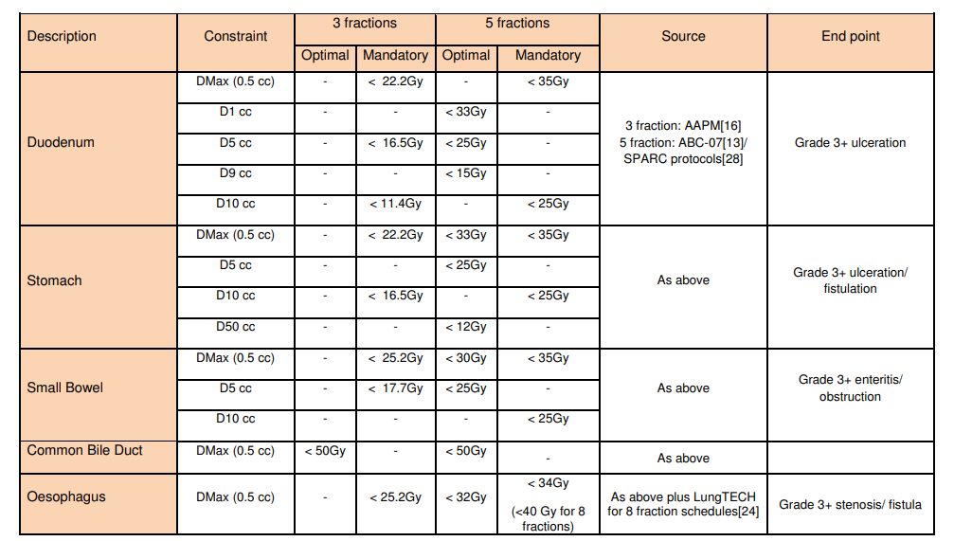
Limitations/constraints

Slide 20
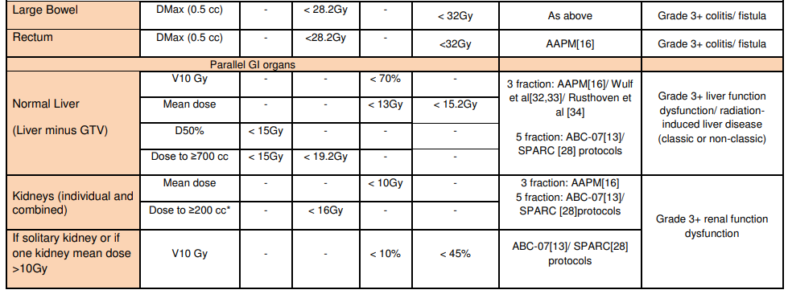
Limitations/constraints

Slide 22
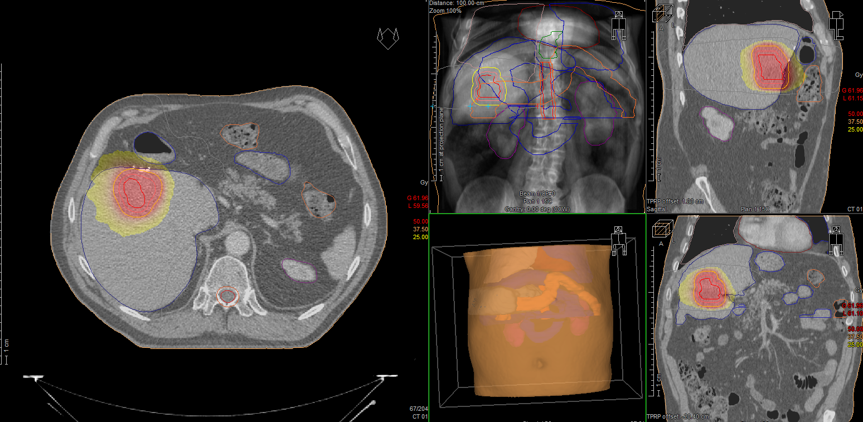

Slide 23
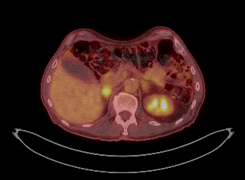

Slide 24
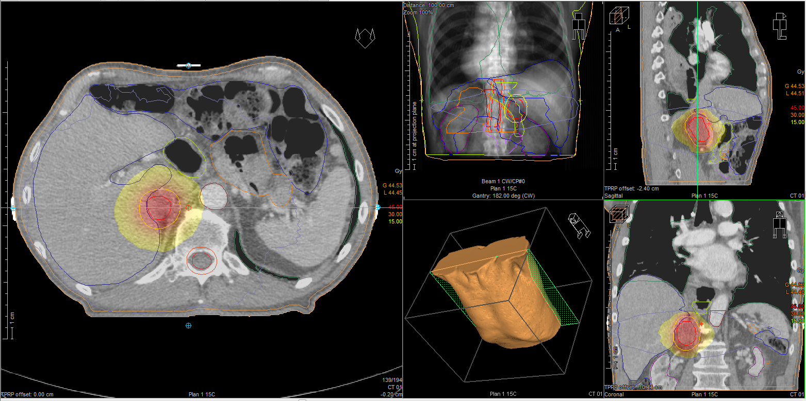

Slide 25
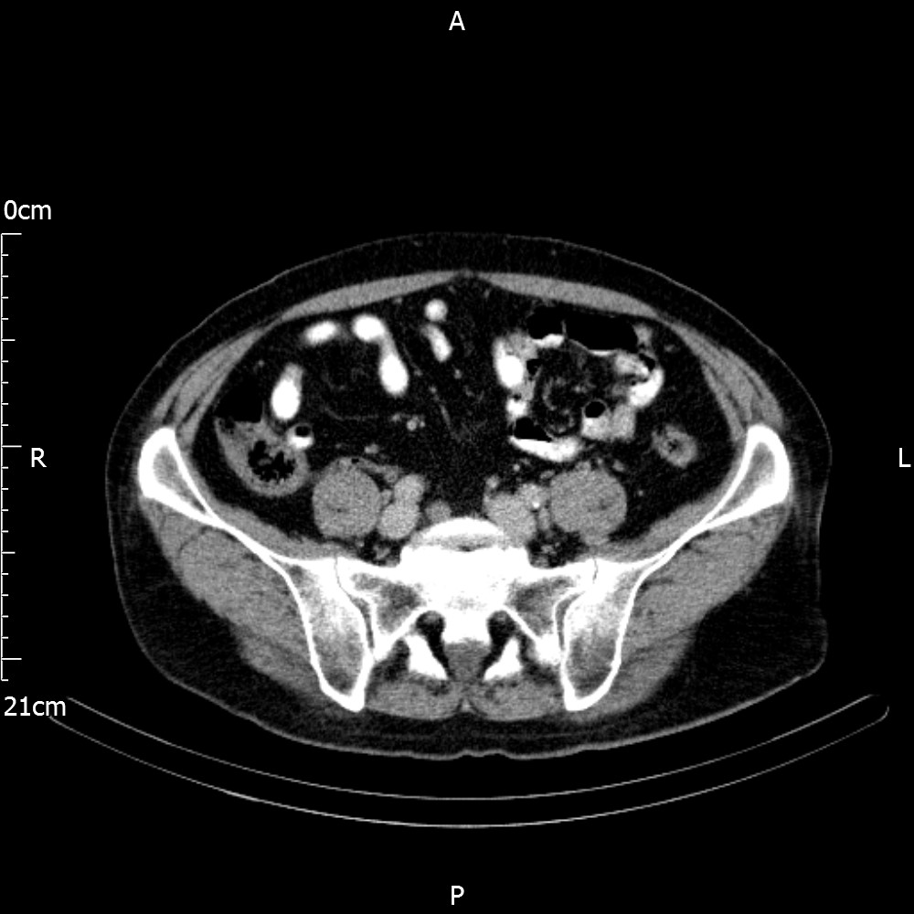

Slide 26
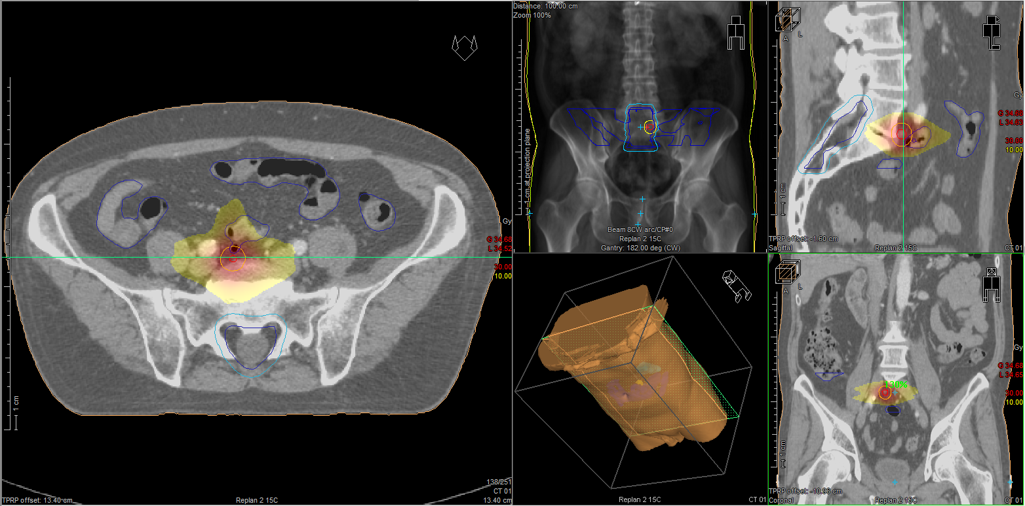

Slide 28
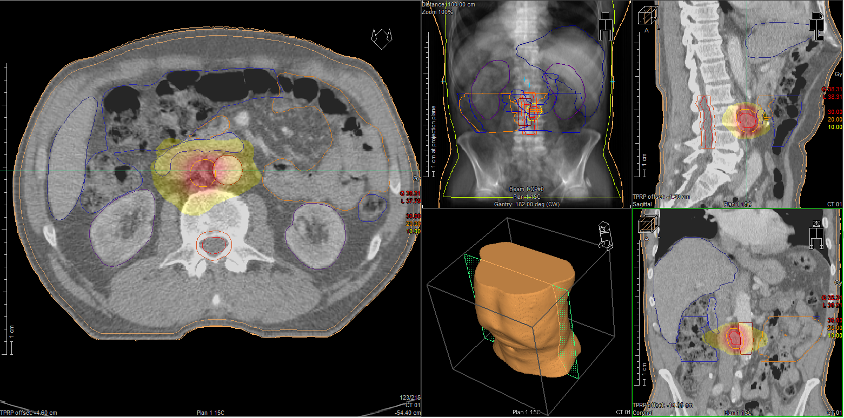

Slide 29

Modified BCLC staging system and treatment strategy
HCC in cirrhotic liver
Very early stage (0)
Single <2 cm
Preserved liver
function*
PS 0
Early stage (A)
Solitary or
2–3 nodules <3 cm
Preserved liver
function*
PS 0
Intermediate stage (B)
Multinodular,
unresectable
Preserved liver
function*
PS 0
Advanced stage (C)
Portal invasion/
extrahepatic spread
Preserved liver
function*
PS1†–2
Terminal stage (D)
Not transferable HCC
End-stage
liver function
PS 3–4
Prognostic
stage
Solitary
2–3 nodules
≤3 cm
Optimal surgical
candidate‡
Yes
No
Transplant
candidate
Yes
No
Treatment§
Ablation
Resection
Transplant
Ablation
Chemoembolization
Systemic therapy‖
BSC
Survival
>5 years
>2.5 years
≥10 months
3 months
*Child–Pugh A without ascites. Applies to all treatment options apart from LT; †PS 1; tumour-induced modification of performance capacity; ‡Multiparametric evaluation: compensated Child–Pugh class A liver function with MELD score <10, matched with grade of portal hypertension, acceptable amount of remaining parenchyma and possibility to adopt a laparoscopic/minimally invasive approach; §The stage migration strategy applies; ‖Sorafenib has been shown to be effective in first line, while regorafenib is effective in second line in case of radiological progression under sorafenib. Lenvatinib has been shown to be non-inferior to sorafenib in first line, but no effective second-line option after lenvatinib has been explored. Cabozantinib has been demonstrated to be superior to placebo in 2nd or 3rd line with an improvement in OS. Nivolumab has been approved in second line by FDA but not EMA based on uncontrolled Phase 2 data. Please see notes for full details.
EASL CPG HCC. J Hepatol 2018; doi: 10.1016/j.jhep.2018.03.019
Notes:
BCLC, Barcelona Clinic Liver Cancer; BSC, best supportive care; EMA, European Medicines Agency; FDA, Food and Drug Administration; HCC, hepatocellular carcinoma; LT, liver transplantation; MELD, Model for End-Stage Liver Disease; OS, overall survival; PS, performance status

Slide 30
Local ablation and external radiation
Tumour ablation techniques have improved along with the imaging-guidance tools required to ensure their successful application
Recommendations
Thermal ablation with radiofrequency is the standard of care for patients with BCLC-0 and A tumours not suitable for surgery* | High | Strong
In patients with very early stage HCC (BCLC-0) radiofrequency ablation in favourable locations can be adopted as first-line therapy even in surgical patients | Moderate | Strong
Microwave ablation showed promising results for local control and survival | Low
Ethanol injection is an option in some cases where thermal ablation is not technically feasible, especially in tumours <2 cm | High | Strong
External beam radiotherapy is under investigation So far there is no robust evidence to support this therapeutic approach in the management of HCC | Low | Weak
Level of evidence
Grade of recommendation
*Thermal ablation in single tumours 2–3 cm in size is an alternative to surgical resection based on technical factors (location of the tumour), hepatic and extrahepatic patient conditions
EASL CPG HCC. J Hepatol 2018; doi: 10.1016/j.jhep.2018.03.019
Notes:
BCLC, Barcelona Clinic Liver Cancer; HCC, hepatocellular carcinoma

Slide 31
Metanalysis SBRT HCC
32 studies including 1950 patients
1-, 2-, and 3-year OS rates of 72.6% (95% CI 65.7-78.6), 57.8% (95% CI 50.9-64.4), and 48.3% (95% CI 40.3-56.5), respectively.
1-, 2-, and 3-year LC rates of 85.7% (95% CI 80.1- 90.0%), 83.6% (95% CI 77.4-88.3%), and 83.9% (95% CI 77.6-88.6%), respectively
Rim et al 2019

Slide 32
RFA or SBRT Liver metastases
The two modalities result in equivalent 1- and 2- year OS of 70-80% and 40-50%, respectively.
Higher OS rates for both SABR and RFA were reported by Kim et al. (2019).
This finding suggests that differences in OS are mostly driven by patient characteristics and not due to the treatment effect

Slide 33
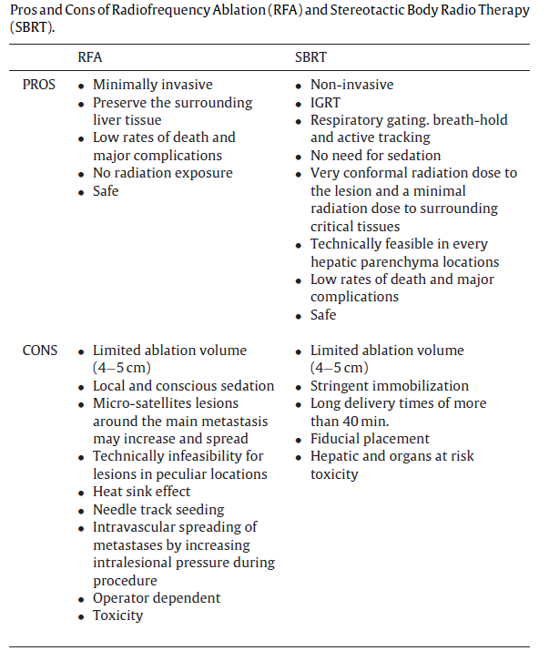

Slide 34
RFA or SBRT Liver metastases
  There are no randomised studies
  ‘There is little doubt that RFA is preferred for the treatment of no more than three hepatic lesions with a diameter ≤ 2 cm, far from major blood vessels, main bile duct and gallbladder or beneath the diaphragm, not more distant than 1 cm from the glissonian capsule and with a distance from the large hepatic veins equal or major to2 cm’.
  ‘On the other hand, SBRT can provide an excellent local control when the metastases treated are one to five in number and ≤6 cm in diameter in patients with a good performance status and an adequate pre-SBRT liver function; in particular, SBRT should be preferred for lesions larger than 2 cm regardless of the tumour histology’

Slide 35
Conclusions
The MDT can now offer a number of complementary not competing strategies for liver disease
  Surgery
  Ablation – RFA/ Microwave
  SABR
  Next ambition is SIRT where likely further commissioning will take place.
  Requires resolution of IR issues

