Slide 1
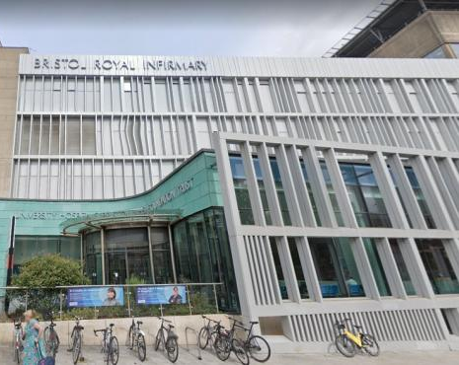
Pancreatic Cancer- Radiological Assessment of Vascular Involvement Pre and Post Chemotherapy
Hedvig Karteszi
University Hospitals Bristol and Weston NHS Foundation Trust
Bristol Royal Infirmary

Slide 2
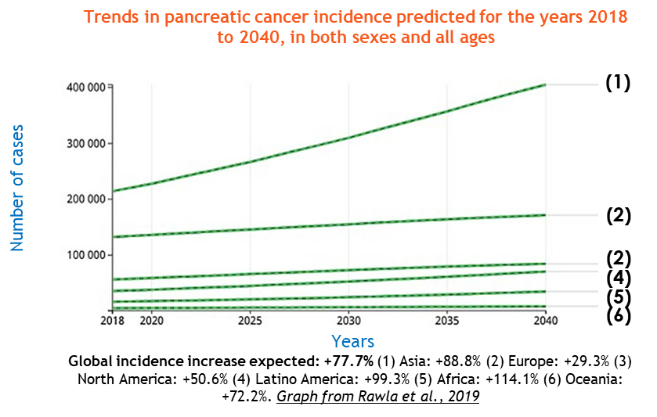
-Despite being a relatively rare tumour PDAC is the 5th biggest cancer killer in the UK and is on track to be the 2nd biggest cancer killer in the USA within a decade unless there is a major improvement in outcome.
-Incidence in constant augmentation for the past 25 years.
-Five- and ten-year survival has not shown significant improvement in the same period.
-Five-year survival of pancreatic cancer in the UK lags behind the rest of the world, with the UK ranking 29th out of 33 countries with comparable data.

Slide 3
Artificial Intelligence and Early Detection of Pancreatic Cancer
2020 Summative Review
Kennet et al. Pancreas Volume 50, Number 3, March 2021
-The proportion of patients with very early stage PDAC ( stage IA and IB) has increased
but
-Still less than 2% of the patients are diagnosed in stage I.
-5-year survival for stage IA is in excess of 80%.
-The survival for other resectable PDAC stages ( IIA, IIB) has improved only marginally despite improvements in therapy.

Slide 4
Multidetector Computed Tomography
-best validated imaging modality to assess local tumour extension and distant metastasis
-accuracy of up to 77% for predicting resectability and 93% for predicting unresectability
Technique:
- multiphase post-contrast acquisitions : late arterial/pancreatic parenchymal and portal venous phase
100-150 ml iv contrast (~ 2ml/kg )
- high-iodine concentration contrast medium (eg Iomeron 400)
- 4-5 ml/sec injection rate
thin-section imaging - optimally sub-mm (0.5 mm)
- post-processing (multiplanar reconstructions, maximum intensity projection images, volume-rendered images)

Slide 7
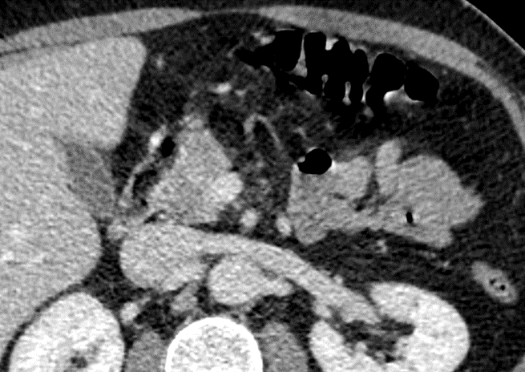
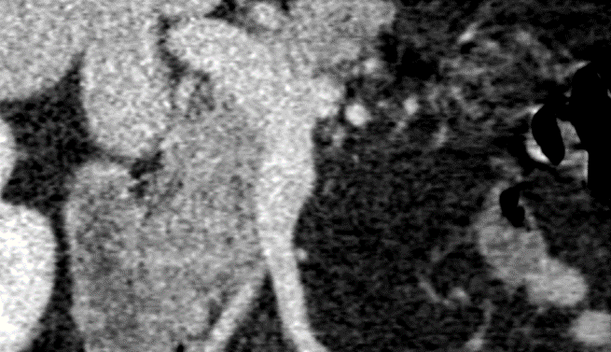
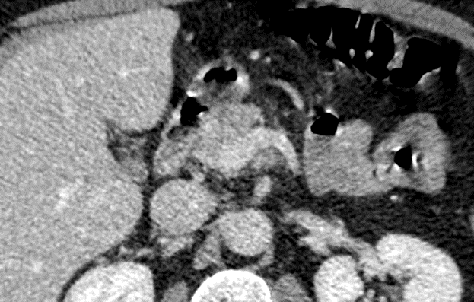

Slide 8
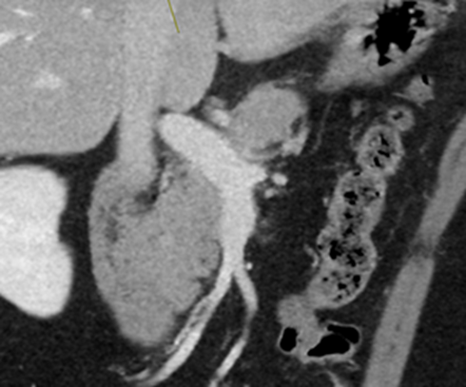
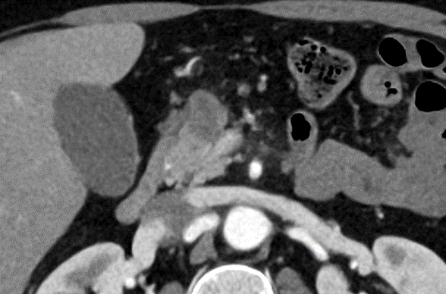
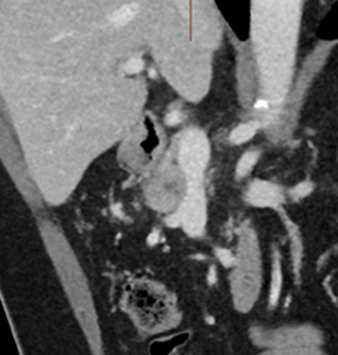
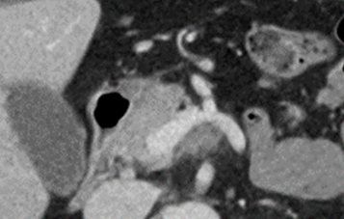
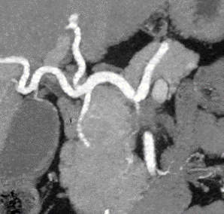

Slide 9
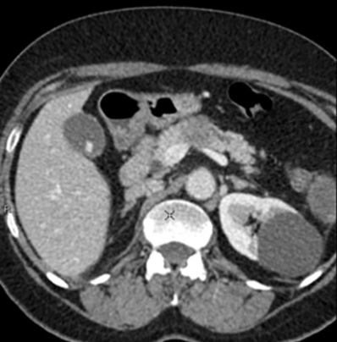
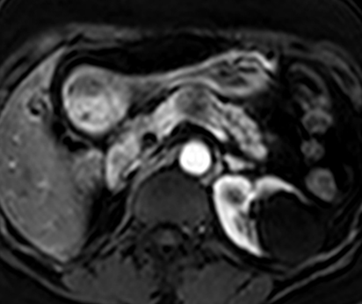
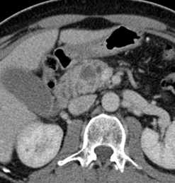
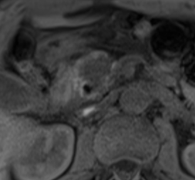
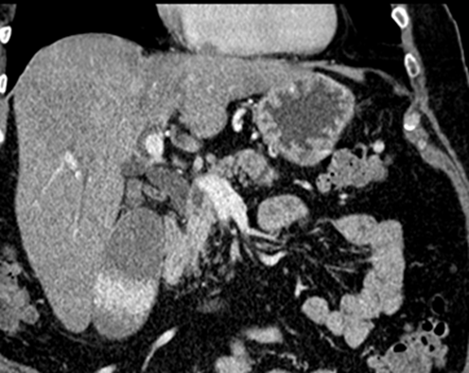
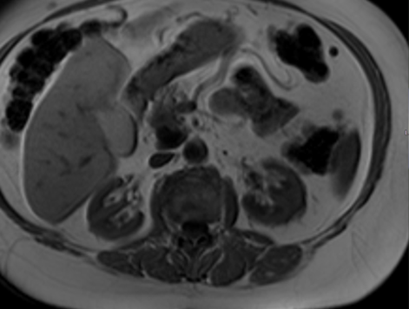
MRI
-greater tumour conspicuity
-detection of CT isodense lesions

Slide 10
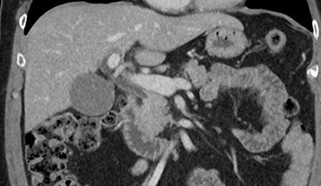
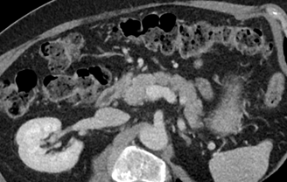
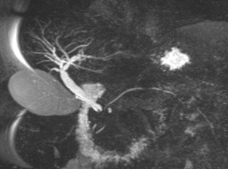
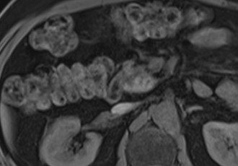
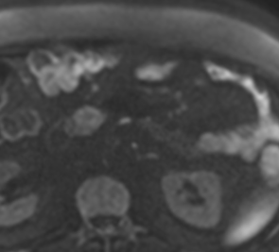

Slide 11
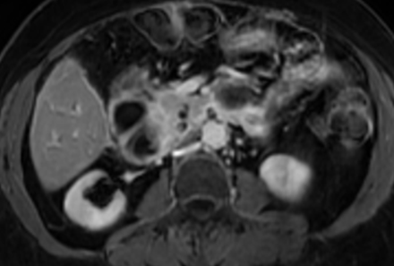
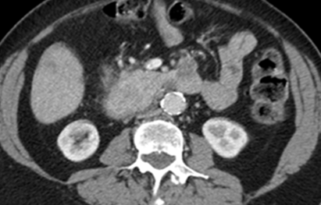
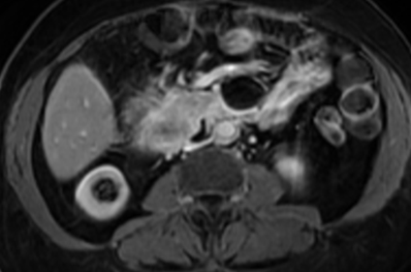
MRI
-MR imaging and CT are equivalent for assessment of vascular invasion.

Slide 12
resectable
unresectable
borderline resectable
In general, borderline resectable pancreatic cancer is neither clearly resectable nor clearly unresectable but rather implies a greater chance of incomplete resection in the setting of upfront surgery.
Many groups have proposed definitions, however, there is not yet a universally accepted definition of borderline resectable pancreatic cancer.
AHPBA/SSO/SSAT/NCCN (American Hepato-Pancreato-Biliary Association/Society of Surgical Oncology/Society for Surgery of the Alimentary Tract /National Comprehensive Cancer Network) Guidelines

Slide 13
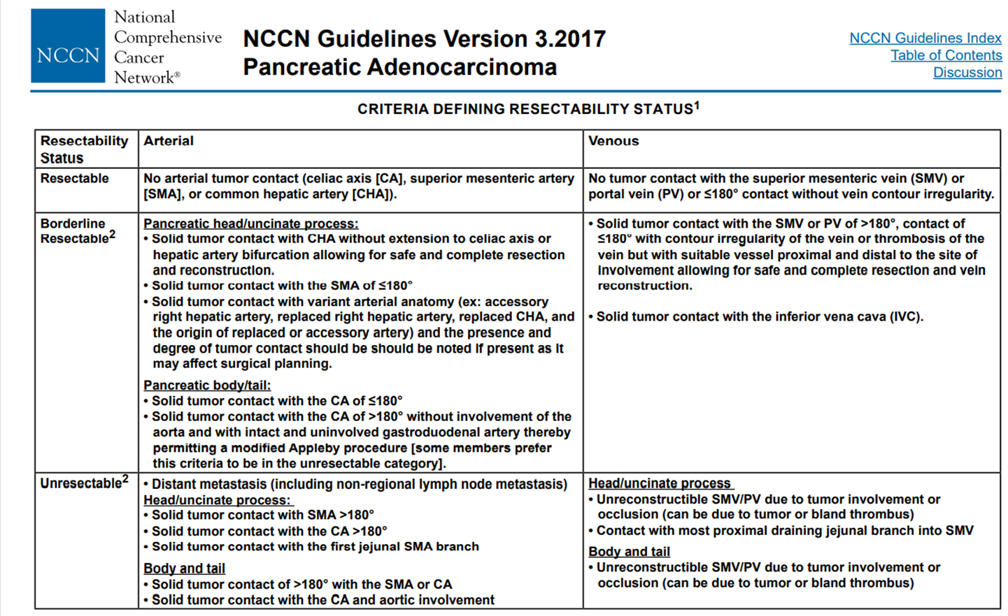
Presence of solid tumour contact with 1st jejunal branch of SMA and with most proximal draining jejunal branch into SMV are no longer locally advanced.

Slide 14
Resectability of Pancreatic Cancer Is in the Eye of the Observer
A Multicenter, Blinded, Prospective Assessment of Interobserver Agreement on NCCN Resectability Status Criteria
Giannone et al.
Annals of Surgery: September 2021-Volume2-Issue 3-p e087
doi: 10.1097/AS9.0000000000000087
-Interobserver agreement varied from fair to moderate, with the lowest agreement for borderline resectable tumors.
-Assessing vascular contact ≤180° had the lowest agreement for all vessels .
-The highest concordance was recorded for venous invasion >180°.

Slide 15
Assessment of venous invasion
-The median survival and 30-day post-operative mortality in cases that require venous resection are comparable to that in cases without a need for venous resection. -> Results encouraged surgeons to perform pancreatectomy with venous resection.
-It can be difficult to differentiate desmoplastic reaction from true vascular invasion on imaging-> approx. 20% of cases with “venous involvement “ on imaging do not have true venous invasion.
-Classifications of venous invasion: Ishikawa’s (1992), Loyer’s ( 1996), Lu’s (1997), Li’s (2005), Klauss’ (2008), Marinelli’s (2014), Teramura’s (2016)

Slide 16
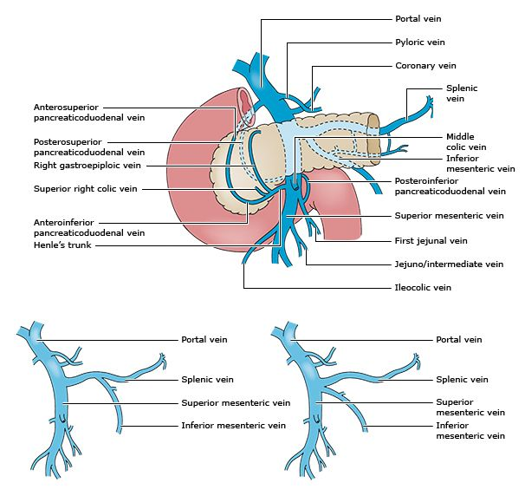
Venous resection
A single and patent segment of the SMV below and a single and patent segment of portal vein or SMV above the involved segment are usually required.

Slide 17
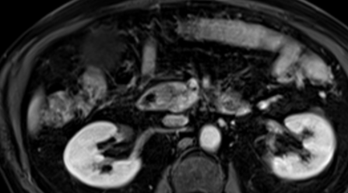
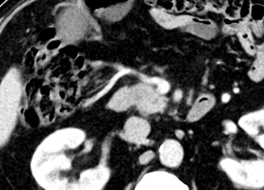
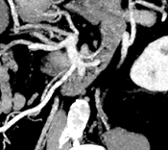
Henle trunk
first jejunal vein
middle colic vein
SMV
Henle trunk

Slide 18
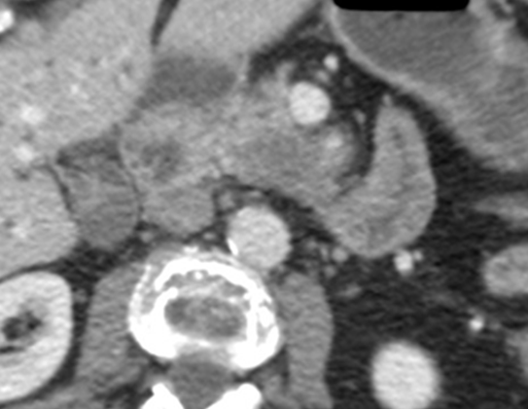
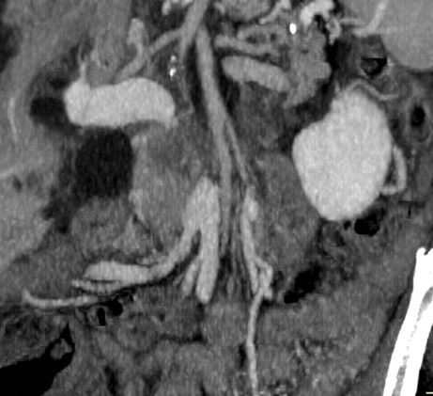
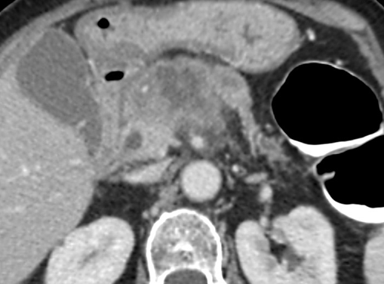
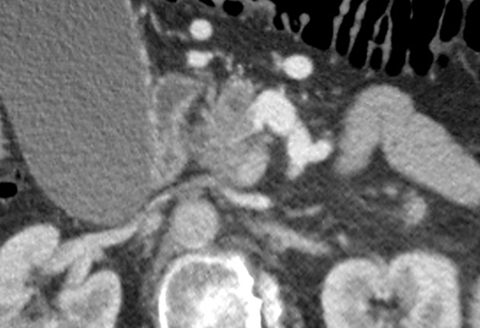
Highly specific signs of vascular invasion
-
-vessel embedment in tumour , venous obliteration
-tumour-vessel contact >180 degree of circumference (encasement)

Slide 19
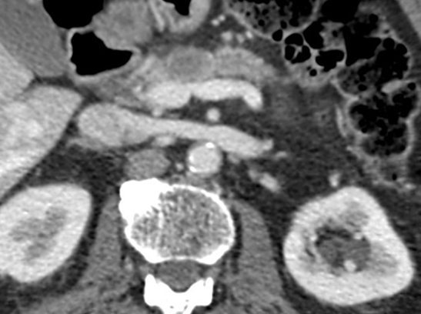
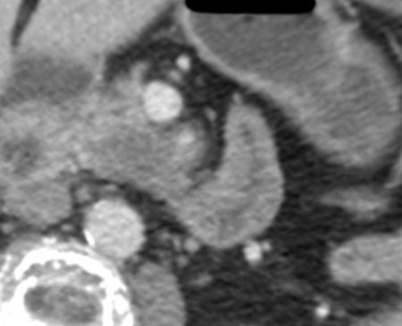
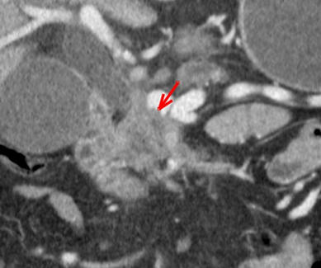
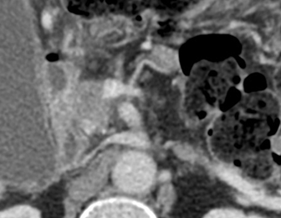
Highly specific signs of vascular invasion
-vessel wall irregularity/ vessel calibre stenosis
-tumour thrombus in vessel
- tear-drop SMV sign

Slide 20
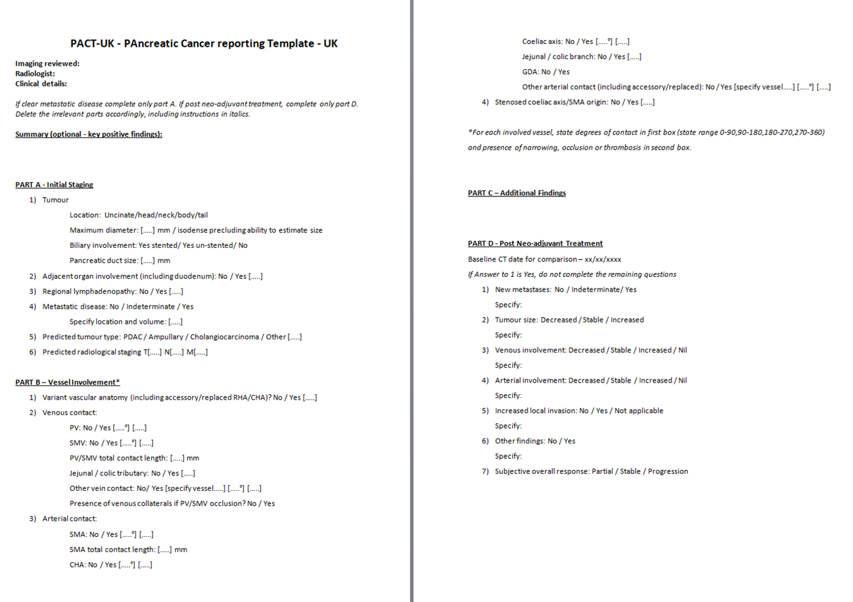

Slide 21
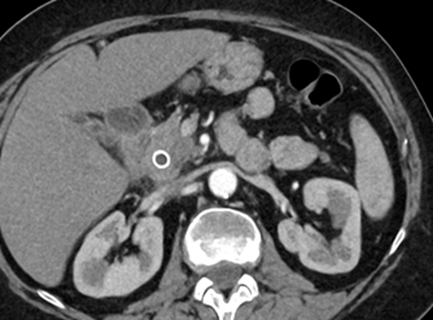
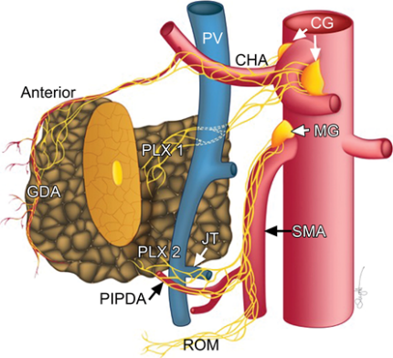
Extrapancreatic neural invasion
The most important pathways of extrapancreatic perineural invasion in pancreatic head cancer are plexus pancreaticus capitalis I (PPC I), plexus pancreaticus capitalis II (PPC II) and gastroduodenal artery plexus.
Preoperative EPNI diagnosis might be a major predictor of poor prognosis in resectable or borderline resectable tumours.
PPC II is the most common way of tumuor spread in pancreatic head cancer with extrapancreatic growth towards the superior mesenteric artery along the inferior pancreatoduodenal artery (IPDA).

Slide 22
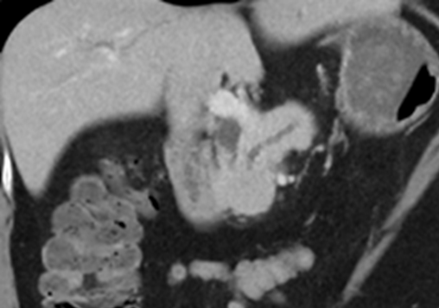
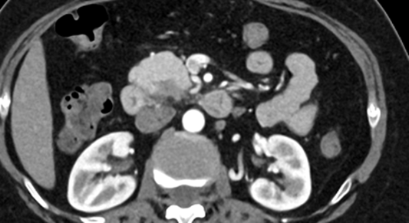
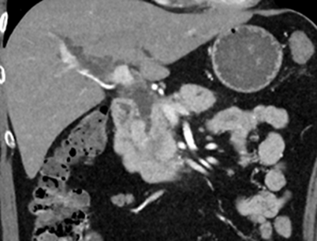
Case1: Resectable PDAC in the HOP
Step 1: detection and delineation of the tumour
double duct dilatation with abrupt termination of both ducts in the head of pancreas
hypodense mass

Slide 23
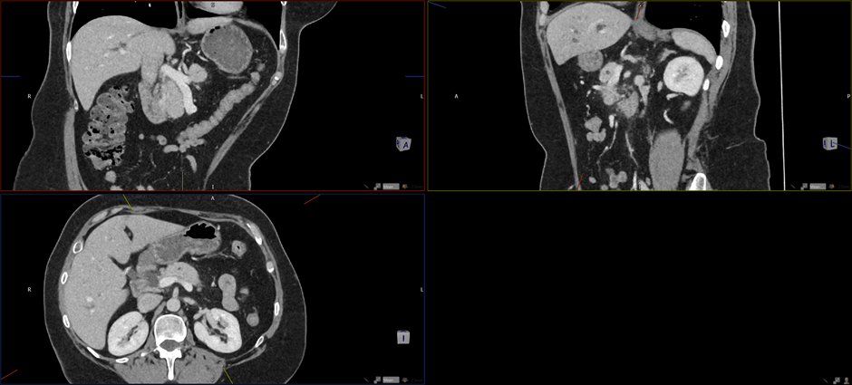
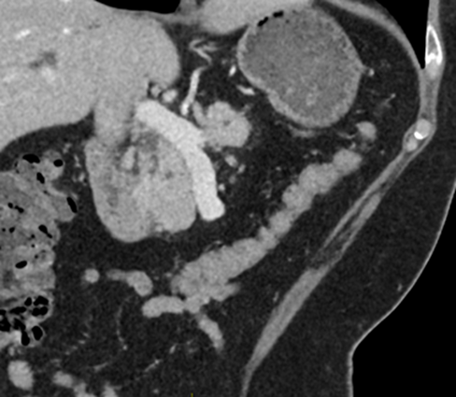
Step 2: assessment of relationship between tumour and vessels

Slide 24
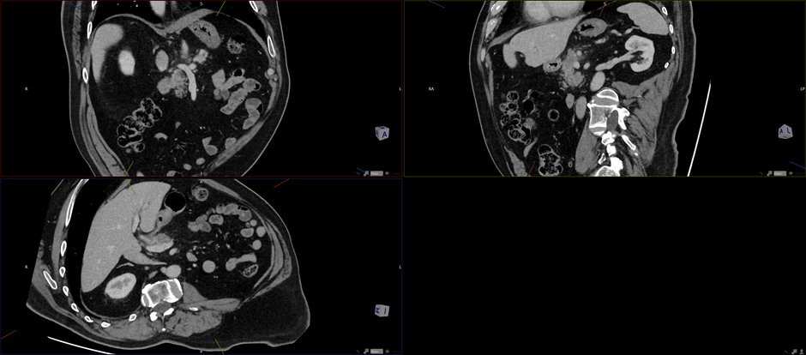
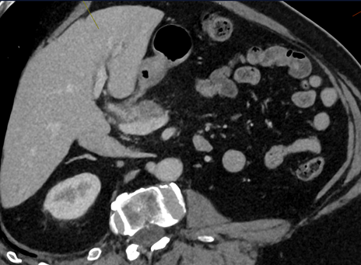
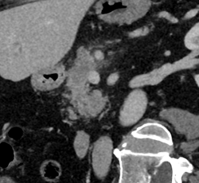
Case No2: Unresectable PDAC in the neck – relationship between tumour and veins

Slide 25
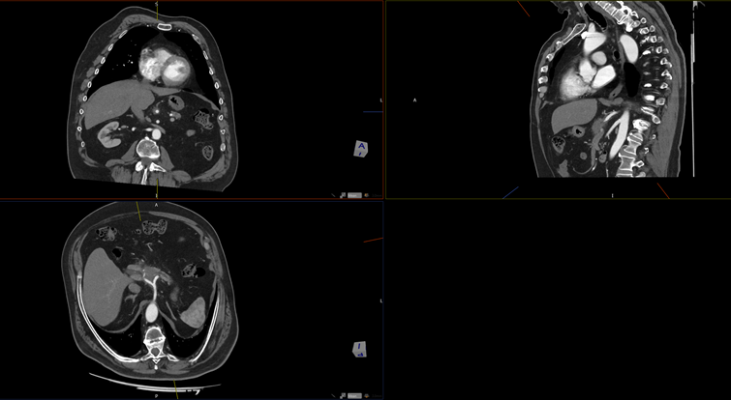
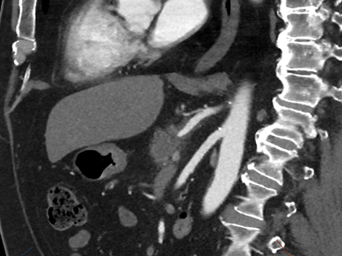
Unresectable PDAC in the neck – relationship between tumour and coeliac trunk

Slide 26
Unresectable PDAC in the neck – relationship between tumour and hepatic artery

Slide 27
Case No3: Resectable tumour in HOP
biliary dilatation with distal stricture
isodense mass, clear fat planes around the vessels
normal parenchyma between tumour and vessels on MRI

Slide 28
Case No4: Resectable PDAC in the HOP
double duct dilatation with isodense mass in HOP
in contact with short section of GDA
clear fat planes around PV and SMV

Slide 29
Case No5: Resectable tumour in HOP
CBD stricture, no discernible mass
No “fat” between SMV and pancreatic parenchyma but there is uninvolved PD between tumour and SMV, normal parenchyma adjacent to SMV on MRI.

Slide 30
Case No6: technically resectable PDAC in the tail of pancreas
direct invasion to spleen
tumour extension into perirenal space
encasement of splenic vessels
extension towards the stomach along perigastric vein

Slide 31
Case No7: unresectable tumour in head and uncinate process
encasement of long section of SMV including tributaries
Tumour abuts SMA and encases mesenteric branches.

Slide 32
Case No8: unresectable HOP tumour ( anatomical variation - ARHA arises from GDA)

Slide 34
Case No9: Borderline resectable tumour ( upfront surgery)
August 2020
February 2021
R1 resection

Slide 35
Case No 10: Borderline resectable tumour in the head of pancreas
in contact with PV and SMV
encases GDA from its origin, solid tumour contact with LHA

Slide 36
Assessment of vasculature prior to surgery
Locally resectable periampullary tumour/distal cholangiocarcinoma
RHA arises from SMA
marked stenosis of the coeliac trunk
arterial collateralization around the head of pancreas
LHA probably fills from dilated GDA

Slide 37
Rationale for neoadjuvant C(R)T:
Patients who undergo upfront surgery:
have R1 resection in ~20% of the cases
early recurrence in third of the cases
low survival, <40% 5 year
up to third of them cannot tolerate/receive adjuvant chemotherapy
Subgroups of worst prognosis:
CA 19-9 > 500
comorbidities
tumour> 30-40 mm
PV abutment
pain prior to surgery
significant weight loss prior to surgery
regional lymphadenopathy
Potential benefits:
increase R0 resection
convert unresectable to resectable disease
select pts with better biology
better compliance than with adjuvant therapy
reduce micrometastatic disease

Slide 38
Challenges to evaluate response to neoadjuvant therapy
-major histopathological response in ~26% of the cases, complete histopathological response in ~16% of the cases
-cancer resectability after Folfirinox therapy: CT sensitivity 67% specificity 37% for R0 resectability
-CT underestimates response and resectability
NCCN downstaging in <10% but R0 can be achieved in many CT non-resectable disease
RECIST response in ~20% but downsizing doesn’t predict resectability
RECIST stable disease in >70%of the cases but R0 resection can be achieved in most cases ( particularly when CA19-9 decreases)
Surgical exploration should be considered in all patients without signs of disease progression.

Slide 39
Case No11 : good therapy response
Before and after neoadjuvant chemotherapy:

Slide 40
Consensus MDT decision- no exploration as persistent and possibly progressive SMA involvement

Slide 41
Case No12: Good therapy response
Before and after neoadjuvant chemotherapy:
Micro metastasis was found on the surface of the liver at surgery.

Slide 42
Case No13: Good therapy response
Before and after neoadjuvant chemotherapy:
T1 N0 R0

Slide 43
Case No14: Stable appearance after neoadjuvant chemotherapy

Slide 44
R0 resection

Slide 45
Case No15: Stable post chemotherapy
R1 resection
local recurrence 4 months later

Slide 46
-close collaboration in HPB Team
-feedback
-proforma reporting
Thank you.

