Slide 1
SWAG Network Breast cancer
Clinical Advisory Group
Research Update - Claire Matthews
25/03/2022

Slide 2
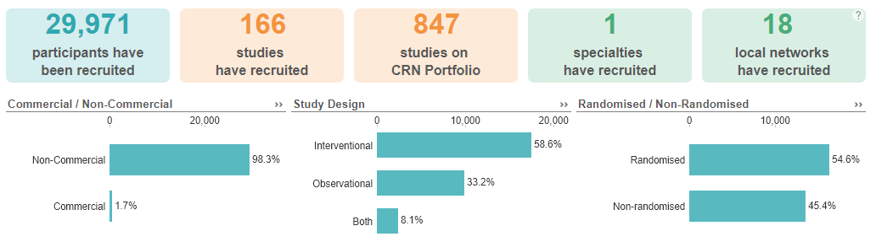
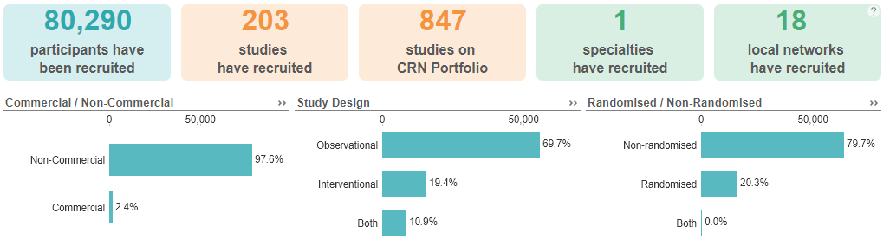
National Recruitment to Breast Cancer Studies
Apr 2020 - Mar 2022
Apr 2018 - Mar 2020
Data cut 10/03/2022
Source: ODP All Portfolio

Slide 3
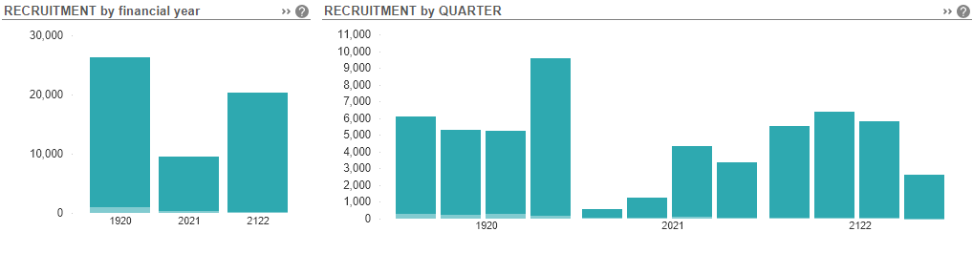
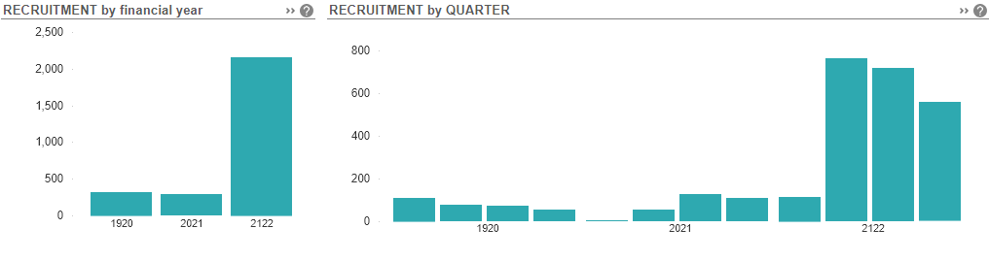
National vs Regional Recruitment to Breast Cancer Studies Apr 2019 - Mar 22
National Recruitment
West of England Recruitment
Data cut 10/03/2022
Source: ODP All Portfolio

Slide 4
West of England (+ Taunt/Yeov) Breast Cancer Studies Opened 21/22
CPMS No. | Short Name | Sites | Open | Closure | Sample Size England | England Recruits
47081 | DESTINY-Breast05 | BHOC (in set up), RUH (0) | 16/12/2021 | 12/05/2024 | (UK 76) | 3
50013 | The MARECA study | NBT (Feasibility) | 08/12/2021 | 31/12/2023 | 500 | 12
50425 | HER2-RADiCAL | BHOC (Feasibility) | 03/12/2021 | 28/02/2030 | 648 | 1
47541 | PRIMROSE CSF - Cerebrospinal Fluid Collection in Breast Cancer | BHOC (in set up), NBT (Feasibility) | 17/11/2021 | 31/03/2024 | 64 | 1
49066 | SERENA-6 | MUS (0) | 21/10/2021 | 26/08/2022 | 16 | 0
46954 | Best-BRA | NBT (1) | 26/07/2021 | 31/01/2023 | 200 | 2
47932 | LI8998 Abemaciclib MBC Chart Review Study | RUH (10) | 22/07/2021 | 31/03/2022 | - | -
47583 | Phase III study of Niraparib vs placebo in patients with Breast Cancer | RUH (0) | 19/07/2021 | 03/04/2024 | 33 | 1
46777 | ASTEFANIA | Chelt (2), MUS (0) | 07/05/2021 | 01/10/2024 | 120 | 4
42733 | WO41554 A Study of GDC 0077 in patients with HR-Positive Breast Cancer | BHOC (0) | 01/03/2021 | 12/01/2023 | 26 | 0
42935 | CA209-7FL Nivo vs Placebo with Chemo & Endocrine Therapy in Breast CA | MUS (0) | 31/03/2021 | 01/08/2023 | 24 | 0
47008 | SMR-3760 | MUS (0) | 19/07/2021 | 01/06/2022 | 10 | 0

Slide 5
West of England In Setup Breast Cancer Studies 21/22
CPMS No. | Short Name | Sites | Planned Opening | Planned Closure | Sample Size England | Sample Size UK
51327 | EFC16133 | BHOC, YEO | 02/05/2022 | 02/04/2024 | - | 120
51326 | INFORM Study | NBT | 01/03/2022 | 01/03/2024 | - | 500
50765 | SGNTUC-028 | RUH | 01/07/2022 | 01/11/2023 | - | -
49999 | TROPION-01 | BHOC | 30/11/2021 | 19/05/2023 | - | -
49188 | EUCHARIS | RUH | 29/10/2021 | 31/05/2022 | - | 800
48418 | PEAR-TNBC | Chelt | 01/04/2022 | 30/06/2023 | - | 30
51297 | IMPARTER:4 | YEO | 31/01/2022 | 31/01/2023 | 250 | 250
50904 | 50904 | YEO | 31/03/2022 | 31/03/2024 | - | 223

Slide 6
West of England recruitment by site 21/22
Short Name | Trust Name | Recruitment (>5)
PROSPECTS | North Bristol NHS Trust | 1548
BRAID | Gloucestershire Hospitals NHS Foundation Trust | 457
PRIMETIME | North Bristol NHS Trust | 38
The EMBED Study: Early Markers for Breast Cancer Detection | Somerset NHS Foundation Trust | 21
The EMBED Study: Early Markers for Breast Cancer Detection | North Bristol NHS Trust | 21
PRIMETIME | University Hospitals Plymouth NHS Trust | 18
PRIMETIME | Somerset NHS Foundation Trust | 17
Add-Aspirin | Yeovil District Hospital NHS Foundation Trust | 10
Add-Aspirin | Somerset NHS Foundation Trust | 10
OPTIMA | University Hospitals Bristol And Weston NHS Foundation Trust | 9
The EMBED Study: Early Markers for Breast Cancer Detection | Gloucestershire Hospitals NHS Foundation Trust | 7
CONTEST Study | Gloucestershire Hospitals NHS Foundation Trust | 7
ROSCO | Somerset NHS Foundation Trust | 7
NOSTRA-Feasibility Study, Version 1.0, 30 July 2018 | Gloucestershire Hospitals NHS Foundation Trust | 6
OPTIMA | Great Western Hospitals NHS Foundation Trust | 6

Slide 7
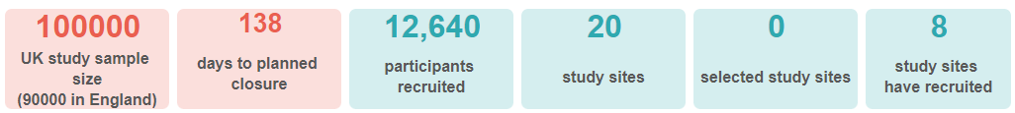
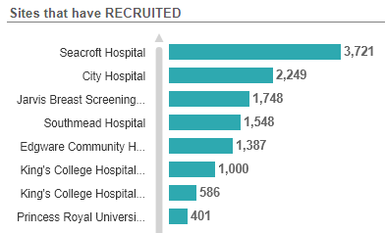
PROSPECTS CPMS ID: 33373
Prospective randomised trial of digital breast tomosynthesis (DBT) plus standard 2D digital mammography (2DDM) or synthetic 2D mammography (S 2D) compared to standard 2D digital mammography in breast cancer screening.
The aim of this trial is to measure the impact and cost-effectiveness of DBT + 2DDM or S 2D in routine screening compared to standard 2DDM.
Half the trial participants will undergo standard 2DDM (the control group) and half will undergo 2DDM + DBT (the intervention group).

Slide 8
NIHR ODP https://odp.nihr.ac.uk/
Open data platform. Data on performance and restart across whole CRN, including all specialty areas
NIHR Be Part of Research https://www.ukctg.nihr.ac.uk/
See which studies are open across the country
National Cancer Research Institute Portfolio Maps http://csg.ncri.org.uk/portfolio/portfolio-maps/
View current national portfolio of open, closed and ‘in set up’ cancer studies
Find a Clinical Research Study (ODP) http://csg.ncri.org.uk/portfolio/portfolio-maps/
Search for a study to fit criteria. Good for horizon scanning, eligibility criteria

Slide 9
Research Delivery Manager
claire.matthews@nihr.ac.uk
Research Portfolio Facilitator
To be appointed
Sub-specialty Lead
Mark Beresford

