Slide 1
NHSE Community Liver Surveillance Pilot Fiona Gordon Bristol & Severn Hepatitis C Operational Delivery Network

Slide 2
Why Liver Cancer?
NHS Long Term Plan Commitments
By 2028, the NHS will diagnose 75% of cancers at stage 1 or 2.
From 2028, 55,000 more people each year will survive their cancer for at least five years after diagnosis.
Primary risk factors are:
Cirrhosis caused by alcohol addiction or hepatitis
Fatty liver disease
Strong link with deprivation (including: homelessness, drug addiction, obesity).
NICE guidance recommends liver surveillance for those with cirrhosis and/or Hep B.
Notes:
~6,000 liver cancers per year
~50% increase in liver cancer rates over past decade
Around 1/3 diagnosed at an early stage (but poor staging data – 60% completeness)
Liver cancer survival:
Diagnosed at stage 1 – five year survival is 50-70%
Diagnosed at stage 4 – average survival is 4 months

Slide 3
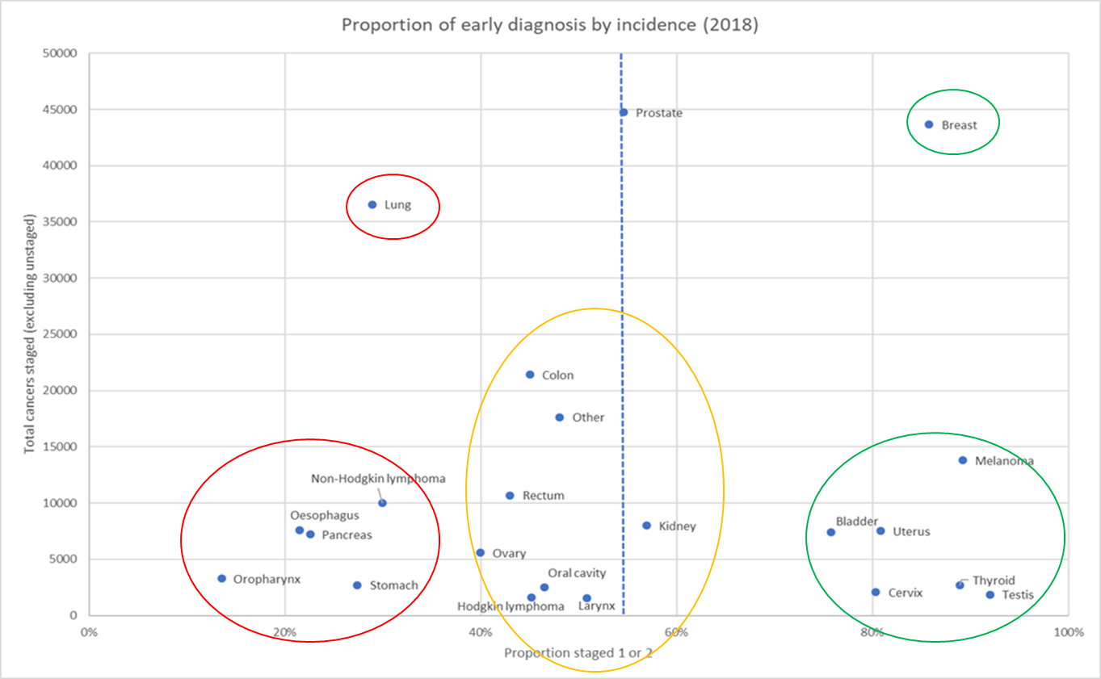
Why liver cancer?
Liver
Notes:
The ones in red are less common, but currently have really poor early diagnosis - so lots of ground to make up
And we need to move all cancers towards the 75% line if we're going to achieve our target

Slide 4
Proposed approach for 12 pilot sites
Funding through the HCV ODN structure
Liver fibrosis/cirrhosis case finding (via fibroscan) alongside Hep-C testing and treatment in addiction services/via community vans programme/among target population
Directly book patients into a liver clinic/US appointment for surveillance
Ongoing peer support/navigation provided to maintain patients in pathway ​ eg providing transport, text/call prompts, accompany some patients.
Pilot for 12 months from 1.4.2022 before considering wider rollout and continued funding – potentially to 2025
Notes:
Approach agreed by NCB earlier this month

Slide 5
Technical specifications
Proposed clinical model:
Fibroscans offered to all drug and alcohol support service users, patients in key unmet need areas (eg homeless health, diabetes, relevant ethnic groups (HBV) aged 35 – 75 with a history of:
More than 10 years of excess alcohol consumption or
Current or past viral hepatitis or
Non alcoholic fatty liver disease (NAFLD)
Service users with a fibroscan of >11.5 kPa or cirrhosis:
Referred into a liver surveillance pathway at their local secondary care centre
Supported to remain in the surveillance programme with peer and professional support
Offered an alpha-foetoprotein test (AFP) with those who return a positive test urgently referred on a 2 week wait pathway with support from peers/navigators to aid attendance
Notes:
Approach agreed by NCB earlier this month

Slide 6
Delivery Mechanisms
Peer support & pathway navigators
Peer support will be vital to both:
Converting a fibrosis/cirrhosis diagnosis into an attended surveillance appointment
Maintaining patients on the liver surveillance pathway for 6+ months
Aim to build on ODN expertise to make this work effective eg via mobile resources, links to support agencies, regular HCV screening events in key locations
Notes:
Approach agreed by NCB earlier this month

Slide 7
Success Measures for Pilots
Number of people fibroscanned
Number/proportion of people referred into liver surveillance pathway
Number/proportion of patients who attend their first surveillance appointment
Number/proportion of patients who attend their second surveillance appointment (after 6 months)
Number & stage of liver cancers diagnosed
Teams to report data monthly
Notes:
Approach agreed by NCB earlier this month

Slide 8
Bristol & Severn ODN pilot
Model based on existing structure for mobile-assisted outreach
Enhance access to Fibroscan to all at risk of liver disease through existing outreach pathways
Re-engagement of known cirrhosis patients lost to HCV and HCC surveillance clinics across region
Develop closer links for outreach into alcohol-dependency specific support locations eg Acer Unit Bristol, Serenita House W-S-M
Resources: additional fibroscanner(s), Co-ordinating nurse specialist(s), Local peer support/navigators for patient engagement, additional hours radiology time

Slide 9
How can SWAG help?
Ensure co-ordinated approach
Development more robust call-back methods for surveillance scans across region with radiology services – eg as per mammography. Help advise on how best to co-ordinate practically.
Help support a consistent approach to HCC surveillance across Bristol & Severn region – some parts this is patchy and patients are referred back to primary care to organise.
Advise on how best to engage patients in ‘life-long’ screening programmes
Help advocate for wider HCC surveillance ie requiring increased radiographer resource across region to support pilot
Be mindful of limited time-frame to deliver/recruitment constraints ie 12 months

