Slide 1
SWAG Network Hepato-pancreato-biliary (HPB) cancer
Clinical Advisory Group
Research Update - Claire Matthews & Sharath Gangadhara
25/03/2022

Slide 2
National Recruitment to Upper GI Cancer Studies
Apr 2020 - Mar 2022
Apr 2018 - Mar 2020
Data cut 25/03/2022
Source: ODP All Portfolio

Slide 3
National vs Regional Recruitment to Colorectal Cancer Studies
National Recruitment
West of England Recruitment
Data cut 25/03/2022
Source: ODP All Portfolio

Slide 4
West of England Open HPB Cancer Studies
CPMS ID | Short Name | Sites | Open | Closure | Sample Size Eng | Eng Recruits
42837 | UK-EDI: UK Early Detection Initiative for Pancreatic Cancer | Yeovil, NBT | 18/12/2020 | 01/07/2022 | 2200 | 18
39879 | TACE-3 | BHOC | 08/08/2019 | 31/12/2024 | 380 | 22
19234 | ABC-07 | BHOC | 16/11/2015 | 30/06/2022 | 83 | 69
45983 | Checkpoint inhibitor-induced liver injury study | Yeovil | 28/09/2020 | 01/09/2023 | 160 | 78
33836 | PHITT | BRHC | 25/08/2017 | 31/12/2021 | 64 | 85
36511 | PRIMUS 001 | BHOC/NBT | 28/11/2017 | 01/04/2022 | 300 | 127
37518 | PrecisionPanc | UHBW | 28/11/2017 | 28/10/2022 | 500 | 188

Slide 5
Advanced/Metastatic
Short Name | Sites | Opening date | Closure date | Sample Size England | England Recruits
TACE-3 A two-arm multi-stage (TAMS) seamless phase II/III randomised trial of nivolumab in combination with TACE for patients with intermediate stage HCC | BHOC | 08/08/2019 | 31/12/2024 | 380 | 22
ABC-07 Addition of stereotactic body radiotherapy (SBRT) to systemic chemotherapy in locally advanced biliary tract cancers | BHOC | 16/11/2015 | 30/06/2022 | 83 | 69
Paediatric Hepatic International Tumour Trial (PHITT) | BRHC | 25/08/2017 | 31/12/2021 | 64 | 85
PRIMUS 001: A Study Looking at Two Different Chemotherapy Regimens in Patients With Metastatic Pancreatic Cancer | BHOC/NBT | 28/11/2017 | 01/04/2022 | 300 | 127
PrecisionPanc | UHBW | 28/11/2017 | 28/10/2022 | 500 | 188

Slide 6
Other-Epidemiologic/Diagnostic/Genetic
Short Name | Sites | Opening date | Closure date | Sample Size England | England Recruits
UK-EDI: UK Early Detection Initiative for Pancreatic Cancer | Yeovil, NBT | 18/12/2020 | 01/07/2022 | 2200 | 18
Checkpoint Inhibitor-induced Liver Injury (ChILI) | Yeovil | 28/09/2020 | 01/09/2023 | 160 | 78

Slide 7
West of England In Setup HPB Cancer Studies 21/22
CPMS No. | Short Name | Sites | Planned Opening | Planned Closure | Sample Size Eng | Sample Size UK
47681 | NIS793 in combination with gemcitabine and nab-paclitaxel for mPDAC | UHBW | 31/05/2022 | 01/01/2026 | - | 10
45655 | FOENIX-CCA3 | UHBW | 10/03/2022 | 13/06/2024 | - | 6
43749 | PRIMUS 004 | UHBW | 31/05/2020 | 31/01/2021 | 30 | 80
National In Setup HPB Cancer Studies 21/22
CPMS Study ID | Short Name | Title | Planned Opening | Planned Closure | Sample Size Eng
51710 | Update of the EORTC QLQ-PAN26 | Update of the EORTC QLQ-PAN26 questionnaire for the assessment of health-related quality of life (HRQoL) in patients with pancreatic adenocarcinoma | 01/04/2022 | 30/09/2022 | 40
38580 | BBC | Phase II study of neoadjuvant cisplatin and gemcitabine chemotherapy versus upfront surgery in patients with resectable proximal biliary tract cancer: | 01/03/2019 | 15/06/2019 | 72

Slide 8
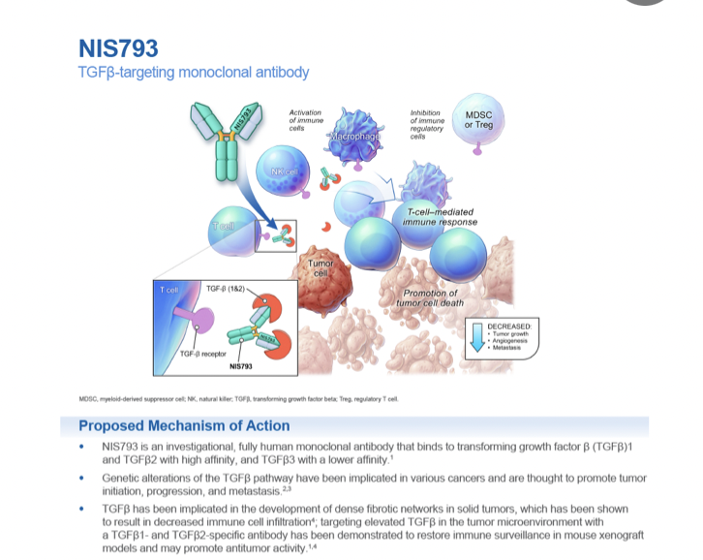
NIS793 in combination with gemcitabine and nab-paclitaxel for mPDAC

Slide 9
FOENIX-CCA3

Slide 10
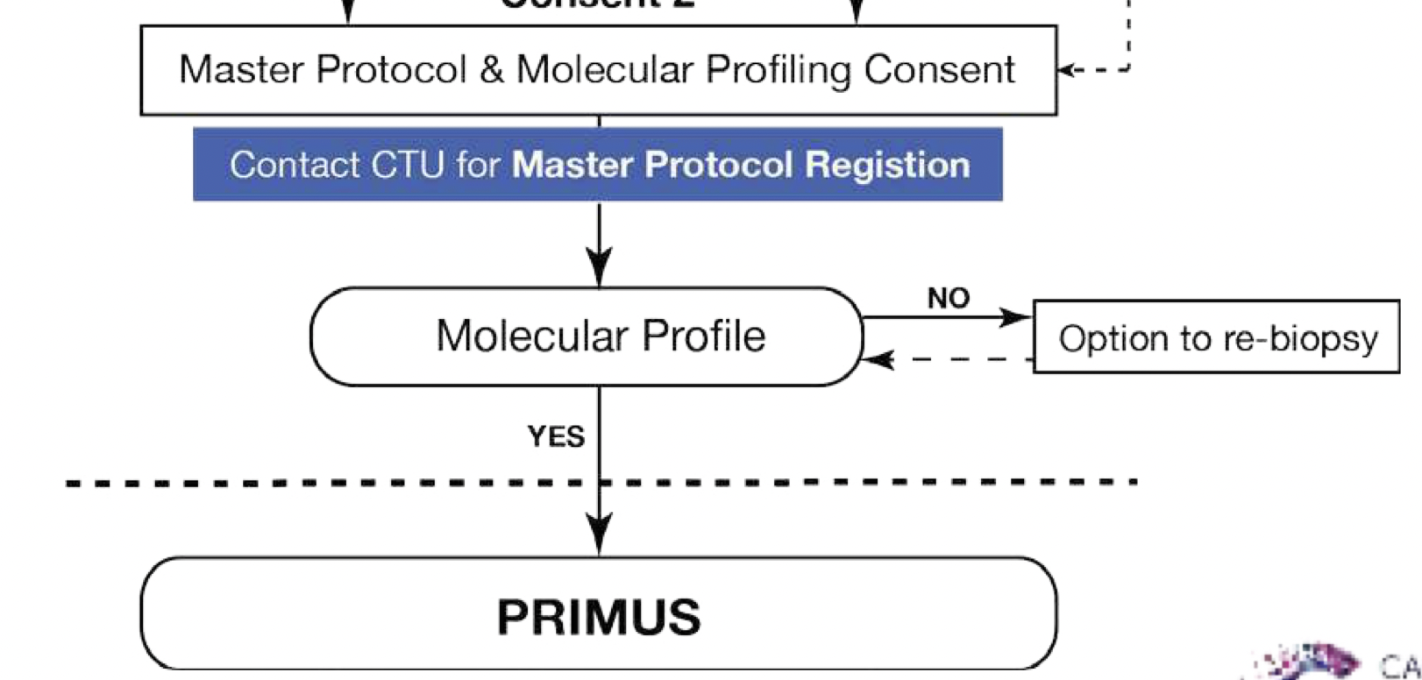

Slide 11
NIHR ODP https://odp.nihr.ac.uk/
Open data platform. Data on performance and restart across whole CRN, including all specialty areas
NIHR Be Part of Research https://www.ukctg.nihr.ac.uk/
See which studies are open across the country
National Cancer Research Institute Portfolio Maps http://csg.ncri.org.uk/portfolio/portfolio-maps/
View current national portfolio of open, closed and ‘in set up’ cancer studies
Find a Clinical Research Study (ODP) http://csg.ncri.org.uk/portfolio/portfolio-maps/
Search for a study to fit criteria. Good for horizon scanning, eligibility criteria

Slide 12
Research Delivery Manager
claire.matthews@nihr.ac.uk
Research Portfolio Facilitator
tbc
Sub-specialty Lead
Sharath Gangadhara

