Slide 1
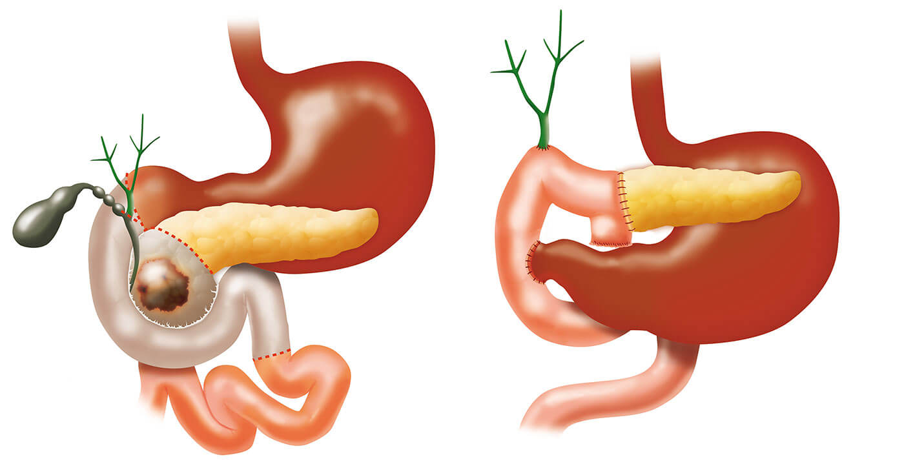
Fast-track Whipples
Andy Strickland
Consultant HPB and General Surgeon

Slide 2
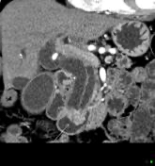
Standard Pathway
USS
CT for staging
Endoscopic drainage
MDT discussion
PET scan
Recovery from Jaundice
Clinic Assessment
POAC
Date for Surgery allocated
THIS CAN TAKE AN OVERLY LONG TIME

Slide 3
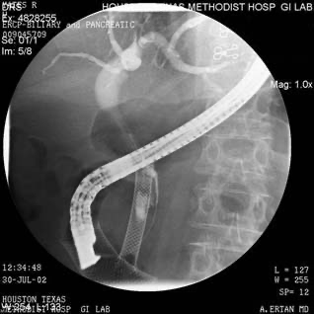
Rationale for Biliary Drainage Pathway
Jaundice nephrotoxic/clotting probs
Drainage provides symptom relief
Diagnosis can be obtained
Clinical/POAC assessment of fitness
Nutritional Interventions
Diabetic control
Interventions for fitness instituted
Pre op Investigations
Elective surgery listing

Slide 4
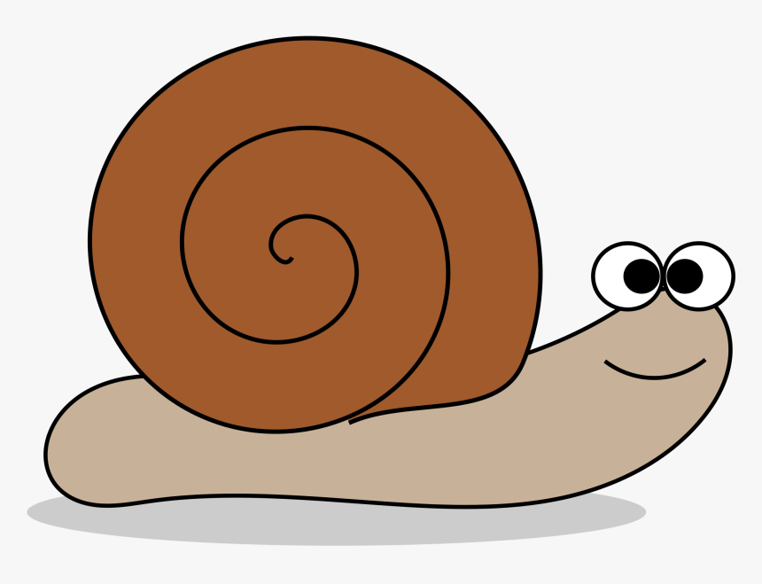
Standard Biliary Drainage Pathway:- Problems
Endoscopy complications-pancreatitis/perforation/bleeding/cholangitis
Repeat Endoscopic procedures required/PTC for unstentable patients
Delays to definitive surgery progression to unresectable disease
Surgery more challenging-Increased haemorrhage, Increased POPF risk
THERE WILL ALWAYS BE THE NEED FOR PRE-OP BILIARY DRAINGE IN SOME PATIENTS……
HOWEVER ARE WE IMPEDING PROGRESS THROUGH OUR SYSTEM PATIENTS WHO COULD HAVE UNDRAINED SURGERY?

Slide 5
Unstented whipple trials
PBD complications in 46% pts 2% in ES
Cholangitis (27/47)
Pancreatitis (7)
Perforation (2)
Haemorrhage (2)
Need for stent exchange (31)
Dutch trial NEJM 2010
202 panc/periamp ca
Bilirubin. 40-250umol/l
Randomised to PBD or early surgery
1ry outcomes
Serious complications (in 120 days)
2ndry Outcomes
Death/LOS
Complications Post op
ES 35% PBD 48% HIGHLY SIGNIFICANT
Panc fistula- no difference
LOS- 2 days longer in PBD group
Death No difference
() patient numbers

Slide 6
ES vs PBD for Patients undergoing whipples
BUT……
THIS STUDY USED PLASTIC BILIARY STENTS

Slide 7
Question: Would the use of metal biliary stents improve the outcome for PBD patients?

Slide 8
Metal v Plastic stents
A- Reintervention
B- Pre op complications
C- Pancreatitis
D- Cholangitis
Much increased risk of pancreatitis

Slide 9
What does that Odds Ratio of 3.6 mean?
The odds of having pancreatitis following ERCP is 3.6 times higher if the patient underwent stenting with metal as opposed to a plastic stent
What other problems occur with PBD?

Slide 10
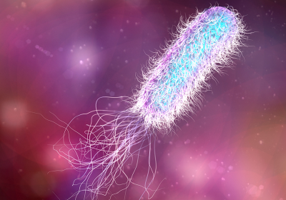
Introduction- Gut Microbiome
Gut organisms form a microbiome^{11,17}
Digestion, Epithelial mucosal barrier, immune resistance¹⁸
Alverdy et al ^{18,19}- Enterococcus faecalis colonised intestinal anastomoses predisposed to leak
Bile is physiologically sterile
Biliary instrumentation (ERCP) disrupts natural barrier between GI & biliary systems
Post-PD organisms similar in pancreatic, bile, jejunal & faecal samples²⁵
Post-PD bile cultures match infectious sources in >50%⁶

Slide 11
BRI- Demographics
4 years: Jan 2014-Dec17
Abx prophylaxis: 81% Amox(Teic)/Met/Gent
114 consecutive pts
55% male
Median age 67 yrs
Median BMI 25
Median LoS 13 days
65% ERCP
Median duct diameter 3mm
56% soft pancreas
%

Slide 12
BRI- Microbiome
Bacterobilia 70% (80/114)
24% Resistant
76% Sensitive
Better coverage with Amox/Met/Gent
N

Slide 13
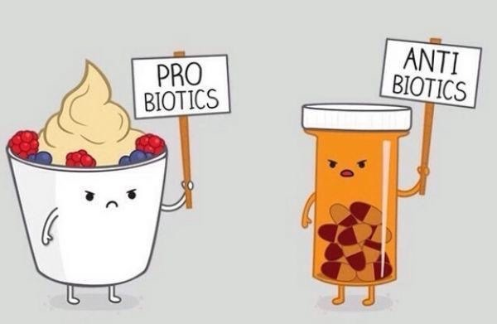
Discussion & Conclusions
+ve biliary swabs associated with poor outcomes
Major complications
SSI/DSI
?POPF?
Specific bacteria associated with major & septic complications
?Abx?
Pre-op Abx not providing complete cover (?Import?)
Consider broadening/extending pre-op Abx (Enterococcus/Streptococcus)
Patients with sterile bile had lowest risk of post-op complications
Reducing rates of bacterobilia, such as avoiding/limiting biliary instrumentation, is crucial

Slide 14
Birmingham experience
Began August 2015
Funding from PCUK
For dedicated nurse
To study barriers/enablers to implementation
Roadshow at each local MDT at the project launch
Kept one operating list empty per week
Anaesthetists involved from the start
Colleagues supportive

Slide 15
Birmingham fast track pathway
Referral
Timescale
Central review of CT + patients case/history
Within 24 hours
Schedule:
MDT review
Surgical clinic
Anaesthetic clinic
Theatre date
CNS calls patient
Oral vit K
Implement nutrition pathway***
Provide patient information
Anticipate need for EUS
or MRI + arrange
Unsuitable for ‘fast track’ pathway*
Suitable for ‘fast track’ pathway**
Biliary drainage + review at central MDT
Review at central MDT (Thursday)
Within 7 days
See in clinic (Friday both clinics)
Within 8 days
Admit day before surgery for IV fluids
Surgery
Within 15 days

Slide 16
Lessons learnt
65 DAYS
Its not about the operation….
Communication is key – CNS to CNS
BILIRUBIN LEVELS INCREASE AT APPROX
100umol/l PER WEEK
16 DAYS

Slide 17
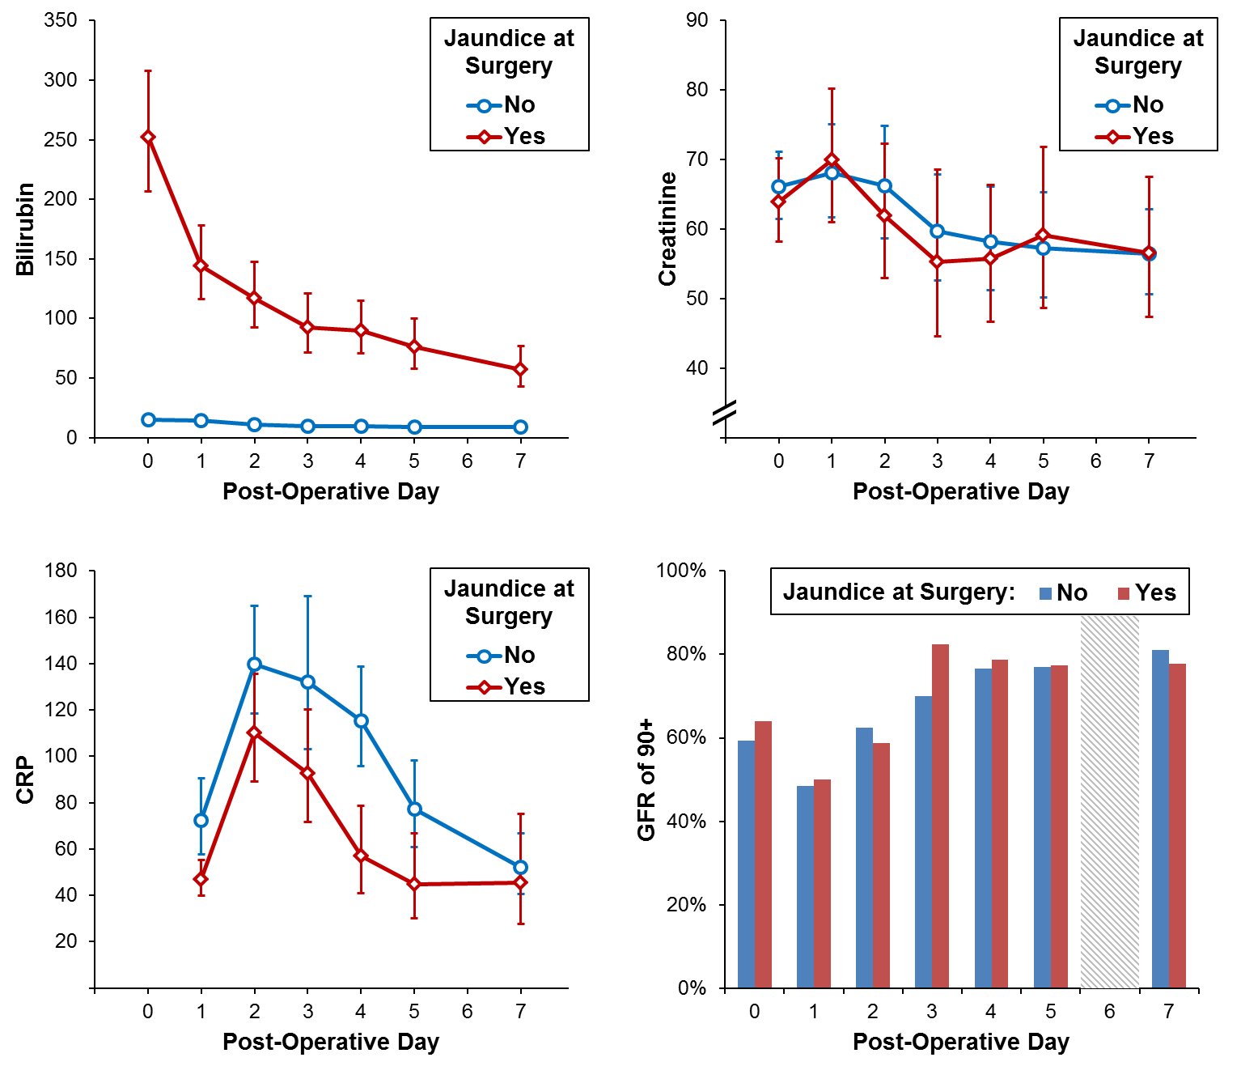
Lessons learnt
 | Jaundice at Time of Surgery
 | No (N=64) | Yes (N=36) | p-Value
Length of Stay | 9 (7 – 12) | 7 (6 – 13) | 0.629
Any Complication | 26 (41%) | 16 (44%) | 0.833
Vascular Repair Specific Complication | 2 (3%) | 0 (0%) | 0.535
Comprehensive Complication Index | 11.4 | 14.8 | 0.450
Its not about the operation….
Communication is key – CNS to CNS
PD is a good treatment for obstructive jaundice
Its Safe

Slide 18
Fast track surgery pilot: first 21 months
Patients undergoing attempted pancreaticoduodenectomy
n= 245
Patients unsuitable for fast track at referral
n=86
Pre-operative biliary drainage
n= 95
Fast track
n=64
No jaundice n=66
Downstaging chemo n=13
Emergency transfer n=5
Not fit for surgery n=1
2nd opinion other centre n=1
PBD prior to referral n= 87
Logistic delays n=3 *
High bilirubin n=5 *
Thus 96% (64/67) patients proceeded successfully down the pathway

Slide 19
Recent fast track experience-can we do this?
Most Recent Fast Track Patient
Day 1-CT Scan
Day 5 Phone call to HPB Con O/C
Initial Review of CT in 24 hrs
Day 7 Clinic App/CNS contact
Day 7, 1 stop POAC
Day 8, MDT discussion
Day 12 Surgery
Day 20 Home post Whipples Pancreaticoduodenectomy

Slide 20
Fast Track Whipples at BRI since 2020
9 Patients 9/55, 16% of all whipples
Bilirubin at surgery 37-373 median 219
CT scan to surgery 5-62 median 12 days
LOS 8-82 median 13
Pancreatic fistula 2 of 9 (1 home with drain on day 16)

Slide 21
Thanks- any questions?

