Slide 1
Borderline Resectable Pancreatic Ductal Adenocarcinoma- A discussion of the evidence & UHBW results
James Skipworth
HPB Surgeon, UHBW
HPB MDT Away Day
March 25, 2022

Slide 2
Contents
Evidence & Criteria for borderline resectable pancreas cancer
Literature
Local
UHBW BR-PDAC
Pathway
Results to date

Slide 3
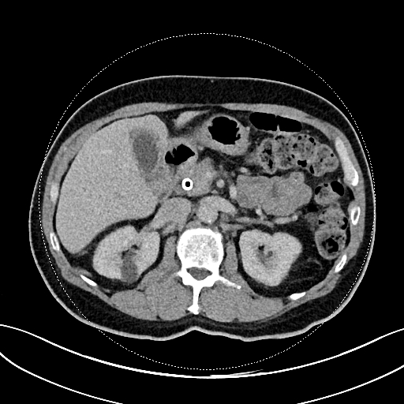
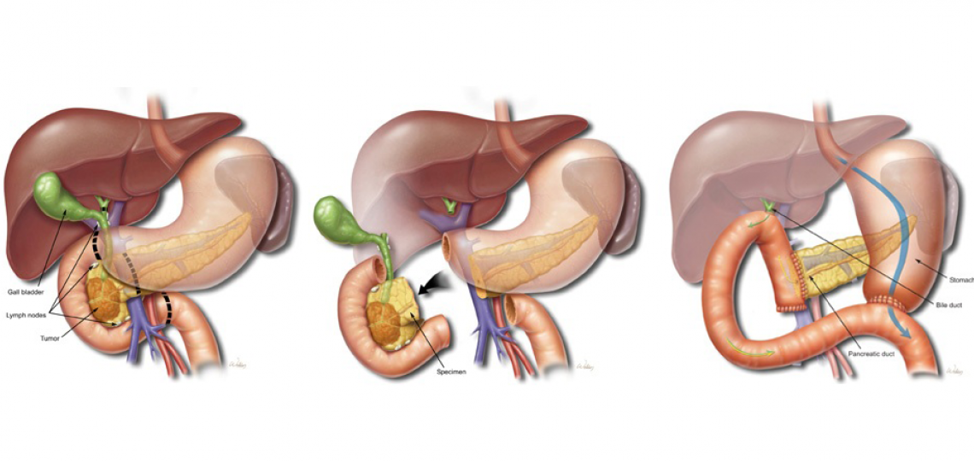
Background
Current PDAC optimal treatment- Resection + adjuvant chemotherapy
50-60% of patients who undergo resection receive adjuvant chemotherapy
R1 resection rate is about 50%
25% of patients will develop disease recurrence within 6 months

Slide 4
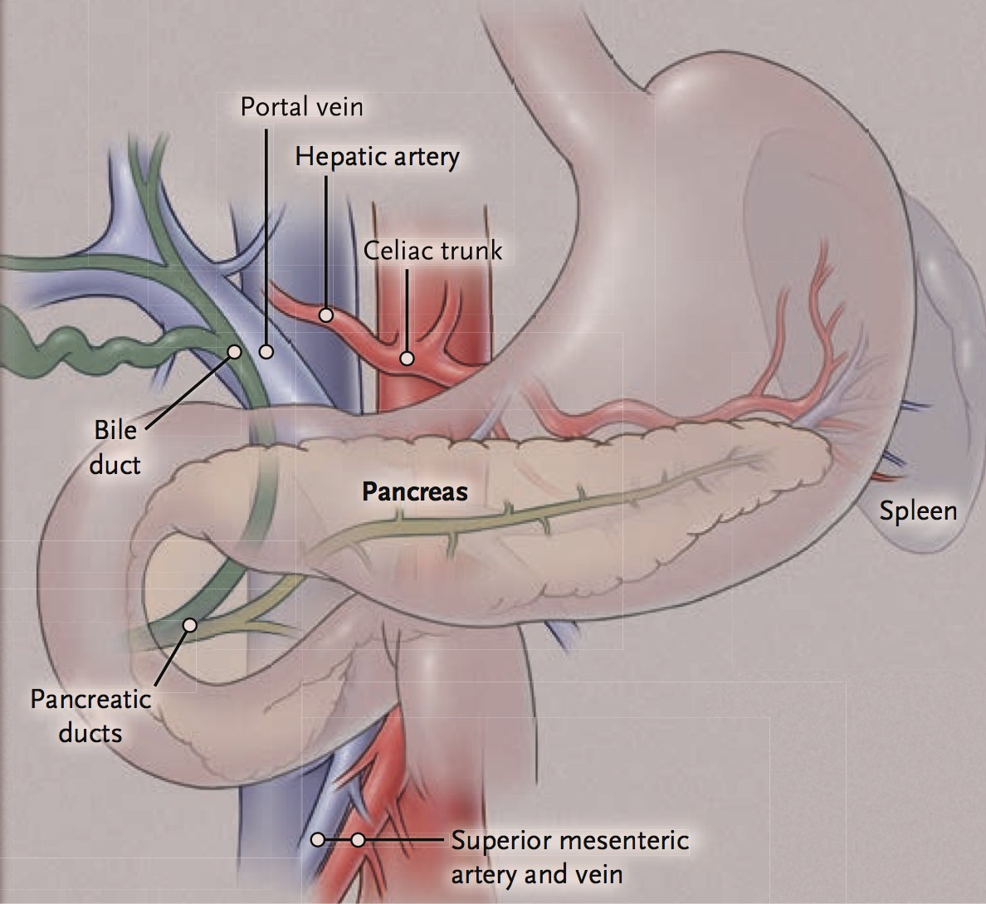
‘RESECTABLE’
No vein/artery involvement
Venous involvement
Venous encasement
Arterial involvement
Arterial encasement
Distant metastases
‘UNRESECTABLE’
Clinical Staging
Stage | Treatment
Resectable (20%) | Surgery + Adjuvant Chemotherapy
Borderline Resectable/Locally Advanced (40%) | Neoadjuvant Chemotherapy +/- Radiotherapy
Metastatic (40%) | Palliative Chemotherapy
Ryan et al. N Eng J Med 2014

Slide 5
Borderline Resectable Pancreas Cancer
 | NCCN | AHPBA/SSO/SSAT | MDACC* | Toronto
Venous | Solid tumour contact with the SMV or PV of >180°or contact of < 180° with contour irregularity of the vein or thrombosis with suitable vein proximal and distal for reconstruction | Tumor associated deformity of PV SMV/PV abutment >Short segment occlusion of SMV/PV | 1. Occlusion of SMV/PV with patent SMV or PV below and above | Any PV/SMV involvement = Resectable
Celiac Artery | Solid tumour contact <180° | No abutment or encasement | Abutment | Reconstruction of left and right HA possible
Common Hepatic Artery | Solid tumour contact without extension to celiac axis or hepatic artery bifurcation allowing safe and complete resection and reconstruction | Short segment abutment or encasement amenable to reconstruction | Abutment or short segment encasement | No involvement of bifurcation
SMA | Solid tumour contact <180° or involvement of aberrant hepatic artery | Abutment < 180° | Abutment < 180° | Proximal to middle colic artery
*MDACC Type A only. B: suspicion for N1 or metatastic disease, C: poor performance status
Abrams et al., Ann Surg Oncol, 2009; Katz et al., J Am Coll Surg, 2008; NCCN; Kim et al, Brit J Surg, 2013
Notes:
National Caomprehensive Cancer netowrk- USA/ 31 institutions not for profit
MD Anderson Cancer Centre
NICE- NA only as part of a trial

Slide 6
PREOPANC Trial
Upfront surgery(N=127) vs. Pre-op chemorad(N=119)
Pre-op chemorad
3 cycles Gem; 2nd cycle with RT
Surgery + Adj chemo (4 cycles Gem)
Upfront surgery
Adj chemo (6 cycles Gem)
Results
Resection rate: 61% vs. 72% (P=0.058)
R0 Rate: 72% vs. 40% (P<0.001)
Survival: 35.2 vs. 19.8 months (P=0.029)
Versteijne et al., J Clin Oncol 38:1763-1773,2020
Notes:
Locoregional failure free interval
Distant metastasis fre interval

Slide 7
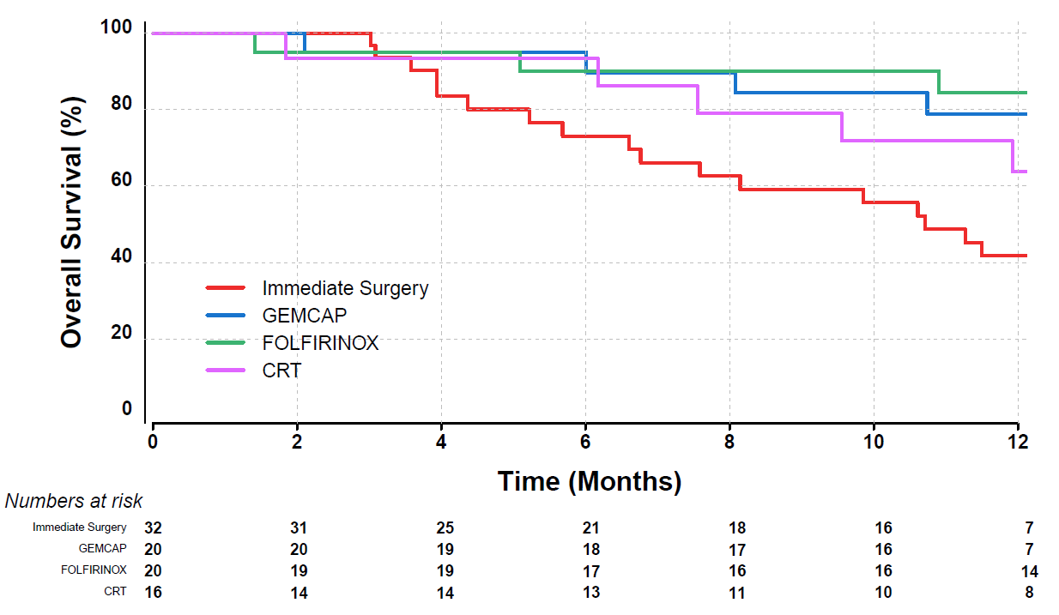
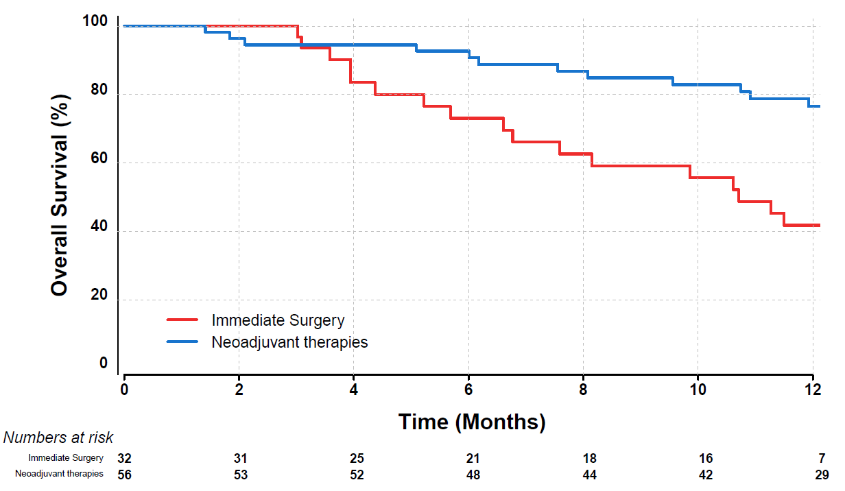
Neoadjuvant Therapy for BR-PDAC: FOLFIRINOX
Systematic Review
24 studies
8 prospective / 16 retrospective
313 pts
Resection: 67.8%
R0: 83.9%*
ESPAC-5F (BR-PDAC)
Surgery vs. NA GEMCAP / FOLFIRINOX / CRT
Resection Rate: 62% surgery vs. 55% NA
R0: 15% surgery vs. 23% NA
1-Yr survival: 40% surgery vs. 77% NA
Janssen et al., JNCI Natl Cancer Inst 2019
*Mixed definition
Ghaneh et al, JCO 2020

Slide 8
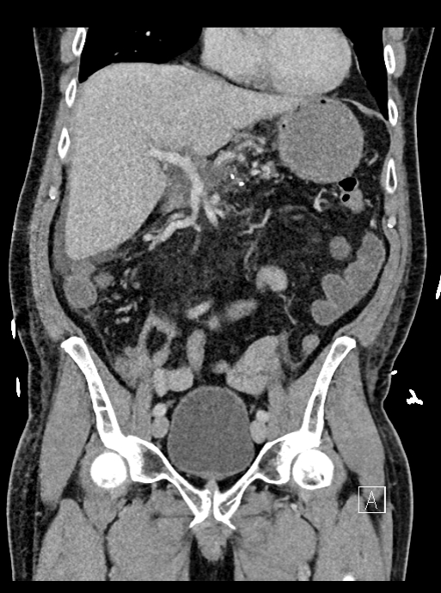
Neoadjuvant therapy recommended for BR-PDAC
Rationale
>80% have occult metastatic disease at presentation
Treat systemic disease with neoadjuvant chemotherapy
Patient selection
Assess tumour biology via test of time
Help avoid unnecessary operations
Abrams et al. Ann Surg Oncol 2009; 16:1751-1756

Slide 9
Response after NA-Chemo
Biologic response
- CA19-9 normalisation after NA-CRT predicts L-T survival
Radiologic response
- CT downstaging not always possible or required
Not always correlate with pathologic response
Lack of radiologic response does not preclude resection
77% of patients without radiographic response R0
Xia et al., J Surg Oncol 2017; Truty et al., Ann Surg 2019
NCCN Guidelines 2021
Operative exploration of BR-PDAC
- CA 19-9 stable or lower
- No clear progression on imaging
Tsai et al., Ann Surg 2020; NCCN 2021

Slide 10
Surgical Resection for BR-PDAC
Goals
1. Margin negative resection
2. Safe resection
3. Comparable/Improved long-term outcomes

Slide 11
Margins: Does the Vein Need to be Resected?
Study | N | Histologic Vein invasion | Effect on Survival
Tseng et al., 2004 | 62 | 38 (61%) | No
Al-Haddad., 2007 | 22 | 14 (64%) | NA
Kim et al., 2013 | 47 | 28 (60%) | Yes
Kaneoka et al., 2009 | 42 | 25 (60%) | Yes
Riediger et al., 2006 | 42 | 25 (60%) | NA
Wang et al., 2012 | 85 | 57 (67%) | Yes
Operatively difficult to determine invasion vs. desmoplastic reaction
High rate of histologic vein invasion
Need to resect vein to achieve R0
“Peeling” vein away to minimize PV resection goes against surg-onc principles

Slide 12
Surgical Resection
- Margins

Slide 13
Surgical Resection- Margins

Slide 14
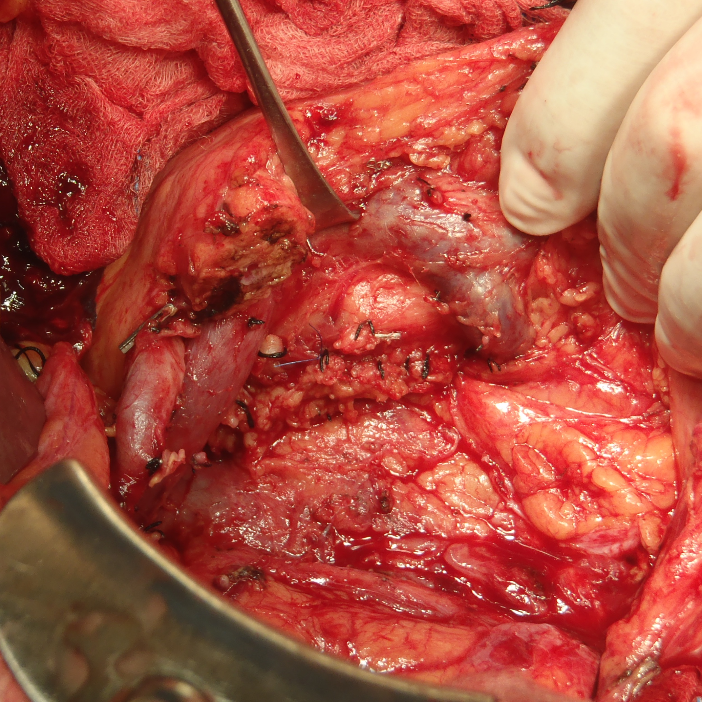
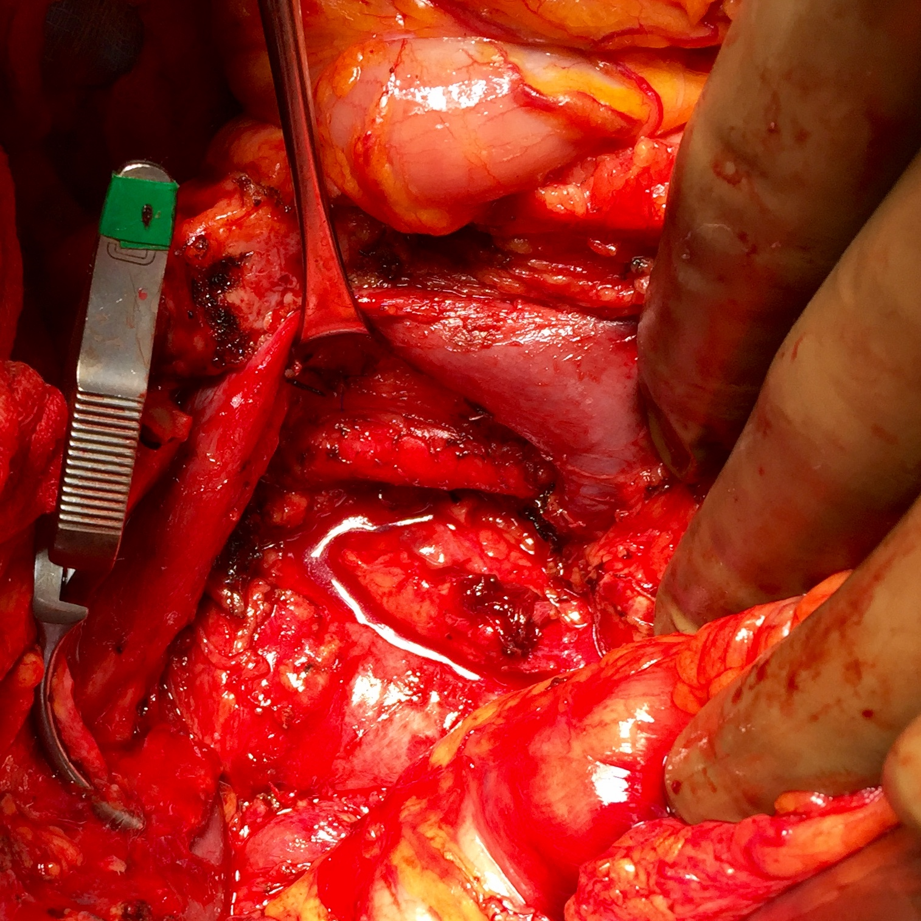
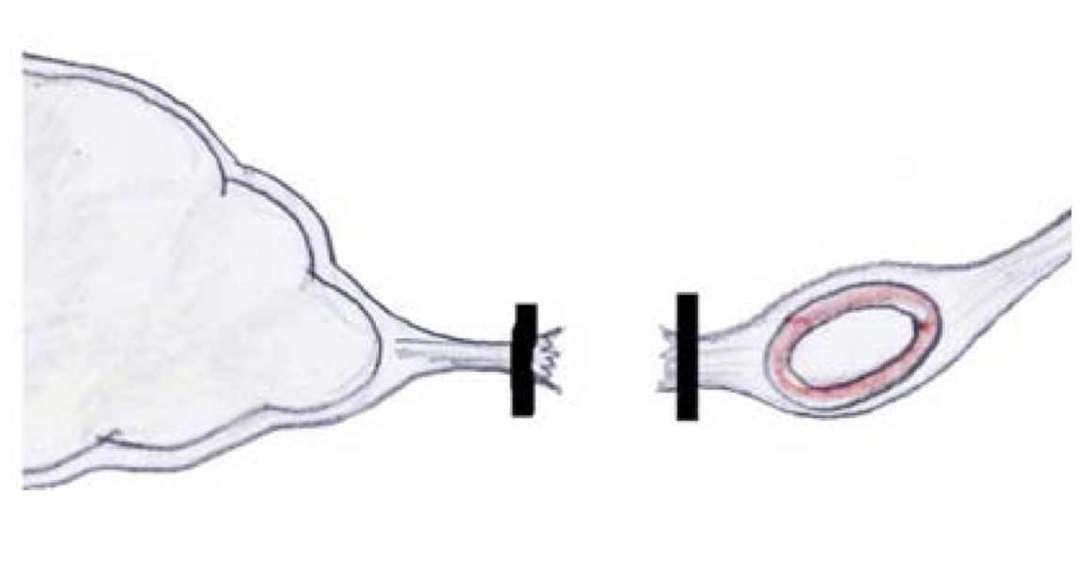
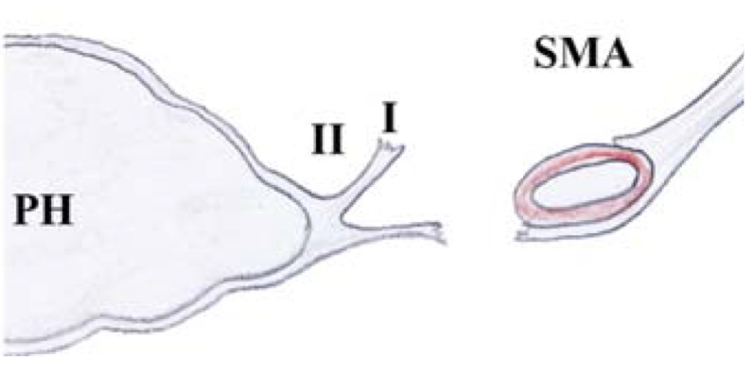
PV
PV
SMA
SMA
SMV
Uncinate or SMA margin
SMV
Uncinate or SMA margin

Slide 15
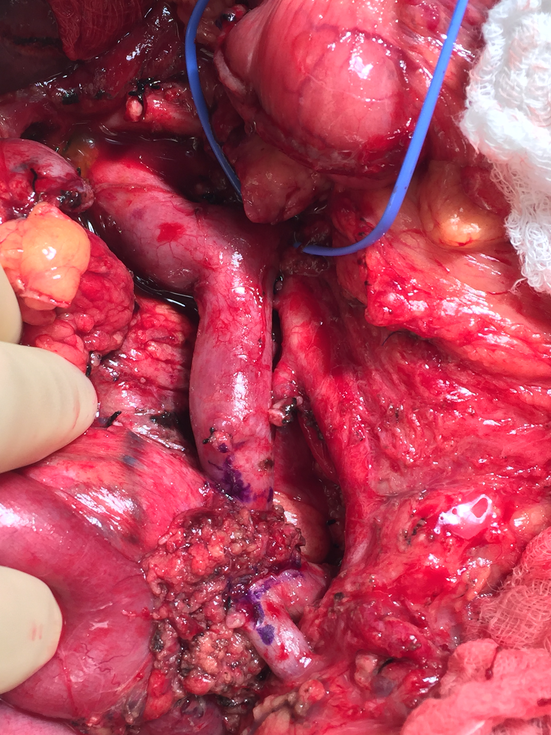
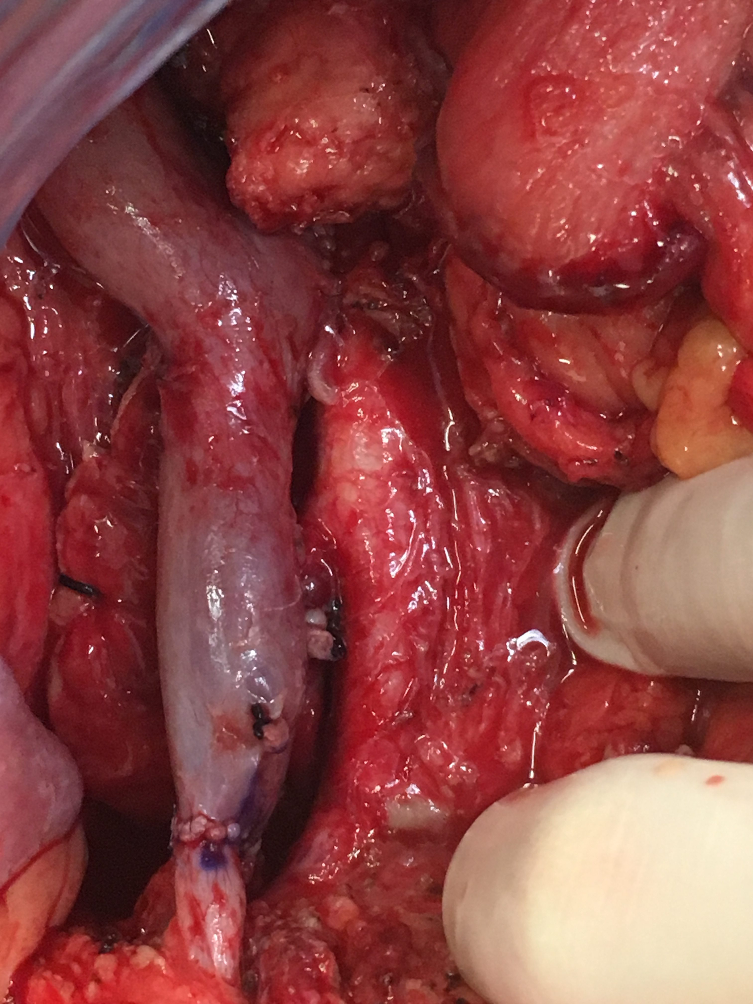
Margins: True R1 vs. Retraction?
Resection
Reconstruction
PV
SV
PV
SV
SMV
SMA
SMV
SMA
Tumor
Middle colic
Positive vein margin: retraction of the vein into tumor with formalin
R1 Rate: 18.5% (no VR) vs. 38% (VR)
Pathology: Margin = Survival

Slide 16
Margins: Path Processing
Addition of another dimension to path specimen with PV resection
No one believes surgeon, 50% believe radiologist, 100% believe pathologist
Accurate path reporting of Whipple specimen is part surgeon’s responsibility
Rad/Surg/Path correlation is crucial
Send separate margins for PV & SMV

Slide 17
Vascular Resections in PD: Safety
Vascular resections with PD
May have higher blood loss and longer operative time
May have lower pancreatic fistula rate (15% vs. 9.5%, P=0.004)
In experienced centers, no increase in mortality
Delpero et al., Ann Surg Oncol 2015
Study | Survival (months) | Morbidity | Mortality
Tseng et al., 2004 | PD: 27 VR: 23 (P=0.18) | PD: 22% VR: 18% | PD: 1% VR: 1%
Yekebas et al., 2008 | Similar | PD: 40% VR: 40% | PD: 4% VR: 3.7%
Al-Haddad et al., 2007 | PD: 25%* VR: 20% | NA | PD: 0% VR: 0%
Kaneoka et al., 2009 | PD: 26** VR: 20 | PD: 43% VR: 33% | PD: 0% VR: 4.8%
Riediger et al., 2006¶ | PD: 16.6% VR: 10.9% | PD: 50% VR: 42% | PD: 4% VR: 4%
*5 year survival
** R0 dependent
¶mixed tumors
Tseng et al., J Gastrointest Surg 2004; Yekebas et al., Ann Surg 2008; Al-Haddad et al., J Gastrointest Surg 2007

Slide 18
BR-PDAC Resection: Long-Term Outcomes
Portal Vein Resection in Borderline Resectable Pancreatic Cancer: A UK Multicenter Study. Ravikumar et al on behalf of UK Vascular Resection in Pancreatic Cancer Study Group. J Am Coll Surg 2014
Notes:
RESULTS: One thousand five hundred and eighty-eight patients underwent surgery for borderline resectable pancreatic cancer; 840 PD, 230 PDVR, and 518 SB. Of 230 PDVR patients, 129 had primary closure (56%), 65 had end to end anastomosis (28%), and 36 had interposition grafts (16%). Both resection groups had greater complication rates than the bypass group, but with no difference between PD and PDVR. In-hospital mortality was similar across all 3 surgical groups. Median survival was 18 months for PD, 18.2 months for PDVR, and 8 months for SB (p ¼ 0.0001).
CONCLUSIONS: This study, the second largest to date on borderline resectable pancreatic cancer, demonstrates no significant difference in perioperative mortality in the 3 groups and a similar overall survival between PD and PDVR; significantly better compared with SB. (J Am Coll Surg 2014;218: 401e411. 2014 by the American College of Surgeons)
This is the only study specifically related to borderline resectable pancreatic adenocarcinoma comparing PD, PDVR, and SB. We have demonstrated PDVR to be as safe as PD with similar morbidity rates. More importantly, we have demonstrated that patients having a vein resection have a prognosis identical to PD, and significantly greater than SB, irrespective of tumor size and resection margin status. We believe that isolated involvement of the portomesenteric axis is not a contraindication to resection with a curative intent and should be routinely offered to patients with borderline resectable pancreatic cancer treated in high-volume specialized centers.

Slide 19
Summary
BR-PDAC pts are recommended to be treated with neoadjuvant chemo followed by surgery
Radiologic stability + biologic response are recommended prior to proceeding with resection
Pancreatectomy techniques have evolved to achieve safe venous resections

Slide 20
UHBW BR-PDAC Pathway
Pathway developed 2020
UHBW Definition of BR-PDAC
Radiological
Evidence of pancreatic cancer- mass in pancreas
No distant or loco-regional organ or lymph node metastases
No involvement of Common Hepatic, Coeliac or Superior Mesenteric arteries, aorta or vena cava
2cm or less contact/contour irregularity of PV/SMV without jejunal tributary involvement
Pathological
Confirmation of PDAC
Physiological
Age 75 years or less
ECOG performance status (PS) 0 or 1
Normal liver function tests
No prohibitive co-morbidities e.g. renal failure, significant cardio-respiratory disease etc

Slide 21
Referral to Central HPB MDT
- Diagnosis of BR-PDAC
Time point: 0
Local Oncology Review
- Neo-Adjuvant Chemotherapy
- 6 Cycles FOLFIRINOX
2-4 Weeks
MDT Review of post NA-Chemo CT
- Enlarged tumour or distant mets
- No Longer Resectable
Approx. 3 Months
MDT Review of post NA-Chemo CT
- Unchanged/smaller
tumor and no distant mets
- Resectable
Approx. 3 Months
Surgical Review
- Counselling/Consent
- Plan Op Date
Within 7 Days of MDT
Oncology Review
- Ongoing Palliative Therapies
Radical Pancreatic Resection
with Venous Resection
4 Weeks >Last Chemo Cycle
UHBW BR-PDAC
Pathway

Slide 22
UHBW BR-PDAC Pathway
9x Whipple with SMV/PV resection over 12 months
Up-front surgery; N= 5
Reconstruction
1x Segmental & End to End
1x Wedge & Graft
3x Wedge & Primary closure
Path
R0x 1 / R1x 4
N0x2 / N1x1 / N2x2
Complications
0x vein-related complications
0x Pancreatic Leak
0x 30-day and 90-day Mortality
Post NA Chemo; N= 4
Resection & Reconstruction
All segmental & End to End
Path
2x R0 / 2x R1
3x N0 /1x N2
Complications
0x vein-related complications
0x Pancreatic leaks
0x 30-day and 90-day Mortality
3x Unresectable
2x Cis-Gem (1x Locally unresectable and 1x Liver mets)
1x FOLFIRINOX (Liver Mets)

Slide 23
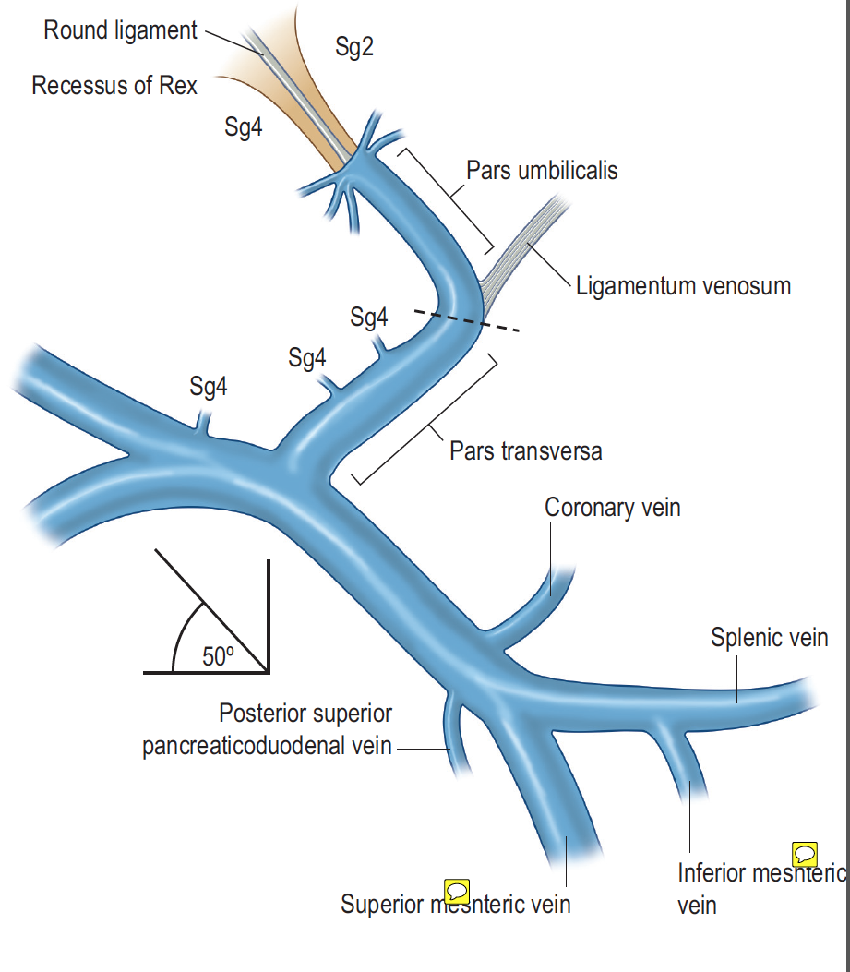
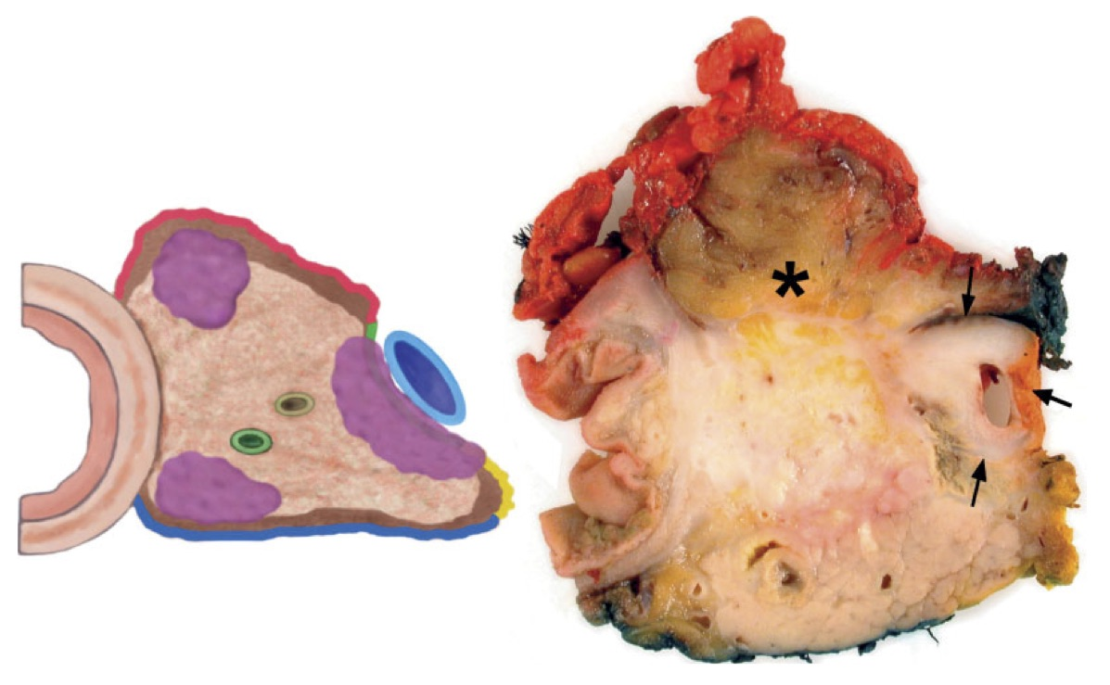
UHBW Conclusions
FOLFIRINOX
Pre-op radiological-surgical staging
Quality of pre-op imaging
Post-op pathological-surgical correlation
PD with Vascular resection safe at UHBW

Slide 24
Thankyou
Questions

