Slide 1
SWAG Network Skin Cancer
Clinical Advisory Group
Research Update
Claire Matthews
09/02/2022

Slide 2
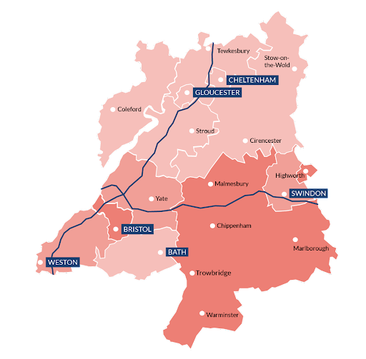
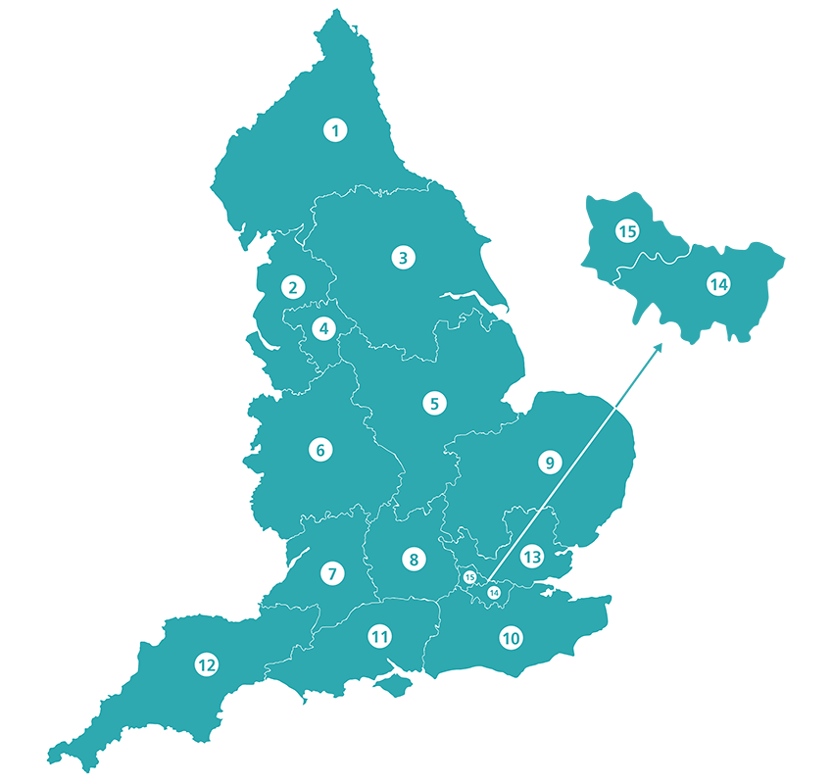
SWAG vs CRN regions
SWAG Region Trusts
Gloucestershire Hospitals NHS Foundation Trust
North Bristol NHS Trust
Royal United Hospitals Bath
University Hospitals Bristol & Weston NHS Foundation Trust
CRN West of England
Yeovil District Hospital NHS Foundation Trust
Somerset NHS Foundation Trust
CRN South West Peninsula
CRN Wessex
Salisbury NHS Foundation Trust
No data for Salisbury available for this meeting

Slide 3
National Recruitment to Skin Cancer Studies
Apr 2020 - Feb 2022
Pre-Pandemic:
Apr 2018
- Mar 2020
Data cut 02/02/2022
Source: ODP All Portfolio

Slide 4
National vs Regional Recruitment to Skin Cancer Studies Apr 2019 - Feb 22
National Recruitment
West of England Recruitment
Data cut 02/02/2022
Source: ODP All Portfolio

Slide 5
SWAG region Open Skin Cancer Studies 21/22
CPMS ID | Commercial Study | Short Name | Sites | Open | Closure | Sample Size Eng | England Recruits
47497 | Non-Comm | EPIC Trial (penile cancer) | BHOC (1/4) | 23/08/21 | 31/03/23 | 37 | 4
46315 | Comm | irAEs in patients with melanoma/RCC receiving nivolumab/ipilimumab | CGH (41/30) | 19/10/21 | 31/12/21 | 200 | 81
44182 | Comm | UV1-202 | BHOC (2/5) | 01/12/20 | 31/05/22 | 30 | 14
44146 | Non-Comm | Melanoma Wide Excision Trial - MelMarT-II | NBT (0/24) | 18/08/20 | 28/02/25 | 750 | 41
43756 | Non-Comm | MITRE | SFT, BHOC (0/28), RUH (3/33) | 08/07/20 | 31/01/25 | 1296 | 61
41173 | Comm | Cancer-0456/0232-Regeneron | BHOC (2/3) | 24/12/19 | 30/06/23 | 21 | 2
38748 | Comm | Observational Study of Melanoma Patients Treated with IMLYGIC® | GRH (11/4) | 22/01/19 | 31/12/21 | 5 | 18
37867 | Non-Comm | The PRIMM Study | BHOC (0) | 02/08/18 | 02/05/23 | 410 | 145
20657 | Non-Comm | Minitub (EORTC 1208) | NBT (0) | 29/04/16 | 31/10/22 | 50 | 114
35180 | Non-Comm | DANTE (Duration of Anti-PD1 therapy for melanoma) | CGH (2/12) | 03/09/18 | 28/02/23 | 4538 | 89
46063 | Comm | PROPHETIC | CGH (20/20) | 04/06/21 | 01/09/22 | 167 | 33
36774 | Non-Comm | Long and Short-Term effects of Standard-of-Care treatments for Cancer | NBT (0/25) | 13/05/20 | 01/12/22 | 250 | 64
15941 | Non-Comm | NIHR BioResource - Rare Diseases | UHBW (325), NBT (25), RUH (41) | 13/09/12 | 31/03/22 | 22000 | 13,218
Data cut 02/02/2022
Source: ODP All Portfolio

Slide 6
SWAG region In Setup Skin Cancer Studies 21/22
CPMS No. | Short Name | Sites | PI | Planned Opening | Planned Closure | Sample Size England | Sample Size UK
50777 | HBI-8000 with Nivolumab v Placebo with Nivolumab | BHOC | Chris Herbert | 14/02/2022 | 23/04/2023 | - | 11
49858 | CA224-098: Adjuvant Immunotherapy Combo vs Mono after Complete Resection of Stage III-IV Melanoma | BHOC | Chris Herbert | 21/11/2021 | 15/12/2023 | - | 40
51482 | REACT-CEMI | BHOC | Amarnath Challapalli | 01/02/2022 | 13/02/2023 | - | 100
50169 | A multi-arm phase II basket protocol testing reduced intensity immunotherapy across different cancers (REFINE) | YEO | Duncan Gilbert | 04/01/2022 | 03/07/2023 | 882 | 1082
National In Setup Skin Cancer Studies 21/22, open to new sites
CPMS No. | Short Name | Lead LCRN | CI | Planned Opening | Planned Closure | Sample Size England | Sample Size UK
48994 | Circulating tumour DNA guidEd Therapy for stage IIB/C mElanoma after surgiCal resecTION (DETECTION) | Greater Manchester | Paul Lorigan | 01/07/2021 | 31/03/2026 | 990 | 1050
Data cut 03/02/2022
Source: ODP All Portfolio

Slide 7
CRN High Level Objectives (HLOs) 21/22
46315: irAEs in patients with melanoma/RCC receiving nivolumab/ipilimumab
81 recruited in UK, planned end date 31/12/2021 - extension? Site in Cheltenham recruiting well
39566: NKTR-214 and Nivolumab in melanoma patients.
Closed - PASS. Site in MPH
None in scope

Slide 8
Managed Recovery Studies - Skin Cancer
Managed Recovery studies have been selected by the funder as important studies to complete.
They are the basis of two of our Efficient Study Delivery metrics
No open MR studies in SWAG region
CPMS Study ID | Commercial Study | Short Name | Status | Planned / Actual Opening | Planned / Actual Closure | Sample Size England | England Recruits
46501 | Non-Commercial | IMM60 & pembrolizumab in Melanoma and NSCLC | Open, With Recruitment | 01/06/2021 | 30/07/2022 | 12 | 4
39566 | Commercial | NKTR-214 and Nivolumab in melanoma patients | Closed to Recruitment, In Follow Up | 29/07/2019 | 22/09/2021 | 11 | 11 PASS
30900 | Non-Commercial | HARE-40 | Open, With Recruitment | 11/04/2017 | 31/12/2022 | 44 | 26

Slide 9
NIHR ODP https://odp.nihr.ac.uk/
Open data platform. Data on performance and restart across whole CRN, including all specialty areas
NIHR Be Part of Research https://www.ukctg.nihr.ac.uk/
See which studies are open across the country
National Cancer Research Institute Portfolio Maps http://csg.ncri.org.uk/portfolio/portfolio-maps/
View current national portfolio of open, closed and ‘in set up’ cancer studies
Find a Clinical Research Study (ODP) http://csg.ncri.org.uk/portfolio/portfolio-maps/
Search for a study to fit criteria. Good for horizon scanning, eligibility criteria

Slide 10
LCRN Contacts
Research Delivery Manager
West of England: claire.matthews@nihr.ac.uk
South West Peninsula: joannetaylor1@nhs.net
Wessex: J.C.Walters@soton.ac.uk
Research Portfolio Facilitator
West of England: iqra.hussain@nihr.ac.uk
Sub-specialty Lead
West of England: Chris Herbert

