Slide 1
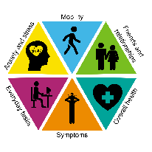
Cancer Quality of Life Survey
Jo Chambers
Patient Rep – National QoL Survey Team
#CancerQualityOfLife
#LivingWithAndBeyondCancer
#PersonalisedCare
NHS England and NHS Improvement
Notes:
Hi, I’m Jo. I’m a patient rep within the Alliance and also the National Cancer Programme, and one of the things I’m involved with is the Cancer QoL Survey.
I will go through the basics of how the survey works, a summary of the first set of data and look at the ‘so what’?

Slide 2
Cancer Quality of Life Survey
The LTP Ambition
‘From 2019, we will begin to introduce an innovative quality of life metric…to track and respond to the long-term impact of cancer.’
Notes:
So where has the QoL survey come from? It is an ambition in the Long Term Plan.
It is reasonably well known that there are long term QoL issues as a result of cancer treatment. This survey is a big step forward in the recognition that QoL is important, and its an opportunity to gain evidence to support an improvement in services from a QoL perspective.

Slide 3
Success!!!
Notes:
Why is that important? Because as a cancer patient this is what success of treatment can look like.
I’m a breast cancer patient and 18 months after finishing my active treatment for my primary breast cancer, from the outside most people assumed that I was ok. I was just about managing my job although not at the pace I used to, I struggled with brain fog where I couldn’t remember things or think quickly, fatigue, bone pain and lymphedema that limited the amount of physical activity that I could do, menopausal symptoms, and low mood. I was grateful to be alive. But the long-term side effects had an impact on my life and forced me to make some changes, I couldn’t do everything I used to do or wanted to do.
The effects are really wide ranging, both physical and psychological, and are different for everyone, but the impact on your day to day life can be huge.
Its hard when you finish active treatment and you’re left stood there in that pile of rubble by yourself with your body and mind in pieces trying to work out how to put yourself back together.

Slide 4
Patient’s View – What matters to me
Impact of my cancer
Understand who I am
Quality of my survival
Design services that support me to live well
Notes:
I’m now metastatic, but its important to remember that despite that I’m not just a breast cancer patient. Breast cancer is just one part of my life. Being a patient is a bit like a hobby, its just that I didn’t choose to take it up. I have a real life outside of being a patient. I’m an engineer, I climb mountains, I run, I cycle, I canoe, and I have a Labrador called Bryn who wants to eat everything. That’s who I am and that’s what is important to me. Cancer is something I have to fit in somehow around the rest of my life.
So QoL is a hugely important aspect of cancer treatment.

Slide 5
Who and When?
September
2020
10% sample
December 2020
100% breast prostate colorectal
Nationwide test
Breast prostate colorectal
July
2021
October 2021
Patients invited to complete the survey when they reach 18 months post-diagnosis
(All patients - primary and metastatic)
10% sample of ‘all’ cancers
Patient summaries
100% of 'all' cancers
Regular data publications every 6 months
Notes:
Patients will be invited to complete the survey when they reach 18 months post-diagnosis. This is important as it ensures that both primary and metastatic patients are included.
The development timeline is there but the 2 key points to take away are that from December 20 it covered 100% of prostate, colorectal and breast patients, and from October last year it was expanded to cover all other cancer types.
I will talk about availability of data shortly.
The development timeline is there but the 2 key points to take away are that from December last year it covered 100% of prostate, colorectal and breast patients, and from last month it was expanded to cover all other cancer types.
I will talk about availability of data shortly

Slide 6
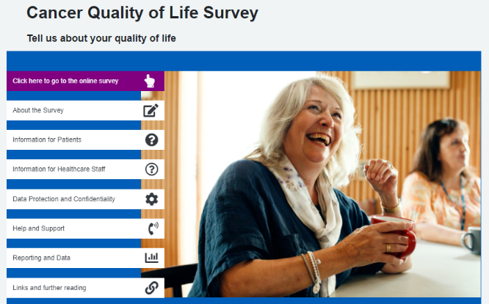
How?
Patients identified from the Cancer Register
Sent an invite letter
- Website address, username and password to access the survey
Reminder letter after 3 weeks
- Will include a paper copy of the survey
www.CancerQoL.england.nhs.uk
Notes:
Patients are identified from the Cancer Register and receive an invite letter. This will have information to be able to access the survey online with a paper copy sent out after 3 weeks.
It is available in multiple languages, help online and a phone line to call if you need assistance.
The survey is sent out automatically based on what is in the National Register. There are some blood cancers that are excluded and if you want to know which ones then we can get that confirmed for you. We are also aware of some issues with incorrect classification on the national register for several reasons leading to a small number of people incorrectly receiving the survey. This is something we are following up but if you come across any problems please feed that back to us.

Slide 7
Metric Reporting
Level 1
National reporting
Level 2
Regional and Alliance reporting
Pre-defined cut off scores, RAG rating; use case mix adjustment e.g. Cancer Stats 2
Level 3
Patient summaries reporting
Visualisations of summary QoL scores seen by patients
Focus LWBC work on managing the impact of cancer
Engage stakeholders and encourage commissioning of work on QoL improvement.
Identify good practise or areas for concern
Inform service improvement or sharing of best practise for QoL
Prompt supportive care planning conversations in primary and secondary care.
Differences between groups e.g. by cancer type, treatment type, stage of disease, co-morbidity, deprivation, gender, ethnicity etc.
Notes:
How will the data be used?
At a National level, the Living With and Beyond Cancer team will use the data to focus their work, generating evidence to help encourage commissioning work for QoL improvement.
At an Alliance level the data can be compared with the National results, allowing areas of good practice or areas of concern to be identified, and encouraging the sharing of best practice.
And at the bottom, but an equally important aspect, is the patient summary.

Slide 8
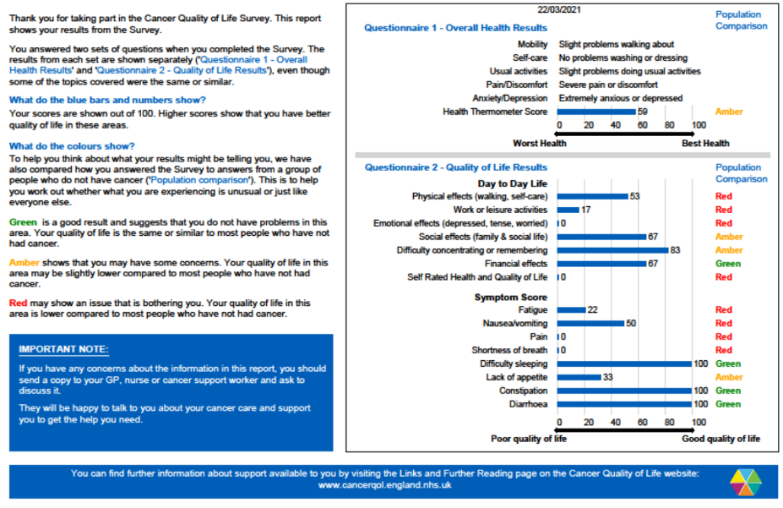
Patient summary
Notes:
This is what an individual patient summary looks like. All patients completing the QoL survey receive one. This shows where a patient has scored themselves relative to someone who hasn’t had cancer treatment and helps to identify areas where there may be issues.
It’s a prompt or a piece of evidence to encourage patients to feel like they can have open and honest conversations with their clinicians about the impact of treatment and about what is important to them. It’s about patients knowing that they can go back to their team after active treatment has finished. Rather than thinking that their cancer treatment is over so they just need to try and struggle on.

Slide 9
Data Publication
First data release: 25 Oct
100% coverage of breast, prostate and colorectal patients
Filter by:
Geographical area: NHS Region or Cancer Alliance
Cancer type
Age and gender
Future additions planned such as stage at diagnosis and treatment
Available on:
Cancer Data webpage (https://www.cancerdata.nhs.uk/cancerqol)
CancerStats2 from March 2022
- No end date for data collection – rolling updates approx. every 6 months
Notes:
The first release of data was in October. This is data from the 100% coverage of breast, prostate and colorectal, with the other cancer types hopefully being added in the next data release. And you can filter the data in a number of different ways
The data is available on the public facing Cancer Data webpage, and then on CancerStats2 in the next few months.
And just to clarify that this survey doesn’t have an end date, the data will continue to be updated over time and the current aim is for 6 monthly updates.
I’m going to fly through the next few slides due to time but they are in the slide pack if you want to look in more detail. This is the SWAG data from the 3 tumour sites combined.

Slide 10
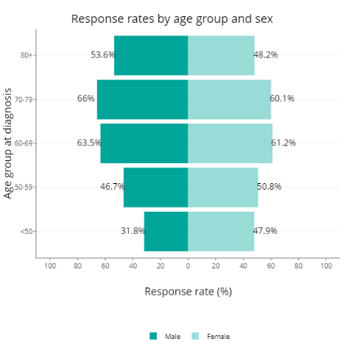
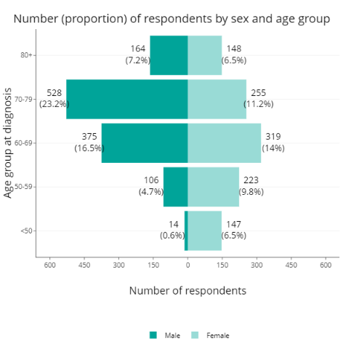
Response Rate
- The response rate is around 50% for all age ranges, with the exception of males under 50 who have a lower rate.
- However as the actual number of cancer patients in each age range is not equal, responses are biased towards males aged 60-80.
Notes:
So the data itself, starting with the response rate.
The response rate is around 50% on average
However as the actual number of cancer patients in each age range is not equal, responses are biased towards males aged 60-80.

Slide 11
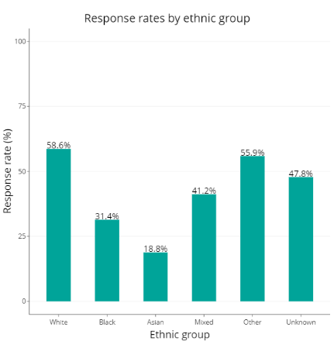
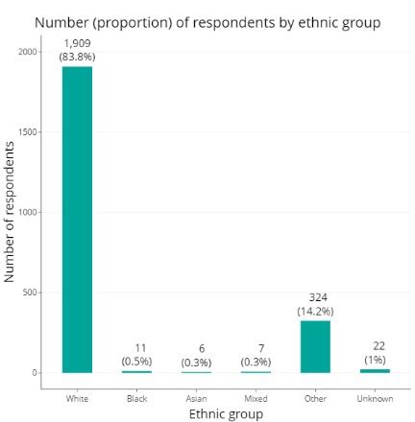
Response Rate
- A lower number of patients from a non-white background are responding.
Notes:
Ethnicity is a similar picture, again with percentages of those responding on the left and what that looks like in terms of actual numbers on the right.
The QoL team are doing work to address this however the breakdown of those responding is important to take into account as this survey currently only gives an indication of the QoL picture, not the full story.

Slide 12
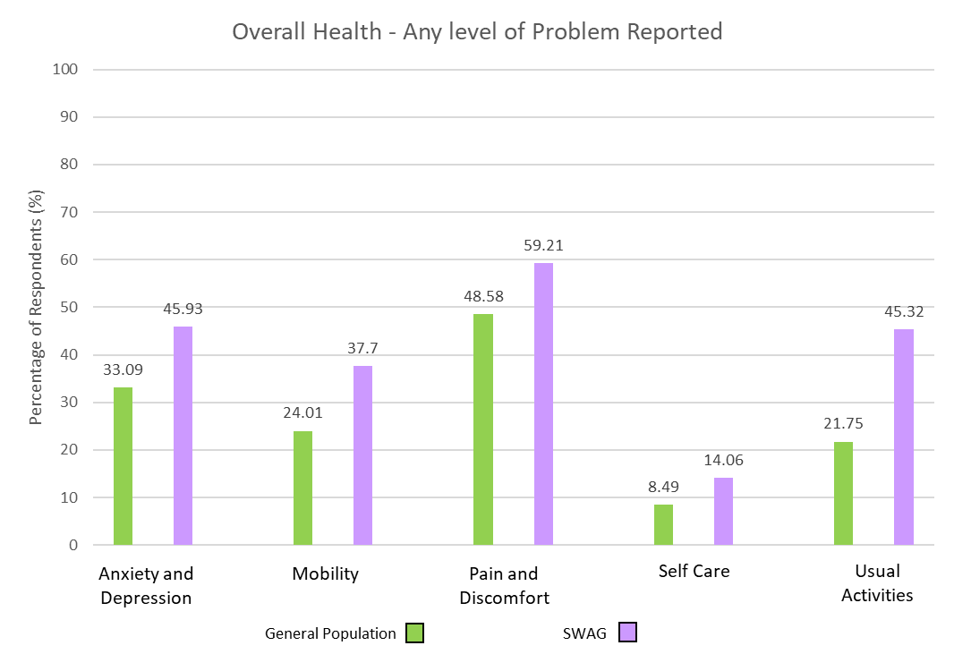
EQ-5D
- A Higher percentage of cancer patients report problems compared to the general population across all 5 categories.
- This increase is most significant in doing usual activities.
- Between 40-60% of cancer patients report problems with anxiety and depression, mobility, and pain and discomfort.
- Problems with self-care are lower but still almost twice as high as the general population.
Notes:
Starting with results from the EQ-5D which is a set of general health questions meaning it can be compared to results from the general population.
Here you can see a higher percentage of cancer patients report problems compared to the general population across all 5 categories. This increase is most significant in doing usual activities. Between 40-60% of cancer patients report problems with anxiety and depression, mobility, and pain and discomfort. Problems with self-care are lower but still almost twice as high as the general population.

Slide 13
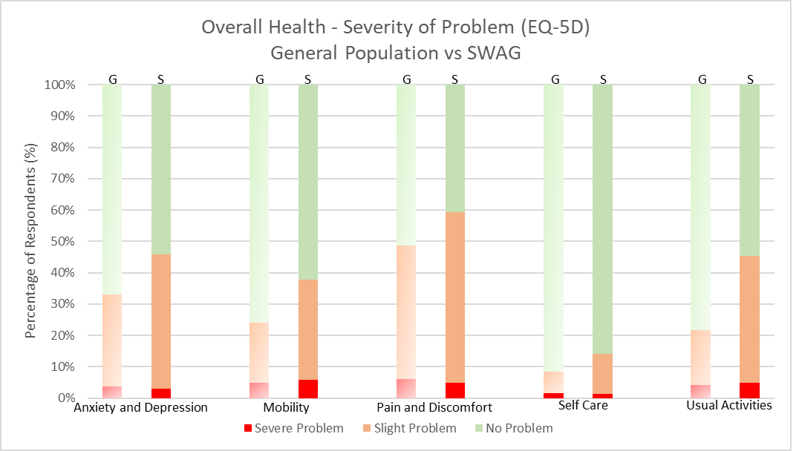
EQ-5D
The numbers reporting severe problems are very similar between the general population and cancer patients, but cancer patients report higher levels of slight problems across all 5 categories
Notes:
This slide shows the severity of the problem being reported, with results from the general population on the left and cancer patients on the right for each activity. The numbers reporting severe problems are very similar between the general population and cancer patients, but cancer patients report higher levels of slight problems across all 5 categories. I have an issue with the word slight as I would describe all of my symptoms as slight despite them having an impact on my life and changing what I’m able to do. So don’t read into the word slight as unimportant. But I will come back to this finding later.

Slide 14
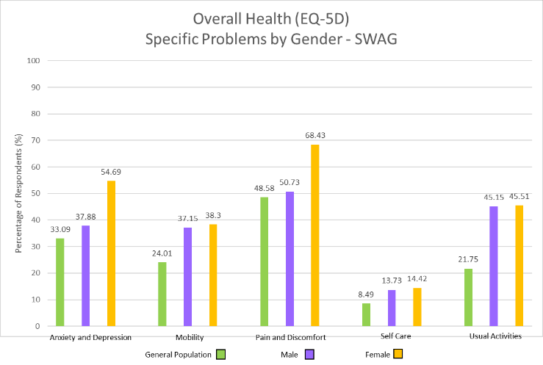
EQ-5D
- A higher percentage of females had difficulties with anxiety and depression, and pain and discomfort than males.
- The levels for mobility, self-care and doing usual activities were similar for both male and female.
- All cancer patient responses again were above that of the general population.
Notes:
Breaking down by gender, a higher percentage of females had difficulties with anxiety and depression, and pain and discomfort than males. The levels for mobility, self-care and doing usual activities were similar for both male and female. All cancer patient responses again were above that of the general population.

Slide 15
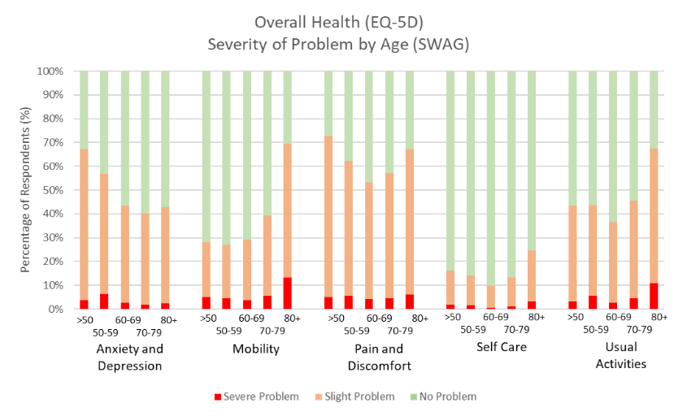
EQ-5D
- More patients report slight problems compared to severe problems across all areas.
- Over 50% of patients report problems with pain and discomfort.
- Over 40% of patients report anxiety and depression, and issues doing usual activities.
- Anxiety and depression is higher in younger patients.
- Older patients have more issues with mobility.
Notes:
Breaking down by age, again more patients report slight problems compared to severe problems across all areas. Over 50% of patients report problems with pain and discomfort. Over 40% of patients report anxiety and depression, and issues doing usual activities. Anxiety and depression is high in younger patients. Older patients have more issues with mobility.

Slide 16
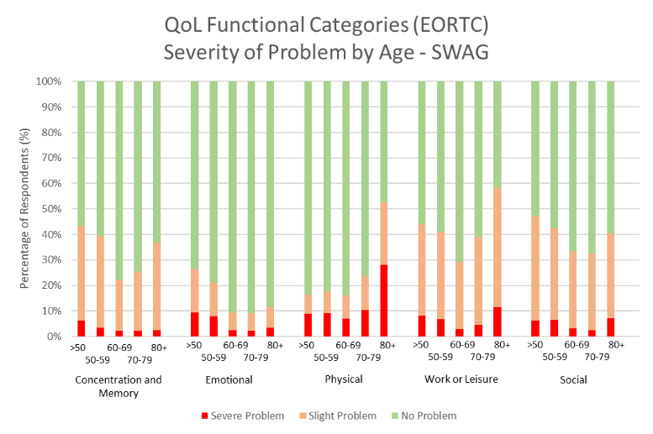
EORTC
- More slight rather than severe problems across all activities. Although more severe problems compared to the EQ-5D categories.
- The most common problems for all age groups are concentration and memory, work or leisure and social activities.
- Over 40% of younger patients report problems with concentration and memory, emotional issues, work and leisure and social activities.
- Older patients tend to have more issues with physical aspects and work or leisure.
Notes:
Moving to the EORTC question set which is cancer specific, the vast majority of patients report slight rather than severe problems across all activities. However, a higher level of severe problems are noted here compared to the EQ-5D categories. Breaking down by age, the most common problems for all age groups are concentration and memory, work or leisure and social activities. Over 40% of younger patients report problems with concentration and memory, emotional issues, work and leisure and social activities. Older patients tend to have more issues with physical aspects and work or leisure.

Slide 17
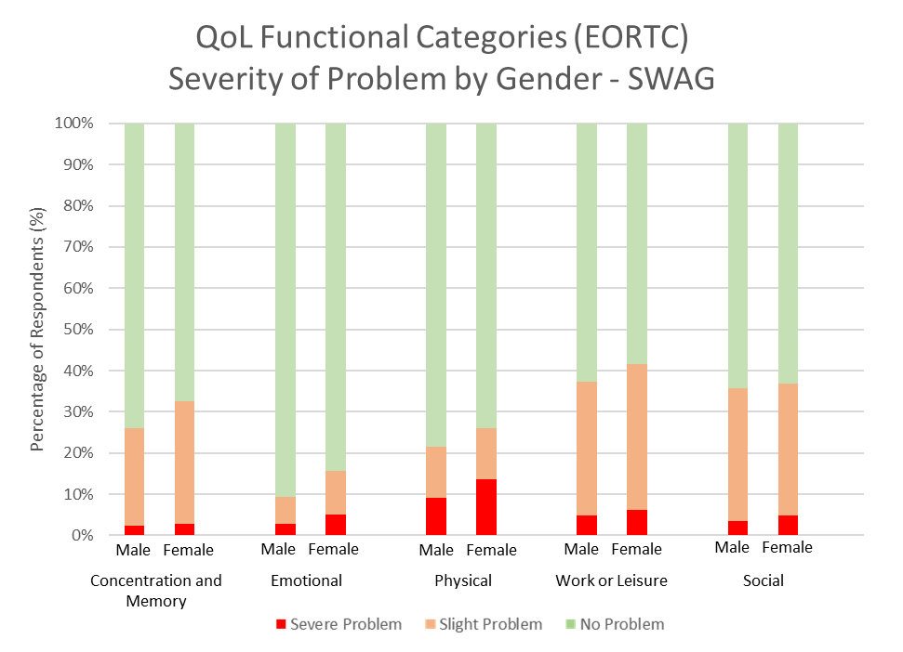
EORTC
- A higher percentage of females report problems in all areas compared to males, except in social activities where the levels are very similar.
Notes:
Breaking down by gender, a higher percentage of females report problems in all areas compared to males, except in social activities where the levels are very similar.

Slide 18
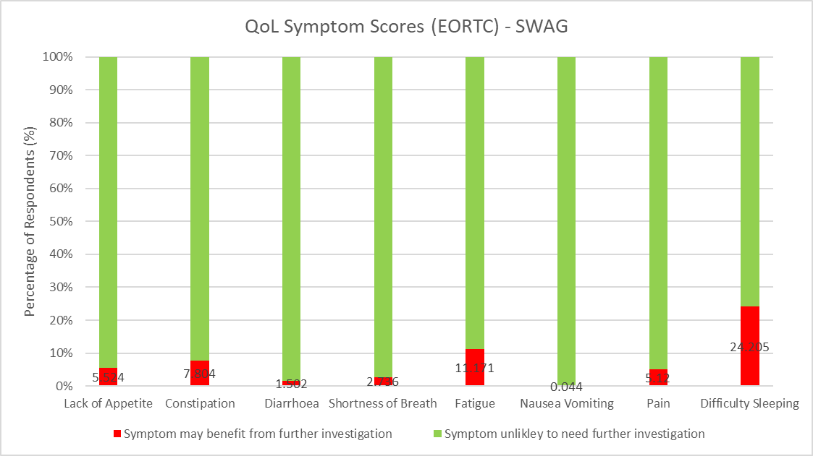
EORTC
- The most common symptoms needing further investigation are difficulty sleeping, fatigue, constipation, pain and lack of appetite.
Notes:
And finally, the most common symptoms needing further investigation are difficulty sleeping, fatigue, constipation, pain and lack of appetite.

Slide 19
So What? (Patient View)
The data shows there is a QoL issue for cancer patients
Change as a result of the data will take a long time
It’s not all about big sweeping changes to cancer services
Better educate patients on self-management
Normalise psychological after-effects of cancer treatment
Think about the language used
Understand every single contact counts
Every conversation should be a holistic conversation
Fully use all resources that already exist
Look at the barriers to patients accessing support
Use HNAs
Continuity of clinician
Share information - joined up personalised care
Don’t underestimate the positive impact on patients of getting the basics right.
Notes:
So what?
The data shows that cancer patients have more issues with QoL than the general population.
Change in terms of commissioning new services as a direct result of the data will take a long time. I also appreciate your job is pretty difficult right now with limited time and resource.
So I want to focus on the fact that the majority of cancer patients are reporting slight or lower level rather than severe problems. And I want to highlight the impact that getting the basics right, and making small adjustments to what you do has on patients.
So a few things I think will help improve QoL right now:
- Better educate patients.
You take each patient through the list of possible side effects to consent to treatment. You tell us what to expect. But you don’t tell us how to manage them, or how to cope.
So why not alongside that big list of side effects on the consent form give patients some information to take away about how to manage the low-level effects. Just arming patients with that information will help because otherwise we don’t know.
Don’t assume that as patients we know all the things that to you may seem really obvious, and often we need telling multiple times. The pre and post treatment information days being cancelled in some places due to covid were also a big loss.
- Normalise the psychological after-effects of cancer treatment and provide low level psychological support to everyone as standard. Just tell people life doesn’t go back to normal the day after you finish treatment. Educate people on fear of recurrence and what to look out for and what the follow up will be and why. And also don’t underestimate how scary it is to be immunosuppressed right now and how difficult it can be going through cancer treatment alone due to Covid restrictions.
- Think about the language you use to get patients to talk about QoL. If you asked me right now how are you getting on I’d say yeah I’m doing ok. Because I am. If you asked me how well I was managing to do things and how I was feeling about treatment you would get a different answer.
And every contact counts. Every conversation regardless of which clinician it is with should take into account that the person sat in front of you is a real person with a real life. We are more than the cancer diagnosis.
- You don’t have to fix things yourself. Use the resources that already exist.
There is so much support already out there, clinically led, peer support and advice on how to self-manage, people (both patients and clinicians) just don’t know it exists. Websites with reliable verified information, podcasts, apps, in person and virtual support groups, exercise groups, retreats, patient conferences, hard copy leaflets. Things available in different languages, put together and run by different cultural groups, and accessible in different ways so patients can choose what works best for them and in a way that they feel most comfortable.
Use HNAs, they are such a great tool to help start the QoL conversation. But they’re only useful if they’re actually being done and then followed up and information shared with everyone involved in that patient’s care.
Its about continuity of care and all the benefits that brings, and sharing information between clinicians, between specialties, between primary and secondary care. Not just throwing it over the wall and hoping someone picks it up, or worse not sharing at all so that other clinicians involved in that patients care have no idea. Its about joined up care to find the best way ahead for the patient.
So my view on the so what of the data so far, is to start with the basics and don’t underestimate how much of a difference getting those small things right has on patients.

Slide 20
Supporting products
Product | Brief description | Location
Communications toolkit | Visual identity guide Tailored slide set Slide template Briefing notes and key messages Locally printable poster Social media suggestions FAQs Example surveys and letters QoL Case Studies / ‘personas’ Patient information leaflet Films | Cancer Alliance Workspace: https://future.nhs.uk/canc/view?objectID=19564592 Or on request from your Cancer Alliance.
Website and helpline | Information for patients and the public Access to online survey completion Fully searchable and open to all | www.CancerQoL.england.nhs.uk
Notes:
If you want any more information at this point then the QoL survey comms toolkit is on the Cancer Alliance workspace at the link. And some more general info on the public facing webpage

Slide 21
Who can I contact for more information?
Contact | Details
Alliance team | Helen Shallcross (helen.shallcross@nbt.nhs.uk) Jo Chambers (Patient Rep)
National Cancer Programme | Hannah Raphael (hannah.raphael@nhs.net)
Notes:
The point of contact within SWAG is Helen Shallcross, and I’m the patient rep.
Hannah Raphael is the national point of contact

Slide 22
Thank you! This survey is being run jointly by Public Health England and NHS England and NHS Improvement.
#CancerQualityofLife
#LivingWithAndBeyondCancer
#PersonalisedCare

