Slide 1
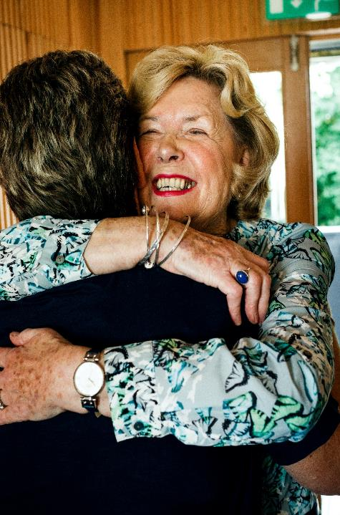
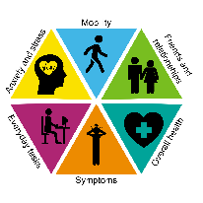
Cancer Quality of Life Survey
Jo Chambers
Patient Rep – National QoL Survey Team
#CancerQualityOfLife
#LivingWithAndBeyondCancer
#PersonalisedCare
NHS England and NHS Improvement

Slide 2
Cancer Quality of Life Survey
The LTP Ambition
‘From 2019, we will begin to introduce an innovative quality of life metric…to track and respond to the long-term impact of cancer.’
Notes:
So where has the QoL survey come from? It is an ambition in the Long Term Plan.
It is reasonably well known that there are long term QoL issues as a result of cancer treatment. This survey is a big step forward in the recognition that QoL is important, and its an opportunity to gain evidence to support an improvement in services from a QoL perspective.

Slide 3
Success!!!
Notes:
Why is that important? Because as a cancer patient this is what success of treatment can look like.
Cancer treatment is pretty brutal and it is completely focused on treating the cancer, which sounds obvious but its at the expense of pretty much everything else. It’s like going to knock through a wall in the kitchen and the whole house falling down around you. But ultimately you’ve knocked through that original wall so it’s a success right?
I’m a breast cancer patient and 18 months after finishing my active treatment for my primary breast cancer, my hair had almost fully grown back and from the outside most people assumed that I was ok. I was just about managing my job although not at the pace I used to, I struggled with brain fog where I couldn’t remember things or think quickly, fatigue, bone pain and lymphedema that limited the amount of physical activity that I could do, menopausal symptoms, and low mood. I was grateful to be alive. But the long-term side effects of treatment and of hormone therapy had an impact on my life and forced me to make some changes, I couldn’t do everything I used to do or wanted to do.
Other people have problems with urinary incontinence and bowel problems with patients always having to think about where the nearest toilet is whenever they go out. There are problems with intimacy and body image. These things can have wider impacts on relationships to the point marriages break down. There’s the financial impact of treatment, the impact on your job if you have an employer that doesn’t get it. There’s scanxiety and the fear of recurrence.
The effects are really wide ranging, both physical and psychological, and are different for everyone, but the impact on your day to day life can be huge.
Its hard when you finish active treatment and everyone around you talks about success and how you’ve finished. And that is usually the point where all the support both clinically and from family and friends starts to reduce because you’re all done with treatment now, and you’re left stood there in that pile of rubble by yourself with your body and mind in pieces trying to work out how to put yourself back together.

Slide 4
Patient’s View – What matters to me
Impact of my cancer
Understand who I am
Quality of my survival
Design services that support me to live well
Notes:
I’m now metastatic, but its important to remember that despite that I’m not just a breast cancer patient. Breast cancer is just one part of my life. Being a patient is a bit like a hobby, its just that I didn’t choose to take it up. I have a real life outside of being a patient. I’m an engineer, I climb mountains, I run, I cycle, I canoe, and I have a Labrador called Bryn who wants to eat everything. That’s who I am and that’s what is important to me. I’m more than just that diagnosis and the MDT outcome written on a bit of paper. Cancer is something I have to fit in somehow around the rest of my life.
So QoL is an important aspect of cancer treatment. The QoL survey will help to understand the impact of cancer and treatment and the importance of those factors against what is important to patients. That in turn can then help design services that support patients to live well both with and beyond cancer. It will also raise the profile of QoL amongst clinicians and patients so that more QoL conversations can be had.

Slide 5
Who and When?
September
2020
10% sample
December 2020
100% breast prostate colorectal
Nationwide test
Breast prostate colorectal
July
2021
October 2021
Patients invited to complete the survey when they reach 18 months post-diagnosis
(All patients - primary and metastatic)
10% sample of ‘all’ cancers
Patient summaries
100% of 'all' cancers
Regular data publications every 6 months
Notes:
Patients will be invited to complete the survey when they reach 18 months post-diagnosis. This is important as it ensures that both primary and metastatic patients are included.
The development timeline is there but the 2 key points to take away are that from December last year it covered 100% of prostate, colorectal and breast patients, and from last month it was expanded to cover all other cancer types.
I will talk about availability of data shortly

Slide 6
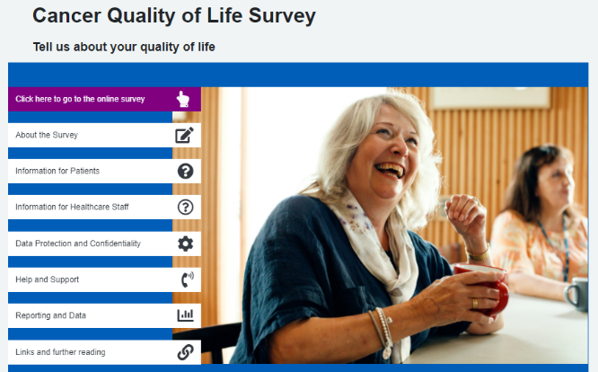
How?
Patients identified from the Cancer Register
Sent an invite letter
- Website address, username and password to access the survey
Reminder letter after 3 weeks
- Will include a paper copy of the survey
www.CancerQoL.england.nhs.uk
Notes:
Patients are identified from the Cancer Register and receive an invite letter. This will have information to be able to access the survey online. The homepage is shown below and includes some really good background information about the survey and how to access help to complete it. Anyone can access that webpage if you’re interested, but only those invited can complete the survey.
A reminder letter is sent out after 3 weeks which includes a paper copy for those that don’t want to complete it online.
A lot of work has been put in to try and ensure a maximum response rate – online and hard copy versions, multiple languages, help online and a phone line to call if you need assistance. You will see in the data that there is more work to be done here, it is so important that we get as wide and diverse a response as possible.

Slide 7
Metric Reporting
Level 1
National reporting
Level 2
Regional and Alliance reporting
Pre-defined cut off scores, RAG rating; use case mix adjustment e.g. Cancer Stats 2
Level 3
Patient summaries reporting
Visualisations of summary QoL scores seen by patients
Focus LWBC work on managing the impact of cancer
Engage stakeholders and encourage commissioning of work on QoL improvement.
Identify good practise or areas for concern
Inform service improvement or sharing of best practise for QoL
Prompt supportive care planning conversations in primary and secondary care.
Differences between groups e.g. by cancer type, treatment type, stage of disease, co-morbidity, deprivation, gender, ethnicity etc.
Notes:
How will the data be used?
At a National level, the Living With and Beyond Cancer team will use the data to focus their work, generating evidence to help encourage commissioning work for QoL improvement.
At an Alliance level the data can be compared with the National results, allowing areas of good practice or areas of concern to be identified, and encouraging the sharing of best practice.
And at the bottom, but an equally important aspect, is the patient summary.

Slide 8
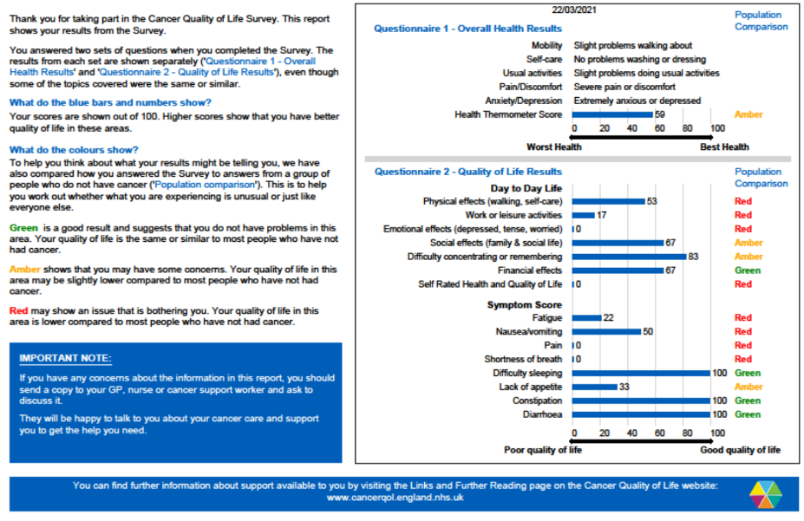
Patient summary
Notes:
This is what an individual patient summary looks like. All patients completing the QoL survey receive one. This shows where a patient has scored themselves relative to someone who hasn’t had cancer treatment and helps to identify areas where there may be issues.
It’s a prompt or a piece of evidence to encourage patients to feel like they can have open and honest conversations with their clinicians about the impact of treatment and about what is important to them. It’s about patients knowing that they can go back to their team after active treatment has finished. Rather than thinking that their cancer treatment is over so they just need to try and struggle on. Don’t assume patients understand, I had absolutely no idea that I was struggling mentally after my first diagnosis which sounds ridiculous but I just had no clue. It’s about making patients feel empowered to engage in discussions with clinicians about how they’re really feeling and what they need.

Slide 9
Data Publication
First data release: 25 Oct
100% coverage of breast, prostate and colorectal patients
Filter by:
Geographical area: NHS Region or Cancer Alliance
Cancer type
Age and gender
Future additions planned such as stage at diagnosis and treatment
Available on:
Cancer Data webpage (https://www.cancerdata.nhs.uk/cancerqol)
CancerStats2 from March 2022
- No end date for data collection – rolling updates approx. every 6 months
Notes:
The first release of data was in October. This is data from the 100% coverage of breast, prostate and colorectal, with the other cancer types hopefully being added in the next data release.
You can filter the data by geographical region, cancer type, age and gender. There are planned future additions to this breakdown such as stage at diagnosis and treatment.
The data is available on the public facing Cancer Data webpage, and then on CancerStats2 from around March 2022.
And just to clarify that this survey doesn’t have an end date, it’s a bit like the CPES in that the data will continue to be updated over time and the current aim is for 6 monthly updates.
So I’ll take you through some of the results. There is a lot of data available on the webpage and I have pulled out the key themes that I feel are important to share as a patient - I’ve not pulled out comparisons with other Alliances for example. I’m not interested in whether SWAG is doing ok compared to anyone else, I’m interested in improving the qol of cancer patients in relation to those who haven’t had cancer treatment. But there are lots of other ways to view this data so please go and have a look yourself about the aspects you are interested in.
I’m going to show you the SWAG specific data which includes all 3 cancer types.

Slide 10
Results Overview
Response Rate:
The response rate is around 50% on average
However as the actual number of cancer patients in each age range is not equal, responses are biased towards males aged 60-80.
A much lower number of patients from a non-white background are responding.
Overall:
A higher percentage of cancer patients report problems compared to the general population across all 5 categories.
Higher levels of ‘slight’ rather than severe problems
EQ-5D: (comparison to the General Population)
Between 40-60% of cancer patients report problems with doing usual activities, anxiety and depression, mobility, and pain and discomfort.
Problems with self-care are lower but still almost twice as high as the general population.
A higher percentage of females had difficulties with anxiety and depression, and pain and discomfort than males.
EORTC: (Cancer specific questions)
The most common problems are concentration and memory, work or leisure and social activities.
Over 40% of younger patients report problems with concentration and memory, emotional issues, work and leisure and social activities.
Older patients tend to have more issues with physical aspects and work or leisure.
A higher percentage of females report problems in all areas compared to males, except in social activities where the levels are very similar.
The most common symptoms needing further investigation are difficulty sleeping, fatigue, constipation, pain and lack of appetite.
Notes:
Response Rate:
The response rate is around 50% for all age ranges, with the exception of males under 50 who have a lower rate.
However as the actual number of cancer patients in each age range is not equal, responses are biased towards males aged 60-80.
A lower number of patients from a non-white background are responding.
EQ-5D: (comparison to the General Population)
A Higher percentage of cancer patients report problems compared to the general population across all 5 categories.
This increase is most significant in doing usual activities.
Between 40-60% of cancer patients report problems with anxiety and depression, mobility, and pain and discomfort.
Problems with self-care are lower but still almost twice as high as the general population.
The numbers reporting severe problems are very similar between the general population and cancer patients, but cancer patients report higher levels of slight problems across all 5 categories
A higher percentage of females had difficulties with anxiety and depression, and pain and discomfort than males.
The levels for mobility, self-care and doing usual activities were similar for both male and female.
EORTC: (Cancer specific questions)
More slight rather than severe problems across all activities. Although more severe problems compared to the EQ-5D categories.
The most common problems for all age groups are concentration and memory, work or leisure and social activities.
Over 40% of younger patients report problems with concentration and memory, emotional issues, work and leisure and social activities.
Older patients tend to have more issues with physical aspects and work or leisure.
A higher percentage of females report problems in all areas compared to males, except in social activities where the levels are very similar.
The most common symptoms needing further investigation are difficulty sleeping, fatigue, constipation, pain and lack of appetite.

Slide 11
So What? (Patient View)
The data shows there is a QoL issue for cancer patients
Change as a result of the data will take a long time
Don’t sit back and wait for the data to give the answer – what can be done now?
It’s not all about big sweeping changes to cancer services
Better educate patients on self-management
Normalise psychological after-effects of cancer treatment
Fully use all resources that already exist
Look at the barriers to patients accessing support
Think about the language used
Every conversation should be a holistic conversation
Understand every single contact counts
Don’t be afraid to ask
Use HNAs
Continuity of clinician
Share information - joined up personalised care
Don’t assume you know what patients need – co-produce with patients
Notes:
So what?
When I give this presentation to clinicians the questions are always what are the numbers and it almost feels like there’s a bit of an expectation that the numbers will tell you everything you need to know. Whereas I don’t feel that is the case. The next steps aren’t obvious just by looking at the data and there are already a lot of discussions ongoing between both patients and clinicians about what happens next. And as such, change in terms of commissioning new services as a direct result of the data will take a long time.
But what I don’t want that to mean is that we sit back and wait until the data does tell us the answers. Because what the data does show is that cancer patients have more issues with qol than the general population.
One of the important things that stands out to me is that the majority of cancer patients are reporting slight rather than severe problems. What that says to me is that there are a lot of lower level problems. So maybe the first step is to focus on these to put things in place to try and solve a proportion of them and prevent them from becoming bigger problems that need additional services down the line. Giving you more time to deal with those who have more complex issues.
In my view this would be simpler things that can be done right now.
So a few things I think will help improve QoL right now:
- Better educate patients.
You take each patient through the list of possible side effects to consent to treatment. You tell us what to expect. But you don’t tell us how to manage them, or how to cope.
It’s simple things like telling someone to try using something like a list to help with chemo brain to stop you forgetting things. Or planning out your time each day to help manage your energy and be better able to cope with fatigue. Maybe top tips about diet and how to keep eating when you lose your appetite and taste.
So why not alongside that big list of side effects on the consent form give patients some information to take away about how to manage the low-level effects, and some idea of what level of severity you’d want them to start contacting someone for some additional help, noting who they should contact, and say don’t suffer please tell us as we have additional things to help. Just arming patients with that information will help because otherwise we don’t know. There was a great example at the Head and Neck CAG on Tues where patients were cancelling a dental check that was made for them pre-radiotherapy because they didn’t know it was to make sure they weren’t likely to have issues in their mouth as a result of radiotherapy. Why would we know unless you tell us?
I had abdominal surgery a few months ago and I thought it was just me being unlucky with my experience but several patients have said the same recently. The only post-surgery advice I got was to take painkillers and keep my wound dry. At no point from consent through pre-op, the surgery itself or the discharge process did anyone tell me not to lift anything heavy, that I wouldn’t be able to drive for 3-4 weeks, that I’d need time off work. Why didn’t I ask these obvious questions myself? I assumed someone would tell me as had happened in other surgery I’d had, and by the time I realised no-one was going to tell me I was exhausted from a night on the ward, I was in pain and just wanted to go home.
Don’t assume that as patients we know all the things that to you may seem really obvious, and often we need telling multiple times. The pre and post treatment information days being cancelled in some places due to covid were also a big loss.
- Normalise the psychological after-effects of cancer treatment and provide low level psychological support to everyone as standard. Tell people life doesn’t go back to normal the day after you finish treatment. Educate people on fear of recurrence and what to look out for and what the follow up will be and why.
- Fully use the resources that already exist.
There is so much support already out there, clinically led, peer support and advice on how to self-manage, people (both patients and clinicians) just don’t know it exists. Websites with reliable verified information, podcasts, in person and virtual support groups, exercise groups, retreats, patient conferences, hard copy leaflets. Things available in different languages, put together and run by different cultural groups, and accessible in different ways so patients can choose what works best for them and in a way that they feel most comfortable – we are all different and all need different things. Its also about accessing it at a time that works for them as not everyone can take time off work during the day especially after having a long period off sick. I had absolutely no idea what was out there when I started treatment and I really struggled, it made a huge difference as I’ve gone through treatment knowing what support existed and how to access it. Don’t think the NHS can provide everything, you can’t and you don’t need to. Improve the use what is already out there and then look at where the gaps are.
- Look at why not everyone accesses support
I’ve heard a consultant say that if patients aren’t there then how can we help them. Well to be a cancer patient they will have had to have sat in clinic in front of someone at some point. Just because they’re not there when you think QoL comes into the pathway doesn’t mean the patient is in the wrong. If you expect them to disappear once active treatment has finished for whatever reason, then you need to take the opportunities when they are sat there in front of you.
Patients struggle to get time off for appts after cancer treatment as they’ve used up their sick leave, people can’t always access support during the working day once they’re back at work. Some patients don’t know they need help or don’t know it exists. Patients can’t access care because they can’t get through to their team. You have deaf patients who are still struggling with f2f appts as they can’t lipread whilst everyone is wearing a mask and clear facemasks aren’t commonly being used. Patients who don’t feel listened to are less likely to come back – I turned down a referral to a menopause clinic as the consultant that wanted to refer me only wanted to talk about hot flushes when I’d said I was struggling with fatigue and brain fog so I thought what’s the point in the referral if they’re not going to listen to me.
Don’t just put everyone on an open access appt and assume they will come back if they need to. I was on a ward with a breast patient whose first language was not English. She couldn’t communicate with the ward staff that she needed to go to the toilet to the point she wet herself. If she wasn’t able to communicate that then she is unlikely to be able to communicate that she needs help with QoL. Different patients need different approaches.
It’s things like thinking about the language you use to get patients to talk about QoL. If you asked me right now how are you getting on I’d say yeah I’m doing ok. Because I am. If you asked me how well I was managing to do things and how I was feeling about treatment I’d say I’m probably now at my limit of self-managing fatigue and its starting to impact what I’m doing, and I’m really worried about starting my next treatment.
And every contact counts. I’ve heard that in some places HNAs haven’t been happening and they’ve been replaced by what is being referred to a holistic conversation. Every single conversation should be a holistic conversation! Regardless of which clinician it is with, regardless of where that patient is in the pathway. Every conversation should take into account that the person sat in front of you is a real person with a real life, with family and friends, with a job, with things that are important to them. We are more than the cancer diagnosis. Sometimes it feels like clinicians are too scared to open a can of worms by asking.
Use HNAs, they are such a great tool to help start the QoL conversation. But they’re only useful if they’re actually being done. And it’s not about ticking a box once its done, where problems are identified what is done? And then how is it followed up?
And its about continuity of care and all the benefits that brings, and sharing information between clinicians, between specialties, between primary and secondary care. Not just throwing it over the wall and hoping someone picks it up, or worse not sharing at all so that other clinicians involved in that patients care have no idea. Its about joined up care to find the best way ahead for the patient.
And finally don’t assume that you as clinicians know what we as patients need and in what way we need it. If you want to get it right, co-produce with patients right from the start.
So my view on the so what of the data so far, is to start with the basics. Don’t sit there and say well I already do that. I’m pretty confident everyone on this call already does. But does everyone else around you? Just because you have policies and processes in place doesn’t always mean things happen. People change, things have been disrupted by Covid, staff are overworked and demoralised. So I would say start at the beginning and start with simple things, and don’t underestimate how much of a difference getting those things right has on patients.
QoL means something different to all of us and so there is no one size fits all. But its about putting that clinical diagnosis to one side for a moment and just remembering that I’m also a real person.
That’s just my patient view. I’m really interested in your view and also trying to understand what the barriers are from your side.

Slide 12
Supporting products
Product | Brief description | Location
Communications toolkit | Visual identity guide Tailored slide set Slide template Briefing notes and key messages Locally printable poster Social media suggestions FAQs Example surveys and letters QoL Case Studies / ‘personas’ Patient information leaflet Films | Cancer Alliance Workspace: https://future.nhs.uk/canc/view?objectID=19564592 Or on request from your Cancer Alliance.
Website and helpline | Information for patients and the public Access to online survey completion Fully searchable and open to all | www.CancerQoL.england.nhs.uk
Notes:
Before I go into the data itself, if you want any more information at this point then the QoL survey comms toolkit is on the Cancer Alliance workspace at the link. And some more general info on the public facing webpage.

Slide 13
Who can I contact for more information?
Contact | Details
Alliance team | Helen Shallcross (helen.shallcross@nbt.nhs.uk) Jo Chambers (Patient Rep)
National Cancer Programme | Hannah Raphael (hannah.raphael@nhs.net)
Notes:
The point of contact within SWAG is Helen Shallcross, and I’m the patient rep.
Hannah Raphael is the national point of contact

Slide 14
Thank you! This survey is being run jointly by Public Health England and NHS England and NHS Improvement.
#CancerQualityofLife
#LivingWithAndBeyondCancer
#PersonalisedCare

Slide 15
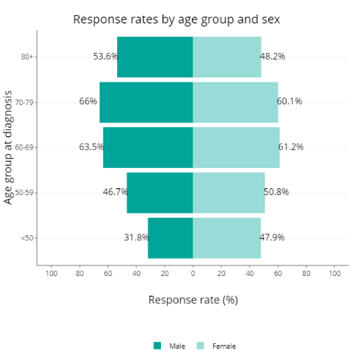
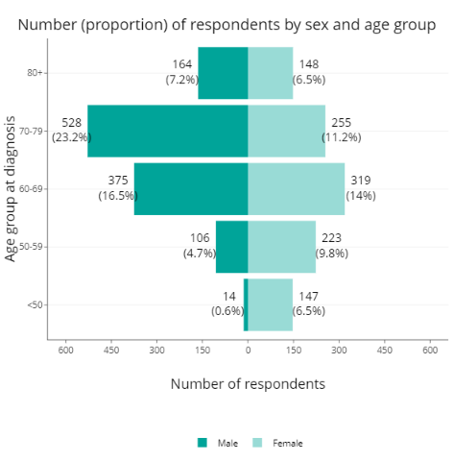
Response Rate
- The response rate is around 50% for all age ranges, with the exception of males under 50 who have a lower rate.
- However as the actual number of cancer patients in each age range is not equal, responses are biased towards males aged 60-80.
Notes:
So the data itself, starting with the response rate.
When you look at the percentage of those responding against those asked on the left here, the response rate is around 50% for all age ranges which is the target level, with the exception of the males under 50 who have a lower rate.
However the actual number of patients in each age range is not equally spread, typically fewer younger patients for example. So when you look at the actual number of people responding on the right you can see the data is heavily biased towards males aged 60 to 80.

Slide 16
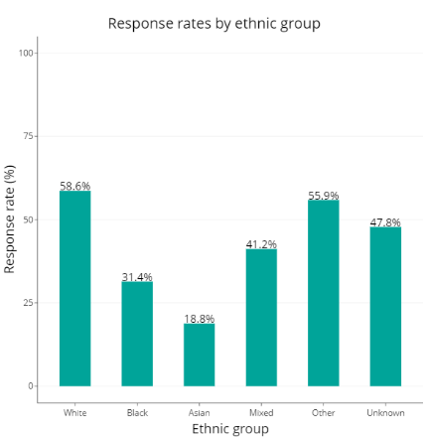
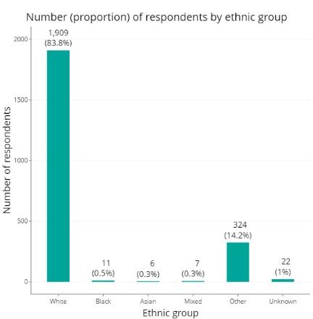
Response Rate
- A lower number of patients from a non-white background are responding.
Notes:
Ethnicity is a similar picture, again with percentages of those responding on the left and what that looks like in terms of actual numbers on the right.
The QoL team are doing work to address this however the breakdown of those responding is important to take into account as this survey currently only gives an indication of the QoL picture, not the full story.

Slide 17
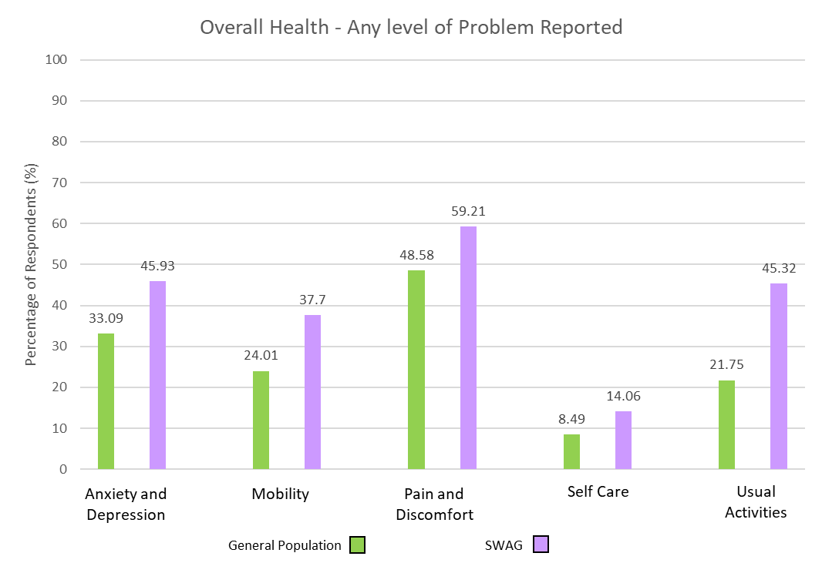
EQ-5D
- A Higher percentage of cancer patients report problems compared to the general population across all 5 categories.
- This increase is most significant in doing usual activities.
- Between 40-60% of cancer patients report problems with anxiety and depression, mobility, and pain and discomfort.
- Problems with self-care are lower but still almost twice as high as the general population.
Notes:
Starting with results from the EQ-5D which is a set of general health questions meaning it can be compared to results from the general population.
Here you can see a higher percentage of cancer patients report problems compared to the general population across all 5 categories. This increase is most significant in doing usual activities. Between 40-60% of cancer patients report problems with anxiety and depression, mobility, and pain and discomfort. Problems with self-care are lower but still almost twice as high as the general population.

Slide 18
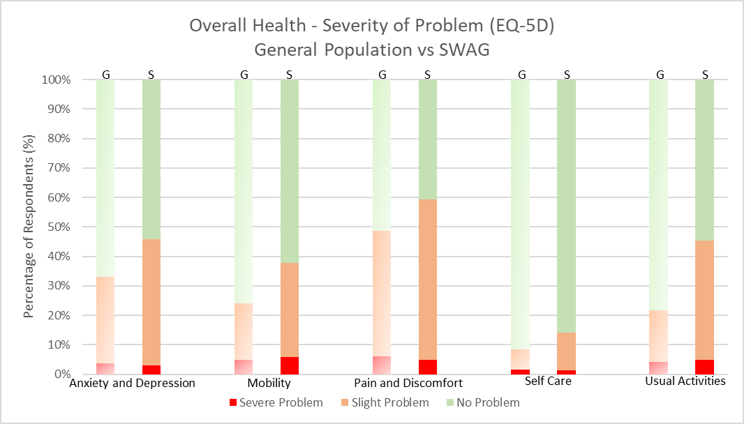
EQ-5D
The numbers reporting severe problems are very similar between the general population and cancer patients, but cancer patients report higher levels of slight problems across all 5 categories
Notes:
This slide shows the severity of the problem being reported, with results from the general population on the left and cancer patients on the right for each activity. The numbers reporting severe problems are very similar between the general population and cancer patients, but cancer patients report higher levels of slight problems across all 5 categories. I have an issue with the word slight as I would describe all of my symptoms as slight despite them having an impact on my life and changing what I’m able to do. So don’t read into the word slight as unimportant. But I will come back to this finding later.

Slide 19
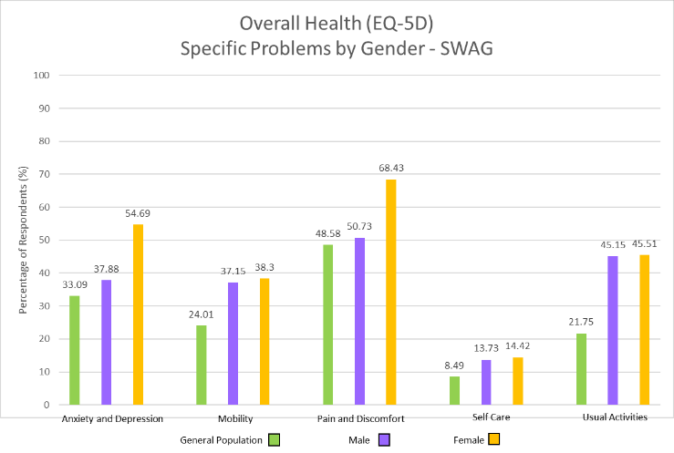
EQ-5D
- A higher percentage of females had difficulties with anxiety and depression, and pain and discomfort than males.
- The levels for mobility, self-care and doing usual activities were similar for both male and female.
- All cancer patient responses again were above that of the general population.
Notes:
Breaking down by gender, a higher percentage of females had difficulties with anxiety and depression, and pain and discomfort than males. The levels for mobility, self-care and doing usual activities were similar for both male and female. All cancer patient responses again were above that of the general population.

Slide 20
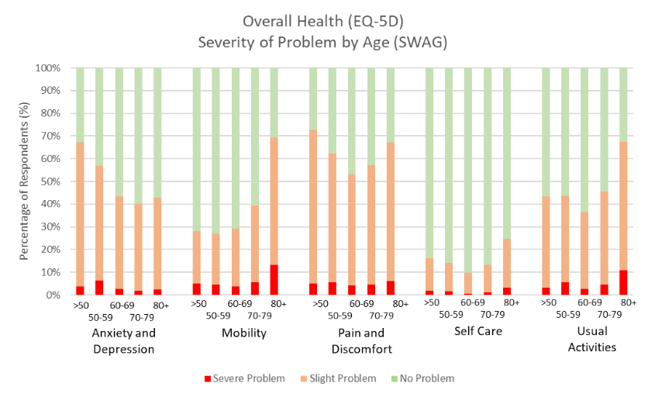
EQ-5D
- More patients report slight problems compared to severe problems across all areas.
- Over 50% of patients report problems with pain and discomfort.
- Over 40% of patients report anxiety and depression, and issues doing usual activities.
- Anxiety and depression is higher in younger patients.
- Older patients have more issues with mobility.
Notes:
Breaking down by age, again more patients report slight problems compared to severe problems across all areas. Over 50% of patients report problems with pain and discomfort. Over 40% of patients report anxiety and depression, and issues doing usual activities. Anxiety and depression is high in younger patients. Older patients have more issues with mobility.

Slide 21
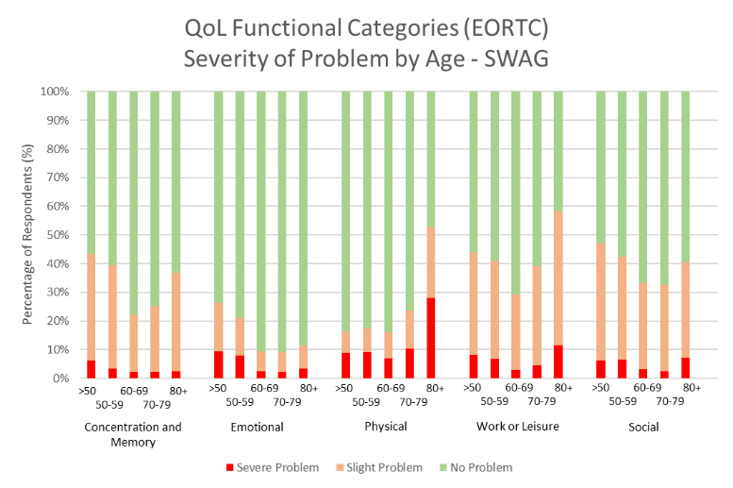
EORTC
- More slight rather than severe problems across all activities. Although more severe problems compared to the EQ-5D categories.
- The most common problems for all age groups are concentration and memory, work or leisure and social activities.
- Over 40% of younger patients report problems with concentration and memory, emotional issues, work and leisure and social activities.
- Older patients tend to have more issues with physical aspects and work or leisure.
Notes:
Moving to the EORTC question set which is cancer specific, the vast majority of patients report slight rather than severe problems across all activities. However, a higher level of severe problems are noted here compared to the EQ-5D categories. Breaking down by age, the most common problems for all age groups are concentration and memory, work or leisure and social activities. Over 40% of younger patients report problems with concentration and memory, emotional issues, work and leisure and social activities. Older patients tend to have more issues with physical aspects and work or leisure.

Slide 22
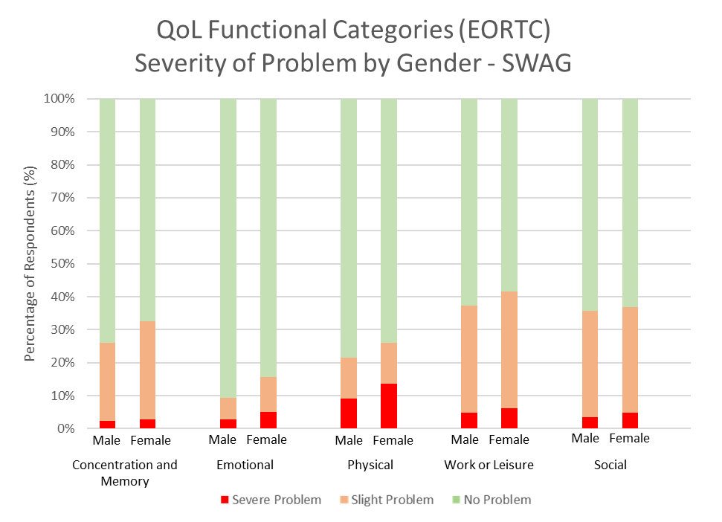
EORTC
- A higher percentage of females report problems in all areas compared to males, except in social activities where the levels are very similar.
Notes:
Breaking down by gender, a higher percentage of females report problems in all areas compared to males, except in social activities where the levels are very similar.

Slide 23
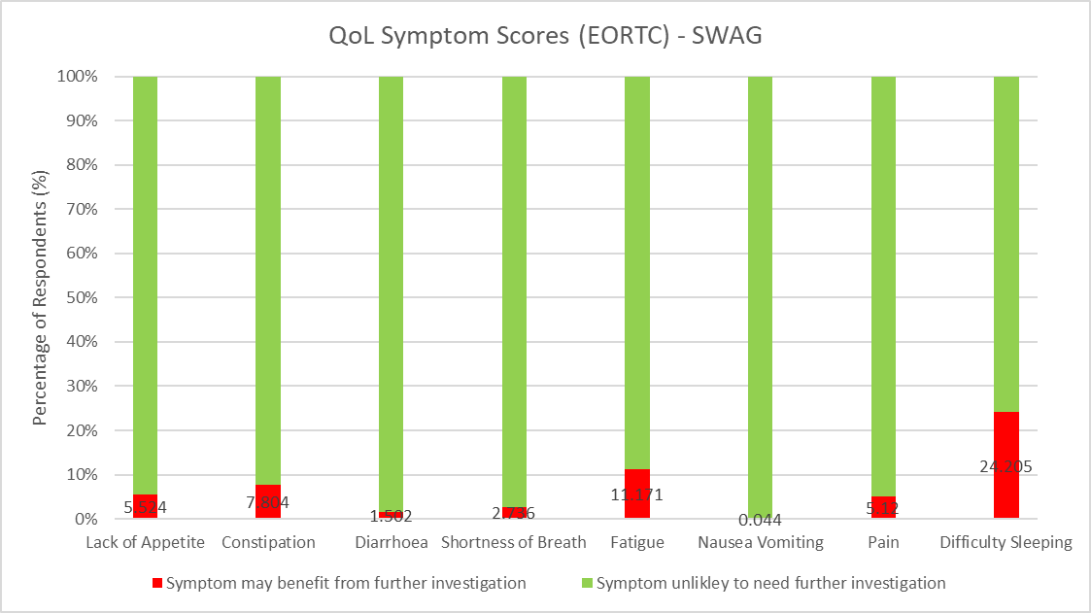
EORTC
- The most common symptoms needing further investigation are difficulty sleeping, fatigue, constipation, pain and lack of appetite.
Notes:
And finally, the most common symptoms needing further investigation are difficulty sleeping, fatigue, constipation, pain and lack of appetite.

