Slide 1
SWAG Network Oesophago-gastric (OG) Cancer
Clinical Advisory Group
Research Update
Claire Matthews & Sharath Gangadhara
21/01/2022

Slide 2
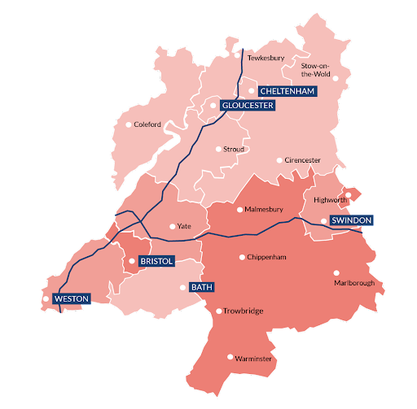
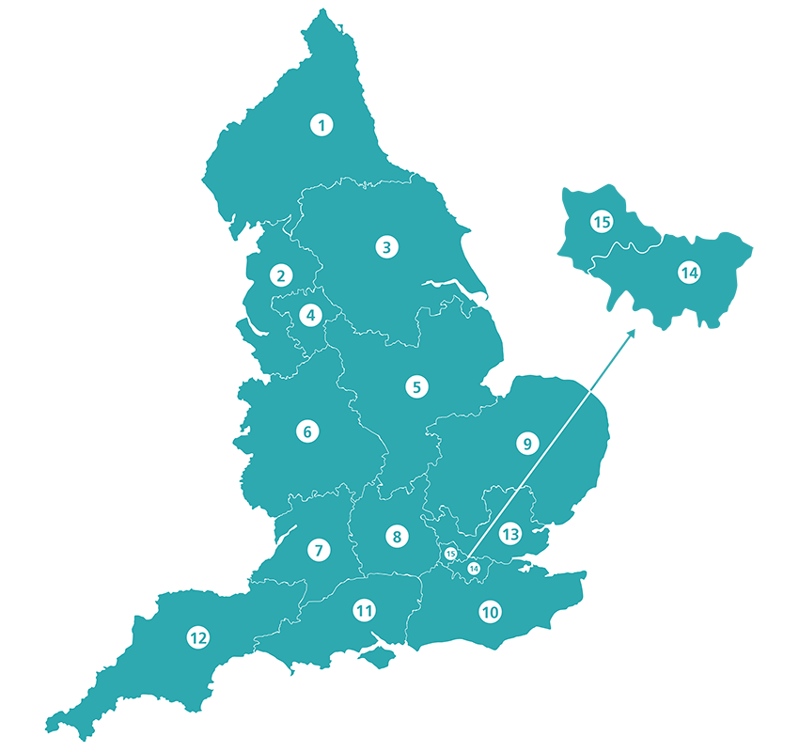
SWAG vs CRN regions
SWAG Region Trusts
Gloucestershire Hospitals NHS Foundation Trust
North Bristol NHS Trust
Royal United Hospitals Bath
University Hospitals Bristol & Weston NHS Foundation Trust
CRN West of England
Yeovil District Hospital NHS Foundation Trust
Somerset NHS Foundation Trust
CRN South West Peninsula
CRN Wessex
Salisbury NHS Foundation Trust
No data for Salisbury available for this meeting

Slide 3
National Recruitment to Upper GI Cancer Studies
Apr 2020 - Jan 2022
Data cut 14/01/2022
Source: ODP All Portfolio

Slide 4
National vs Regional Recruitment to Upper GI Cancer Studies Apr 2019 - Nov 2021
National Recruitment
West of England Recruitment
(no activity in south Somerset)
Data cut 14/01/2022
Source: ODP All Portfolio

Slide 5
SWAG region Open OG Cancer Studies 21/22
CPMS No. | Short Name | Sites | Open | Closure | Sample Size England | England Recruits
44579 | DESTINY-Gastric 03 | BRI | 15/07/2021 | 28/07/2022 | 9 | 2
42715 | WAKING: Wnt and checKpoint INhibition in Gastric cancer | BHOC | 06/07/2020 | 11/02/2022 | 52 | 7
41068 | GLOW | BHOC | 16/08/2019 | 01/04/2021 | 4 | 5
37311 | EMERGE | BHOC | 11/01/2019 | 30/11/2022 | 75 | 28
20358 | SCOPE 2 | BHOC, Chelt, MUS | 15/12/2015 | 01/12/2022 | 146 | 165
1203 | RECaD | GRH | 01/01/2001 | 31/12/2021 | 500 | 419
18432 | PLATFORM | MUS, GWH, WES, YEO, RUH, UHBW | 23/02/2015 | 16/02/2020 | 694 | 939
8880 | OCCAMS: Multicentre Study Determining Predictive Biomarkers & Targets for Oesophageal Adenocarcinoma | GRH | 19/07/2010 | 31/03/2026 | 2000 | 3,814
Data cut 14/01/2022
Source: ODP All Portfolio

Slide 6
Early stage
Short Name | Sites | Opening date | Closure date | Sample Size England | England Recruits
SCOPE 2-A Randomised Phase II/III Trial to Study Radiotherapy Dose Escalation in Patients With Oesophageal Cancer Treated With Definitive Chemo-radiation With an Embedded Phase II Trial for Patients With a Poor Early Response Using Positron Emission Tomography (PET) | BHOC, Chelt, MUS | 15/12/2015 | 01/12/2022 | 146 | 165

Slide 7
Advanced/Metastatic
Short Name | Sites | Opening date | Closure date | Sample Size England | England Recruits
DESTINY-Gastric 03-Ph1b/2 Study of the Safety and Efficacy of T-DXd Combinations in Advanced HER2+ Gastric Cancer | BRI | 15/07/2021 | 28/07/2022 | 9 | 2
WAKING: Wnt and checKpoint INhibition in Gastric cancer | BHOC | 06/07/2020 | 11/02/2022 | 52 | 7
GLOW-A Study of Zolbetuximab (IMAB362) Plus CAPOX Compared With Placebo Plus CAPOX as First-line Treatment of Subjects With Claudin (CLDN) 18.2-Positive, HER2-Negative, Locally Advanced Unresectable or Metastatic Gastric or Gastroesophageal Junction (GEJ) Adenocarcinoma | BHOC | 16/08/2019 | 01/04/2021 | 4 | 5
EMERGE-Epigenetic Modulation of the immunE Response in GastrointEstinal Cancers | BHOC | 11/01/2019 | 30/11/2022 | 75 | 28
PLATFORM-Planning Treatment for Oesophago-gastric Cancer: a Maintenance Therapy Trial | MUS, GWH, WES, YEO, RUH, UHBW | 23/02/2015 | 16/02/2020 | 694 | 939

Slide 8
Other-Epidemiologic/Diagnostic/Genetic
Short Name | Sites | Opening date | Closure date | Sample Size England | England Recruits
OCCAMS: Multicentre Study Determining Predictive Biomarkers & Targets for Oesophageal Adenocarcinoma | GRH | 19/07/2010 | 31/03/2026 | 2000 | 3,814

Slide 9
SWAG region In Setup OG Cancer Studies 21/22
CPMS No. | Short Name | Sites | Planned Opening | Planned Closure | Sample Size England | Sample Size UK
50774 | Augmented biomarker response in oesophagogastric cancer | YEO | 01/01/2022 | 01/07/2023 | 558 | 648
50562 | Meso-ORIGINS | NBT | 01/10/2021 | 31/03/2027 | 239 | 539
50090 | Ph1b/3 Bemarituzumab in Advanced Gastric Gastroesophageal Cancer | BRI, BHOC | 01/04/2022 | 01/04/2024 | - | -
49425 | HERIZON-GEA-01 | BHOC | 28/02/2022 | 31/01/2025 | - | 37
48280 | PORCUPINE2 STUDY | BHOC | 08/06/2021 | 04/06/2022 | - | 40
There are no additional OG trials opening nationally which are open to new sites.
Data cut 17/01/2022
Source: ODP All Portfolio

Slide 10
CRN High Level Objectives (HLOs) 21/22
Efficient Study Delivery metrics (study level): Currently no studies in scope for OG cancer
Proportion of new commercial contract studies achieving or surpassing their recruitment target during their planned recruitment period, at confirmed CRN sites (studies opened and closed within the year) [80%]
Proportion of commercial contract studies in the Managed Recovery process achieving or surpassing their recruitment target during their planned recruitment period [80%]
Proportion of non-commercial studies in the Managed Recovery process achieving or surpassing their recruitment target during their planned recruitment period [70%]

Slide 11
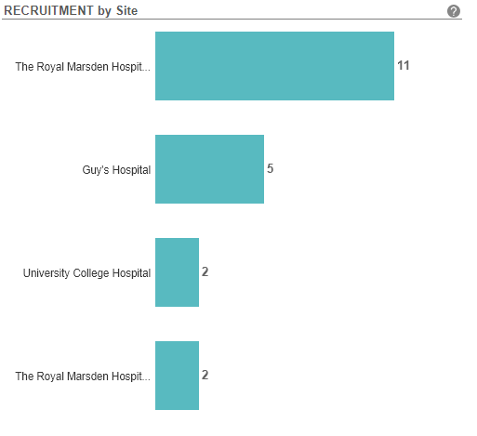
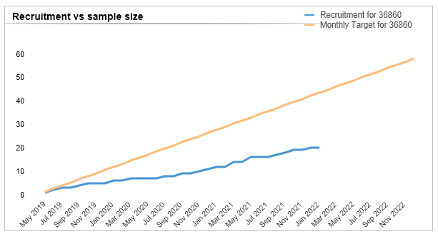
Managed Recovery Studies - OG Cancer
36860 ROLo: Phase II study of ROS1 targeting with crizotinib in advanced E-cadherin negative, ER positive lobular breast cancer or diffuse gastric cancer
No Sites in region
Open, With Recruitment. Opened 09/05/2019, Closing 31/12/2022. Sample Size UK - 58 UK recruits - 20

Slide 12
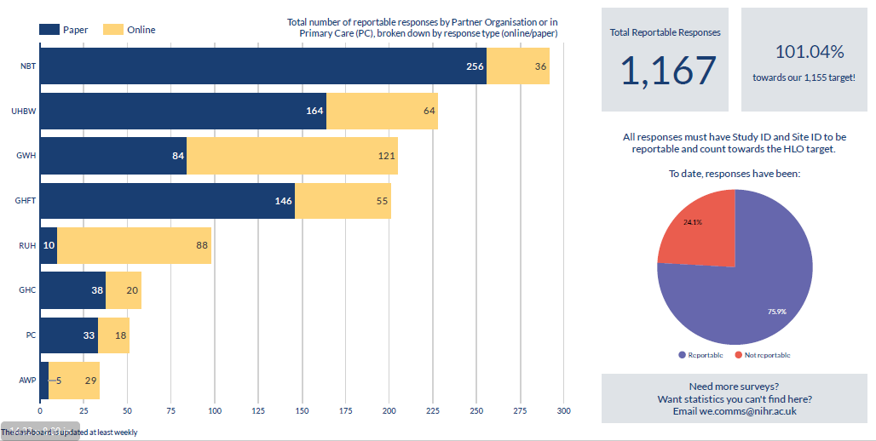
The Participant in Research Experience Survey 2021-22

Slide 13
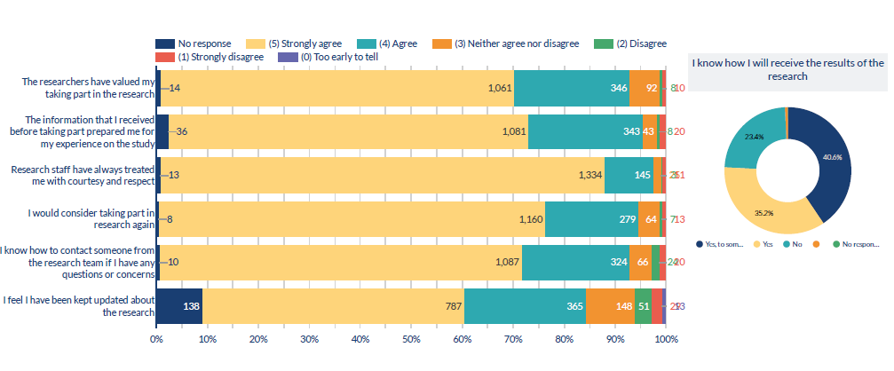
PRES Question responses
The survey has so far captured information from participants in 123 different studies

Slide 14
Research Scholars Programme
This new scheme offers financial and learning and development support for health and care staff looking to become research leaders of the future.
Open to early career health and care research professionals including:
Specialty and general practice trainees (including those out-of-programme)
New consultants within 5 years of taking up their post
Nurses, midwives and Allied Health Professionals (usually Band 7 or above)
Health and care professionals at a similar stage of their career (including research practitioners, clinical psychologists, pharmacists, public health and social care practitioners, healthcare scientists, dental practitioners)
The programme is targeted at those working in the West of England, which covers Bristol, Bath and North East Somerset (BaNES), Swindon, Gloucestershire, North Somerset and North Wiltshire.
Funded at one day per week (2 PAs, 0.2wte Agenda for Change) rate until March 2024.
https://local.nihr.ac.uk/documents/crn-we-research-scholars-programme-2022-2024/29586

Slide 15
NIHR ODP https://odp.nihr.ac.uk/
Open data platform. Data on performance and restart across whole CRN, including all specialty areas
NIHR Be Part of Research https://www.ukctg.nihr.ac.uk/
See which studies are open across the country
National Cancer Research Institute Portfolio Maps http://csg.ncri.org.uk/portfolio/portfolio-maps/
View current national portfolio of open, closed and ‘in set up’ cancer studies
Find a Clinical Research Study (ODP) http://csg.ncri.org.uk/portfolio/portfolio-maps/
Search for a study to fit criteria. Good for horizon scanning, eligibility criteria

Slide 16
LCRN Contacts
Research Delivery Manager
West of England: claire.matthews@nihr.ac.uk
South West Peninsula: joannetaylor1@nhs.net
Wessex: J.C.Walters@soton.ac.uk
Research Portfolio Facilitator
West of England: iqra.hussain@nihr.ac.uk
Sub-specialty Lead
West of England: sharath.gangadhara@nhs.net

