Slide 1
SWAG OG RDS Update
21/01/2022

Slide 2
RDS Overview
7 Key Principles that need to be embedded into the RDS Pathways
Aim to meet the FDS 28 day target
As part of the Long Term Plan, all pathways must be RDS pathways by end of 23/24

Slide 3
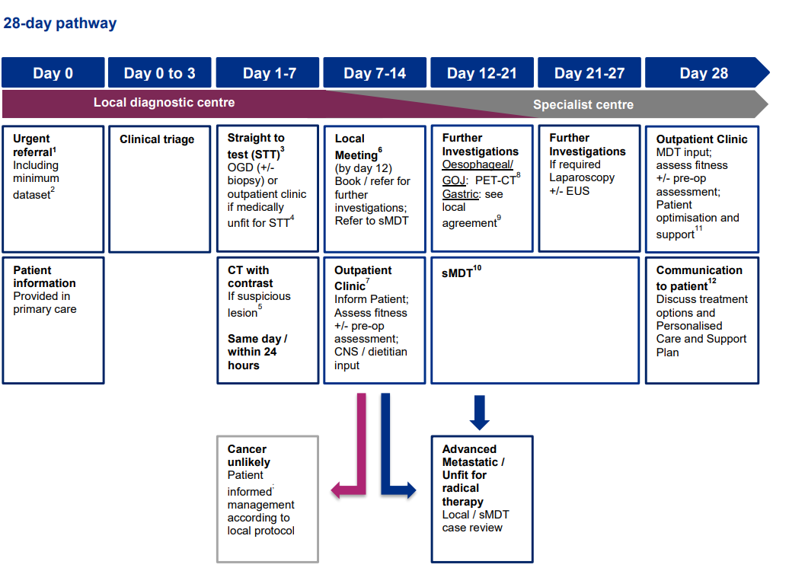
RDS Overview – Best Practice Timed Pathway
OG Key National Milestones | Clinical triage by day 3
 | OGD (+/- biopsy) performed or outpatient clinic by day 7
 | CT with contrast performed If suspicious lesion by day 8

Slide 4
OG Plan on a Page
OG Plan on a page template
Examples of Good Practice: For resectable oesophagus/GOJ cases – PET-CT and EUS performed same week to enable timely treatment plan Early dietetics input (at or within few days of diagnosis being given)
Alliance Objectives | Action Plan to Implement | Delivery Timelines | Resource Requirements
Apply RDC Principles to suspected OG Pathway
Implement the timelines as described in the National Timed Pathway for Oesophago-gastric Cancer (previous slide) inc. communication by day 28 (FDS standard)
Specialist OG RDC Navigator with supported clinical triage for planning investigations, subsequent clinic appointments & driving patients through the pathway at all Units and Centres ensuring regional equity. Co-ordination of ongoing investigations for other malignancies to minimise delays in the OG pathway.
Engagement with Radiology to streamline investigations for any additional malignancies; e.g. a fast track referral route.
Standardised Dysphagia grade & performance status at referral – embed this into referral process at GP & provide training for GPs where required/desired.
Staging CT test prior to specialist MDT Referral (unless patient is too unwell/unfit) – to take place by day 14. Protocol in place if Staging CT has not been done.
Additional investigations by day 21 (ideally Oesophageal/GOJ: PET-CT +/- EUS)
Early nursing and/or dietetics contact for new diagnosis patients and additional supportive care including dietician, palliative care, OT, physio. Holistic needs assessment.
Nasogastric Tube support in the community & earlier education around nutrition for patients and referrers.
Engage with the Cancer Alliance to deliver evaluation e.g.: Nation RDC minimum data set, patient experience evaluations (with support from CSU), Pathway Analysis.

Slide 5
OG Due Diligence Criteria
SWAG SS OG RDS Requirement | Achieved | Partially Achieved | To be achieved Q4 21/22 | Evidence of Achievement
Implement triage by Day 3 for urgent 2WW referrals (principle 4) |  |  |  | In SOP for Pathway
System wide measures to increase appropriate referrals & standardise referral forms – to include standardised Dysphagia grading (principle 1)
Referral quality feedback loop (principle 2)
Protocol for internal escalation from DA OGD to Cancer Pathway (principal 6) |  |  |  | In SOP for Pathway
Single point of contact (with cover) for patient incl. MECC approach and patient information throughout diagnostic journey followed by handover to CSW where cancer diagnosed (principle 7) |  |  |  | Phone number & role for Single point of Contact
STT OGD pathway by day 7 unless patient is too unwell/unfit (principle 3) |  |  |  | In SOP for Pathway
Local Review/MDT by day 12 (principle 5) |  |  |  | In SOP for Pathway
Coordinated testing minimising number of hospital visits (principle 4) |  |  |  | In SOP for Pathway
Specialist MDT by day 21 (principle 5) |  |  |  | In SOP for Pathway
Communication cancer / no cancer to patients by day 28 (principle 5) |  |  |  | In SOP for Pathway + FDS performance
All patients that are well/fit enough to receive staging CT prior to OG MDT referral (principle 3) |  |  |  | In SOP for Pathway
Clear responsibilities and guidelines for diagnosis report or onward referral for relevant patients (principle 6)
Patient Information to include all relevant charity support & signposting towards help available for the patient & family (principle 7) |  |  |  | Examples of patient leaflet etc.

Slide 6
RDS Update Jan 2022
Original aim to get feedback on the planning templates in December 2021, however this was extended due to requests from Operational Teams at most trusts.
Deadline moved to Jan – so far 4/7 providers have submitted their plans & 1 – UHBW – has confirmed meeting the RDS criteria & submitted SOP (other 3 are being reviewed by SWAG management)
Agreement/Understanding within SWAG that Covid pressures have been high in recent weeks.
Further improvement ideas & suggestions for the RDS funding are always welcome – feel free to contact me!
Also looking for feedback on dysphagia grading and a standard we can apply across SWAG

