Slide 1
SWAG Network Haematological Cancer
Clinical Advisory Group
Research Update - Claire Matthews
12/01/2022

Slide 2
National Recruitment to Haematological Cancer Studies
Apr 2020 - Jan 2022
Data cut 06/01/2022
Source: ODP All Portfolio

Slide 3
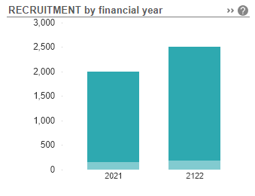
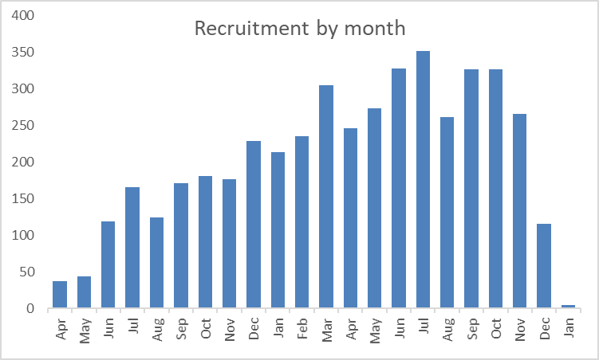
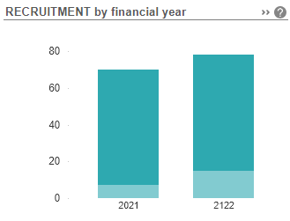
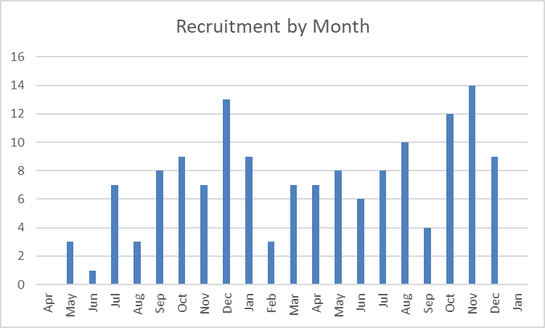
National vs Regional Recruitment to Haematological Cancer Studies Apr 2020 - Jan 2022
National Recruitment
Apr 20 - Mar 21 recruitment during the pandemic
Apr 21 - Jan 22
Some recovery of recruitment to research being seen
West of England Recruitment
Apr 20 - Mar 21 recruitment during the pandemic
Apr 21 - Jan 22
Some recovery of recruitment to research being seen
Data cut 06/01/2022
Source: ODP All Portfolio

Slide 4
West of England (+ Taunt/Yeov) Haematological Cancer Studies Opened 2021-2022
CPMS ID | Short Name | Sites | Open | Closure | Target Eng | Eng Rec.
50523 | CREST UK: REAL-WORLD EFFECTIVENESS AND SAFETY STUDY | BHOC | 16/12/21 | 31/05/22 | 35 | 0
47333 | Asciminib evaluation in previously treated CML patients | RUH | 23/11/21 | 13/04/23 | 12 | 4
50721 | Standard of Care for Relapsed Refractory Multiple Myeloma | NBT | 18/11/21 | 30/11/22 | 9 | 2
48653 | Safety and acceptability of exercise for Chronic Lymphocytic Leukaemia | RUH, NBT | 01/10/21 | 31/03/23 | 40 | 0
47308 | INCB 50465-313 | GRH | 27/09/21 | 31/12/22 | 13 | 0
44896 | Mobilising tumour and immune cells via exercise in CLL | RUH | 03/09/21 | 13/02/22 | 60 | 0
47316 | INCB 50465-304 | GRH | 30/06/21 | 01/11/23 | 5 | 0
46867 | VICTOR | BHOC | 01/06/21 | 30/11/22 | 109 | 3
43741 | ALLTogether1 | BHOC, RUH, BRHC, GWH, GRH | 18/05/21 | 31/05/27 | 1745 | 18
47218 | MDS-3674/0013-Forty Seven-Gilead | BHOC | 17/05/21 | 06/07/22 | 11 | 5
45865 | ALXN-1210-TMA-314 | BRHC | 14/05/21 | 01/05/22 | 2 | 0
44923 | RADAR (UK-MRA Myeloma XV) | BHOC, GRH | 11/05/21 | 30/04/23 | 1040 | 51
46602 | CCP-Cancer UK | NBT | 22/03/21 | 01/10/22 | 2500 | 0
45864 | Uproleselan with chemotherapy vs chemo alone in adults with R/R AML | BRI, BHOC | 18/03/21 | 16/09/21 | - | 0
46679 | M15-954:Venetoclax and/or Azacitidine in Newly Diagnosed High-Risk MDS | BHOC | 02/03/21 | 01/09/22 | 16 | 4
44269 | ITHACA | BHOC | 01/03/21 | 31/10/22 | - | 2
41019 | VERITAS | BRHC | 11/01/21 | 31/03/24 | 28 | 1

Slide 5
Additional Information
Data for all open studies opened before 2021 is available here:
https://docs.google.com/spreadsheets/d/1HsjFxLmeNiBOaO6OPKIIEjh6QaNDVSs4/edit?usp=sharing&ouid=116508400395350162569&rtpof=true&sd=true
Total of 48 Studies

Slide 6
West of England (+ Taunt/Yeov) Lead Haematological Cancer Studies - Open
CPMS Study ID | Lead LCRN | Commercial Study | Short Name | Sites | Open | Closure | Sample Size Eng | Sample Size UK | England Recruits | UK Recruits
50523 | West of England | Commercial | CREST UK: REAL-WORLD EFFECTIVENESS AND SAFETY STUDY | BHOC | 16/12/21 | 31/05/22 | 35 | 150 | 0 | 0
48653 | West of England | Non Commercial | Safety and acceptability of exercise for Chronic Lymphocytic Leukaemia | RUH, NBT | 01/10/21 | 31/03/23 | 40 | 40 | 0 | 0
44896 | West of England | Non Commercial | Mobilising tumour and immune cells via exercise in CLL | RUH | 03/09/21 | 13/02/22 | 60 | 60 | 0 | 0
43741 | West of England | Non Commercial | ALLTogether1 | BHOC, RUH, BRHC, GWH, GRH | 18/05/21 | 31/05/27 | 1745 | 2090 | 18 | 18
38207 | West of England | Non Commercial | ALL-RIC | BHOC | 17/09/18 | 30/09/22 | 202 | 242 | 63 | 70
Data cut 06/01/2022
Source: ODP All Portfolio

Slide 7
West of England In Setup Haematological Cancer Studies
CPMS ID | Short Name | Sites | Opening | Closure | Sample Size Eng | Sample Size UK
49750 | Post-Authorisation Registry of ELZONRIS in patients with BPDCN | BHOC | 01/01/22 | 13/08/24 | - | 19
49320 | CARTITUDE-5 | BHOC | 06/12/21 | 16/08/23 | 26 | 36
49247 | MajesTEC-3 | BRI | 17/12/21 | 22/05/23 | 25 | 28
49229 | DREAMM-14 | RUH, GRH | 10/01/22 | 04/01/23 | - | 18
49183 | CA057-001 | GRH | 09/01/22 | 25/07/23 | - | 30
49111 | ASC4FIRST: Asciminib vs TKI in newly diagnosed CML-CP | RUH | 12/01/22 | 11/01/29 | - | 14
48432 | MULTIPLE MYELOMA | BHOC | 01/07/22 | 24/07/23 | - | -
48001 | IgLINK Non-interventional study of IgRT in secondary immune deficiency | BHOC, RUH, NBT | 15/10/21 | 31/03/23 | - | 850
47943 | ENHANCE-2 | BHOC | 30/11/21 | 13/02/23 | - | 33
47474 | AGAVE-201- Phase 2 Study to evaluate Axatilimab in cGVHD | BHOC, BRHC | 07/10/21 | 02/07/23 | - | 7
46701 | M19-753: Navitoclax w & w/o Ruxolitinib in MPN patients | BHOC, GRC | 07/10/21 | 02/07/29 | - | 9
46564 | C1071003 Participants with Multiple Myeloma | BHOC, RUH | 01/06/21 | 30/09/21 | 6 | 7
44121 | Phase 3 study of Viralym-M in patients with virus associated HC | BHOC, BRHC | 31/07/21 | 01/09/22 | 16 | 16
Data cut 06/01/2022
Source: ODP All Portfolio

Slide 8
National In Setup Haematological Cancer Studies open to new sites 21/22
CPMS ID | Commercial Study | Short Name | Phase | Geo Scope | Planned / Actual Opening | Planned / Actual Closure | Sample Size Eng | Sample Size UK
48916 | Non-Commercial | REPAIR-MDS | II | UK Multi-site | 31/05/2021 | 31/08/2023 | 105 | 120
48476 | Non-Commercial | T-cell Project 2.0_Version 1.0 – June 18, 2018 | N/A | International, Multi-site | 30/04/2021 | 10/05/2023 | 40 | 50
48347 | Non-Commercial | Update of the EORTC QLQ-MY20 QOLQ for MM | N/A | International, Multi-site | 13/12/2021 | 30/06/2023 | 20 | 20
48133 | Non-Commercial | ProMMise | I | UK Multi-site | 03/01/2022 | 30/04/2026 | 38 | 46
48001 | Commercial | IgLINK Non-interventional study of IgRT in secondary immune deficiency | N/A | UK Multi-site | 15/10/2021 | 31/03/2023 | - | 850
47305 | Non-Commercial | E-MPN | N/A | UK Multi-site | 15/02/2021 | 01/04/2024 | 150 | 150
46918 | Commercial | Study of Tazemetostat alone & combined with itraconazole & rifampin | I | International, Multi-site | 30/06/2021 | 01/07/2022 | - | 15
43724 | Non-Commercial | The UK-MPN-MF Registry | N/A | UK Multi-site | 31/07/2021 | 31/01/2022 | 150 | 200
41723 | Non-Commercial | Pre-clinical assessments for precision medicine in myeloma - OASIS | N/A | UK Multi-site | 01/05/2020 | 01/05/2025 | 400 | 400
33876 | Non-Commercial | UK CLL LTFU Study | N/A | UK Multi-site | 01/07/2020 | 01/01/2040 | 700 | 800
Data cut 06/01/2022
Source: ODP All Portfolio

Slide 9
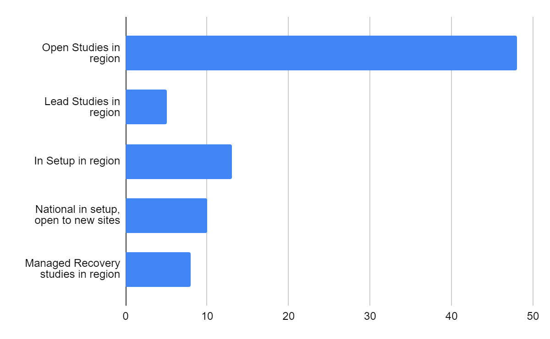

Slide 10
CRN High Level Objectives (HLOs) 21/22
Efficient Study Delivery metrics (study level):
Proportion of new commercial contract studies achieving or surpassing their recruitment target during their planned recruitment period, at confirmed CRN sites (studies opened and closed within the year) [80%]
Maribavir 12 months Chart Review - No sites in WE/SW Pen
M19-191 Front line study of Navitoclax for Myelofibrosis - No sites in WE/SW Pen
Proportion of commercial contract studies in the Managed Recovery process achieving or surpassing their recruitment target during their planned recruitment period [80%]
M19-191 Front line study of Navitoclax for Myelofibrosis - No sites in WE/SW Pen

Slide 11
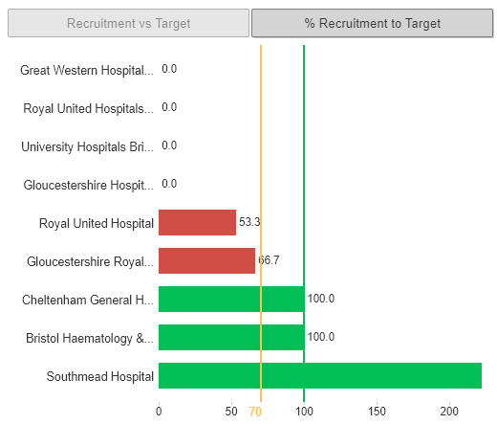
CRN High Level Objectives (HLOs) 21/22
Proportion of non-commercial studies in the MR process achieving or surpassing their recruitment target during their planned recruitment period [70%]
Myeloma XII (ACCoRd trial) V1 - CGH, GRH, NBT, RUH, BHOC

Slide 12
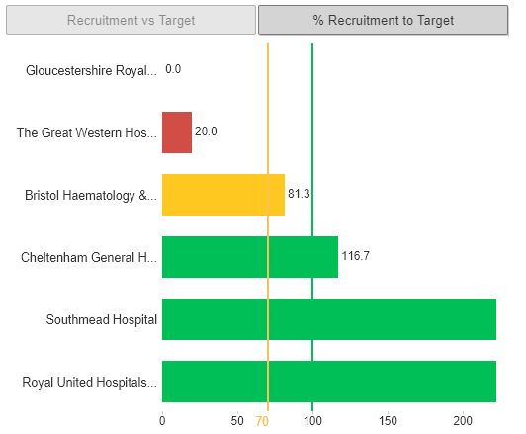
CRN High Level Objectives (HLOs) 21/22
Proportion of non-commercial studies in the MR process achieving or surpassing their recruitment target during their planned recruitment period [70%]
FLAIR - GRH, GWH, BHOC, CGH

Slide 13
Managed Recovery Studies in Region
CPMS ID | Short Name | Sites in SWAG region | Planned / Actual Opening | Planned / Actual Closure | Sample Size England | Sample Size UK | England Recruits | UK Recruits
46564 | C1071003 Participants with Multiple Myeloma | BHOC, RUH | 01/06/2021 | 30/09/2021 | 6 | 7 | 0 | 0
41533 | Azacitidine + MBG453/placebo in patients with MDS or CMML-2 | MPH, RUH, | 16/12/2020 | 01/04/2022 | 4 | 5 | 4 | 4
47218 | MDS-3674/0013-Forty Seven-Gilead | BHOC | 17/05/2021 | 06/07/2022 | 11 | 30 | 5 | 5
38923 | STELLAR | YDH | 23/07/2019 | 07/01/2022 | 72 | 84 | 21 | 23
19700 | MyeChild 01 | BRHC | 29/04/2016 | 28/04/2022 | 304 | 350 | 263 | 304
42281 | Myeloma XIV (FiTNEss) | NBT, BHOC, GRH, RUH | 04/08/2020 | 04/02/2023 | 725 | 740 | 277 | 306
32907 | Myeloma XII (ACCoRd trial) Version 1.0 | RUH, GRH, BHOC, NBT, MPH, CGH, GWH | 20/03/2017 | 31/03/2022 | 420 | 498 | 406 | 466
16675 | FLAIR | GRH, GWH, BHOC, CGH, MPH | 21/08/2014 | 31/01/2022 | 1552 | 1552 | 1,249 | 1,477

Slide 14
CRN High Level Objectives (HLOs) 21/22
Participant Experience:
Number of NIHR CRN Portfolio study participants responding to the Participant Research Experience Survey (PRES) each year [1,155].
1077 surveys returned to date (06/12/21)
Aim for each trust is to return surveys from 5% of participants recruited.
Overall figure is 4.5% (range across the trusts is 0.7% - 28.3%)
Ensure study is identified on completed PRES forms

Slide 15
Research Scholars Programme
This new scheme offers financial and learning and development support for health and care staff looking to become research leaders of the future.
Open to early career health and care research professionals including:
Specialty and general practice trainees (including those out-of-programme)
New consultants within 5 years of taking up their post
Nurses, midwives and Allied Health Professionals (usually Band 7 or above)
Health and care professionals at a similar stage of their career (including research practitioners, clinical psychologists, pharmacists, public health and social care practitioners, healthcare scientists, dental practitioners)
The programme is targeted at those working in the West of England, which covers Bristol, Bath and North East Somerset (BaNES), Swindon, Gloucestershire, North Somerset and North Wiltshire.
Funded at one day per week (2 PAs, 0.2wte Agenda for Change) rate until March 2024.
https://local.nihr.ac.uk/documents/crn-we-research-scholars-programme-2022-2024/29586

Slide 16
NIHR ODP https://odp.nihr.ac.uk/
Open data platform. Data on performance and restart across whole CRN, including all specialty areas
NIHR Be Part of Research https://www.ukctg.nihr.ac.uk/
See which studies are open across the country
National Cancer Research Institute Portfolio Maps http://csg.ncri.org.uk/portfolio/portfolio-maps/
View current national portfolio of open, closed and ‘in set up’ cancer studies
Find a Clinical Research Study (ODP) http://csg.ncri.org.uk/portfolio/portfolio-maps/
Search for a study to fit criteria. Good for horizon scanning, eligibility criteria

Slide 17
Research Delivery Manager
claire.matthews@nihr.ac.uk
Research Portfolio Facilitator
iqra.hussain@nihr.ac.uk
Sub-specialty Lead
sally.moore@ruh.nhs.uk
sallymoore5@nhs.net

