Slide 1
Spinal Cord Compression Pathway
Dr Sarah Hargreaves
Consultant Clinical Oncologist

Slide 2
Malignant Spinal Cord Compression

Slide 3
Spinal Cord Compression Pathway at UHBW
Clinical or radiological concern about spinal cord compression?
Contact on call oncology SpR
Bleep 2490
Out of hours: via switch

Slide 4
Radiological suspicion of cord compromise
16mg Dexamethasone PO/IV STAT

Slide 5
DEMOGRAPHICS
Over 4000 patients a year in the UK
Metastatic disease
5% Patients
Frequently vague presenting symptoms
30% will live for over 1 year - QOL
Tumour type determines time to progression, ambulation at presentation and response to therapy

Slide 6
SYMPTOMS/SIGNS
Back pain - 95%
Weakness – 75%
Marked, symmetrical
Upper motor neurone deficit = Brisk ankle and knee flexes, up going plantars
Autonomic disturbance – 50%
Loss of sphincter function is late
Sensory disturbance – 50%
Symmetrical

Slide 7
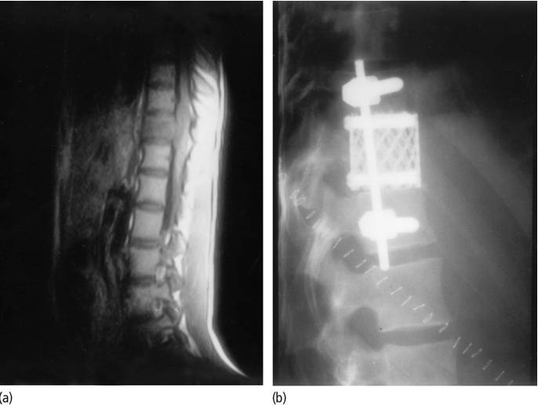
Management
Radiotherapy – Majority of patients
Neurosurgery?
Fragments
PS 0-2
Stable disease
Life expectancy over 3 months
No diagnosis
Radioresistant disease
Chemotherapy? HD, NHL, GERM CELL

Slide 8
Radiotherapy
Randomised to single 8Gy/1F versus 20Gy/5F
PEP = ambulatory status at 8 weeks
694 patients (255 died before 8 weeks)
8Gy/1F did not meet non inferiority criterion for being ambulatory at 8 weeks (69.3% vs 72.7%)
Could be considered for patients with LE less than 6 months/poor PS

Slide 9
Radiotherapy
Prognostic factors may influence the need for treatment, type of treatment and treatment schedule.
Potential prognostic factors that might help to determine a positive functional outcome after treatment include:
Performance status (ECOG PS 0-2)
More favourable histology (lymphoma, myeloma, seminoma, breast, prostate and gastrointestinal)
Still ambulatory
More than two years since original diagnosis
Slow development of motor deficit

Slide 10
Radiotherapy: Outcomes
Retrospective study of 1852 patients
8% recurred in field
39% improved neurology
47% no progression of neurology

Slide 11
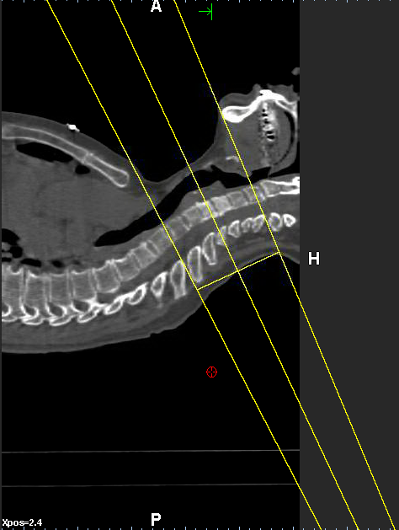
Side effects related to site

Slide 12
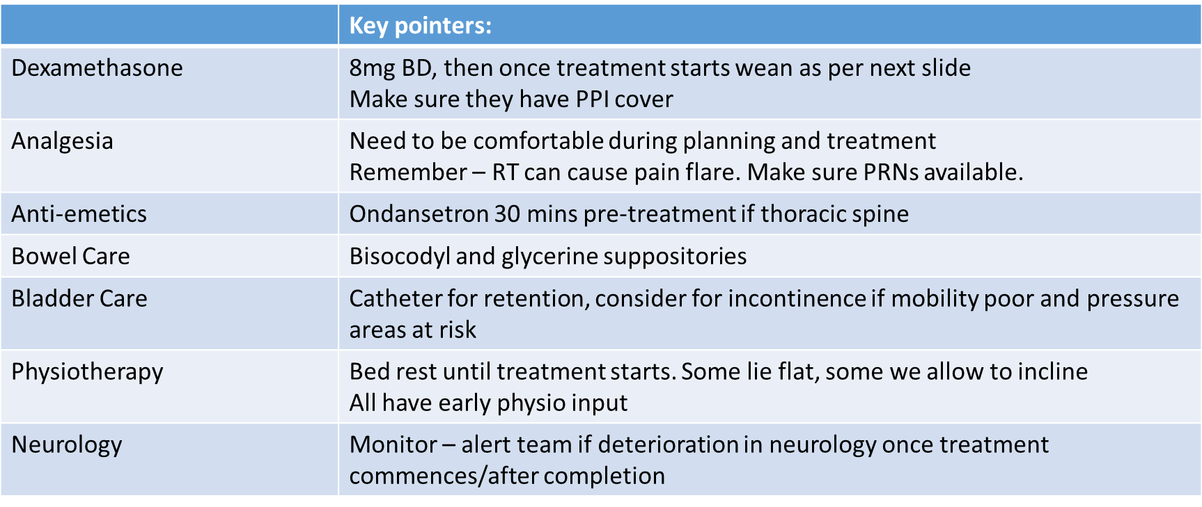
Holistic Care

Slide 13
Steroid management

Slide 14
Remember Cauda Equina
Lower motor neurone signs:
Flaccid paralysis
Reduced reflexes
Urinary retention
Saddle paraesthesia

Slide 15
Spinal Cord Compression Pathway at UHBW
Clinical or radiological concern about spinal cord compression?
Contact on call oncology SpR
Bleep 2490
Out of hours: via switch

Slide 16
The End
Thank you, any questions?

