Slide 1
Free flaps Bristol 2010-2020
Etienne Botha ST7 OMFS
Emily Gray DCT2 OMFS

Slide 2
Objectives
To retrospectively collect data on free flap survival from 2010 to 2020.
To determine number and types of free flaps which did not survive.

Slide 3
Data collection
Starting point – email to Business Intelligence
Query for 10 years of data was forwarded to coding department

Slide 4
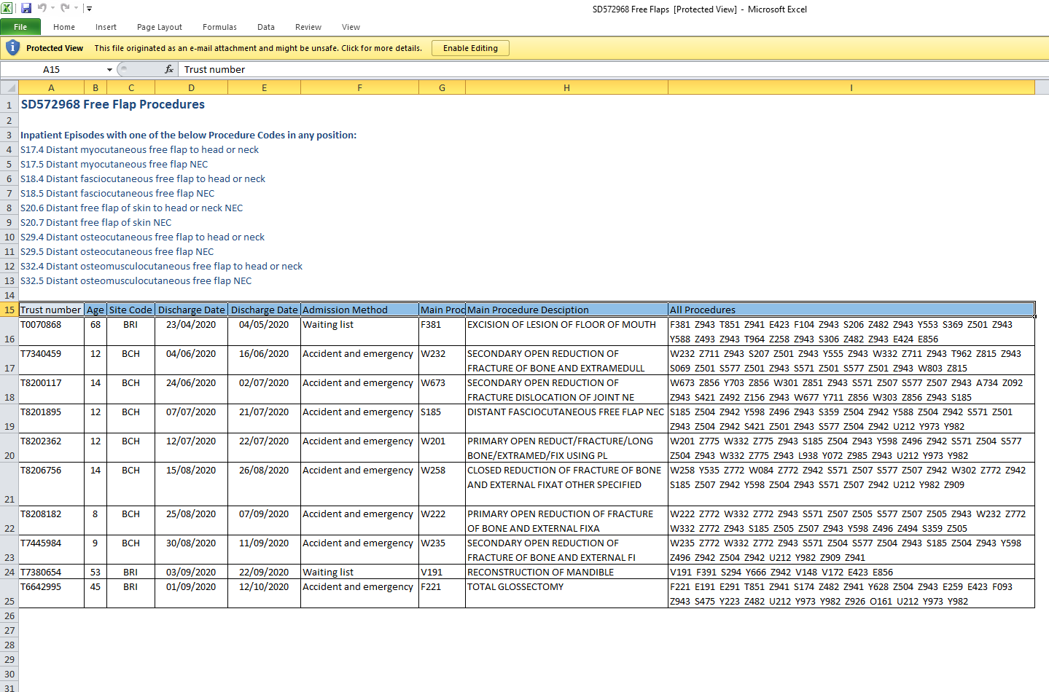

Slide 5
Data collection issues
Estimate of approx 300 flaps over this time period.
Why were results not being displayed?
Bluespiere software was analysed. Previous 12 months of flaps were reviewed and the codes for the procedures noted. It was found that nurses coded the procedures and this was sometimes done incorrectly.
I attempted to run a search through Bluespiere using the codes…

Slide 6
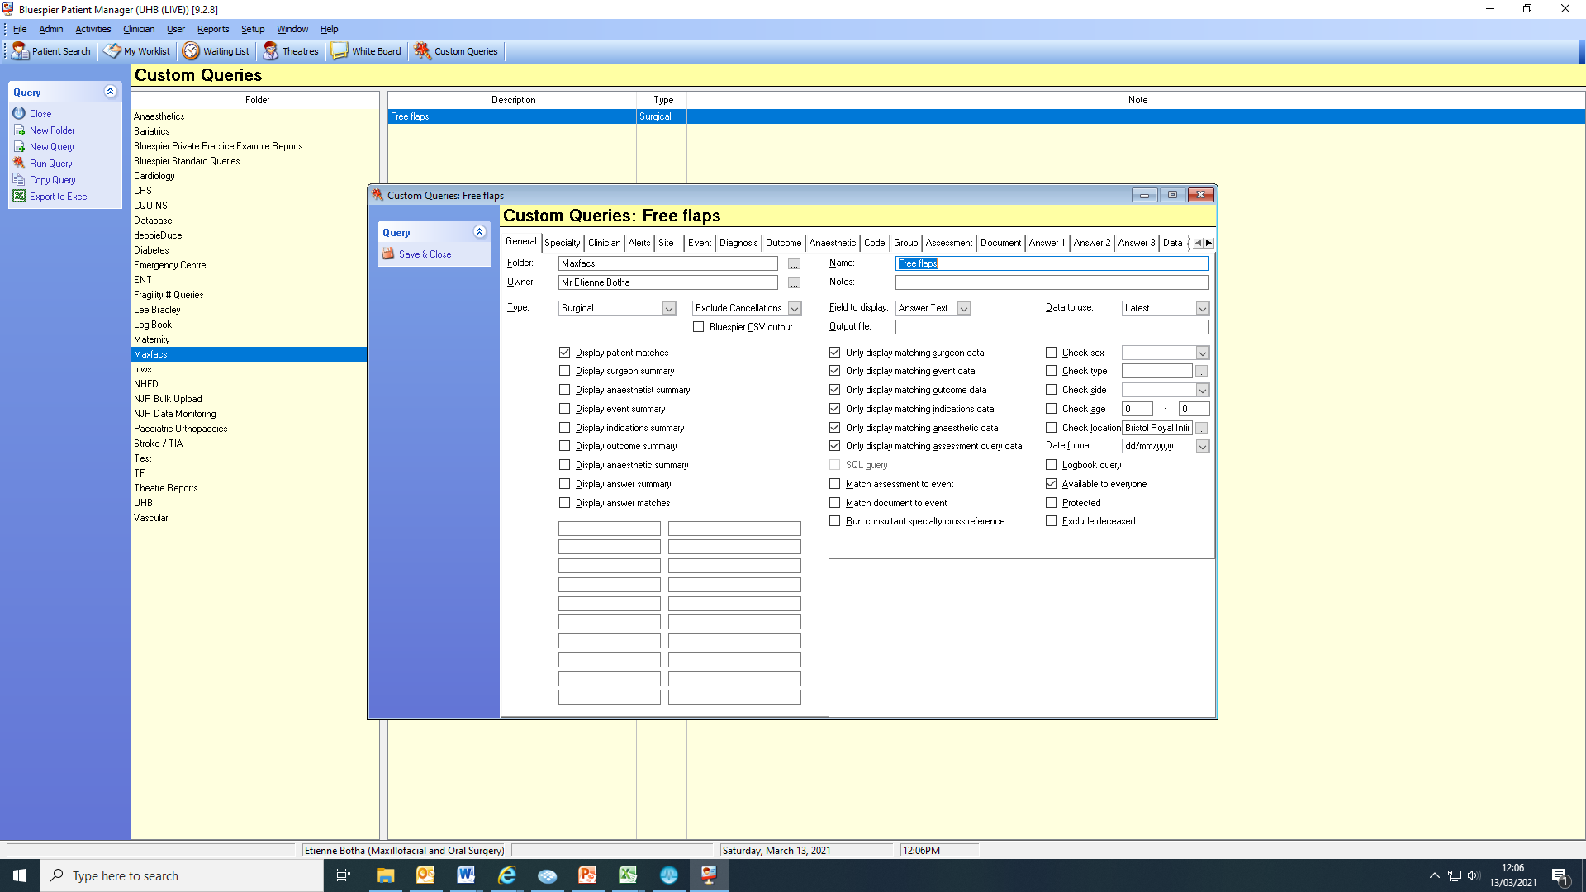

Slide 7
Data collection issues
Bluespiere entries 2010-2016 archived – unable to retrieve.
However light at the end of the tunnel…

Slide 8
Data Collection
New list from coders contained 226 patients spanning 2010-2020.
Next task was to verify the list. This was done by looking at electronic records – Medway, Bluespiere and Evolve to confirm if patients received a free flap.
The search found 199 patients.

Slide 9
Finding more data
Good stroke of luck – Dr Rachel Craven was doing a project on head and neck patients admitted to ITU.
This list contained 479 patients.
Hypothesis: all OMFS free flaps will go to ITU post surgery.
Craven list contained data on all head and neck patients being admitted to ITU – included ENT patients, infections etc.

Slide 10
Data completed
Craven list was cross referenced with list from coders.
All non-oncology operations were removed from the list.
Remaining patients had electronic records searched to determine if there they received a free flap.
Final list 237 patients

Slide 11
Demographics
Females 80 Males 159
Average age 62 years old. Range 26-87
Average female weight 64kg. Range 39-120
Average male weight 81kg. Range 49-157
Average number of days on ITU 3 days. Range 1 – 13.

Slide 12
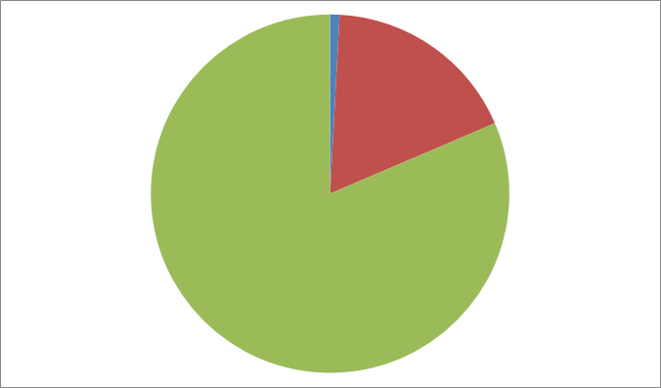
Flaps
ALT 2
Fibula 42
Radial 193

Slide 13
Flap Failures
3 flaps did not survive and were removed
2x radial and 1x fibula
3/237 = 1.3%

Slide 14
CB
Sex: Female
Age at operation: 50
Date of operation: 19/6/2014
Diagnosis: T1N0M0 SCC soft palate
Procedure: Resection, SND, RFFF
Return to theatre 22/6/2014 for re-look and re-anastamosis
Return to theatre 2/7/2014 for removal of non-viable flap.
Sphincter Pharyngoplasty 2016

Slide 15
SS
Sex: Male
Age at operation: 51
Date of operation: 02/02/2018
Diagnosis: T4N0M0 Right RMT
Procedure: Resection –Rt hemi-mandibulectomy, SND and Fibula flap.
Return to theatre 10/2/2018 – skin paddle necrotic, underlying bone non-viable with evidence of pus. Flap removed and defect closed primarily.
Of note patient had renal transplant with end stage renal failure. Tacrolimus restarted on day 2 post op.
Discharge 28/2/2018.
Recurrence in right neck June 2018.
Rapid deterioriation, unfit for radiotherapy
Date of Death 2/8/2018 aged 52

Slide 16
PJ
Sex: Male
Age at operation: 69
Date of operation: 23/4/2020
Diagnosis: T1N2bM0 left FOM/ventral tongue Procedure: Resection, SND, RFFF
Return to theatre 26/4/2020 – complete obstruction of vein, unable to flush. Flap removed and defect partially closed.
Discharged 4/5/21 on soft oral diet.
Of note patient has prothrombin gene mutation and has suffered with multiple VTE while on anticoagulation

Slide 17
Number of flaps

Slide 18
How has covid affected flap service?
ST6 year Aug 2020 – Aug 2021
41 Flaps
24 RFFF
12 Fibulas
4 ALTs
1 Scapula
Included 6 orbital exenterations!

Slide 19
Improvements
Data collection
UK national head and neck flap registry
All free flaps should be entered onto database
Small number of flap failures makes it difficult to generalise why flaps fail however patient selection clearly important

