Slide 1
Audit of dental extraction healing time prior to radiotherapy
Department of Restorative Dentistry
Alexander Gormley (NIHR Academic Clinical Fellow)
Sarah Garner, Tom Dudding, Lisa McNally

Slide 2
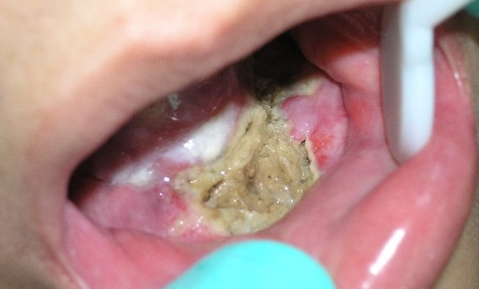
Osteoradionecrosis
Osteoradionecrosis (ORN) is a common complication of radiotherapy for head and neck malignancy whereby the bone undergoes necrosis, becoming exposed. This is usually symptomatic and may cause intra- or extra-oral fistulae, infection, pain and eventually pathological fracture (Dhanda et al. 2016)
Notes:
Risk factors for ORN include dental infection (at the root) and the extraction of teeth

Slide 3
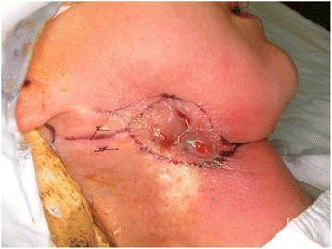
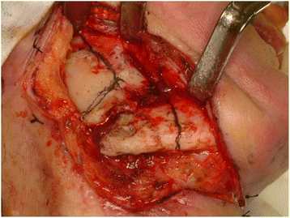
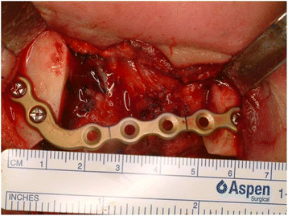
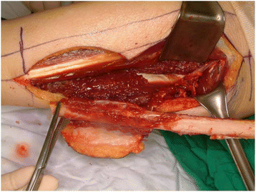
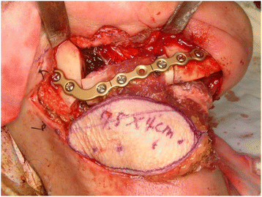
Osteoradionecrosis
Kim et al. 2016

Slide 4
ORN @ UHBW
Service Evaluation (2019)
All eligible patients from 2015-19 who received 60Gy of radiotherapy following a diagnosis for coded head and neck cancer
Sample (n = 60) of a total 332 eligible patients
6.6% (n = 4) developed ORN
Likely under-estimation (only clinical letters where ORN explicitly mentioned included)

Slide 5
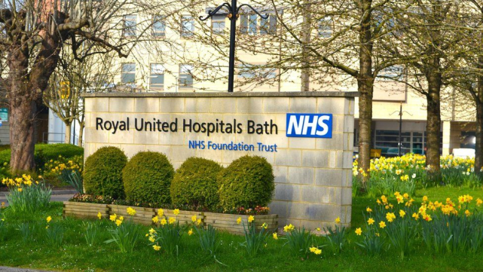
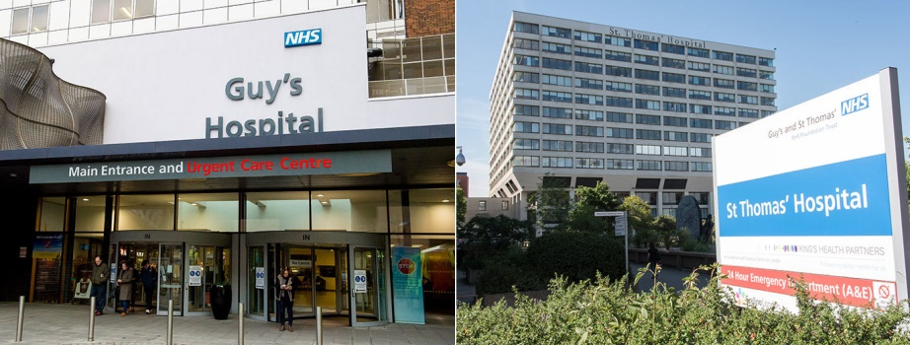
ORN: Wider Picture
6.9% - RUH, Bath (Fitton et al. 2019)
5.5% - GSTT, London (2009-14)(de Felice et al. 2016)
7.0% - International Systematic Review and Meta-Analysis (Nabbil and Samman, 2011)

Slide 6
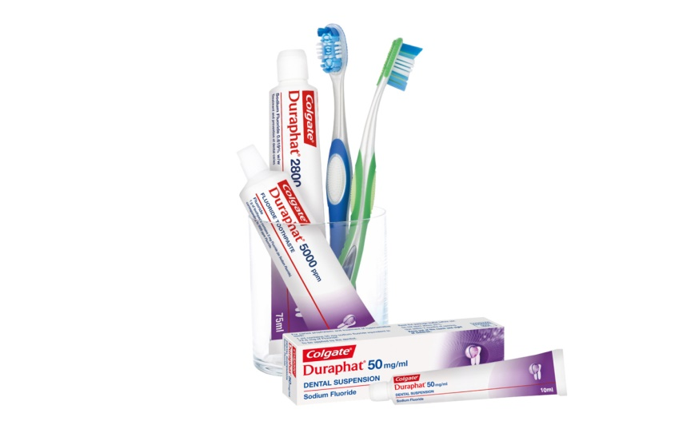
Reducing the Risk
EVERY patient having radiotherapy to the head and neck region should have a dental screen
Notes:
The screen aims to identify teeth of poor prognosis (decay, severe gum disease, root infections and partially erupted teeth) in the radiotherapy field and extract these prior to radiotherapy.

Slide 7
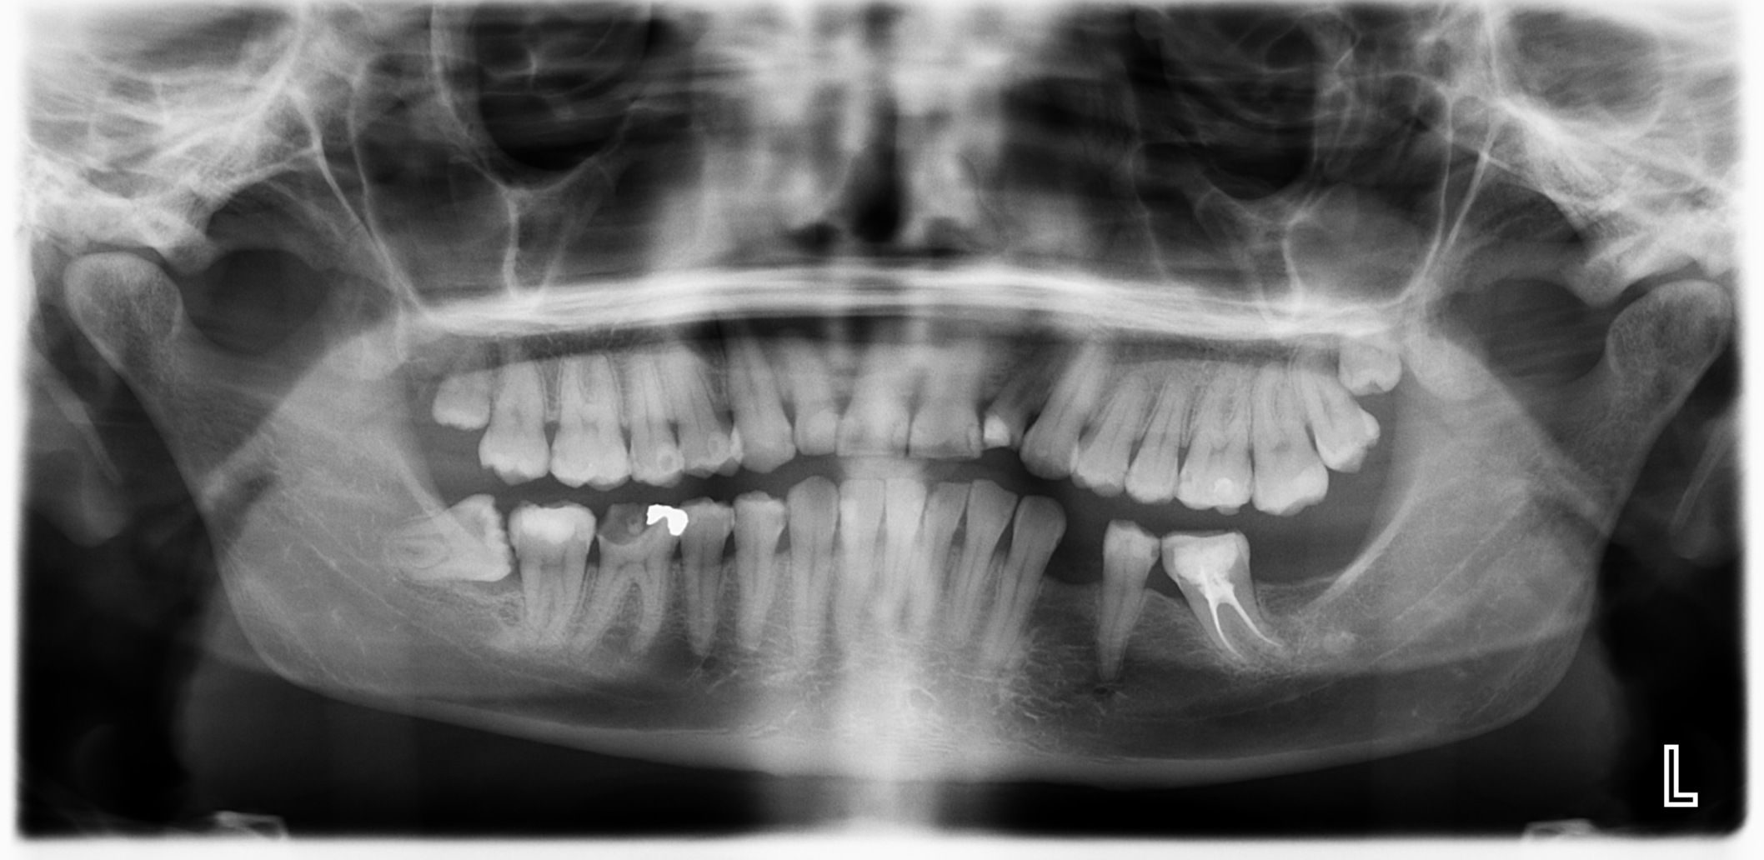
Reducing the Risk
Notes:
The screen aims to identify teeth of poor prognosis (decay, severe gum disease, root infections and partially erupted teeth) in the radiotherapy field and extract these prior to radiotherapy.

Slide 8
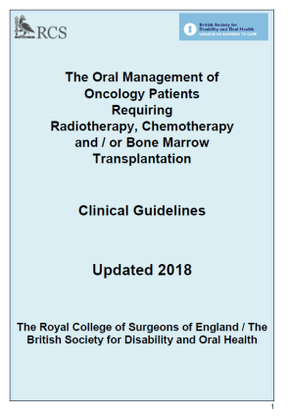
Reducing the Risk
Notes:
Observational evidence suggests lack of adequate healing time post-extraction can impact upon the incidence of ORN

Slide 9
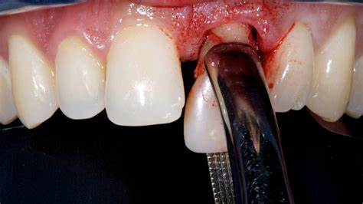
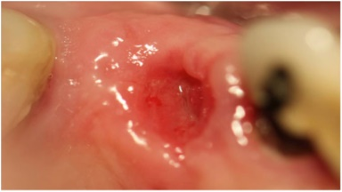
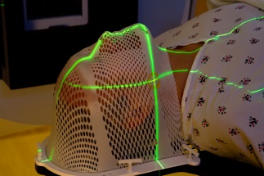
Healing Time Audit (1)
01/03/2020
01/01/2015
n = 50
+
+

Slide 10
Healing Time Audit (1)
Criteria | Target | Result
10 day gap between extractions and radiotherapy | 100%
14 day gap between extractions and radiotherapy | 75%
Review of extraction site 14 days post-extraction | 75%
Review of extraction site (at all)

Slide 11
Healing Time Audit (1)
Criteria | Target | Result
10 day gap between extractions and radiotherapy | 100% | 96% (48/50)
14 day gap between extractions and radiotherapy | 75% | 72% (36/50)
Review of extraction site 14 days post-extraction | 75% | 2% (1/50)
Review of extraction site booked (at all) |  | 6% (3/50)

Slide 12
Action Points
Dental Screen
(Restorative)
Kuldip/Fran
(BDH Management)
Extractions
Radiotherapy
(Oncology)
10 – 14 days
Extraction
(Oral Surgery)

Slide 13
Action Points
Dental Screen
(Restorative)
Kuldip/Fran
(BDH Management)
Extractions
AND mucosal check 14 days later
Radiotherapy
(Oncology)
Mucosal Check
(Oral Surgery)
Extraction
(Oral Surgery)
14 days

Slide 14
Healing Time Audit (2)
Criteria | Target | Result (1) | Result (2)
10 day gap between extractions and radiotherapy | 100% | 96% (48/50)
14 day gap between extractions and radiotherapy | 75% | 72% (36/50)
Review of extraction site 14 days post-extraction | 75% | 2% (1/50)
Review of extraction site booked (at all) |  | 6% (3/50)
Cancel no re-book/Did Not Attend (DNA) rate |  | 33% (1/3)

Slide 15
Healing Time Audit (2)
Criteria | Target | Result (1) | Result (2)
10 day gap between extractions and radiotherapy | 100% | 96% (48/50) | 100% (40/40)
14 day gap between extractions and radiotherapy | 75% | 72% (36/50) | 83% (33/40)
Review of extraction site 14 days post-extraction | 75% | 2% (1/50) | 43% (17/40)
Review of extraction site booked (at all) |  | 6% (3/50) | 73% (29/40)
Cancel no re-book/Did Not Attend (DNA) rate |  | 33% (1/3) | 17% (5/29)

Slide 16
Healing Time Audit (2)
 | Time (days) between extraction and review | Time (days) between review and radiotherapy
Mean (SD) | 13.7 (4.5) | 8.2 (11.9)
Median | 14 | 5
Min | 5 | -4
Max | 24 | 55

Slide 17
Healing Time Audit (2)
 | 1st Audit – Time (days) between extraction and radiotherapy | 2nd Audit – Time (days) between extraction and radiotherapy
Mean (SD) | 18.8 (7.6) | 21.7 (11.8)
Median | 18.9 | 19
Min | 7 | 11
Max | 42 | 69

Slide 18
Conclusion
Increased compliance with RCS Dental Oncology Guidelines
Time and economic consequences of this
Current service evaluation into number of ORN follow-up appointments
Complete second cycle and develop next action points

