Slide 1
Lynch syndrome southwest
Neil Ryan
Southwest Genomic Medicine Service Alliance Clinical Lead: Lynch syndrome.

Slide 3
Lynch Syndrome Management
Colonoscopy:
Every 2 years from
Aspirin
~50% reduction of cancer risk
Lifestyle Modification
Prophylactic TAH-BSO
~age 40 years
PGD
@ Cancer diagnosis
Adaptive surgery
Personalised onco-therapy
MLH1 MSH2: 25 years onwards
MSH6 PMS2: 35 years onwards

Slide 4

What should we be doing

Slide 5
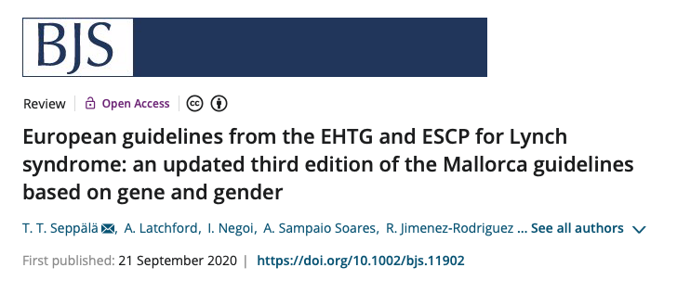

Slide 6
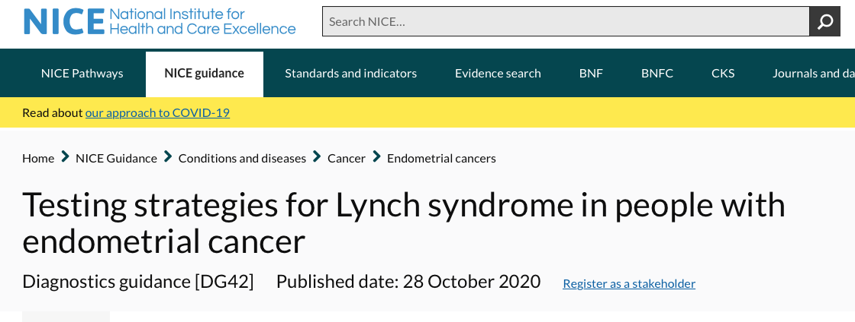
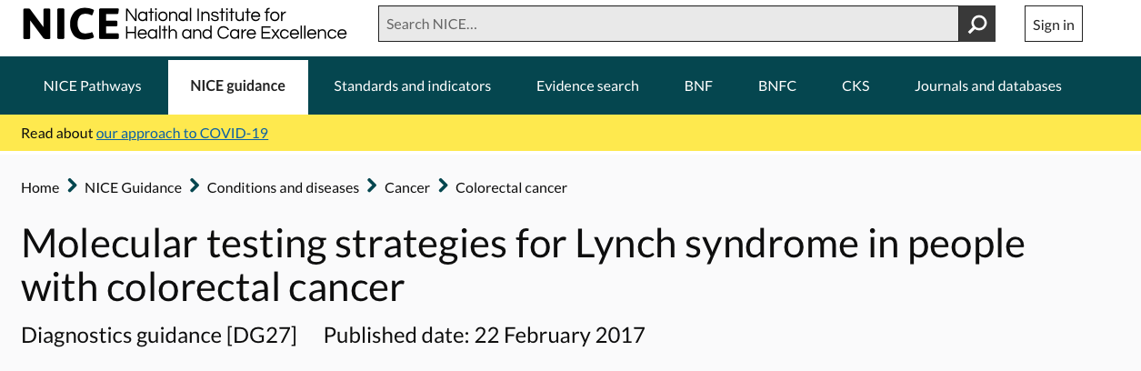

Slide 7
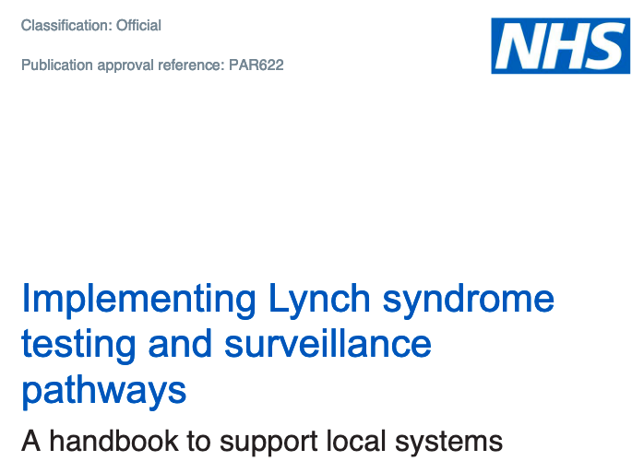

Slide 9

How are we doing

Slide 10
Cancer stats 2 data

Slide 11
20% of GO didn’t known LS was associated with OC
18% of GO didn’t agree with the universal LS screening in EC
<5% of Cancer Centers we carrying out universal screening in EC
The management of women with LS was far from uniform

Slide 12

How to improve

Slide 14
Genomic Medicine Service Alliance
Embedding genomics into routine care
Equity of access
Personalised medicine
Workforce Transformation programmes
Strong collaborations
Patient engagement

Slide 15
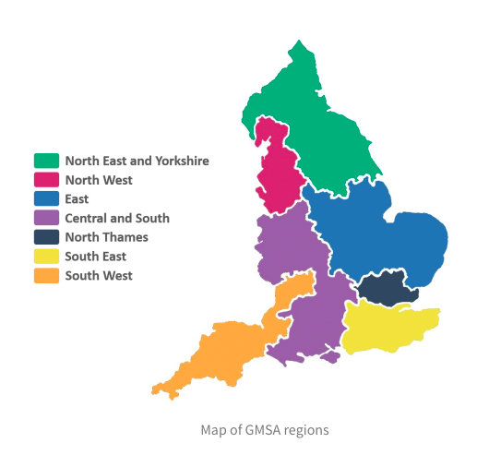
Genomics Medical Service Alliances (GMSAs)
January 2021
7 x GMSAs linked to Genomic Laboratory Hubs (GLHs)
Embedding genomics into routine patient care pathways
Clinical Reference Group (CRG)
  Advise on clinical policy and strategy for genomics
7 x National Projects

Slide 16
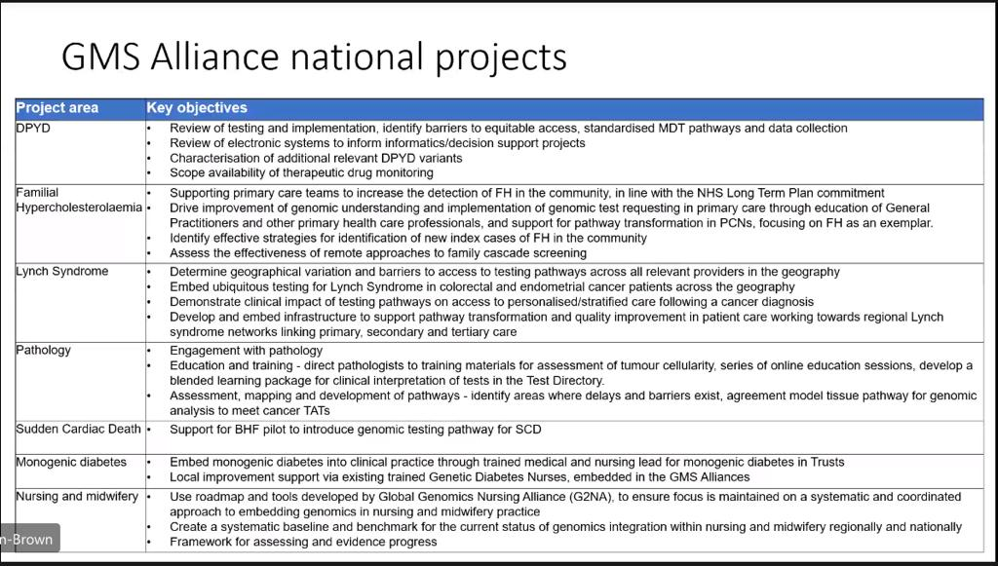
Genomics Medical Service Alliances

Slide 17

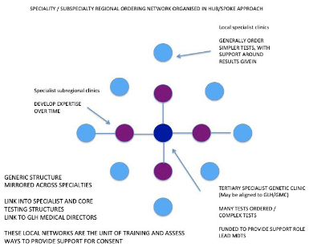
LS champion each cancer MDT
Ensure delivery testing pathway
Coordinate surveillance
Apply interventions e.g. aspirin
Regional Expert Centres
Affiliated RGCs/GMSAs & Cancer Networks
Truly multidisciplinary
Manage complexity, e.g. host MDMs
Ensure equity of access
CPD coordination
2 yearly CPD

Slide 19
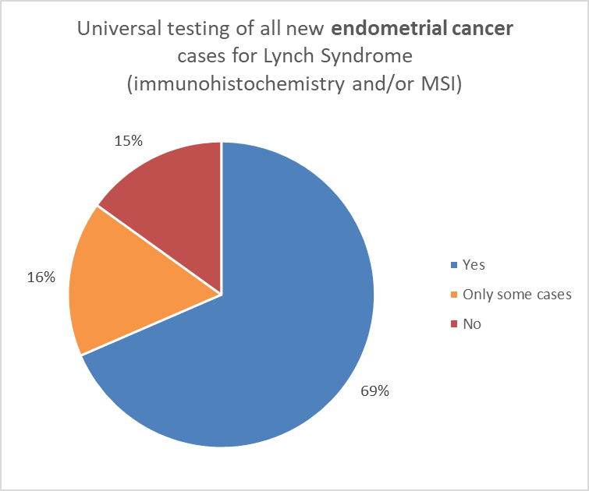

Slide 20
Endometrial | Peninsula | 2014 | 9 | 281 | 3.20%
Endometrial | Peninsula | 2015 | 5 | 275 | 1.82%
Endometrial | Peninsula | 2016 | 2 | 303 | 0.66%
Endometrial | Peninsula | 2017 | 1 | 307 | 0.33%
Endometrial | Peninsula | 2018 | 6 | 301 | 1.99%
Endometrial | Somerset, Wiltshire, Avon and Gloucestershire | 2014 | 3 | 406 | 0.74%
Endometrial | Somerset, Wiltshire, Avon and Gloucestershire | 2015 | 3 | 419 | 0.72%
Endometrial | Somerset, Wiltshire, Avon and Gloucestershire | 2016 | 6 | 421 | 1.43%
Endometrial | Somerset, Wiltshire, Avon and Gloucestershire | 2017 | 10 | 407 | 2.46%
Endometrial | Somerset, Wiltshire, Avon and Gloucestershire | 2018 | 6 | 428 | 1.40%

Slide 21
Registry
Surveillance
Clinical lead
Regional coordinator
Regional MDT
MDT coordinators
GLA results

Slide 22

Key areas to address in the region
My outstanding
Audit compliance with testing
Database of all LS patient
Follow up standardisation
A pan SW specialist MDT
Needed from you:
National survey completion
Network of MDT LS leads

Slide 23
MDT
Ensure delivery of NICE DG27 or DG42 i.e. universal testing for Lynch syndrome for newly diagnosed patients
  Allocate specific responsibilities within their team
  Eligible patients are referred for genetic testing OR offered genetic testing locally via ‘mainstreaming’ pathway
Link to regional network via cancer/genomic alliance
  Streamline referrals i.e. ensure a robust mechanism for referrals is implemented
  Refer new Lynch syndrome patients for colonoscopic surveillance
  Complex case management: can be discussed with regional centre
Complete the brief national survey: To assess current state of service within their MDT and identify support required https://www.surveymonkey.co.uk/r/lynch_survey
Training
  Complete short online training modules
https://rmpartners.nhs.uk/lynch-syndrome-early-diagnosis-pathway/
  2-yearly focused CPD delivered by regional expert centre

Slide 24
Name | Location | Specialty | Email
Pinias Mukonowesuro | Bath | Gynae (Pathologist) | pmukonoweshuro@nhs.net
Jane Borley | Cornwall | Gynae | jane.borley@nhs.net
Neil Ryan | Bristol | Gynae | neilryan@nhs.net
Katharine Edey | Exeter | Gynae | k.edey@nhs.net
Geoff Hughes | Plymouth | Gynae | geoff.hughes@nhs.net
? | Gloucester | Gynae | ?

Slide 26

Support

Slide 27
Resources
Patient Passport
Handbook from NSHE
NHS Futures website
https://future.nhs.uk/NHSgenomics/view?objectId=28572208
QIP supporting documents
Training website
https://rmpartners.nhs.uk/lynch-syndrome-early-diagnosis-pathway/

Slide 28
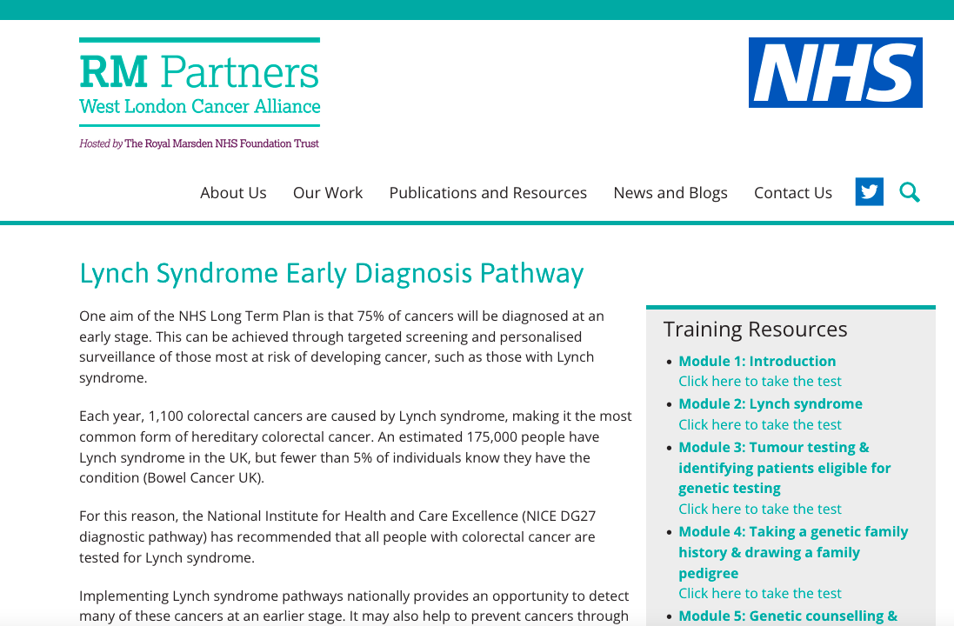

Slide 29
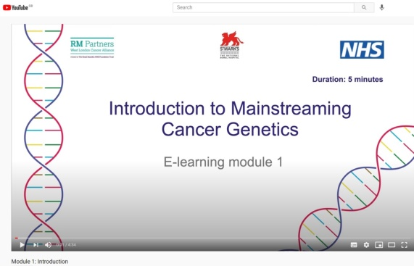
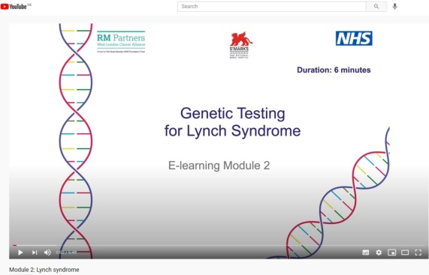
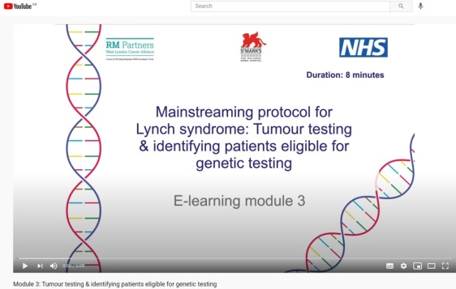
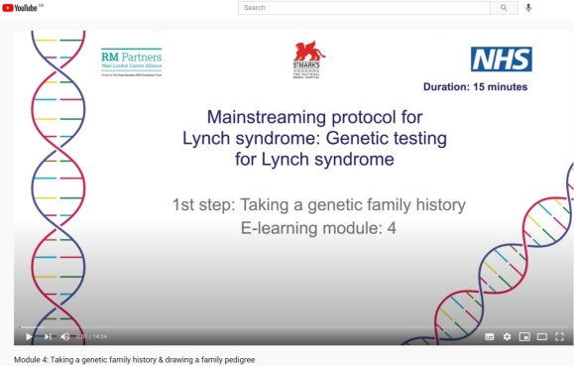
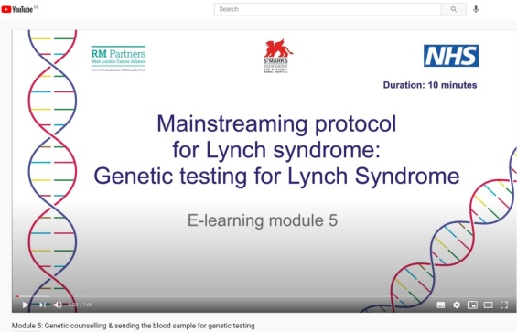
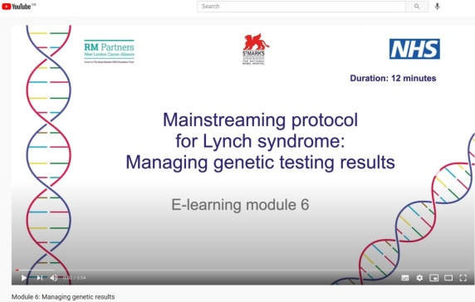
Online training Modules
Introduction: 5 minutes
Introduction LS: 6 minutes
Identifying LS: 8 minutes
Family Pedigree: 15 minutes
Genetic counselling: 10 minutes
Genetic Results: 12 minutes
Notes:
This template is copyright of Presentation Magazine. www.presentationmagazine.com

Slide 30

Focus on delivery of testing & team responsibilities
  Pragmatic solutions
1-2pm 10th and 23rd November
https://national-workshop-lynch-cancer-mdts.eventbrite.co.uk

Slide 31

Quick Questions
What software do you currently use to record your MDT meeting?
What is the main software package is used by your hospital?

Slide 32

Questions?
neilryan@nhs.net

Slide 33
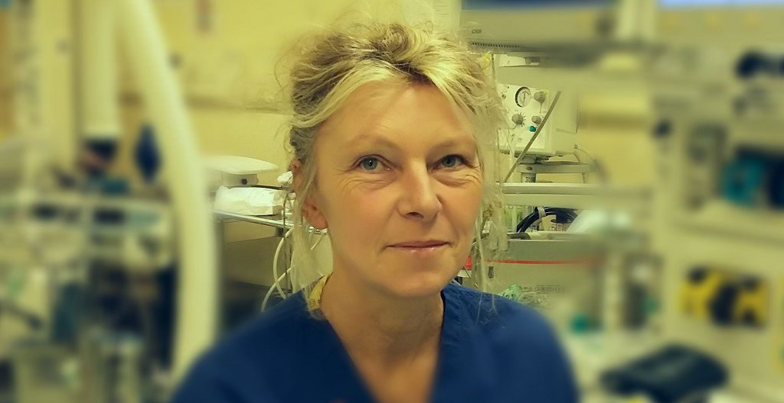

Slide 34

Mainstreaming

Slide 35
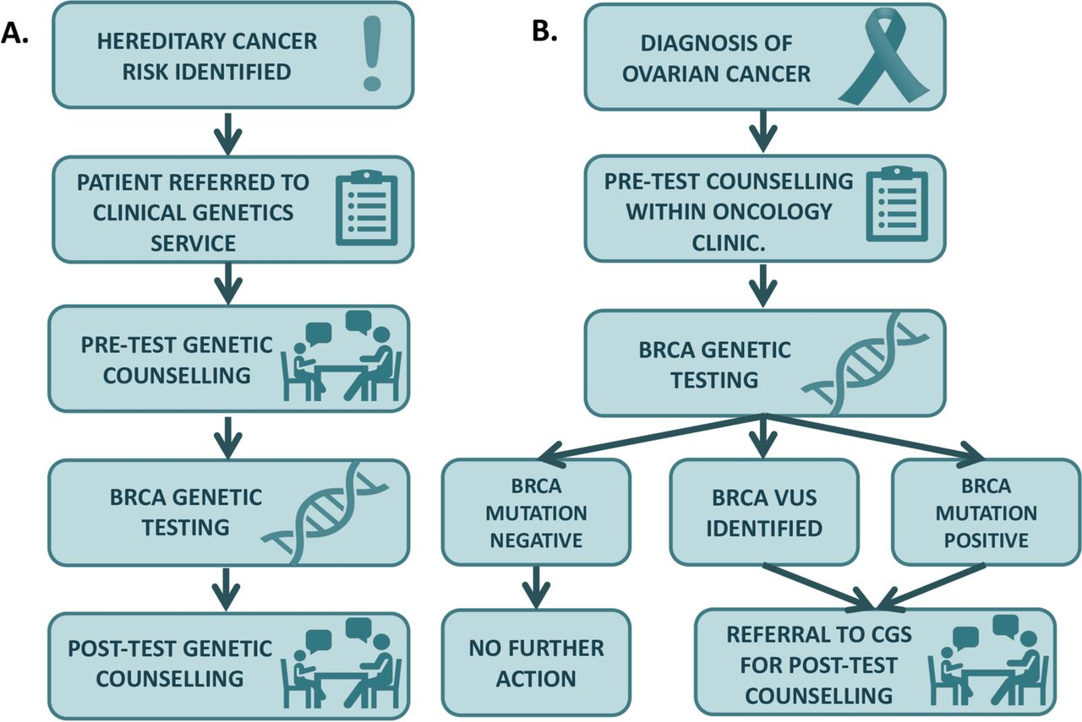

Slide 36
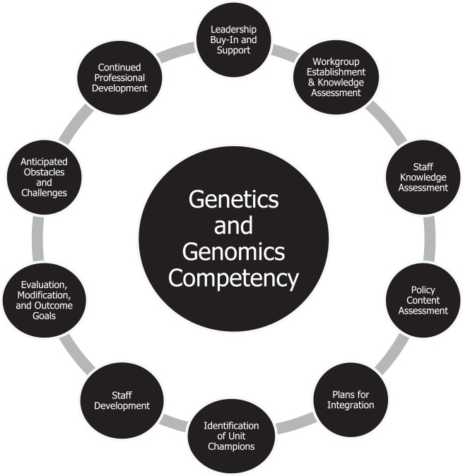
CNS and genomic literacy
The National Human Genome Research Institute at the National Institute of Health defines genomic literacy as the understanding of what a genome is, how genomic science works, and its affordances and limitations, applications, and impacts on society
How-to knowledge refers to practical knowledge about the application of oncogenomics and genomic services into oncology practice. Principles-based knowledge pertains to an understanding of the underlying theoretical principles of oncogenomics.

