Slide 1
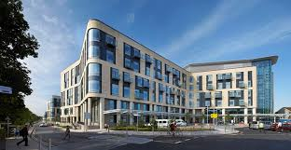
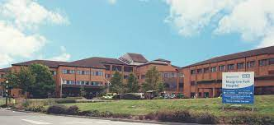
Prostate Cancer MDT Quality Improvement Project
Mr Jonathan Aning, Consultant Urological Surgeon

Slide 2
Todays Brief
To discuss progress to date
Baselining of MDT data
Logistics
To enable understanding of the pilot
The system and how it is deployed
The pilot roll out plan
Evaluation and potential next steps

Slide 3
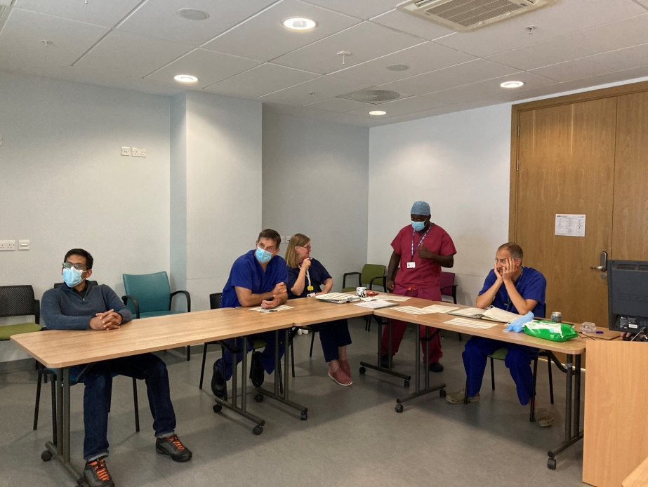
The Prostate MDT
Resource
High volume – 40+ per week
Competing pressures
Cancer Alliance MDT Survey 2019 ( n=5 )
‘Too Long’
‘Only discuss patients where there is something worth discussing’
‘Increasing numbers of complex patients for discussion’

Slide 4
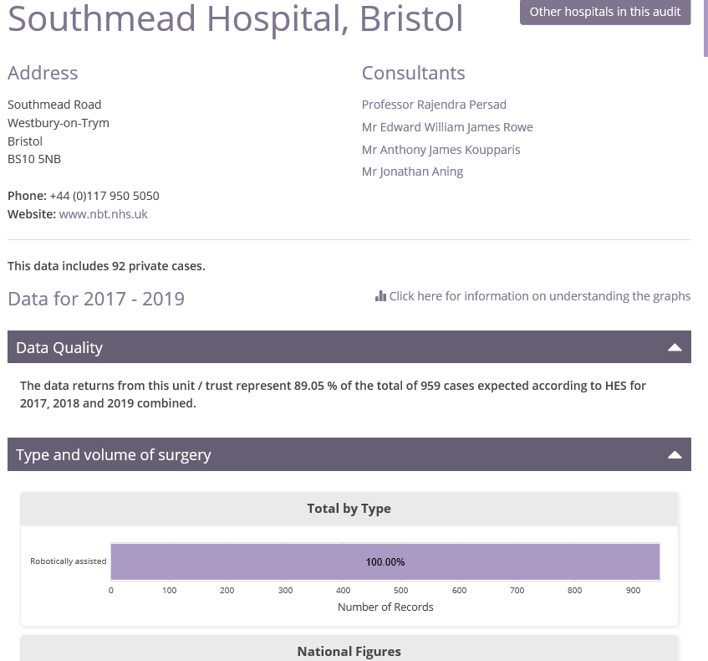
The Prostate MDT
What don’t we have time for?
 | Bristol Trusts Combined submission |  | SWAG |  | England
Metric Name | Count (whole year combined) | % | Count (whole year combined) | % | Count (whole year combined) | % | Comment
L2.1a: with a Cancer Diagnosis (diagnosis may not have been at this Trust) | 815 | 100.0% | 2310 | 100.0% | 45068 | 100.0% | This is any patient for which data has been supplied and will include patients diagnosed at the Trust and patients referred in from other Trusts that have gone onto your system
L2.1b: with a treatment record submitted | 702 | 86.1% | 2046 | 88.6% | 37710 | 83.7%
L2.1c: where the first treatment was surgery | 128 | 15.7% | 273 | 11.8% | 4719 | 10.5%
L2.1d: with a basis of diagnosis | 684 | 83.9% | 2157 | 93.4% | 42581 | 94.5%
L2.1e: with a histological basis of diagnosis | 552 | 67.7% | 1660 | 71.9% | 33499 | 74.3%
L2.1f: with a CNS indication code submitted | 296 | 36.3% | 1193 | 51.6% | 27672 | 61.4%
L2.1g: diagnosed who had a CNS contact | 260 | 31.9% | 827 | 35.8% | 21636 | 48.0%
L2.1h: diagnosed where age at diagnosis is under 25 | 0 | 0.0% | 0 | 0.0% | 0 | 0.0%
L2.1i: which are stageable | 815 | 100.0% | 2310 | 100.0% | 45068 | 100.0%
L2.1j: stageable with full stage at diagnosis | 116 | 14.2% | 1060 | 45.9% | 25741 | 57.1% | This is our usual metric for staging completeness, however, in large tertiary centres it may be a little inaccurate due to many patients not being discussed at MDT, although in this case, this is comparable with metric 2.2b discussed at MDT with a full stage
L2.1k: discussed at MDT | 787 | 96.6% | 2220 | 96.1% | 37406 | 83.0% | The number of patients discussed at MDT is used at the denominator for all metrics below.
L2.1l: discussed at MDT with a performance status | 38 | 4.8% | 1054 | 47.5% | 21430 | 57.3%
L2.1m: discussed at MDT which are stageable cancers | 787 | 100.0% | 2220 | 100.0% | 37406 | 100.0%
L2.2a: discussed at MDT with a first treatment of surgery | 127 | 16.1% | 269 | 12.1% | 4193 | 11.2%
L2.2b: discussed at MDT with a full stage | 114 | 14.5% | 1047 | 47.2% | 22949 | 61.4%
L2.2c: discussed at MDT with a full stage and a performance status | 29 | 3.7% | 874 | 39.4% | 16498 | 44.1%
L2.2d: discussed at MDT with a full stage and a TNM version supplied | 107 | 13.6% | 944 | 42.5% | 22234 | 59.4%
L2.3a: discussed at MDT with a full stage section | 114 | 14.5% | 1047 | 47.2% | 22949 | 61.4%
L2.3a: discussed at MDT with a partial stage section | 18 | 2.3% | 43 | 1.9% | 2906 | 7.8%
L2.3b: discussed at MDT with a full pre-treatment stage | 99 | 12.6% | 1019 | 45.9% | 21462 | 57.4%
L2.3b: discussed at MDT with a partial pre-treatment stage | 18 | 2.3% | 43 | 1.9% | 2625 | 7.0%
L2.3c: discussed at MDT with a full integrated stage where first treatment was surgery | 22 | 17.3% | 77 | 28.6% | 1654 | 39.4%
L2.3c: discussed at MDT with partial integrated stage where first treatment was surgery | 0 | 0.0% | 1 | 0.4% | 293 | 7.0%
L2.3d: discussed at MDT with a site-specific stage | 0 | 0.0% | 0 | 0.0% | 0 | 0.0%

Slide 5
Evidencing the PROBLEM

Slide 6
Prostate network section
1 patient was discussed at previous meeting
2 missing pathology:
Two patients: c/f path and were discussed a second time
Number of patients | 14
Number of MDT episodes | 16
Total duration | 00:59:58
Maximum discussion time | 00:14:00
Minimum discussion time | 00:00:50
Mean discussion time | 00:03:06
Notes:
Pt who took 14 min – complex and complicated case + review of scan that was to be repeated as per 1st MDT decision– was already discussed in previous meeting and decision was that of the last meeting (salvage Prostate bed RT vs PSA surveillance and repeat PSMA PET if PSA rises to 0.5 on 23/12/21) PSMA discussed on 6/1
First duplicate (1st meeting: C/F path) no decision in the second meeting as he opted to have RALP privately in London. (S Rose) Why then was he referred to MDT for discussion?
B Cardwell: 1st meeting c/f path 2nd meeting: not for surgery due to PSA kinetics, back to onc
P Blakeman – missing path - decision was c/f path and to c/f RALP. If gleason 4+5
All options patient ended up having RALP

Slide 7
Prostate radiology section
3 episodes when patients were missing info:
One missing PET: c/f PET and was discussed a second time – fitness assessment missing
One missing PSA: c/f PSA+MRI
Number of patients | 22
Number of MDT episodes | 23
Total duration | 01:23:13
Maximum time | 00:07:35
Minimum time | 00:01:37
Mean discussion time | 03:17
Notes:
Inadequate info:
1- same patient first time c/f path – 2nd time needed fitness assessment- needed OPA to assess fitness (P Kyte)
2-PSA & MRI were missing (R Wright), discussed twice after that MDT meeting: for radical options
Further info required : C Hoon known prostate ca required Liver Bx ?liver mets on CT
Protocolised:
1- Age 88 diffuse skeletal mets PSA 2510
2- Age 72 diffuse bone mets PSA 1339
3- Age 81 Bone mets PSA 156
Discussion:
Rising PSA post RALP

Slide 8
Time spent discussing cases that could be protocolised: 6 minutes
Notes:
Time spent discussing cases that could be protocolised: 6:20
Questions for JKA:
Criteria for protocolising
Why old, diffuse mets need discussion?
Any other details when it comes to decision analysis

Slide 9
Prostate pathology section
5 patients were missing info:
4 were missing path results and were C/F path
1 was referred for pathology instead of radio - missing PET report?
Number of patients | 59
Number of MDT episodes | 62
Total duration | 01:16:16
Maximum discussion time | 00:11:50
Minimum discussion time | 00:00:10
Mean discussion time | 00:01:20
Notes:
1- (C Williams) one patient was poor referral quality – decision was OPA and he was deemed inadequate info
2- D Shattock suspicious for malignancy decision OP in 6 m
3- J Bilings decision was BS MDT opa --- at the end had RALP
The longest discussion duration was poor quality of referral had to review letters in s drive and needed dual urology input ( func+pelvic onco)

Slide 10
Time spent discussing cases that could be protocolised: 39 minutes
Notes:
Criteria of discussion:
Complicated cases i.e HN
PIN
Criteria for protocolized :
1- Post RALP
2- Benign/ Inflammation
3- Radical
Patients who needed discussion:
1- poor referral quality (HN) decision was OPA+Onc DISCUSSION
2- 5 pts -High Grade PIN suspicious for malignancy – 59 y/o decision was OPA in 6 months DISCUSSION
3- Gleason 4+3 decision was BS + MDT OPA to see if fit.

Slide 11
Prostate radio+path section
6 patients were missing info:
5 were missing pathology decision was c/f path
One was missing PET report decision was to c/f PET report (Private P from Torquay)
One patient was a network patient decision was for OPA in swindon and onc r/v
Number of patients | 74
Number of MDT episodes | 74
Total duration | 02:55:43
Maximum discussion time | 00:08:30
Minimum discussion time | 00:00:30
Mean discussion time | 00:02:06
Notes:
1- One patient has PSA missing and did not affect decision
2- Bone scan was missing but did not affect decision
3- bilateral HN, needed MDT discussion to trigger question about RFs

Slide 12
Time spent discussing cases that could be protocolised: 90 minutes
Notes:
Criteria for discussion:
1- Age
2- LUTS
3- High risk prostate Ca
4- PIN

Slide 13
Observations
Inconsistent terminology used for MDT outcomes
All bone scans that were requested for patients who were for a radical pathway of management did not change the outcome and all were normal
Most patients referred to network MDT went on to have surgery
Protocol implementation could work well in the Network, Pathology and Radiology and Pathology sections
Notes:
We noticed radio+path were the easiest to get outcomes because we had all info at hand
Most missing info were path results

Slide 14
The Prostate MDT Objective Data
MDT external review using validated methodology
(Feb 2021 x 3 – 2 evaluators)
Prostate and bladder MDT n=202
Average discussion time 2.10 mins (Range - 20 secs – 7 mins)
23/202 deferred for discussion at a future meeting – 11%
MDT planning time for MDT coordinator – at least 7.5 hours
Clinical trials mentioned 4/202 – 2%
Helen Dunderdale

Slide 15
The Prostate MDT - Need
Increased caseload resulting in longer meetings, less time spent per case [NBT]
Incomplete information available to make sound informed decisions [NBT]
Increased preparation time for MDTC, Radiologist and Pathologists [NBT, Taunton]
Lack of educational value [NBT, Taunton]
Lack of automated clinical audit for governance [NBT, Taunton]
Lack of reliable mechanism to identify patients who are eligible for clinical trials [NBT, Taunton]
Lack of reliable mechanism to factor in patients perspectives [NBT, Taunton]
Suboptimal quality of clinical data submitted to COSD [NBT, Taunton]
Taunton may experience this problem in future after joint YDH MDT

Slide 16
Prostate Cancer MDT Quality Improvement Project
Project aims
Customisation of Deontics standalone decision support platform for:
MDT meeting use case and
Pre MDT CDS assisted Triage use case
Creation of executable pathway covering management of localised and metastatic prostate cancer based on NICE and EAU guidelines
End-to-end MDTM Operational Process Mapping for both sites with a clear report describing feasibility, costs and time scale for the future IT integration
Data transformations to auto populate relevant COSD and CWT data fields with a clear report describing feasibility, costs and time scale for the integration with SCR and other tracking systems.
Functional evaluation of the Decision Support tool in both use cases including:
Validation of the system output [by clinicians]
Usability for data entry and outcome capture [by MDT Coordinator]
In Vitro assessment of end-to-end MDT workflow [by MDT Coordinator]

Slide 17
KPIs and Success Criteria
Clinical validation of PRE-MDTM CDS Triage tool: the agreement between tool recommendations and clinicians’ decision is an indicator of the number of cases that can be taken out of the main MDTM.
Usability of the tool: The ability of the MDT coordinator and other MDT members to use the tool successfully to input data and capture outcomes, throughout the MDT workflow without any adverse impact on the process. Subjective assessment by the user.
In vitro demonstration of improvements in the key MDT relevant parameters:
Demonstrable compliance with standard of care/guidelines
MDT preparation time
MDT meeting time
Time from MDT referral to Decision
Time spent on post MDT governance
Quality of MDT data and outcome documentation
Perceived educational value of MDT
Demonstration of the benefits of the tool in assisting operational processes including patient tracking and data flow. Subjective assessment by MDT coordinators.
Plan of technical and workflow integration to explore future opportunities that align with Trust’s goals and objectives.

Slide 18
Artificial Intelligence
Definition
The theory and development of computer systems that are able to perform tasks normally requiring human intelligence

Slide 19
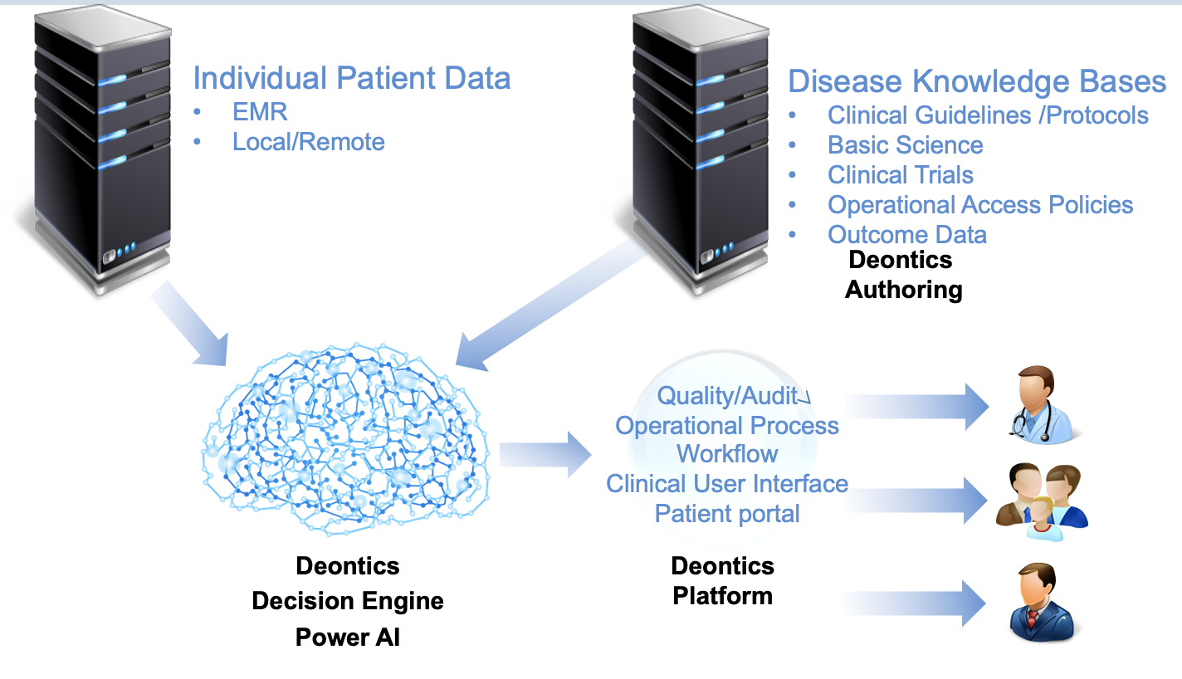
The Platform Simplified Overview

Slide 20
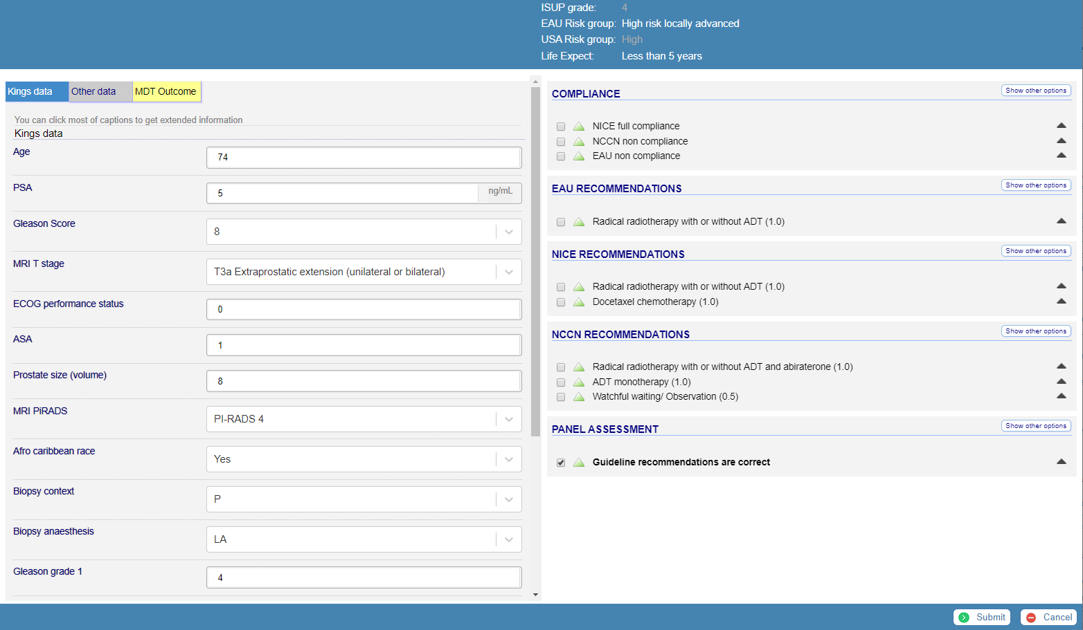
Triage functionality: Prototype
Output 1: Risk stratification
Input data ( Patient, Tumour parameters & Clinician’s recommendation)
Output 2: Compliance check
Output 3: Guideline recommendations
USA

Slide 21
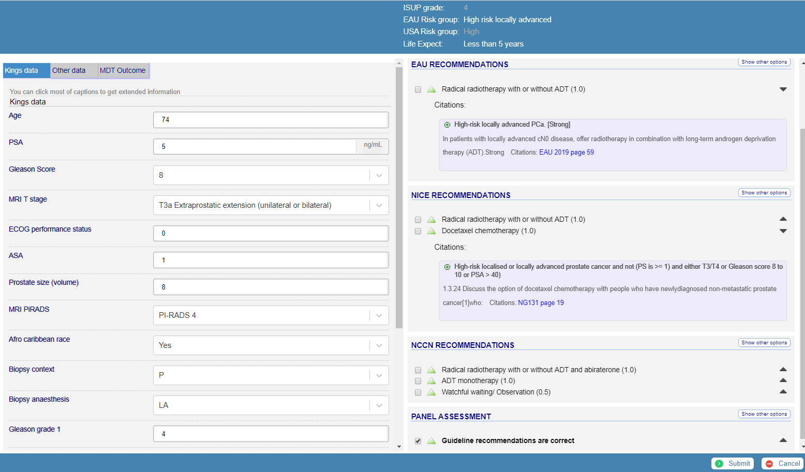
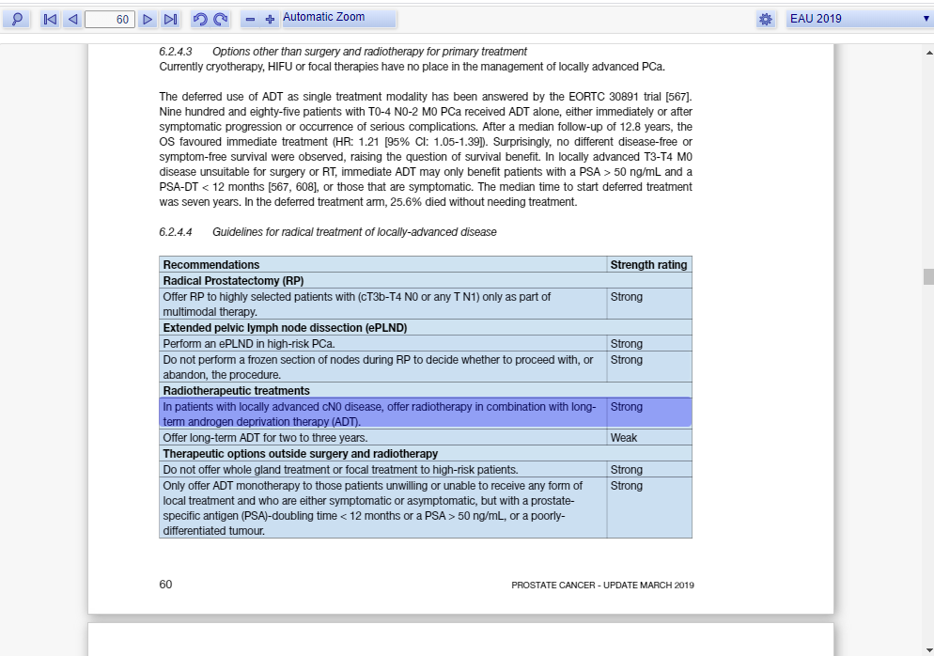
Triage functionality: Prototype
Transparent Explanation and
Evidence source validation
Direct access to the exact line or sentence in the source guideline that recommends the treatment.

Slide 22
Project plan overview
Obtaining funding
Registering as a quality improvement project
Baseline evaluation
Process mapping MDT
Establishing deliverables with Deontics
Developing the application
Obtaining Information Governance approvals
Testing application in parallel with the MDT
Analysing results
Refining application

Slide 23
Summary
Prostate cancer is the commonest cancer in men
Deontics + NBT + TFT partnership
Aim - improve the quality of the prostate MDT using AI
Through this project we will:
Improve the quality of data in to the MDT
Develop clear management pathways for patients with localised and metastatic prostate cancer
We will #streamline the Prostate MDT
Disseminate the outcomes and contribute evidence to the nationally recognised issue and need
Pursue relevant research opportunities

Slide 24
Acknowledgements
Marc Williams SWAG
Raj Persad John Graham
Helen Dunderdale Tariq White
Rhona Galt Tim Keen
Tim Whittlestone Sara Moghabi
Rana Asir Lorraine Woodward
Helen Williamson

