Slide 1
The PMB Pathway at RCHT
8th October 2021
SWAGGER
Sophia Julian
Consultant Gynaecological Oncologist
sophia.julian@nhs.net

Slide 2
Acknowledgements Ryan Hogan (post CCT Clinical Fellow)

Slide 3
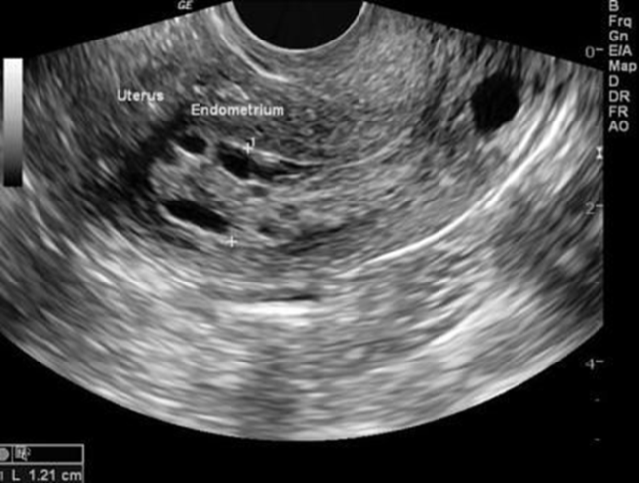
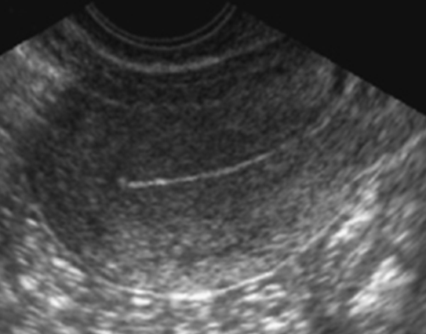
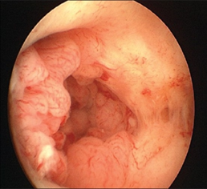
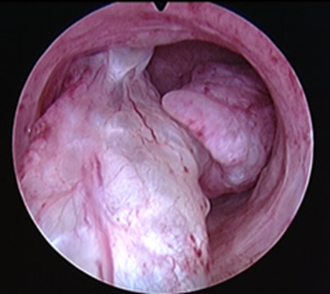
Diagnosing/Excluding Cancer
In first 12 months after menopause 1:10 women report PMB
Atrophic vaginitis is commonest cause (80-90%)
Serious pathology more likely in older age groups
5 - 15 % with PMB women have Endometrial cancer
On ET on TVS ≤ 4mm then 1:339 chance of endometrial cancer
Vulval / Vaginal / Cervical cancer may also present with PMB

Slide 4
Cancer in Women
Ranking | Site | No / year in UK 2016 | 10 year Survival | No / year in Cornwall 2018
1 | Breast | 55213 | 78%
2 | Lung | 22300 | 5%
3 | Bowel | 18600 | 57%
4 | Endometrial | 9314 | 78% | 88
5 | Melanoma | 8300 | 90%
6 | Ovarian | 7470 | 35% | 54
14 | Cervix | 3192 | 60% | 26
Not in top 20 | Vulval | 1318 | 53% | 13
Not in top 20 | Vaginal | 252 | 53% | 3

Slide 5
Jan 2018 – Jan 2019 “One Stop” PMB Clinic
1233 women referred to PMB Clinic
Up to 30 referrals per week
4 PMB Clinics – 8 slots – usually overbooked
2 Consulting Rooms + Small Waiting Area (shared with EPU/EGU)
1 Junior Doctor/Senior Nurse + HCSW as chaperone (history + pipelle if ET >4mm)
1 Sonographer + HCSW as chaperone
3 OPH Clinics (Diagnostic & Treatment/Myosure)
7% diagnosed with Endometrial Cancer (n=88)
1.7 patients per week

Slide 6
Critical Appraisal
The PMB Clinic is largely “non-value adding”
Duplication of primary care work (history and examination)
TVS not being interpreted intelligently
Decisions on complex, elderly patients made by junior staff
“Corridor conversations” with consultants
Pipelle biopsy leads to duplication, delay and may miss pathology
30-40% require a TVS only
Consumes vast resource to detect 88 cancers a year / 1.7 per week
PMB Nurse Specialist is also lead nurse colposcopist
50% increase in colposcopy over next 2 years with HPV Primary Screening
Not Patient-Centred / Not Consistently “One-Stop”
Impossible to utilise OPH resource efficiently without prior TVS
Long waits in clinic (3 hours up to all day for OPH)
Multiple intimate examinations (Up to 3 per patient per day by different practitioner)
Delays in 2WW pathway and 62 day breaches

Slide 7
Appropriate, timely access to TVS and OPH is the key to reassuring those that do not have cancer, and diagnosing & treating those that do within 62 days of referral.

Slide 8
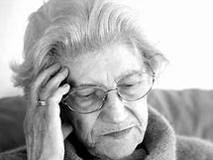
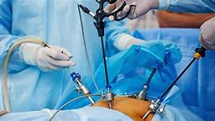
In 2019 we were “just about managing”
We needed to make better use of our resources
The new PMB Pathway was conceived
Agreed with KCCG in Dec 2019

Slide 9
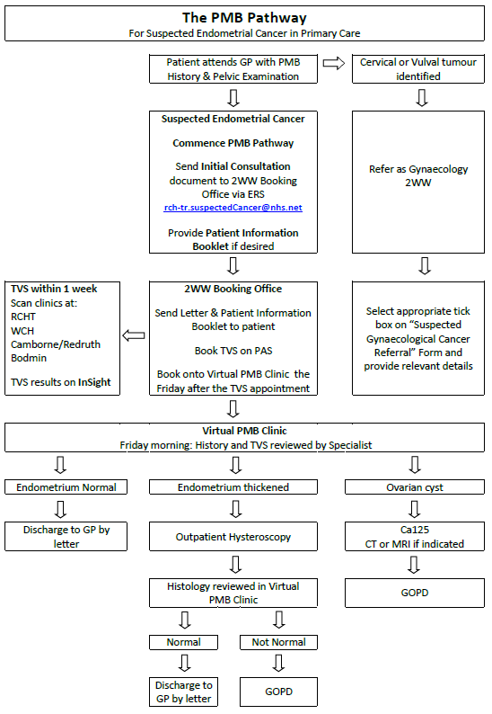
A New PMB Pathway
TVS within one week of referral
35% of women reassured by 7-14 days
Consultant review in Virtual PMB Clinic
Friday morning fixed session
Within max. 9 days of referral
“Follow-up Clinic”: results are checked weekly
Everything after referral co-ordinated by V-PMB Clinic
OPH
Ca125/CT/MRI
Histology results
OPD for complex patients

Slide 10
Comprehensive Patient Information
GP can access
Sent with introductory letter and scan appointment
Sonographers have copies
GOPD
Intranet

Slide 11
2WW Referral forms: Important Background Information

Slide 12
2WW Forms: History & Examination

Slide 13
The Patient’s Perspective Gynae Cancer Patient Support Group
Excluding cancer quickly is just as important to patients as faster diagnosis
Having investigations at a convenient location was important
TVS alone - 1:339 chance of missing a cancer highly acceptable
Very positive feedback about the patient information package
No concerns about not attending OPA – it is the tests that are important
No concerns about communication by letter
Some concerns about telephone communication
Elderly
At work

Slide 14
What Women Want
Maximum 9 days for appointment in Virtual PMB Clinic
35% reassured within 14 days of seeing GP (with 2nd class post)
OPH Day 12 – Day 15 of Pathway
Majority can be reassured about OPH findings on the day
OPD for Breaking Bad News and Cancer diagnosis
Around day 21 of pathway for 80 – 90 women per year

Slide 15
First 8 months 1st June 2020 to 31st Jan 2021
926 “New episodes” (= approx. 1400 per year cf 1200 in 2018)
883 “First episodes”
43 “Second episodes” ie those re-referred within 6 months of initial referral (4% of total – no ACH and no EC diagnosed)
794 had TVS after decision to refer (as per PMB Pathway)
Number of days from DDR to scan
Median = 7
Mean = 8
DDR to initial review in V-PMB
Mean = 11
Median = 10
312 Discharged after initial TVS review in V=PMB (35%)
23 (2%) asked to attend for lower genital tract examination only after initial V-PMB - no cancers diagnosed

Slide 16
First 8 months 1st June 2020 to 31st Jan 2021
Attendances at GO clinic prior to Hysteroscopy = 68 (7%)
?How many accepted OPH / GA H&C
Mean = Day 18
Median = Day 16
523 (56%) OPH
89% completed successfully
Mean = Day 19
Median = Day 17
1-2 per week added to WL for GA H&C

Slide 17
First 8 months 1st June 2020 to 31st Jan 2021
 | All ACH n = 9 (1%) | EC n = 28 (3%)
Diagnosis (28 day target)
Mean | Day 36 | Day 32
Median | Day 39 | Day 29
Range | Day 27 - 47 | Day 20-64
Treatment (62 day target) | Surgery n = 5 | Surgery n = 22
Mean | Day 65 | Day 52
Median | Day 62 | Day 49
Range | Day 20 - 64 | Day 26 – 90

Slide 18
Cancer Performance May 2021
“7 day performance: 11% (referrals up by 250%)
14 day performance: 93% (7 PMB patients booked late)
28 days referral to diagnosis performance: 87%
31 day performance: 100%
62 day performance: 100%
Of note - 2 week wait referral for PMB has been consistently at 250% higher for last 2 months
Additional weekly scan clinic set up from 8th July with an additional 7 slots which seems to be meeting demand at the moment.”

Slide 19
Gynaecology at RCHT 62 day target: Top across all ICS and cancer sites

Slide 20
Patient Feedback
“I am emailing to see if you can explain to me why I have been discharged and not actually seen by a gynaecologist? I first saw my Doctor in March and have now had two scans, two letters and two leaflets but unfortunately my post menopausal bleed has not gone away or been resolved. I am of course very glad that my scans suggest I do not have cancer however my symptoms are getting progressively worse. I have now been bleeding heavily for two weeks and am feeling the consequences of this in terms of the impact this has on my general health, my work, my social and family life. I am really struggling to understand how I have become caught in a pathway loop that computer generates letters rather than deals with my symptoms holistically. How can a woman's reproductive system be so compartmentalised?”
By e-mail

Slide 21
“Flexible, Safe and Acceptable” but more to do
Meeting the 28 days to diagnosis target is really challenging
Unavailable patients / undecided patients / DNA
A “few extra days” at any point in the pathway really matter
Those unwilling to go straight to OPH ?incorporate some telephone appts at end of VPMB?
Waiting times for GA H&C
Scope to further refine OPH activity / increase capacity
Reliably getting histopathology back after OPH in 1 week not 2
Meets the needs of most patients most of the time
No “missed” lower genital tract cancers, or EC on re-referral
Excellent feedback from initially sceptical staff
Flexible & Responsive – V-PMB concept smooths peaks and troughs
Can be proactive about need for temporary extra capacity
Avoid “backlogs”

Slide 22
Discussion

Slide 24
Integrated Care Pathways Bridging the Primary/Secondary Interface
Traditional model of care vs Integrated Pathway
Integrated Pathway
Reduced outpatient attendances
Enhanced patient experience (less “limbo”)
Same clinical outcomes
QoL same in both groups
Integrated pathway cost less

Slide 25
Integrated Care Pathway For PMB
277 women
30% Needed TVS Only as ET ≤ 4mm
“No woman discharged back to her GP has been diagnosed with and endometrial malignancy within 1 year of initial referral

Slide 26
HRT and PMB
HRT can lead to unscheduled vaginal bleeding
25-50% of women will discontinue HRT as a result.
Lack of evidence to guide investigation of unscheduled bleeding on HRT
CCHRT
Usually leads to amenorrhoea
Up to 80% of women unscheduled bleeding in first 6/12
Investigate after 6 months of therapy or after established amenorrhoea
Sequential HRT
Abnormal bleeding: heavy, frequent, change in pattern, breakthrough bleeding
8 – 40% of sequential HRT users
Investigate if symptoms over 2 consecutive cycles
Mean ET is about 2mm > no HRT, but sensitivity of TVS does not vary significantly

Slide 27
Asymptomatic Endometrial Thickening
ET will be reported on TVS taken for reasons other than PMB.
Using ≤ 4mm threshold in women without PMB has a high false positive rate and poor sensitivity
No consensus on recommended threshold with no PMB
Endometrial thickening plus
Increased vascularity
Inhomogeneity of endometrium
Fluid
Thickened endometrium over 10 mm
Should have discussion surrounding further investigations
Decisions about further investigations should be made on a case-by-case basis taking into account individual risk factors for endometrial cancer.

Slide 28
Endometrial Polyps
Aetiology / natural history unknown
Clinical significance questionable: common in women without bleeding
Prevalence 7.8% to 34.9%
Postmenopausal > premenopausal
Prevalence of endometrial hyperplasia/malignancy within polyps
1 - 4% if asymptomatic
3 - 5% if symptomatic
Malignant transformation in up to 12.9%
Risk greatest in polyps > 1.5 cm
Highest risk of malignancy in endometrial polyps in women with PMB
‘Polypectomy’ aims to treat bleeding and obtain histology
The effect of polypectomy on periodic blood loss is questionable

Slide 29
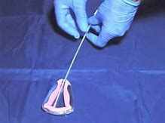
Endometrial Biopsy
Pipelle biopsy will yield adequate samples in 43% - 91%
With ET of ≤ 4 mm
Pipelle only possible in 82%
Adequate sample in 27%
Procedure failure rate of around 10%
10% of samples will result in insufficient tissue
May fail to identify focal pathology of the endometrium eg endometrial polyps, which may be neoplastic (eg contain atypical hyperplasia)
Women with “non-diagnostic” biopsy specimens should therefore be offered further investigation.

Slide 30
The Virtual PMB Clinic
Consultant-led decision making
Target hysteroscopy appropriately
Diagnostic
Operative
Anticoagulation
Increase efficiency
Reduce waiting times
Faster diagnosis and treatment
Improve patient experience and information
Meet “28 Days to Diagnosis” target

Slide 31
RADAR Data n = 33

