Slide 1
Improving the diagnostic pathway for patients with lymph node tuberculosis
Dr Amy Thompson
ST5 infectious diseases/medical microbiology

Slide 2
Background and aims
TB service sees many patients who have undergone repeated neck node aspiration/biopsy
Delay in diagnosis
Delay in treatment
Aims:
Quantify the number of patients undergoing multiple diagnostic procedures
Identify ways to try and reduce this number

Slide 3
Methods
Search of BRI TB database 2016-2020
Records for all patients coded as ‘extrathoracic’, ‘intrathoracic’ or ‘other extrapulmonary TB’ examined
Data collected for all patients who had undergone a neck node aspiration or biopsy

Slide 4
Results
Year | Number of patients undergoing procedure
2016 | 12
2017 | 15
2018 | 6
2019 | 9
2020 | 7
Referring speciality | Number of patients undergoing procedure | 1st sample sent for TB culture | 2nd procedure required
ENT | 18 | 12/18 | 6/18
Respiratory | 14 | 14/14 | -
Oral surgery | 7 | 0/7 | 7/7
Haematology | 4 | 3/4 | 1/4
GP | 2 | 0/2 | 2/2
Cardiothoracics | 1 | 1/1 | -
Colorectal | 1 | 1/1 | -
Gastroenterology | 1 | 1/1 | -
Geriatric medicine | 1 | 0/1 | -
TOTAL | 49 | 32 | 16
Notes:
Some patients have >2 procedures

Slide 5
Risk factors for TB
Origin from country with high TB incidence
Travel to/periods of time spent in high incidence countries
History of working in medical settings in high incidence countries
Recent exposure to known TB case
People living with HIV and CD4 count <200 cells/mm²
Immunosuppression
Diabetes mellitus
Stage 4/5 CKD
Social risk factors
Homelessness
Drug misuse
Previous imprisonment

Slide 6
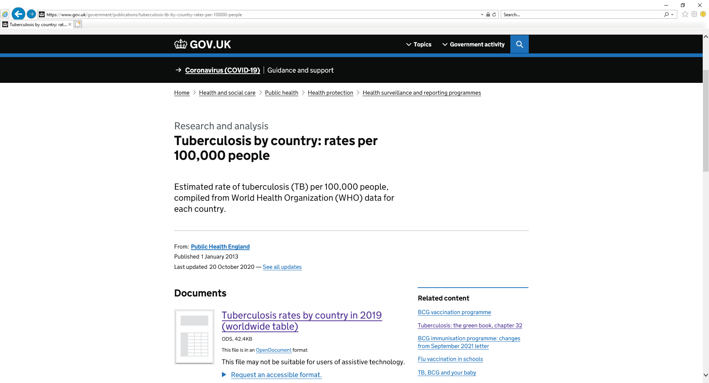
Risk factors for TB
Notes:
High incidence – incidence rate of 40 per 100,000 or greater
Morocco: 97/100,000. Pakistan: 263/100,000. China: 58/100,000

Slide 7
When to think TB and what to do
Symptoms of active TB
Fever
Unexplained weight loss
Night sweats
Loss of appetite
Fatigue
Cough lasting 3/52
Haemoptysis
If you suspect TB:
TB team e-mail
TBTeam@uhbw.nhs.uk
TB nurse phone number
01179543066
Notes:
Currently the South West is one of the worst performing regions in terms of delay between TB symptom onset and starting treatment.
We will start TB treatment if we have high clinical suspicion so no need to wait until culture result is back before referring

Slide 8
Discussion – thoughts from TB team
Talk to referring specialties/specialties performing biopsies
ENT
Oral surgery
Radiology
Modify ICE
Prompt users to consider diagnosis of TB when requesting lymph node biopsy (?age ?country of birth)
Radiology can see this when requesting ICE labels
Lab protocol
Ensure all samples sent for MC&S also go for TB culture
(Although the issue is that most samples never make it to the microbiology lab)
Notes:
Modify ICE – based on whether patient was UK born? If not UK born, send for TB culture. Crude but effective

Slide 9
Discussion
What are your thoughts?
ameeka.thompson@nbt.nhs.uk

