Slide 1
SWAG Head & Neck RDS CAG Presentation

Slide 2
National Rapid Diagnostic Centre Components
RDC Vision and 2019/20 Implementation Specification - Cancer Alliances Workspace - FutureNHS Collaboration Platform

Slide 3
Our Plan for the Head & Neck RDS Project
Engage with Specialists
Identify Head & Neck specialists in the area; including surgeons, nurses, radiologists etc.
Set up regular calls to collaborate
Understand/Adapt the timed pathway
Review the Draft Timed pathway (official release due in Nov.)
What best practice can we embed?
Get Stakeholder Approval
Share with wider groups to get buy in & engagement
Take onboard feedback to make improvements
Aim to be ambitious but realistic
“Go Live”
Release to Providers
Include planning templates to support improvement work
Work with providers to help them achieve the pathway
Once SWAG & Providers agree, the pathway can go live
Start monitoring FDS improvements, patient feedback etc.
Head & Neck will be one of the pathways we intend to implement as an RDS in 22/23
Where providers are already meeting some of the RDS principles, we will look to take best practice and share across the region to encourage equity for our patients.

Slide 4
DRAFT
How does this fit with current practice across SWAG? What adaptions do we need to make?

Slide 5
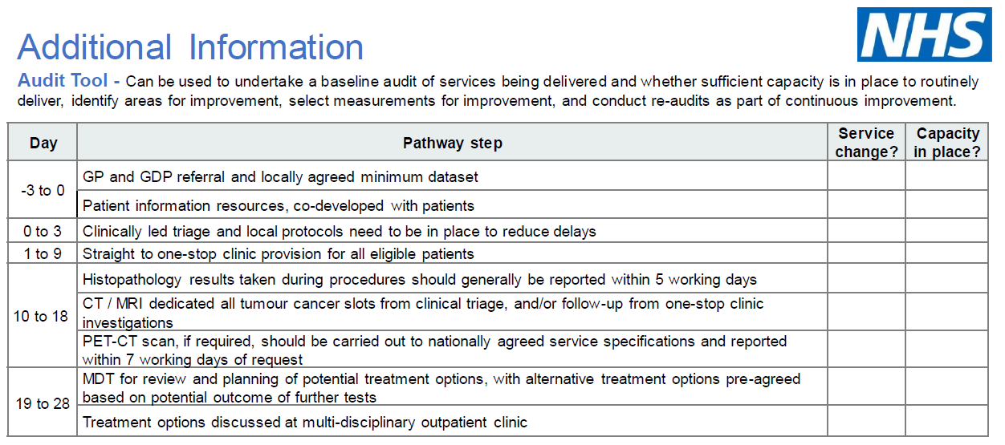
Can also utilise the proposed audit tool to assess how well we currently achieve the National Pathway Milestones.

Slide 6
What Next…?
Call to Action! SWAG are looking for Clinicians that are interested in engaging with this project to start meeting ASAP in order to give our providers as much notice as possible about the improvements proposed.
We have RDS Funds to use and we want to ensure this is done in a way that is best for our patients in our area.
If you have ideas and want to be involved, please contact Belinda Hill – Belinda.hill4@NHS.net to be invited to the Task & Finish team. We would ideally start meeting by January to get the ball rolling with this project.

