Slide 1
CAR-T Cells – BHOC Update

Slide 2
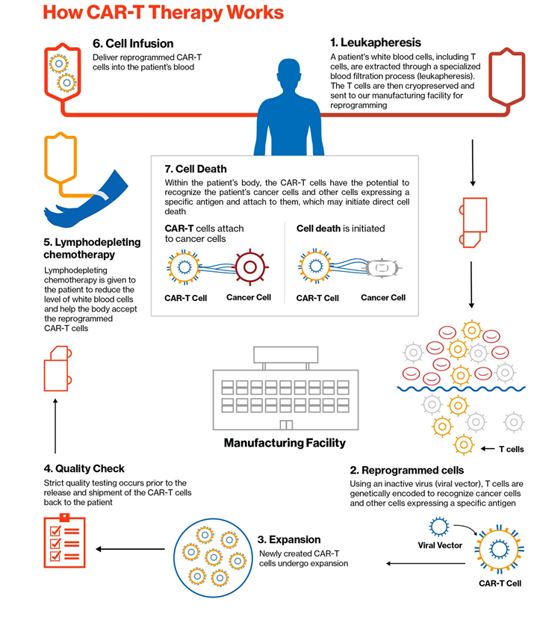

Slide 3
The IEC Service at BHOC
IEC Medics - Consultant, Associate Specialist, BMT Ward SpR, BMT SHO
IEC Nursing Team - IEC CNS, BMT ACP, TYA CNS, Ward Nurses, Day Unit Nurses
Supportive services - ITU, Neurology, Psychologist, Palliative Care, Physio, OT, Dietitian, BMT/IEC Pharmacist, Microbiology/Virology/Mycology, Radiology
Administrative support - MDT Co-ordinator, BMT/IEC Co-ordination, Quality Manager, Data Manager
Research Support - CTU, BMT Research Nurse
Cell Processing - Apheresis Unit, Stem Cell Laboratory

Slide 4
National Process
Referral to CAR-T centre
NCCP
Leuco-
pheresis
Bridging at referral centre
Shared-care & long-term follow-up
Post-infusion Care
CAR-T infusion
Admission for lympho-depletion

Slide 6
BHOC Experience
31 referrals
(Mar 19-Dec 20)
29 eligible at NCCP
27 Apheresis
19 re-infusions
2 Cancelled due to poor PS/PD
2 failed manufacture
(1 declined 3rd attempt,
1 waiting)
5 died (PD)
1 awaiting re-infusion
21 Axi-cel
8 Tisagen
15 Axi-cel
4 Tisagen
Re-collections:
1 patient successful manufacture on 3rd attempt

Slide 7
 | BHOC Cohort (n=27) | NCCP Cohort (n=183)
Age (median) | 61 (25-73) | 57 (18-75)
Male (%) | 68 | 62
ECOG PS 0/1 (%) | 29/71 | 48/52
Bulk (%) | 36 | 27
Subtype (%) DLBCL tFL PMBCL tOther | 75 18 3.5 3.5 | 67 20 8 5
Stage III/IV (%) | 89 | 76
EN Disease (%) | 79 | 62
>3 treatment lines (%) | 46 | 40
Prev BMT (%) Allo Auto | 7 0 | 14 3

Slide 8
Timings
Average time from NCCP approval to apheresis = med 10 days
Average time from apheresis to admission = med 35 days
Average time from apheresis to CAR-T infusion = med 47 days
Bridging
81% of patients required bridging therapy

Slide 9
 | BHOC Cohort (n=19) | NCCP Cohort (n=183)
Gd 3+ CRS (%) | 11 | 9/6
Gd 3+ ICANS (%) | 22 | 19/4
Toci (%) | 68 | 73/36
Steroid (%) | 33 | 40/22
ITU (%) | 42 | 37/20
2 deaths (11% NRM)
1 died due to cardiac failure following prolonged ITU admission for peritonitis following perforated bowel at site of previous lymphoma
1 severe ICANS, recovering neurologically and sudden deterioration. PM showed endocarditis.

Slide 10
16 patients with minimum 1 month PET
28 days (n=17)
54% CMR
12% PR
(ORR 66%)
12% SD
22% PD
3mo (n=13)
38% CMR
62% PD
1 patient improved from PR to CMR
1 death due to late NRM
3 patients awaiting 3mo scan
Notes:
ORR (CR+PR) 82%, 58% CMR in ZUMA, 40% in JULIET
NCCP data = BORR 76%, 30% CR at 3mo

Slide 11
BHOC Experience
69% of patients accepted for CAR-T for Lymphoma are able to proceed to infusion
Of 29 Lymphoma referrals (ITT) – 19% PFS at 3months post CAR-T
Which Lymphoma patients are likely to do well/poorly?

Slide 12
BMT&CAR-T Team
Maria Mazza-Beange
Brijesh Gautama
Rachel Protheroe

