Slide 1
Evaluating and improving MDTMs
North Bristol Trust Urological Cancer MDTM
Wednesday 9th June 2021
Cancer Clinical Advisory Group Manager
Helen Dunderdale, facilitated by Behavioural Scientist Dr Tayana Soukup and Urological Surgeon Benjamin Lamb

Slide 2
Plan for this session
Background
Methods
Results
Discussion.

Slide 3
Background
Multidisciplinary team (MDT) working is seen as the ‘gold standard’ in many countries
Care of cancer patients has become more complex due to the increasing numbers of diagnostic tests, treatments, and increased patient empowerment in decision-making
When MDTs do not work together effectively care can be sub-optimal; recommendations can be clinically inappropriate, or not acceptable to patients, resulting in delays to treatment, distress for patients and frustration for healthcare professionals
Effective MDT decision-making requires consideration of comprehensive patient-centred information at the point of decision-making
https://www.ncbi.nlm.nih.gov/pmc/articles/PMC5783021

Slide 4
The importance of assessing and improving MDT working
Increased performance
  variability exists
  https://www.ncbi.nlm.nih.gov/pubmed/30382292
Patient safety
  “Teamwork as mechanism for enhancing patients safety” (IoM)
Cost-effectiveness
  £822K/year; prep time £100mil/year
  https://www.bmj.com/rapid-response/2011/11/02/cost-mdt

Slide 5
Method

Slide 6
Team Audit and Feedback
[Identify, Assess,
Feedback, Improve]
1. IDENTIFY a problem / issue
Performance in MDMs
2. ASSESS:
Team’s baseline performance against evidence and recommendations, or previous phase
3. FEEDBACK: Feed back results to the team, and introduce QI intervention
4. IMPROVE:
Implement QI intervention
5. REPEAT
the cycle
(steps 2 to 4)
Benchmark
performance against:
2
1. team’s baseline performance
2. recommendations
3. evidence

Slide 7
Team Audit and Feedback
[Identify, Assess,
Feedback, Improve]
1. IDENTIFY a problem / issue
Performance in MDMs
2. ASSESS:
Team’s baseline performance against evidence and recommendations, or previous phase
3. FEEDBACK: Feed back results to the team, and introduce QI intervention
4. IMPROVE:
Implement QI intervention
5. REPEAT
the cycle
(steps 2 to 4)
EVIDENCE-BASED:
Non-punitive and actionable feedback provided to professionals to allow them to assess and adjust their performance is effective in improving practice and supporting quality and safety in healthcare settings.
Flottorp et al., 2010; Michie et al., 2005; Ivers et al., 2012

Slide 8
“We can only be sure to improve what we can actually measure”
Professor A Darzi
High Quality Care for All
Department of Health (UK) 2008

Slide 9

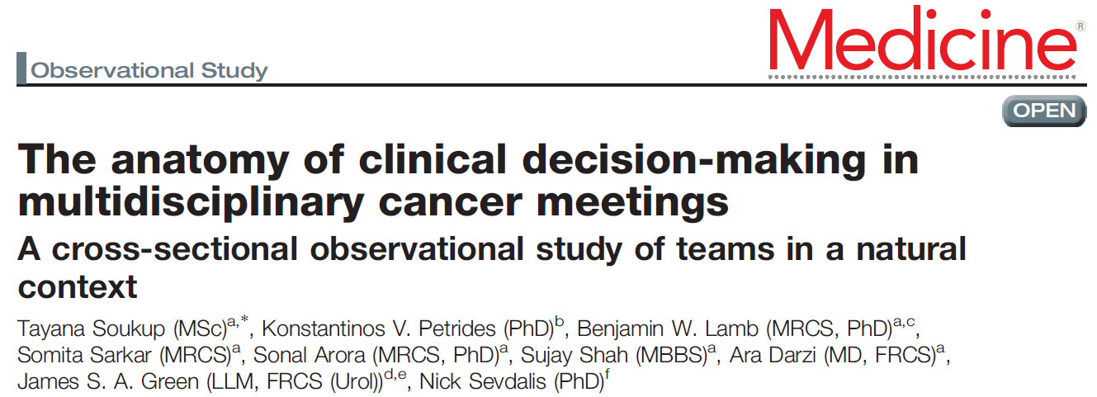
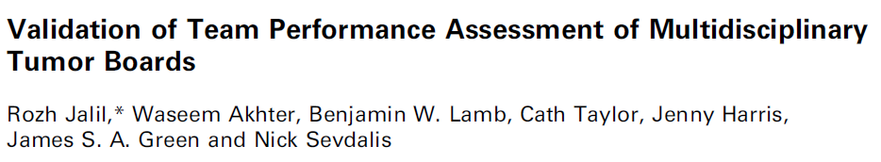
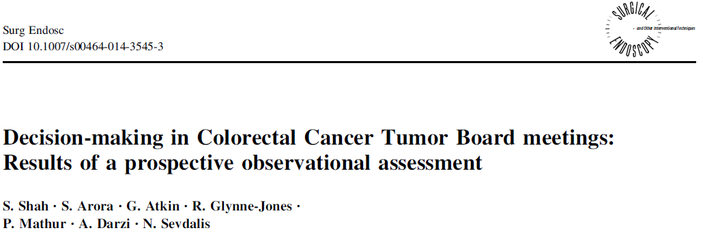
The most widely used MDT tool across different cancers, teams and countries….
Across various cancer:
  Urology
  Colorectal
  Upper GI
  Head & Neck
  Breast
  Lung
  Gynaecological
Used by clinical and non-clinical researchers
Notes:
9

Slide 10
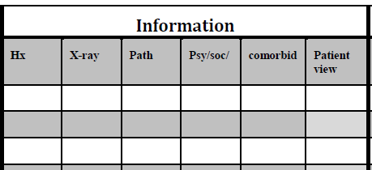
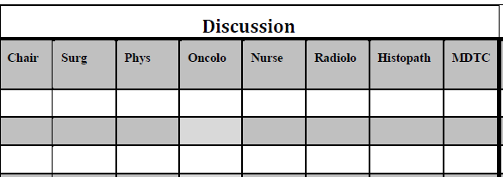
https://www.ncbi.nlm.nih.gov/pubmed/21610266
1. Quality of
information
2. Quality of
contributions
3. Decision made is recorded as yes, no, or deferred to next MDT

Slide 11

MDT-MODe Rating Scale
5-point scale
Anchors vary slightly
1 | 2 | 3 | 4 | 5
Poor, inadequate, no information, absent contribution |  | Average, with some vagueness or inconsistencies |  | Good, comprehensive information & fluid contribution
Chairmanship is scored differently (1-5), with a score of 3 meaning that no further input was required for the decision to be concluded.

Slide 12
MDT-MODe Rating Scale (CONT.)
When a case is benign, contributions from the multi-disciplinary team and information on psychological / social, comorbidities and patient’s view are not applicable
When a case is on a diagnostic pathway, pre-treatment for malignancy, information on psychological / social, comorbidities and patient’s view is not expected due to the speed of the pathway, with the exception of patients on long term Active Surveillance
When a case is flagged in a diagnostic clinic because of suspicion of metastases, then it is expected that the patient would see a nurse, or have an emergency hospital admission assessment
When a patient is pre-treatment for malignancy, contributions from the nursing team are not applicable due to the speed of the pathway
When the case is post treatment for malignancy requiring further review, information on psychological / social, comorbidities and patient’s view is applicable. Information on post treatment discussion for progression of disease or new suspicion of progression is expected due to the need to know detailed information about Performance Status and patient wishes.

Slide 13
Results
It should be noted that observational assessments are subject to bias and require training and calibration. Results have been completed by two trained assessors.

Slide 14
Preliminary findings
Three meetings were observed in total: 3rd February 2021, 10th February 2021, and 24th February 2021.
A total of 202 patients were discussed across the 3 meetings with 63, 81 and 58 discussed respectively within each meeting.
The average discussion time per patient was approximately 2:10 minutes with a minimum of 20 seconds, and a maximum of 7 minutes per patient (6 patients requiring >5 minutes discussion).
A total of 23 cases were deferred for discussion at a future meeting.

Slide 15
Focus on Prostate Cancer
Total of 102 cases

Slide 16
Examples of Decisions Made
D | Deferred due to pathology
Y | CNS call, OPA 6 weeks
D | Deferred due to pathology
D | Not for surgery. Oncology follow up. Deferred due to pathology
Y | Template biopsy. Suitable for all radical treatment options
Y | CNS review, hormones versus watchful waiting
Y | Benign - flexi in 1 year
Y | Interval MRI pending PSA surveillance
Y | PSA / MRI / CNS urgent telephone call
Y | Active Surveillance for several years. Prostate OPA to discuss progressing to treatment/
D | Deferred due to imaging
Y | BHOC and CNS clinic
Y | Hormones for 3 months then re-evaluate
Y | Biopsy / workup for radical salvage prostatectomy
Y | Active Surveillance for several years. Prostate OPA to discuss RALP
Y | Cores inadequate, further biopsy required. Offer radical treatment
Y | Surveillance in 3 months - letter 2
Y | Suitable for radical treatment options - MDT favours surgery. Eligible for NEUROSAFE

Slide 17
Clinic appointment to discuss radical treatment options

Slide 18
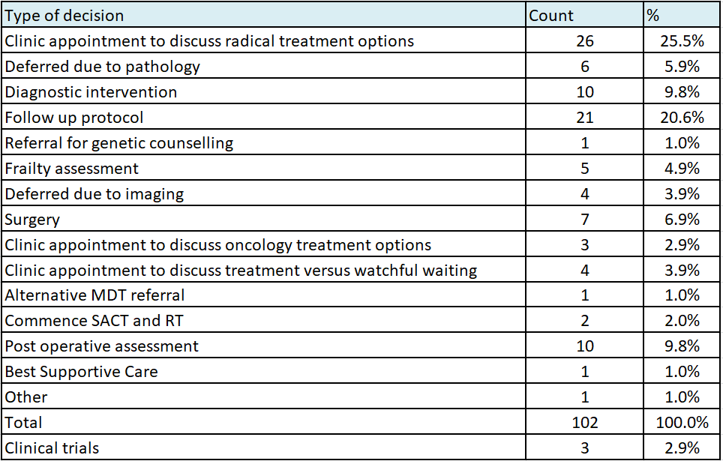

Slide 19
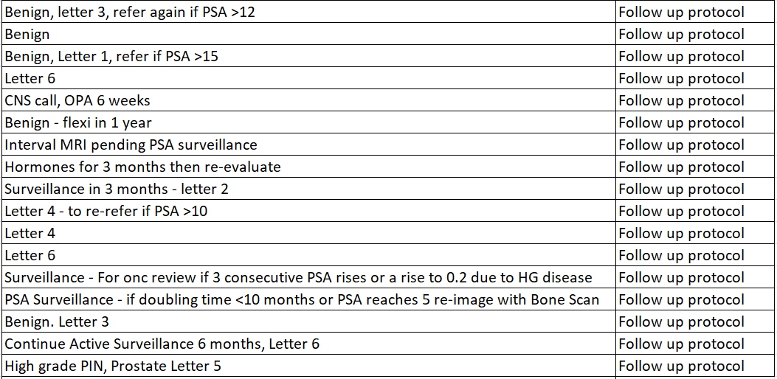
Follow up protocol

Slide 20
Type and quality of information covered across the observed prostate cases
% information coverage on comorbidities compares favourably with other MDTMs assessed to date
Pathology marked as 4 as definition in MDT-Mode scoring of 5 is to include reading of report and presentation of slides, rather than just report

Slide 21
Contribution to prostate case discussion per disciplinary group across the observed meetings
% overall contribution from nurse disciplinary group compares very favourably with other MDTMs assessed to date

Slide 22
Examples of practice to share with other MDTMs
Case discussions are ordered according to the patient pathway and urological cancer site
The MDT member who knows the patient introduces the case history
The meeting room is configured in a U-shape with three large screens which allows participants to see and hear each other clearly
The MDT outcome is relayed directly to the MDT Coordinator, typed immediately into the Somerset Cancer Register, and checked for accuracy by the relevant attendees
Template letters have been developed that detail the numerous different follow up scenarios; this streamlines discussion of surveillance protocols
Some MDT outcomes are pre-populated in the Somerset Cancer Register.

Slide 23
Discussion
For the team to collectively agree points for improvements, and how these should be actioned.
The MDT will be re-assessed once any interventions have been imbedded.

Slide 24
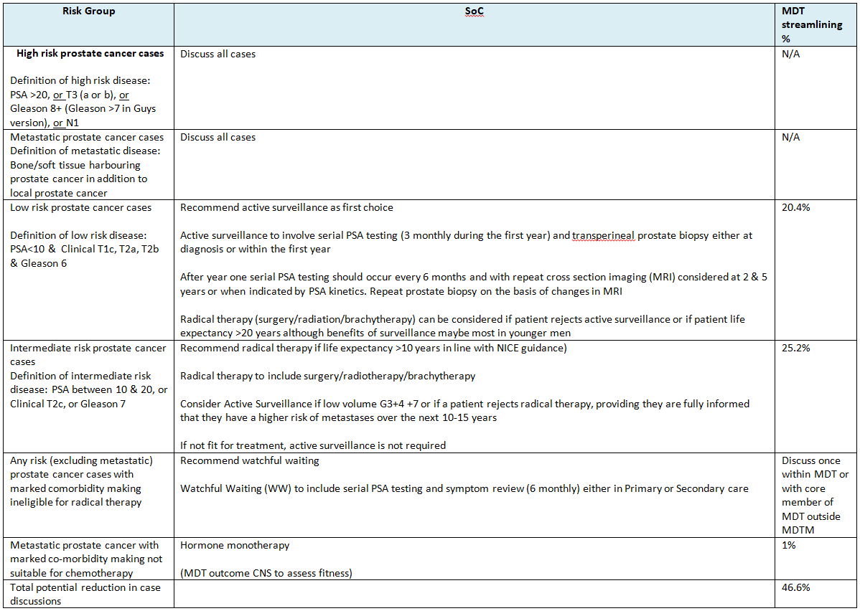
Draft National Prostate Cancer Standards of Care (SoC) to support MDT streamlining

Slide 25
Thoughts from Helen
As discussed in the first meeting of SWAG Cancer Clinical Leads, the prolonged length of meetings has been proven to reduce quality of decision making, particularly after the first hour, or discussion of 20 patients.
The addition of a 10 minute break at this point has been shown to balance the quality of decision making and reduce the length of the overall meeting
https://bmjopen.bmj.com/content/9/5/e027303

Slide 26
Are certain types of information under-represented when it would be useful?
Would it be useful to request a frailty assessment, such as the Rockwood Clinical Frailty Score to your MDT referral proforma? (Eight cases)
Are some professional groups under-represented when they shouldn’t be?
Could attendance be reduced by reordering the case discussions to have a specific slot for oncology, radiology, and pathology discussions?
Could pathology provide a cut-off date for listing cases to report results from surgical samples?

Slide 27
Some MDTs remove surveillance scans prior to the meeting if no change has been reported – would this be possible / appropriate if additional planning time was scheduled?
If additional planning time streamlined the MDT discussions, would it be possible to increase the discussion of relevant clinical research trials?
For the team members joining via MS Teams, can the camera be angled towards the MDT members who are speaking?
For the team members joining via MS Teams, is it possible to check that they can view the screens relevant to the current discussion?
Frequently, the software system Somerset Cancer Register causes delays to discussions as it is often slow to move between screens. Can the IM&T Department improve this?
Could the network MDT review, which includes both bladder and prostate cases, take place after the bladder case reviews, so that only the team members for bladder cancer need attend the first half of the meeting?
Is the team willing to share their results with other MDTs when finalised?

Slide 28
Prostate specific:
Could post treatment cases for which the MDT outcome is for 6 week outpatient appointments be removed from the list if planning time is scheduled?
Of the 26 cases deemed suitable for radical treatment, 13 had an additional action documented in the MDT outcome. Is it appropriate to remove this intermediate risk group from the MDT meeting discussion as recommended in the National Standard of Care, or could these actions be documented outside the MDT if planning time is scheduled?

Slide 29
Thank you for listening.
What do you think?

