Slide 1
Cancer Quality of Life Survey
Jo Chambers
Patient Rep – National QoL Survey Team
#CancerQualityOfLife
#LivingWithAndBeyondCancer
#PersonalisedCare
NHS England and NHS Improvement

Slide 2
Cancer Quality of Life Survey
The LTP Ambition
‘From 2019, we will begin to introduce an innovative quality of life metric…to track and respond to the long-term impact of cancer.’

Slide 3
Patient’s View – What matters to me
Impact of my cancer
Understand who I am
Quality of my survival
Design services that support me to live well

Slide 4
Success!!!

Slide 5
Patient’s View – What matters to me
Impact of my cancer
Understand who I am
Quality of my survival
Design services that support me to live well

Slide 6
Who and When?
September
2020
10% sample
December 2020
100% census
Nationwide test
Breast prostate colorectal
Nationwide cover
Breast prostate colorectal
July
2021
October 2021
Patients invited to complete the survey when they reach 18 months post-diagnosis
(All patients - primary and metastatic)
10% sample of ‘all’ cancers
Patient summaries
100% of 'all' cancers
Regular data publications from 25 Oct

Slide 7
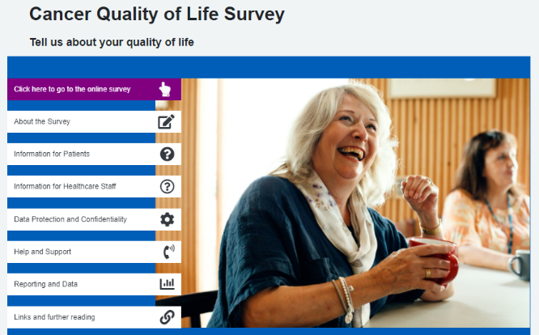
How?
Patients identified from the Cancer Register
Sent an invite letter
- Website address, username and password to access the survey
Reminder letter after 3 weeks
- Will include a paper copy of the survey
www.CancerQoL.england.nhs.uk

Slide 8
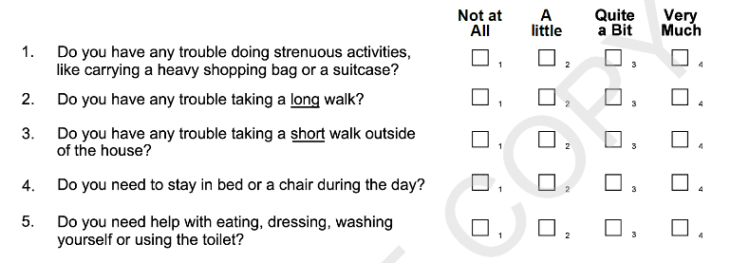
Completing the survey
Range of questions covering aspects including: mobility, self-care, ability to do usual activities, pain/discomfort, anxiety/depression
(EQ-5D 5L and EORTC QLQ-C30 question sets)
It takes around 10 mins to complete

Slide 9
Metric Reporting
Level 1
National reporting
Level 2
Regional and Alliance reporting
Pre-defined cut off scores, RAG rating; use case mix adjustment e.g. Cancer Stats 2
Level 3
Patient summaries reporting
Visualisations of summary QoL scores seen by patients
Focus LWBC work on managing the impact of cancer
Engage stakeholders and encourage commissioning of work on QoL improvement.
Identify good practise or areas for concern
Inform service improvement or sharing of best practise for QoL
Prompt supportive care planning conversations in primary and secondary care.
Differences between groups e.g. by cancer type, treatment type, stage of disease, co-morbidity, deprivation, gender, ethnicity etc.

Slide 10
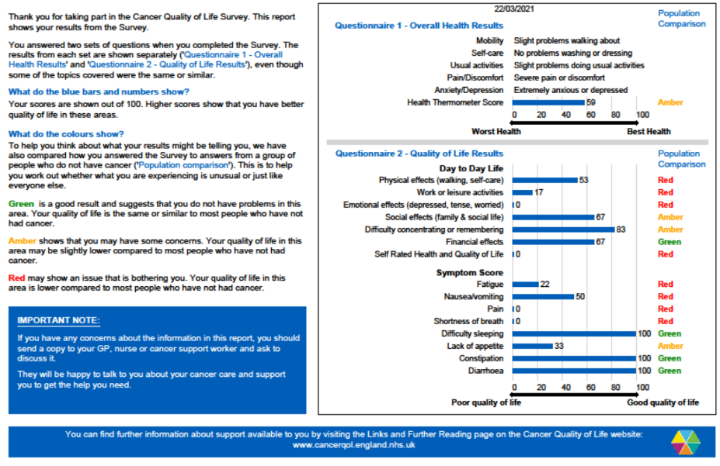
Patient summary

Slide 11
Responses and mode of completion
Total: 1168
50%
Total invited = 50,735 Total responses = 24,563

Slide 12
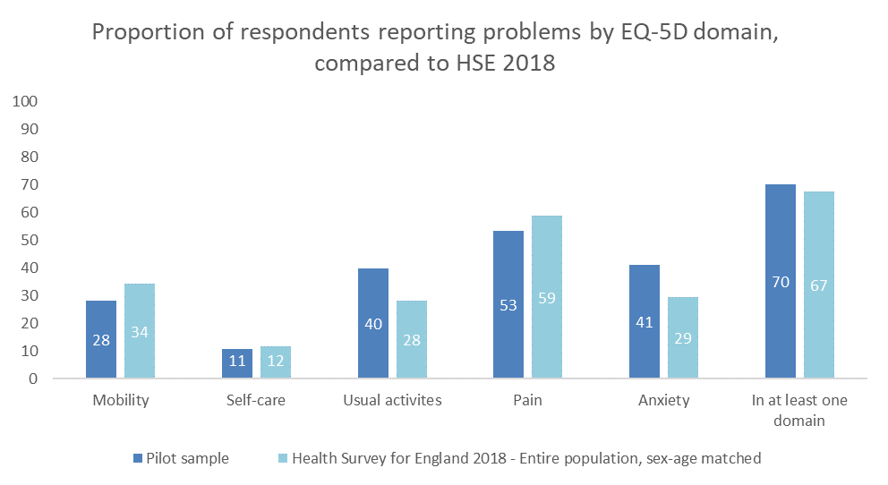
What did the pilot data indicate?
Compared to a ‘non cancer’ general population, people with cancer are more likely to report:
Poorer overall QoL
Anxiety
Difficulties engaging their usual activities (work, study, housework, family, leisure).

Slide 13
Data Publication
First data release: 25 Oct
100% coverage of breast, prostate and colorectal patients
Filter by:
Geographical area: NHS Region or Cancer Alliance
Cancer type
Age and gender
Future additions planned such as stage at diagnosis and treatment
https://www.events.england.nhs.uk/events/improving-cancer-quality-of-life-outcomes-launch-of-national-survey-data-dashboard
Available on:
Cancer Data webpage from 25 Oct (https://www.cancerdata.nhs.uk/)
CancerStats2 from 2022
- No end date for data collection – rolling updates

Slide 14
Data Health Warning!
QoL is a subjective thing
Difficult to describe in numbers
It doesn’t allow any explanation
Only 50% response rate
Change as a result of the data will take a long time
It’s not all about big sweeping changes to cancer services
There are simple things you can do right now that will improve QoL outcomes

Slide 15
Supporting products
Product | Brief description | Location
Communications toolkit | Visual identity guide Tailored slide set Slide template Briefing notes and key messages Locally printable poster Social media suggestions FAQs Example surveys and letters QoL Case Studies / ‘personas’ Patient information leaflet Films | Cancer Alliance Workspace: https://future.nhs.uk/canc/view?objectID=19564592 Or on request from your Cancer Alliance.
Website and helpline | Information for patients and the public Access to online survey completion Fully searchable and open to all | www.CancerQoL.england.nhs.uk

Slide 16
Who can I contact for more information?
Contact | Details
Alliance team | Helen Shallcross (helen.shallcross@nbt.nhs.uk) Jo Chambers (Patient Rep)
National Cancer Programme | Val Shilling (Val.Shilling@nhs.net)

Slide 17
Thank you! This survey is being run jointly by Public Health England and NHS England and NHS Improvement.
#CancerQualityofLife
#LivingWithAndBeyondCancer
#PersonalisedCare

