Slide 1
SWAG Prostate RDC Update
18/11/2021

Slide 2
RDS Overview
7 Key Principles that need to be embedded into the RDS Pathways
Aim to meet the FDS 28 day target
As part of the Long Term Plan, all pathways must be RDS pathways by end of 23/24

Slide 3
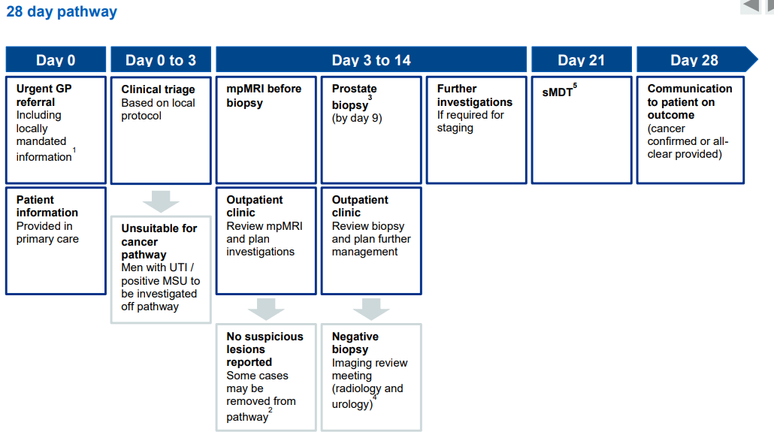
RDS Overview – FDS Pathway
Key Milestones:
Triage or STT by day 3 (5/7 achieved)
mpMRI to take place before Biopsy (6/7 achieved)
LATP Biopsy (6/7 achieved)
Biopsy by day 9 (1/7 consistent)
MDT by day 21 (0/7 consistent)
Patient informed by day 28 (0/7 consistent)

Slide 4
RDS Update November 2021
Our aim was to go live at the End of October but appreciate that all providers are currently under a lot of pressure & hence not all ready to go live as an RDS
Provider | Status | Anticipated “go live” | Outstanding Deliverables
North Bristol Trust | Pathway in place, awaiting “go live” assurance. Capacity still a limiting factor for some milestones. | Imminent | Assurance from trust that RDS principles are being met. Navigator also pending recruitment to take over some elements.
Weston Hospital | Awaiting merger with NBT | TBC
Royal United Hospital Bath | Most elements of pathway in place, “go-live” to be confirmed & capacity still limiting | TBC – likely Q4 | SWAG to receive and review the SOP, STT Nurse Practitioner to be appointed. Increasing Virtual Triage to 3 clinics p/w
Salisbury Foundation Trust | Achieving some elements of the pathway, LATP capacity is limiting at present. Navigator in post. | TBC – aim for Q4 | SOP is in draft, awaiting completion. Registrar training ongoing. Should then be able to target a go-live.
Somerset Foundation Trust | Achieving some elements of the pathway. One Stop Pilot to be extended pending revised MRI slot capacity. Haven’t decided on Navigator recruitment yet. | TBC – aim for Q4 | Training for additional LATP resource (start Q4). MRI pathway confirmation. SOP in progress. Navigator role decision & recruitment.
Yeovil District Hospital | Negotiations around radiology ongoing. CNS roles approved and out for recruitment – will support triage & biopsy milestones. | TBC – potentially not 21/22 | Confirm pathway in place. Recruitment of 2 x CNS & 1 x Navigator + training SOP to be created.
Gloucestershire ICS | Pathway largely in place & awaiting “go live” assurance & evidence of pathway. Recruitment and training all complete. | Imminent | Assurance (e.g. SOP) that the RDS principle and pathway are in place. Single point of contact also needs to be confirmed.

Slide 5
Next Steps
Continue discussions with providers & support to achieve the RDS deliverables as soon as possible while appreciating current pressures.
Open to feedback from clinical teams around the pathways & progress
Ongoing monitoring of FDS and 2WW performance
Start reporting the RDS data set once each provider is “live”
Also For Consideration…
Future RDS for Urology (excluding Prostate) – are there any early thoughts about how this pathway could be improved?
How high a priority should this be? Currently not planned until 23/24 but this is not fixed – if it is deemed a higher priority there is potential for plans to be amended.
Any feedback on this please contact SWAG (Belinda as first point of contact)

