Slide 1
National Rapid Diagnostic Centre Principles

Slide 2
SWAG Prostate Rapid Diagnostic Service Transformation
 | Mar-21 | Apr-21 | May-21 | Jun-21 | Jul-21 | Aug-21 | Sep-21
Prostate RDS Plans on Page and due diligence requirements discussed and agreed with SW Prostate Steering Group and SWAG Core Team
Prostate RDS Plans on Page template and due diligence requirements circulated |  | 30th April
Provider Prostate MDT's work up plans for Prostate RDS transformation (Request from SWAG to invite Nicola Gowen to join these discussions)
Completed Prostate RDS Plans on Page submitted to SWAG |  |  |  | 11th June
SWAG CA to review and approve completed Prostate RDS Plans on Page
SWAG CA work with providers to sign off Prostate RDS Due diligence document as pathway transformation delivered and requirements met
Prostate RDS 'Go Live' |  |  |  |  |  |  | 3rd September

Slide 3
Plan on page – RDS prostate template
Phase 3 prostate Rapid Diagnostic Service Plan on a Page
Examples of good practice (not exhaustive): To be discussed at steering group below @ Bristol, Gloucestershire, Salisbury, Taunton Virtual telephone triage system: Introduced to allow appropriate men to receive an MRI without a face-to-face appointment first, minimising the number of hospital visits and allowing straight to test. mpMRI performed before biopsy: Stratify men towards a biopsy so at least 25% can avoid unnecessary invasive tests, diagnose over 90% of significant cancers and diagnose fewer insignificant cancers. Local Anaesthetic Transperineal (LATP) biopsies replace TRUS (Transrectal ultrasound-guided) and workforce training. LATP biopsies improve accuracy of diagnosis and carry less risk of sepsis to the patient. LATP is performed under local anaesthetic in an outpatient setting. All SWAG providers of prostate cancer services will have implemented this change by April 2021.This change supports the delivery of safer and faster care with optimised resources. Database exports to the South West Prostate dashboard. The implementation of the programme deliverables is monitored and supported by a robust prostate dashboard which generates the information essential to measure the key steps in the clinical pathway and supports equity of provision and access to appropriate diagnostic services across the whole region. The current dashboard is excel based and is now being upgraded to a web-based platform, which would future proof its design and make it possible extend its reach beyond the South West.
Alliance Objectives | Action Plan to Implement: | Delivery Timelines | Resources required
Apply the 7 Rapid Diagnostic Centre principles to suspected prostate cancer pathway Implement pathway SW prostate pathway standards (agree and deliver local action plan) Implement the timelines as described in the National Timed Pathway for Prostate Cancer Communication to patient cancer or no cancer by day 28 (Faster diagnosis standard)

Slide 4
Due Diligence / RDS Criteria – The essential requirements prostate RDS
SWAG SS Prostate RDS requirement | Achieved | Partially achieved | To be achieved pre Q3 21/22 | Evidence of achievement: narrative and audit where appropriate
System wide measures to increase referrals in populations inequitably accessing healthcare (RDC principle 1) |  |  |  | CA Referral rate equality report and PCN CCG audit
Referral quality feedback with Primary care to optimise detection rates (RDC principle 2) |  |  |  | PHE detection rate PCN CCG audit
Virtual Telephone triage (within 3 days) system in place- Straight to mpMRI without F2F/OPA (RDC Principle 3) |  |  |  | SW prostate dashboard report / link to narrative quarterly action report
Biopsy by Day 9 (Local anaesthetic transperineal biopsies should replace all Transrectal Ultrasound Guided Biopsies and Template Biopsies are carried out under local anaesthetic (unless contra-indicated) (RDC principle 4&5) |  |  |  | SW prostate dashboard report/ link to narrative quarterly action report
Plans for 1 stop provision mpMRI / biopsy (RDC Principle 4&5) |  |  |  | Business case submission
Single point of contact for patient incl. MECC approach followed by handover to CNS team where cancer diagnosed (RDC Principle 7) |  |  |  | SOP
Staging Investigations referred by day 14 with (7 day turnaround include report) (RDC Principle 4&5) |  |  |  | SW prostate dashboard report/ link to narrative quarterly action report
MDT day 21 (RDC Principle 5) |  |  |  | SW prostate dashboard report/ link to narrative quarterly action report
Communication cancer / no cancer to patients by day 28 (RDC Principle 7) |  |  |  | FDS CWT data
Diagnosis report or onward referral – referrals to CUP should include details of biopsy referral made (RDC Principle 6) |  |  |  | SOP

Slide 5
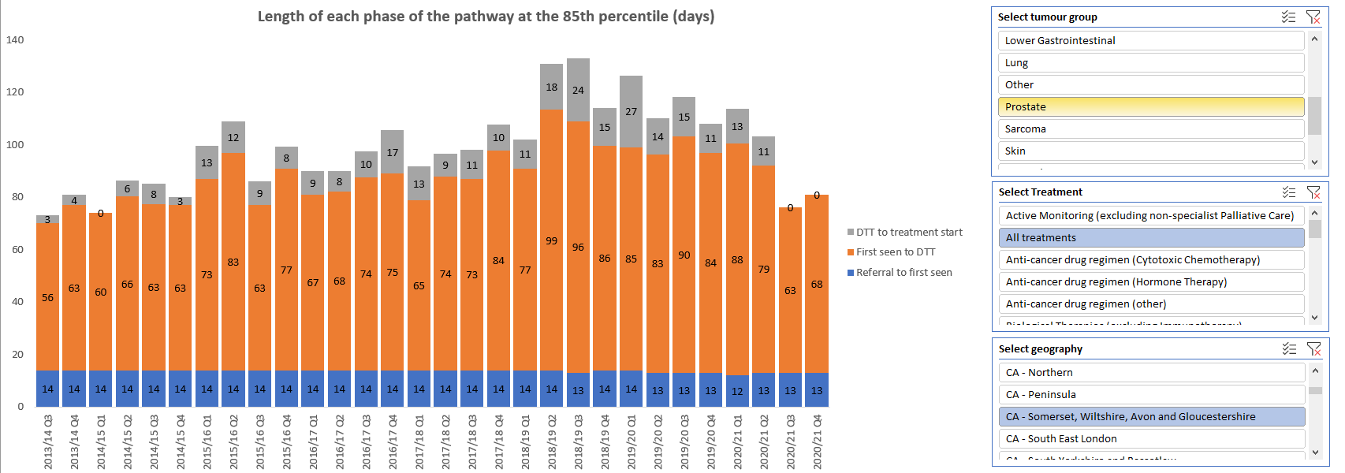
Prostate Pathway length

Slide 6
Days
* Not all providers have submitted all monthly submission to February 2021

Slide 7
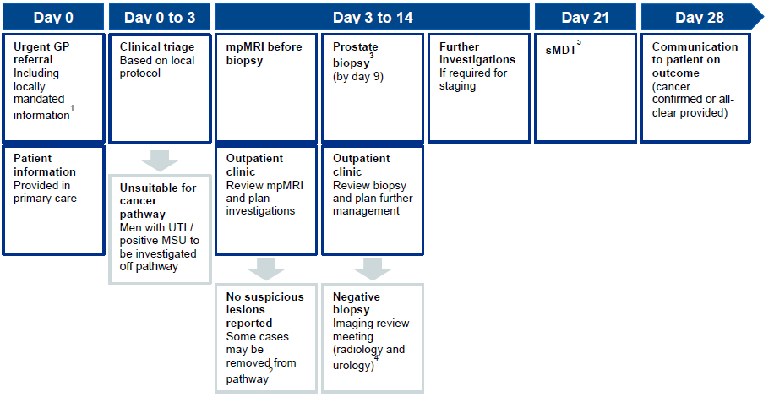
Site specific - Prostate timed pathway

Slide 8
SW Prostate pathway actions
Ref | Topic | Standards Actions
1 | Data | Data submitted monthly
2 | Pathway | Local pathway action plan signed off
3 | Pathway | Meet Faster Diagnosis Standard (28 days)
4 | Referral | Virtual Telephone triage system in place- Straight to mpMRI without F2F/OPA witin 3 days
5 | MRI | Image scanning in line with SW policy
6 | MRI | Multiparametric MRI should be performed before biopsy
7 | MRI | mpMRI should be reported using the PIRADS or LIKERT score
8 | MRI | Trial same day mpMRI and Biopsy for a defined cohort of patients (ask alliance for trial info if interested)
9 | Biopsy | Max. of 18 cores taken at biopsy
10 | Biopsy | Providers create and deliver a workforce plan to reduce the proportion of biopsies performed by consultant surgeons
11 | Biopsy | Biopsies should not be carried out on men whose mpMRI score (PIRADS or LIKERT) is 1 or 2 where mpMRI NPV has reached the metric shown in the table, right
12 | Biopsy | mpMRI signed off as providing good NPV
13 | Biopsy | Local anaesthetic transperineal biopsies should replace all Transrectal Ultrasound Guided Biopsies
14 | Biopsy | Template Biopsies are carried out under local anaesthetic. This means that general anaesthetic template biopsies should cease (unless contra-indicated)
15 | Surgery | The decision to aggressively treat a patient with Gleeson grade group 1 cancer should be fully justified to the MDM
Ref | Topic | Additional Actions
16 | Pathway | Aim to reduce the pathway for patients having both MRI and biopsy as currently <10% achieving the 28 day target
17 | MRI | Use 0.12/0.15 PSAD with MRI score to reliably exclude significant cancer in PIRADS 3 patients
18 | MRI | Use contrast for all MRI diagnosis scans (unless MRI quality is already good enough)

