Slide 1
SWAG Network Colorectal Cancer
Clinical Advisory Group
Research Update - Claire Matthews & Sharath Gangadhara
13/10/2021

Slide 2
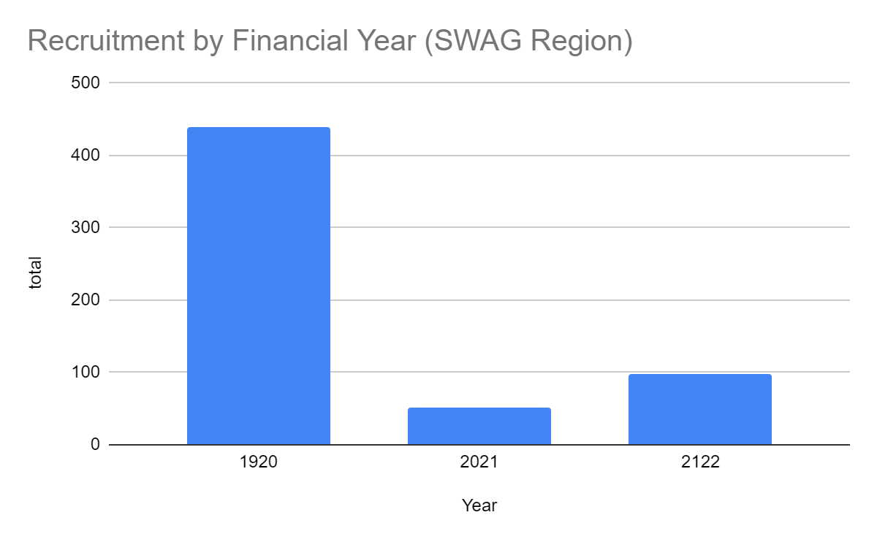
Whole Colorectal Portfolio
West of England
Notes:
In March, on behalf of the Department of Health and Social Care, the NIHR set up a mechanism (UK-wide portal) for applying for funding and/or prioritised support for urgent public health research into COVID-19.
The goal was to gather the necessary clinical and epidemiological evidence to inform national policy and enable new diagnostics, treatments and vaccines to be developed and tested.
The set-up and delivery of UPH studies is expedited by all necessary organisations across the research, health and social care systems including the HRA.
There is a commitment to ensure that research findings and data relevant to COVID-19 from UPH research are shared rapidly and openly.
Currently there are 67 UPH studies, 47 of which are running in CRN WE.
Restart framework was introduced in May with the aim of
Restoring a fully active portfolio of NIHR research
Continuing to support COVID-19 NIHR research
Providing a structure to guide the restarting of a full range of NIHR research
Work in close collaboration with key stakeholders, regulators, HRA, MHRA, patients and the public, and health and care research organisations to support the pace and coordination of this Restart and to ensure coordinated UK-wide working
2nd wave guidance:
The NIHR issued guidance to protect both COVID-19 and non-COVID-19 research during a ‘second wave’ of high COVID-19 activity.
The guidance makes very clear that research staff funded by NIHR should not be deployed to front line duties except in exceptional circumstances. This is in contrast to the ‘first wave’ when numerous staff were deployed to the clinical front line.
Dr William van't Hoff, CEO of the NIHR Clinical Research Network (CRN) and Senior Responsible Officer for the Restart Programme, said: “As the number of people with COVID-19 starts to rise again, it is imperative that our research staff focus on priority COVID-19 studies including vaccine studies. But we also need our teams to continue to support the restart of non-COVID-19 research, both commercial and non-commercial, in tandem with the restoration of NHS routine clinical services. The impact of research being paused in the Spring has been severe and we will make every effort to maintain recruitment rates across the portfolio.”

Slide 3
Colorectal Cancer Studies - open and in set-up in SWAG region
Short Name | Sites | Status | Opening date | Closure date | Sample Size England | England Recruits
Add-Aspirin | UHBW, GHFT, GWH, Musgrove, NBT, Yeovil | Open, With Recruitment | 05/10/15 | 31/01/22 | 7351 | 6,904
ICI Genetics | UHBW, Musgrove | Open, With Recruitment | 12/04/19 | 31/03/24 | 1000 | 312
PLATO - PersonaLising Anal cancer radioTherapy dOse | Cheltenham, UHBW | Open, With Recruitment | 13/01/17 | 31/03/23 | 639 | 417
CORGI 2 | UHBW | Open, With Recruitment | 14/07/17 | 01/03/24 | 4400 | 341
TRIGGER Trial | UHBW, RUH | Open, With Recruitment | 14/03/16 | 31/12/21 | 85 | 168
TRACC - Predicting Relapse in eArly Colorectal Cancer | UHBW, Musgrove | Open, With Recruitment | 05/12/16 | 05/12/19 | 1000 | 933
The SCOTTY Study | UHBW | Open, With Recruitment | 31/08/16 | 31/12/21 | 150 | 76
Phase II single-arm study of tepotinib combined with cetuximab | UHBW | Open to Recruitment | 22/04/21 | 24/02/22 | - | 0
The BREAKWATER Study | Cheltenham, UHBW, Yeovil, Musgrove | In Setup, Appr. Received | 15/04/21 | 01/12/23 | - | 0
APHRODITE | UHBW | Open, With Recruitment | 18/02/20 | 29/08/22 | 95 | 1
PRESERVE | NBT | In Setup, Pending Appr. | 01/01/21 | 31/01/21 | 146 | 0
Short-term Water-only Fasting prior to chemotherapy Trial (SWiFT) | UHBW | Open, With Recruitment | 03/03/20 | 30/04/22 | 30 | 4
A Real World Evidence Study in the Management of Metastatic Colorectal Cancer: A Clinical and Patient Perspective | UHBW | Open, With Recruitment | 14/10/19 | 30/04/22 | 16 | 38
EMERGE | UHBW | Open, With Recruitment | 11/01/19 | 30/11/21 | 75 | 26
Prepare-ABC | NBT | Open, With Recruitment | 01/11/16 | 01/12/21 | 1056 | 631
IMPRESS | Yeovil, Musgrove | Open, With Recruitment | 20/08/14 | 31/08/19 | 243 | 254
Notes:
In March, on behalf of the Department of Health and Social Care, the NIHR set up a mechanism (UK-wide portal) for applying for funding and/or prioritised support for urgent public health research into COVID-19.
The goal was to gather the necessary clinical and epidemiological evidence to inform national policy and enable new diagnostics, treatments and vaccines to be developed and tested.
The set-up and delivery of UPH studies is expedited by all necessary organisations across the research, health and social care systems including the HRA.
There is a commitment to ensure that research findings and data relevant to COVID-19 from UPH research are shared rapidly and openly.
Currently there are 67 UPH studies, 47 of which are running in CRN WE.
Restart framework was introduced in May with the aim of
Restoring a fully active portfolio of NIHR research
Continuing to support COVID-19 NIHR research
Providing a structure to guide the restarting of a full range of NIHR research
Work in close collaboration with key stakeholders, regulators, HRA, MHRA, patients and the public, and health and care research organisations to support the pace and coordination of this Restart and to ensure coordinated UK-wide working
2nd wave guidance:
The NIHR issued guidance to protect both COVID-19 and non-COVID-19 research during a ‘second wave’ of high COVID-19 activity.
The guidance makes very clear that research staff funded by NIHR should not be deployed to front line duties except in exceptional circumstances. This is in contrast to the ‘first wave’ when numerous staff were deployed to the clinical front line.
Dr William van't Hoff, CEO of the NIHR Clinical Research Network (CRN) and Senior Responsible Officer for the Restart Programme, said: “As the number of people with COVID-19 starts to rise again, it is imperative that our research staff focus on priority COVID-19 studies including vaccine studies. But we also need our teams to continue to support the restart of non-COVID-19 research, both commercial and non-commercial, in tandem with the restoration of NHS routine clinical services. The impact of research being paused in the Spring has been severe and we will make every effort to maintain recruitment rates across the portfolio.”

Slide 4
Colorectal Cancer as Sub Specialty - open and in set-up
Short Name | Sites | Status | Opening date | Closure date | Sample Size England | England Recruits
NIHR BioResource - Rare Diseases | UHBW, NBT, RUH | Open, With Recruitment | 13/09/2012 | 31/03/2022 | 22000 | 12,728
Colorectal Cancer Cohort Study (COLO-COHORT) | Glos, Yeovil (EoI) | Open, With Recruitment | 03/12/2019 | 14/07/2024 | 15000 | 1,259
VODECA | RUH, NBT | Open, With Recruitment | 02/01/2019 | 28/02/2022 | 1000 | 731
CReST2 | NBT, Musgrove | Open, With Recruitment | 08/05/2017 | 30/04/2022 | 450 | 292
IntAct- IFA to prevent anastomotic leak in rectal cancer surgery | RUH | Open, With Recruitment | 20/10/2017 | 31/03/2022 | 440 | 231
STAR-TReC | NBT | Open, With Recruitment | 14/06/2017 | 31/12/2021 | 60 | 97
CONSIDER-19: Communicating surgical decisions during COVID-19 | UHBW, Glos, NBT | Open to Recruitment | 15/10/2020 | 31/08/2021 | 30 | 0*
*recruitment data not uploaded by study team yet

Slide 6
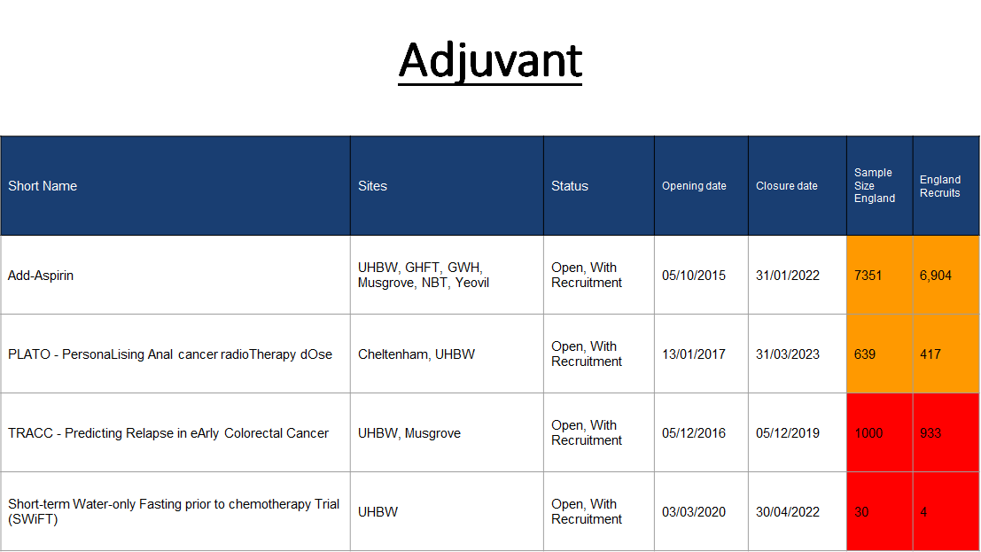

Slide 9
Managed Recovery (MR)
Requested by DHSC, NIHR is working with funders, NHS R&D, research partners across the UK and patients and the public on a process to manage the recovery of multi-site studies.
Funders and National Speciality Leads have identified the most urgent studies
Research delivery teams, LCRNs and R&D leadership have assessed site, regional and national delivery capacity and capability.
https://www.nihr.ac.uk/researchers/managing-research-recovery.htm
Notes:
In March, on behalf of the Department of Health and Social Care, the NIHR set up a mechanism (UK-wide portal) for applying for funding and/or prioritised support for urgent public health research into COVID-19.
The goal was to gather the necessary clinical and epidemiological evidence to inform national policy and enable new diagnostics, treatments and vaccines to be developed and tested.
The set-up and delivery of UPH studies is expedited by all necessary organisations across the research, health and social care systems including the HRA.
There is a commitment to ensure that research findings and data relevant to COVID-19 from UPH research are shared rapidly and openly.
Currently there are 67 UPH studies, 47 of which are running in CRN WE.
Restart framework was introduced in May with the aim of
Restoring a fully active portfolio of NIHR research
Continuing to support COVID-19 NIHR research
Providing a structure to guide the restarting of a full range of NIHR research
Work in close collaboration with key stakeholders, regulators, HRA, MHRA, patients and the public, and health and care research organisations to support the pace and coordination of this Restart and to ensure coordinated UK-wide working
2nd wave guidance:
The NIHR issued guidance to protect both COVID-19 and non-COVID-19 research during a ‘second wave’ of high COVID-19 activity.
The guidance makes very clear that research staff funded by NIHR should not be deployed to front line duties except in exceptional circumstances. This is in contrast to the ‘first wave’ when numerous staff were deployed to the clinical front line.
Dr William van't Hoff, CEO of the NIHR Clinical Research Network (CRN) and Senior Responsible Officer for the Restart Programme, said: “As the number of people with COVID-19 starts to rise again, it is imperative that our research staff focus on priority COVID-19 studies including vaccine studies. But we also need our teams to continue to support the restart of non-COVID-19 research, both commercial and non-commercial, in tandem with the restoration of NHS routine clinical services. The impact of research being paused in the Spring has been severe and we will make every effort to maintain recruitment rates across the portfolio.”

Slide 10
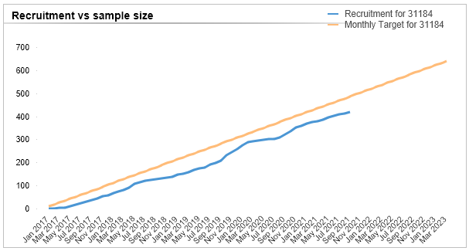
PLATO - PersonaLising Anal cancer radioTherapy dOse (ID 31184)
Cheltenham: PI Nick Reed 8/6 recruited
UHBW: PI Stephen Falk 39/35 recruited
Sponsor: University of Leeds
Funder: CRUK
CI: Prof David Sebag-Montifiore (UoL)
Open to new sites: Yes
Contact: plato@leeds.ac.uk
Note: Recruitment recently extended until 31/03/2023
Data taken from All Portfolio - data cut 29/09/2021
Notes:
PLATO - PersonaLising Anal cancer radioTherapy dOse - Incorporating Anal Cancer Trials (ACT) ACT3, ACT4 and ACT5

Slide 11
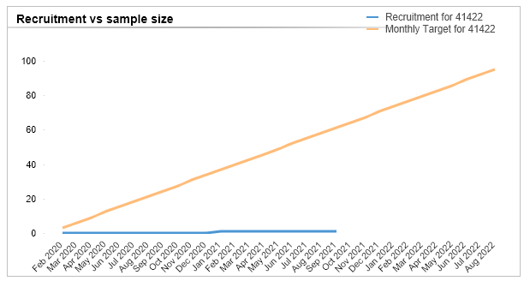
APHRODITE - (ID 41422)
UHBW: PI Stephen Falk, Project in set up
Sponsor: University of Leeds
Funder: Yorkshire Cancer Research
CI: Dr Simon Gollins (Glan Clwyd
Open to new sites: Yes
Contact: aphrodite@leeds.ac.uk
Note: Recently extended to 29/08/2022
Data taken from All Portfolio - data cut 29/09/2021
Notes:
A Phase II trial of Higher RadiOtherapy Dose In The Eradication of early rectal cancer.

Slide 12
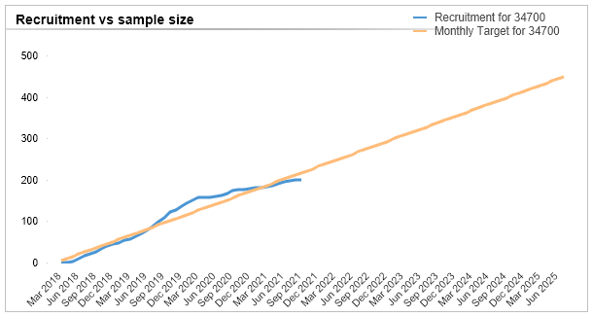
EMT2: EPA for Metastasis Trial 2 (ID 34700)
No Sites in Region
Sponsor: University of Leeds
Funder: Yorkshire Cancer Research
CI: Prof Mark Hull (UoL)
Open to new sites: Yes
Contact: emt2@leeds.ac.uk
Note: Recruitment recently extended until 31/07/2025
Data taken from All Portfolio - data cut 29/09/2021
Notes:
A randomised placebo-controlled phase III trial of the effect of the omega-3 fatty acid eicosapentaenoic acid (EPA) on colorectal cancer recurrence and survival after surgery for resectable liver metastases

Slide 13
Add-Aspirin (ID 18067)
BHOC: PI Axel Walther 150/500 recruited
Weston: PI Serena Hillman 9/30 recruited
GHFT: PI Kim Benstead 42/30 recruited
GWH: PI Anne Kendal 44/40 recruited
Musgrove: PI Emma Gray 40/40 recruited
NBT: PI G. Sasirekha 33/30 recruited
Yeovil: PI Shiyam Kumar 30/20 recruited
(All cohorts - unable to separate out colorectal data)
Sponsor: University College London
Funder: CRUK/NETSCC
CI: Dr Ruth Langley (UCL)
Open to new sites: Yes
Contact: mrcctu.add-aspirin@ucl.ac.uk
Note: Aug 21 Not open to new sites - expecting to close the breast and colorectal cohorts to recruitment within the next 6 months.
Data taken from All Portfolio - data cut 29/09/2021
Notes:
A randomised placebo-controlled phase III trial of the effect of the omega-3 fatty acid eicosapentaenoic acid (EPA) on colorectal cancer recurrence and survival after surgery for resectable liver metastases

Slide 14
Updates from Colorectal National Oversight Group
ARIEL - A biomarker enrichment trial of anti-EGFR agents in patients with advanced colorectal cancer (aCRC) with wild-type RAS and right primary tumour location (right-PTL)
CI Jenny Seligmann
Study in set up, REC meeting next week
Looking for more sites
TRACC - Tracking mutations in cell free tumour DNA to predict Relapse in eArly Colorectal Cancer
CI David Cunningham
Observational study is still ongoing, piloting the nested interventional study (TRACC C) at the Royal Marsden. Using ctDNA results to guide adjuvant therapy; De-escalation of chemotherapy where indicated.
The requirement for pre-op tissue samples may cause logistical challenges. Looking into a post-op plasma sample only.
Open to new sites for feasibility.
Foxtrot-2, Foxtrot-3 also in the pipeline. Foxtrot-2 and TRACC C could co-enroll patients but would need discussion with study teams
Foxtrot-1 and TRACC C not suitable for co-enrollment
Notes:
In March, on behalf of the Department of Health and Social Care, the NIHR set up a mechanism (UK-wide portal) for applying for funding and/or prioritised support for urgent public health research into COVID-19.
The goal was to gather the necessary clinical and epidemiological evidence to inform national policy and enable new diagnostics, treatments and vaccines to be developed and tested.
The set-up and delivery of UPH studies is expedited by all necessary organisations across the research, health and social care systems including the HRA.
There is a commitment to ensure that research findings and data relevant to COVID-19 from UPH research are shared rapidly and openly.
Currently there are 67 UPH studies, 47 of which are running in CRN WE.
Restart framework was introduced in May with the aim of
Restoring a fully active portfolio of NIHR research
Continuing to support COVID-19 NIHR research
Providing a structure to guide the restarting of a full range of NIHR research
Work in close collaboration with key stakeholders, regulators, HRA, MHRA, patients and the public, and health and care research organisations to support the pace and coordination of this Restart and to ensure coordinated UK-wide working
2nd wave guidance:
The NIHR issued guidance to protect both COVID-19 and non-COVID-19 research during a ‘second wave’ of high COVID-19 activity.
The guidance makes very clear that research staff funded by NIHR should not be deployed to front line duties except in exceptional circumstances. This is in contrast to the ‘first wave’ when numerous staff were deployed to the clinical front line.
Dr William van't Hoff, CEO of the NIHR Clinical Research Network (CRN) and Senior Responsible Officer for the Restart Programme, said: “As the number of people with COVID-19 starts to rise again, it is imperative that our research staff focus on priority COVID-19 studies including vaccine studies. But we also need our teams to continue to support the restart of non-COVID-19 research, both commercial and non-commercial, in tandem with the restoration of NHS routine clinical services. The impact of research being paused in the Spring has been severe and we will make every effort to maintain recruitment rates across the portfolio.”

Slide 15
NIHR ODP
Open data platform. Data on performance and restart across whole CRN, including all specialty areas
NIHR Be Part of Research
See which studies are open across the country
National Cancer Research Institute Portfolio Maps
View current national portfolio of open, closed and ‘in set up’ cancer studies
Find a Clinical Research Study (ODP)
Search for a study to fit criteria. Good for horizon scanning, eligibility criteria

Slide 16
Research Delivery Manager
claire.matthews@nihr.ac.uk
Research Portfolio Facilitator
iqra.hussain@nihr.ac.uk
Sub-specialty Lead
Colorectal: Stephen.falk@uhbw.nos.uk
Upper GI/ Colorectal: sharath.gangadhara@nhs.net

