Slide 1
CUP trials update
CUPISCO and CUP-COMP
Dr Tania Tillett Medical Oncologist RUH

Slide 2
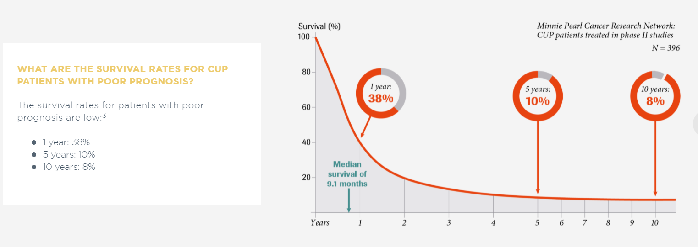
https://cup-syndrome.com/en/home/cupisco-study.html

Slide 3
CUPISCO
November 2021

Slide 4
CUPISCO – Eligability Criteria
https://cup-syndrome.com/en/home/cupisco-study.html
November 2021

Slide 5
CUPISCO Exclusion Criteria
https://cup-syndrome.com/en/home/cupisco-study.html

Slide 6
CUP favourable subsets
November 2021

Slide 7
Lung Cancer or CUP
https://theoncologist.onlinelibrary.wiley.com/doi/10.1002/onco.13744
November 2021

Slide 8
Cholangiocarcinoma or CUP
https://theoncologist.onlinelibrary.wiley.com/doi/10.1002/onco.13744
November 2021

Slide 9
CUP-COMP
https://clinicaltrials.gov/ct2/show/NCT04750109

Slide 10
Difference CUPISCO and CUP COMP
 | CUPISCO | CUP-COMP
Histology | CUP – adeno subtype | CUP – any – squamous cell or NET
WHO PS | 0-1 | 0-2
Trial | RTC – non-liscenced medicines provided | Observational
Biopsy | Only to confirm CUP | Fresh biopsy for trial needed
NGS – Foundation One | Released if randomised to treatment arm or on progression | Released immediately
November 2021

Slide 11
UCL – CUPem – Pembrolizumab
https://clinicaltrials.gov/ct2/show/NCT03752333

Slide 12
Thank you Questions?
Please email t.tillett@nhs.net

