Slide 1
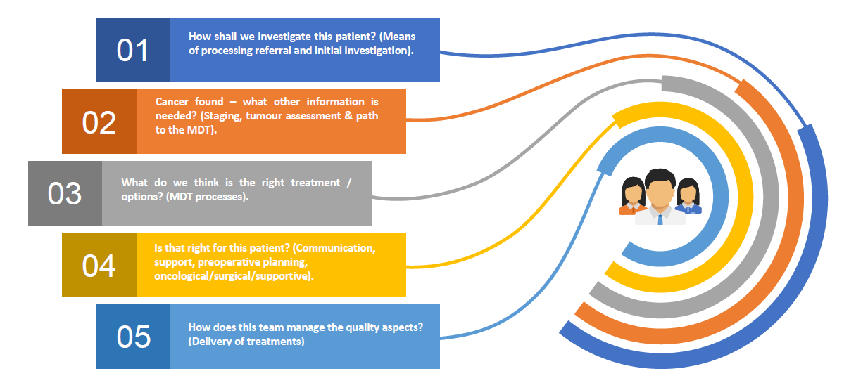
Peer Review Follow up calls
In 2019, under the leadership of Mike and Melanie, we conducted PR across the SW to learn about your local pathways, how your colorectal services are delivered around the 5 complex decision point and about your local challenges.
Individual reports were sent to providers highlighting best practice but also suggested development opportunities to support in optimising the pathway delivery.
CRC PR follow up plans were sent to cancer services teams to understand how your local CRC services team have implemented change ideas to address identified challenges and also an opportunity to highlight your limitations post COVID-19 recovery.
The outcome of those reports will help in creating a SWAG CA CRC Risk register which will be fedback to CAG once finalised but also drive discussions in upcoming CRC PR follow up calls.

Slide 2
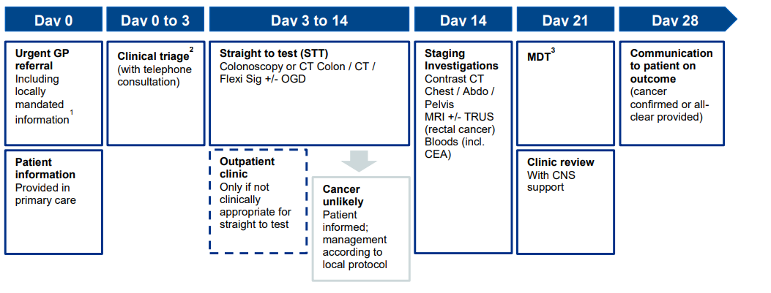
PR Review Follow up calls
Pathway analyser
Launched in August. Monthly submissions for all patients treated in a month.
Understand local delivery of the CRC timed pathway, identify most challenged pathway milestones, address bottlenecks and track improvement over time.

Slide 3
Peer Review Follow Up Calls Next steps
CRC Follow up calls are planned for the W/C 8th November under the leadership of Julie Burton. The discussion will be held around the delivery of CRC pathway from Referral to Treatment and will support in identifying opportunities for innovation and improvement at a macro system level but also specific to individual provider which will be supported with next year’s funding.
Alex-Business Support has been trying to schedule dates over the last 10 days with your local teams for an initial 2hr call with the CRC lead and MDT team. A formal agenda for the day will be communicated once dates are booked.
30 min quarterly follow up calls will also be scheduled with individual providers next year.
We have received so far one response from UHBW MDT lead, and 4 responses from Cancer Managers (SDFT,GHT,NBT,YDH) and the responses are not favourable for the week commencing 8th November.
We have received 4/5 CRC PR Follow up plans. No visit to Gloucestershire due to merger with Cheltenham and NBT best practice show case on the day. For these 2 providers, a discussion will be held around the 5 pathway clinical decision points to understand the pathway in place and supported by the pathway analyser analysis.

