Slide 1
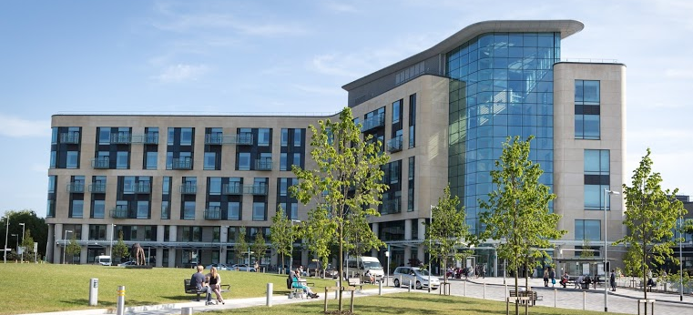
Innovations in bladder cancer
Miss Helena Burden
Prof Raj Persad

Slide 2
Urinary biomarkers
Investigated for many years in bladder cancer
Because:
Flexible cystoscope is invasive
Bladder cancer has a long and potentially intensive follow-up schedule
Huge financial burden
Ongoing problem is that they have not been sensitive or specific enough to compete with flexible cystoscope
Most have similar sensitivity and specificity to urine cytology

Slide 3
Urinary biomarkers
Ideally:
Easy to use
Affordable
Reliable
High sens and spec
Unaffected by benign conditions such as inflammation
However:
Previous focus on sensitivity and specificity, but new focus is high NPV - as per EAU
…….ADXBladder
NMP-22, BTA Stat and BTA TRAK, UroVysion (FISH), ImmunoCyt/uCyt+, Uromonitor and Uromonitor-V2, UroSEEK, EpiCheck, ADXBladder

Slide 4
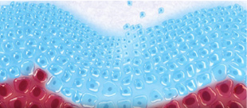
ADXBladder
MCM5 protein expression
Marker of cell proliferation
MCM5 not expressed in fully differentiated cells
Normal bladder - MCM5 cells usually confined to the basal layer (red)
Bladder cancer - cell proliferation – MCM5 positive cells exposed into urine

Slide 5
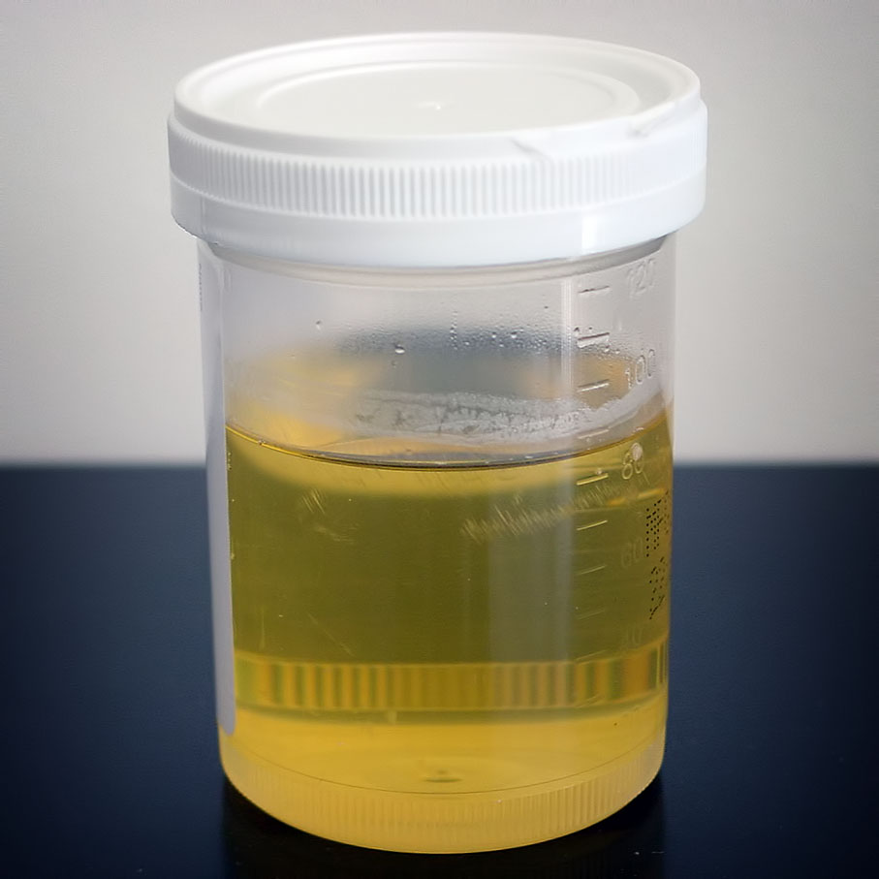
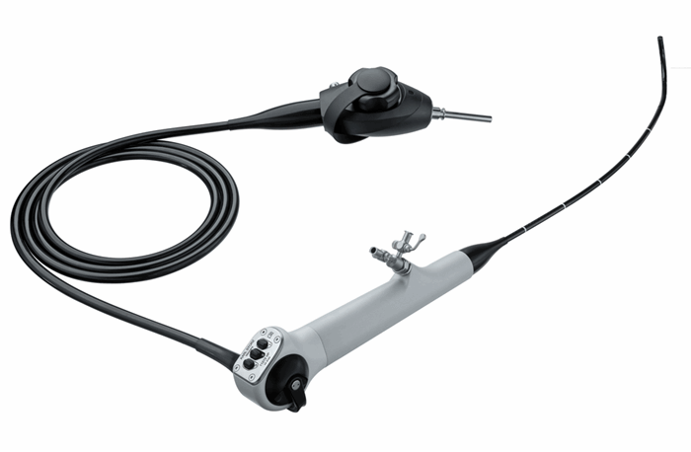
ADXBladder
Standard ELISA
MSU – 10mls voided urine
2.5 hours to result
£35
(Flexible cystoscopy £300)

Slide 6
2 large multicentre studies
Diagnosis (EAU 2020)
856 patients nvh and VH
85% sensitivity (excluding LG Ta)
68% specificity
99% NPV (excluding LG Ta)
Bladder cancer follow-up (J Urol 2020)
1192 patients
84% sensitivity (excluding LG Ta)
72% specificity
99.5% NPV (excluding Lg Ta)
93% NPV for all tumours

Slide 7
Innovation versus risk
Potential advantages
Potential challenges
Improved patient experience
Non invasive
Less patient travel time
Reduced journeys to hospital
Reduced carbon footprint
Less COVID exposure for patient in hospital
Relieve pressure on flexible cystoscopy lists
Risk of biomarker not detecting significant cancer
Risk as no pathway directed trials comparing standard of care to biomarker care
Risk due to biomarker not yet being within NICE or EAU guidelines, where do we stand with potential litigation
Would patients agree to a non-guideline/standard of approach?

Slide 8
Potential for pathway change:
Diagnosis – nvh population:
2ww nvh (NICE guidance)
Low yield (3-5% cancer)
Could use ADXBladder/USS and risk assessment to risk stratify.
non 2ww nvh
Could use ADXBladder to decide who is referred to secondary care routinely.
Surveillance
Low risk
Could replace flexible cystoscopies at 3 months. 1 in 10 get recurrence after 1st year.
2. Intermediate risk
? Could replace some flexible cystoscopies within schedule.

Slide 9
Thank you – opinions?
Helena.burden@nbt.nhs.uk

