Slide 1
SW GLH services for NSCLC – An update
Professor Rachel Butler

Slide 2
The genomic complexity of advanced NSCLC
>50% NSCLC now have actionable variant
Jordan et al. Cancer Discovery (2017)

Slide 4
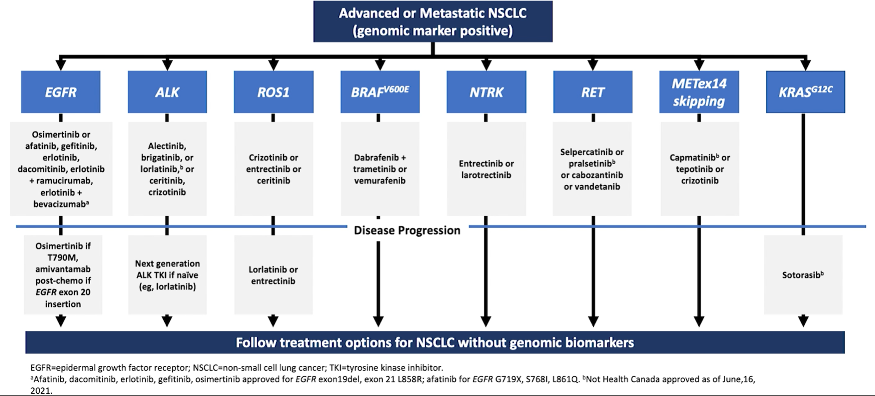
Treatment algorithm

Slide 5
NHSE: National Genomic Test Directory
2021 NGTD update - Add:
MET ex14 skipping
NF1 concurrent mutations (Investigational targets)
2022 Application window has been extended to 31/10/21

Slide 6
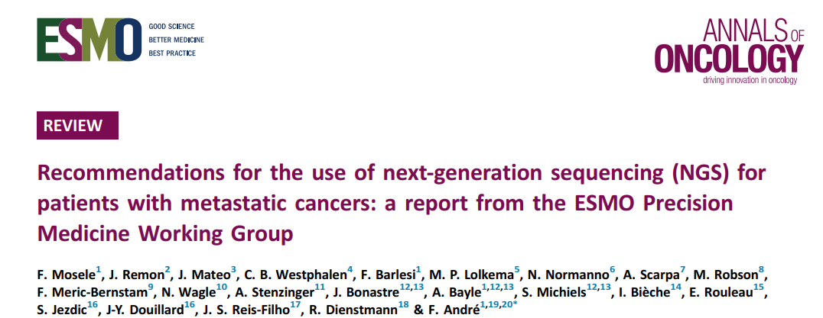
ESMO recommendations

Slide 7
The use of non-NGS (a) misses genes, and (b) misses variants

Slide 8
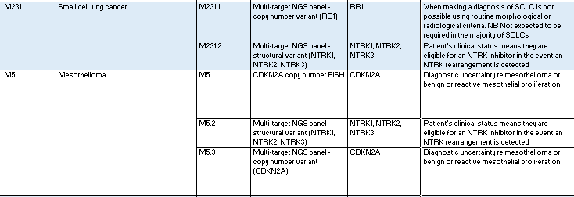
Other lung indications

Slide 9
SW GLH testing algorithm
Gene panel analysis
Now automated – increases capacity, decreases TaTs
Current issues
Reporting
TaT = 10 working days
Genomics Reporting workshop being organised

Slide 10
SW GLH testing algorithm
Salvage pathway
For urgent, scanty and poor quality samples
Targets specific variants in EGFR, KRAS, BRAF, ROS, RET, ALK
Could be run “in parallel” with Gene panel – uses very small amount of DNA/RNA
TaT = 2-3 working days
Gene panel analysis
Now automated – increases capacity, decreases TaTs
Current issues
Reporting
TaT = 10 working days

Slide 11
SW GLH testing algorithm
Salvage pathway
For urgent, scanty and poor quality samples
Targets specific variants in EGFR, KRAS, BRAF, ROS, RET, ALK
Could be run “in parallel” with Gene panel – uses very small amount of DNA/RNA
TaT = 2-3 working days
Gene panel analysis
Now automated – increases capacity, decreases TaTs
Current issues
Reporting
TaT = 10 working days
Liquid biopsy
Evaluation study proposed by GLHs (stage III/IV)
Funding being sought by NHSE
Gene panel analysis
Reduced sensitivity (shedding)
TaT = 10 working days, BUT started earlier
What combination of tests would work?

Slide 12
Urgent request
Blood
Liquid biopsy
EGFR ex19del, L858R, T790M
TaT = 5 working days
Normal
(>90%)
Tissue sample in parallel
0r
Salvage pathway
Targets specific variants in EGFR, KRAS, BRAF, ROS, RET, ALK
TaT = 2-3 working days
Normal (estimated >75%): Reflex to gene panel, or test in parallel
Tissue
Gene panel analysis
Full SoC and investigational gene analysis
TaT = 10 working days
Actionable variant in >50% NSCLC, plus clinical trials
Poor quality material – not suitable for NGS
Salvage pathway
Targets specific variants in EGFR, KRAS, BRAF, ROS, RET, ALK
TaT = 2-3 working days
Salvage pathway
Targets specific variants in EGFR, KRAS, BRAF, ROS, RET, ALK
TaT = 2-3 working days
Tissue
Routine request
Gene panel analysis
Full SoC and investigational gene analysis
TaT = 10 working days
Actionable variant in >50% NSCLC, plus clinical trials
Tissue

Slide 13
GMSA Transformation project: Lung cancer tissue pathway
Aims of the project
To maximise the number of patients receiving timely genomic analysis to inform targeted treatment
To support pathology labs within the SW GMSA to map the tissue pathway for NSCLC
To address inefficiencies in the pathways by making permanent changes to processes, training existing staff and measuring improvements against key metrics
Project leadership:
Dr Nidhi Bhatt, Dr Newton Wong, Prof Rachel Butler, Laura Yarram-Smith, Jonathan Miller

Slide 14
Summary
Gene panel analysis is the recommended way to deliver the comprehensive genomic profiling required to identify NSCLC patients who can benefit from targeted treatment
NGTD is keeping up with clinical requirements
We (GLH) have to deliver our agreed TaTs – 10 working days
The salvage pathway could maximise treatment options, if used in parallel with gene panel
GMSA transformation project on tissue pathways should improve TaTs and patients accessing comprehensive gene profiling

